Slide 1
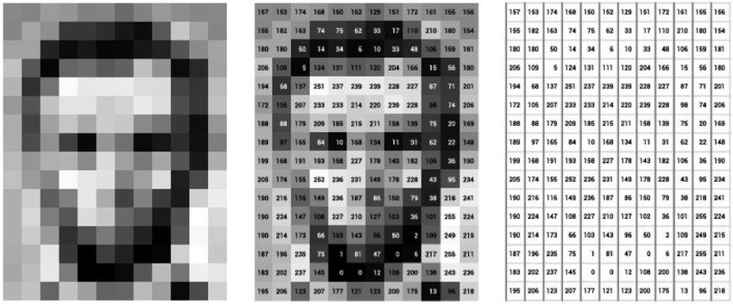
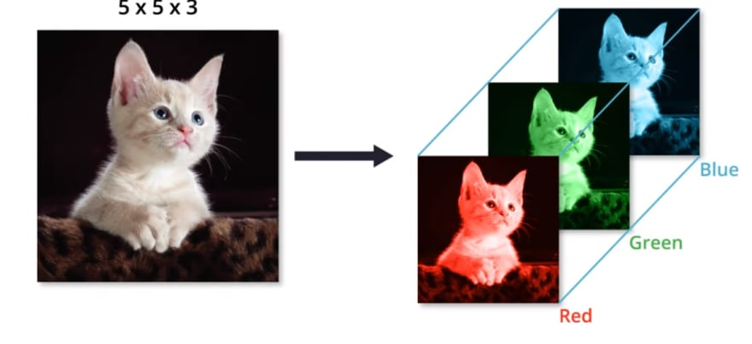

How to represent an Image?
From Bit Map and Geometric Structure Perspectives
Pixel (Pixel Element) $∈[0, 255]$
Black-and-white Image
RGB Image
Bit Map Representation
(RGB Encoding)
Notes:
Hello, guys, nice to meet you today. My name is Shuyue JIA, U guys can just feel free to call me Bruce. I'll be your teaching assistant this term.
Today, we gonna talk about "How to represent an image?" You know, in 2020, 3.2 billion images and 720,000 hours of video are shared online daily.
And more than 90% consumer internet traffic will be images and videos. Single images make up all these videos and different kinds of images on the Internet.
And people may ask "what is an image?".
To answer this question, we have to find out "How to represent an image?" first.
Actually there are two ways to represent an image primarily depending on usage, one is bit map, another is geometric structures.
Firstly, to interpret an image, we could represent it as a collection of pixels, such pixel is a picture element, which is located as a dot in an image.
And the collection of pixels make up a bit map for display. We gonna talk about the black-and-write images.
For a black-and-white image, each pixel can be represented by a single bit whose value depends on whether the corresponding pixel is black or white.
For simplicity, people use 0 to represent black and 1 to represent white.
Besides, for more elaborate black-and-white photographs, each pixel is usually stored by 8 bits to represent a variety of grayness.
And the values of a pixel can be changed from 0 to 2 to the power of eight -1. Similarly, pure black is represented as 0 and pure white is represented as 255.
Furthermore, in the case of color images, the common approach, the RGB encoding, is to represent such image as three components,
a red component, a green component, and a blue component, corresponding to the three primary colors of light.
One byte is normally used to represent the intensity of each color component.
In contrast to the black-and-white images, three bytes of storage are required to represent a single pixel in the color images.

Slide 2
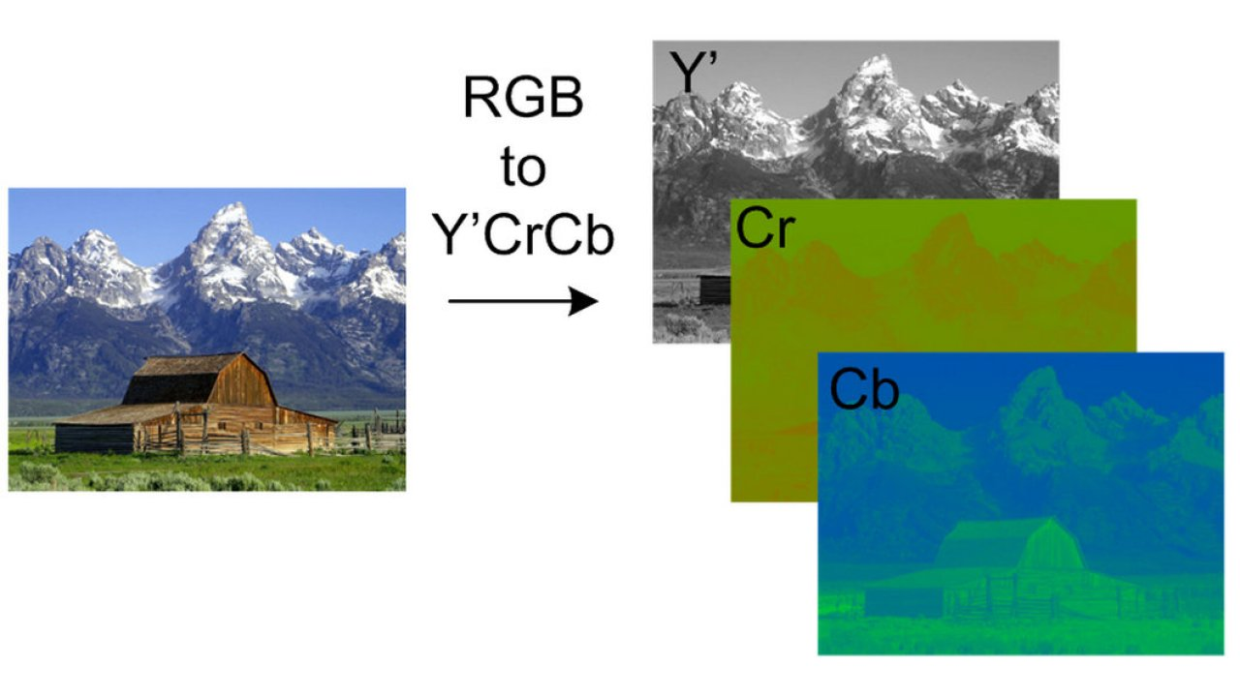
Brightness
Luminance
Red
Chrominance
Blue
Chrominance
Bit Map Representation
(YCbCr Representation)
Notes:
Secondly, another method to represent an image, is to use a brightness and two color components.
This method is widely used in the color television broadcast.
The brightness, also called luminance of a pixel, which is considered to be the amount of white light in the pixel.
The other two components, the blue chrominance and red chrominance are computed as the difference between luminance and the amount of blue and red light.

Slide 3
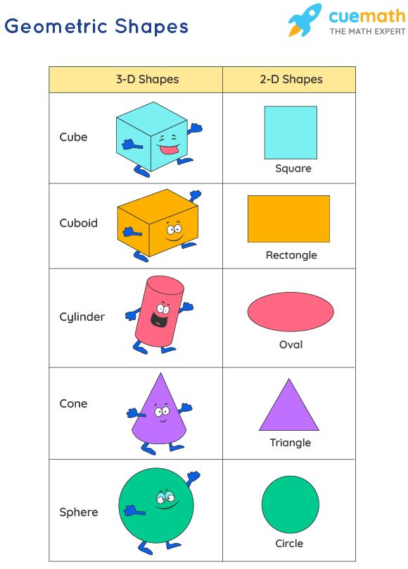
Recap Image Representation:
RGB Encoding
Pixels → bit maps → Image
Geometric Structures
Pixel patterns → e.g., lines, curves → Fonts
Geometric Structure Representation
(e.g., lines, curves, etc.)
Notes:
Last, but certainly not least, since the bits map representation cannot be rescaled into arbitrary size, there is an alternative way to represent images is to describe them as a collection of geometric structures, such as lines and curves. This approach is to produce a particular pixel pattern, which is used as the fonts in modern computers. Like Microsoft and Apple's TrueType, Adobe PostScript, and the popular CAD, which can design 3D objects.
The differences between bit maps and geometric structures lie in the applications. For example, if users wanna use Photoshop to edit an image, such image is represented by bit map. However, if a user wanna draw pictures like pre-established shapes such as rectangles, ovals, and elementary curves, the picture will be represented by geometric structures.

