Slide 1
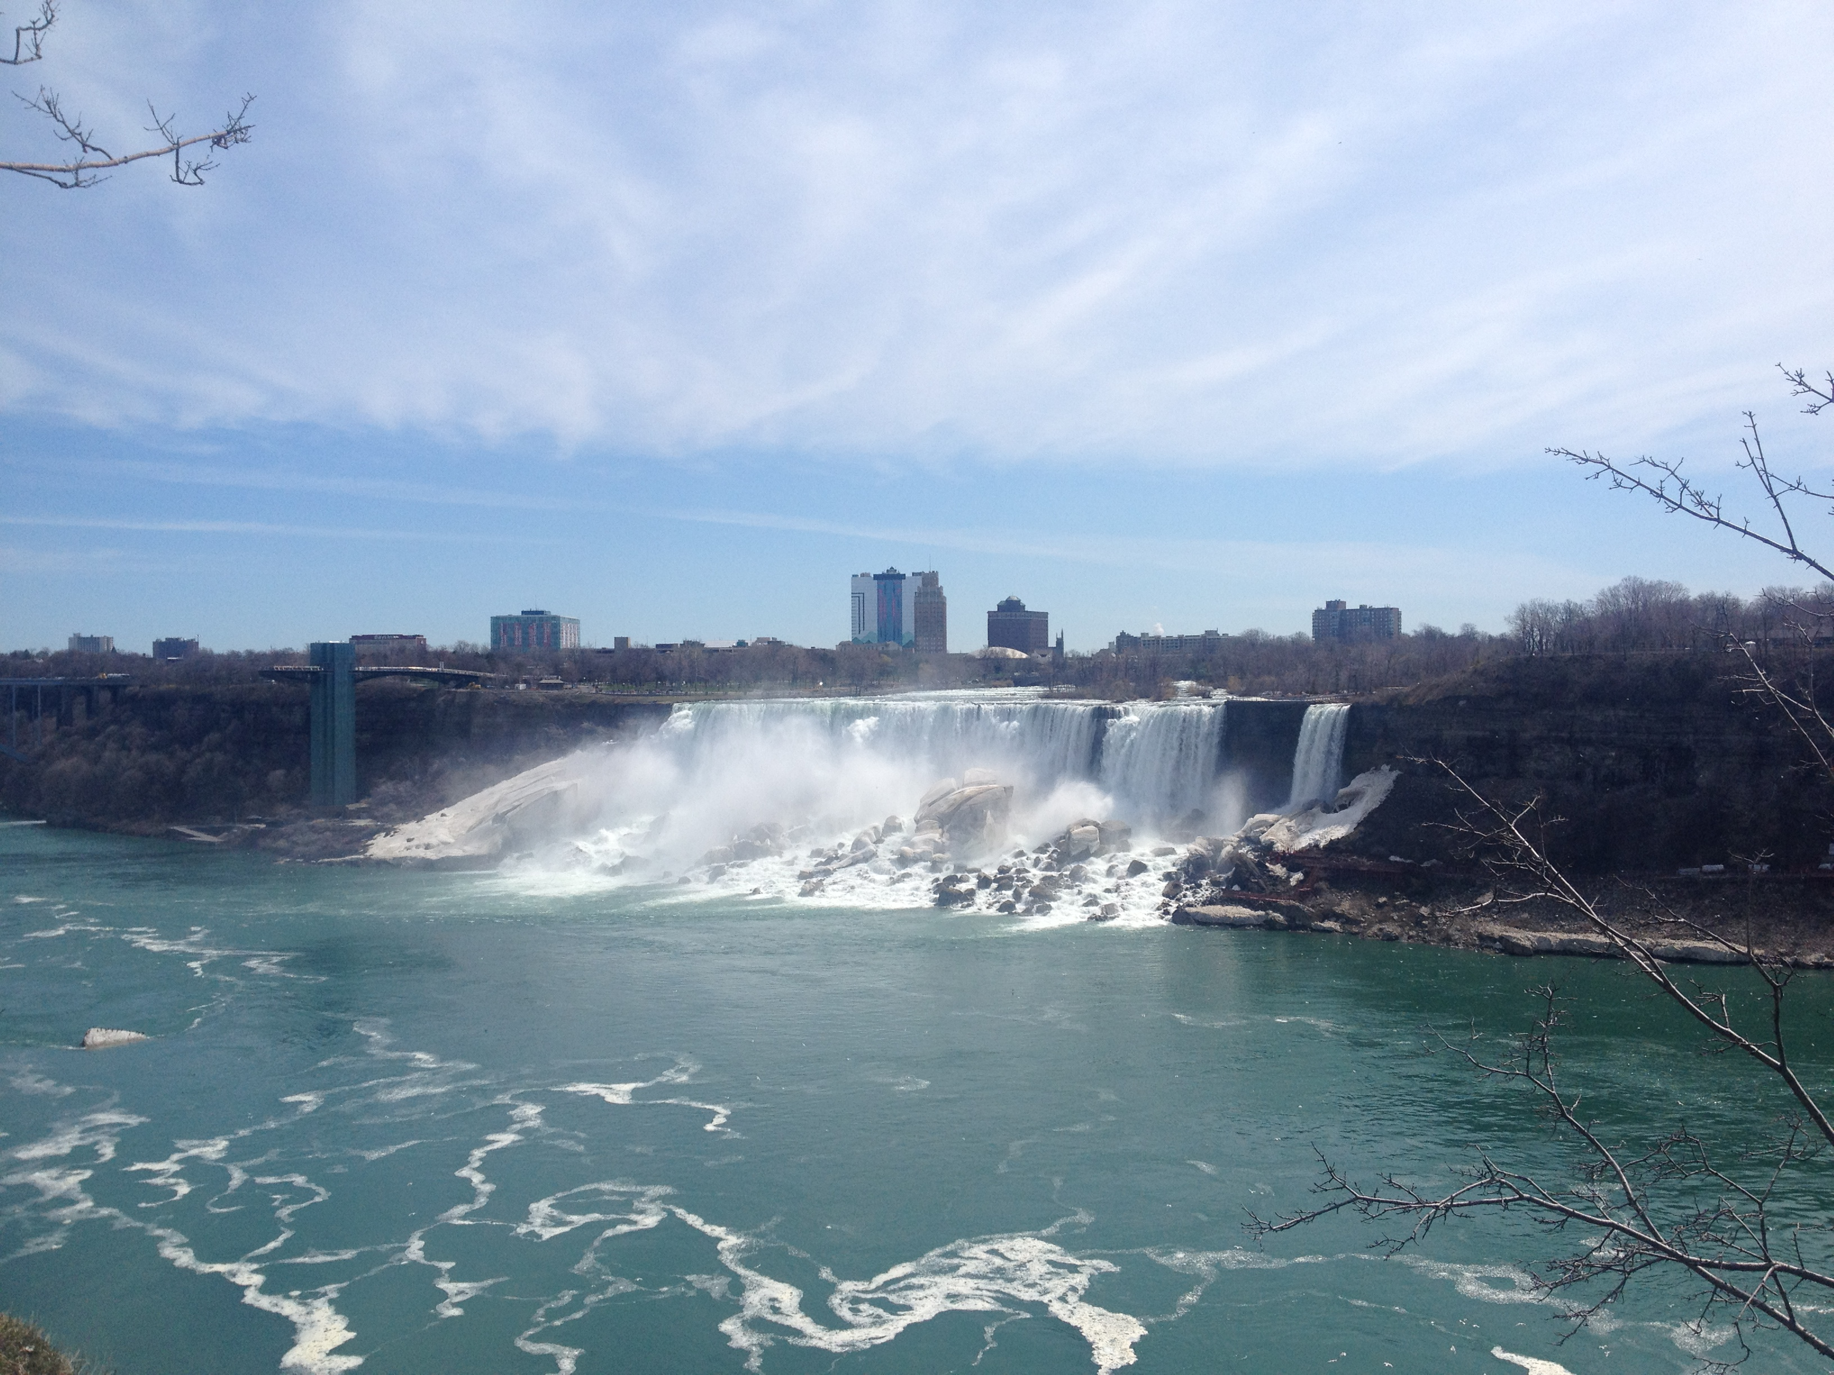
专业英语
自动化工程学院
夏琳琳
prettylin521@aliyun.com
15044219407

Slide 2
Lecture 3 Features of Specialized English
语法特点、修辞特点、词汇特点
The Grammar, Rhetoric & Vocabulary Features

Slide 3
3.1 Grammar Features
  (4) It句型和祈使句使用频繁
（准确、精炼）
It句型：it 充当形式主语，避免句子“头重脚轻”
祈使句: 无主语，精炼。
It is very important (possible, necessary, natural, inevitable) to…
It takes very much time learning…
It is clear (possible, necessary, natural, inevitable) that…
It happened that …
It must be admitted that…
Let A be equal to B.设A等于B。
Consider a high-pressure chamber. 假如有一个高气压气候室。
Suppose there is a high-pressure chamber.

Slide 4
3.1 Grammar Features
(5) 复杂长句使用频繁
（准确、精炼）
为了完整、准确地表达事物内在联系，使用大量从句
1) It has been mentioned above that the electrons in a metal are able to move freely through the metal, that their motion constitutes an electric current in the metal and that they play an important part in conduction of heat.
前面已经提到：金属中电子能自由地通过金属，电子的移动在金属中形成了电流，电子在热传导中起着重要的作用。

Slide 5
3.1 Grammar Features
2) The testing of a cross-field generator will be described in this section with chief reference to the tests that are normally taken on every machine before it leaves the makers works.
交磁发电机的试验将在本节中叙述，它主要涉及每台电机在离开制造厂前应进行的试验。

Slide 6
3.1 Grammar Features
3) This is where I spend my days and years----in this small village in the middle of the city, in a house with a blue door that my wife and I bought together before she left me for a man who looked exactly like Harrison Ford.
在这里我度过了无数个日夜---这是城市中央的一个小村子，在我和我妻子一起买下的有一扇门的房子里，之后妻子离开了我，找个了和哈里森·福特长相一模一样的男人。

Slide 7
3.1 Grammar Features
(6) 后置形容词短语作定语多
（精炼）
代替定语从句作后置定语，使句子简洁、紧凑，不至于累赘。
1) All radiant energies have wavelike characteristics, which are analogous to those of waves moving through water.
All radiant energies have wavelike characteristics analogous to those of waves moving through water.
所有的辐射能都具有波的特性，与水中移动的波的特征相似。
2) The instruments present include some digital ones which are relative to DSPs
The instruments present include some digital ones relative to DSPs.
到场的仪器中还有一些与DSP有关的数字仪器。

Slide 8
3.2 Rhetoric Features
修辞特点
(1) 广泛使用一般现在时
注重科学技术方面的观察、试验和客观规律、事物特征；
涉及的内容(如概念、原理、定理或定律、规则、方法等)大多没有特定的时间关系和时效性；
(2)较多地使用图、表和公式
常使用数据、图、表和公式等非语言因素来表明科技概念、原理、定理或定律、规则、方法等。
(3) 逻辑语法使用多
进行条件论述、理论分析和公式推导时，多使用逻辑语法，即表示条件、原因、语气转折、限制、假设和逻辑顺序等词汇。
although, because, but, if, once, only, suppose, as a result, because of, due to, so, therefore, thus, without, however, whereas, moreover, specifically, overall, in addition, in sequence, 哪怕firstly, secondly, finally, etc.

Slide 9
    并列：and, also, in addition, as well as
    转折：although,even though,but,on the other hand,
    otherwise,while,yet,in spite of,whereas
    承接：first of all, secondly, thirdly, furthermore, moreover, besides, finally
    条件：if, whether, unless, on condition that, so long as
    举例：for example, for instance, as an illustration(作为一个示例), such as
    原因：for, because, for that reason, as, since, in order to
    结果：as a result of, hence, so, consequently, thus, therefore, then
    总结：in conclusion, to sum up, to summarize, to conclude

Slide 10
学术论文撰写

Slide 11
1 将下面英语（论文标题）翻译为中文。
In-class practise:
（1）PASSIVITY-BASED CONTROLLER– OBSERVER FOR ROBOT MANIPULATORS
(2) ADAPTIVE CONTROL OF NON-LINEAR TELEOPERATOR SYSTEMS IN THE PRESENCE OF ADDITIVE INPUT AND OUTPUT DISTURBANCES
(3) AN OPTIMIZATION ALGORITHM FOR THE COORDINATED HYBRID AGENT FRAMEWORK
(4) BEHAVIOUR EMERGENCE MODEL BASED ON CHANGES IN SENSORY INFORMATION AND ITS APPLICATION TO MULTIPLE TASKS
(5) Running Temperature and Mechanical Stability of Grease as Maintenance Parameters of Railway Bearings

Slide 12
(6) An Improved Approach to Delay-dependent Robust Stabilization for Uncertain Singular Time-delay Systems
(7) Stability Analysis of Discrete-time Systems with Additive Time-varying Delays
(8 ) CONTROL OF A SCARA ROBOT: PSO-PID APPROACH
(9) FRACTIONAL CALCULUS-BASED OPTIMAL CONTROLLERS OF AUTOMATIC VOLTAGE REGULATOR IN POWER SYSTEM
(10) RESEARCH OF WEATHERSENSITIVE SHORT-TERM LOAD FORECASTING

Slide 13
(11) DISPERSED GENERATION IN MODERN POWER SYSTEMS AND ITS IMPACT IN EUROPE ON POWER SYSTEM STRUCTURE AND SECURE OPERATION
(12) COMPARATIVE PERFORMANCE ANALYSIS FOR DIGITAL REGULATORS IN SERIES DC MOTOR CONTROLLED DRIVE
(13) An Assessment Tool for Land Reuse with Artificial Intelligence Method
(14) Watermarking of Digital Images in Frequency Domain
(15) Action Control of Soccer Robots Based on Simulated Human Intelligence

Slide 14
(16) Real-time Virtual Environment Signal Extraction and Denoising Using Programmable Graphics Hardware
(17) Soft Sensing Modeling Based on Optimal Selection of Secondary Variables and Its Application
(18) Adaptive Fuzzy Dynamic Surface Control for Uncertain Nonlinear Systems
（19）Kalman Filtering with Partial Markovian Packet Losses
（20）On Problems of Multicomponent System Maintenance Modeling

Slide 15
2将下列标题翻译为英语。
1 有源电力滤波器控制策略综述
Review study of control strategy for active power filter
关于综述的说法：
Summary/summaries on/of
(A) review on/of
Research(es) on
Comment on 评论
Research review/survey
Survey of

Slide 16
2将下列标题翻译为英语。
2 基于粗糙集理论的系统参数重要性评价及其应
用
Significance assessment (importance evaluation) for the system parameters on base of (。。。基础上的，这里可以用based on/upon) rough set theory and it's application
3 基于蚁群算法的多机器人协作策略
Multi-robot coordination strategy based on ant colony algorithm
或者 ant colony algorithm based multi-robot ...
4 电力系统混沌振荡的自适应补偿控制
Adaptive compensating control for chaos oscillation of power system

Slide 17
2将下列标题翻译为英语。
5 基于结构特征的路面裂纹病害检测算法
Detection algorithm of road cracks on surface disease based upon architecture feature
6 基于虚拟仪器技术的电磁阀综合特性测控系统
Research on overall characteristics of measurement and control system for magnetic valve based upon virtual instrument techniques
7 基于自组织映射神经网络的低压故障电弧聚类分析
Clustering/cluster analysis (analyses 复) for low-voltage arc fault based on SOM networks
8 基于小波分解的脑CT图像纹理特征提取
Texture feature extraction for CT brain images based on wavelet decomposition

Slide 18
Abstract:
    I.本文提出了一个。。。方法
    A method is proposed in this work.
    II.为了系统地解决这些问题，。。。
    To address these problems in a systematic way, …
    III. 随着。。。的发展，
    With the development of …
    MEMS技术的发展成熟，使导航系统的低成本、低功耗成为可能。
    The development and maturation of the MEMS technology opens the door to apply low cost and low power dissipations to the navigation systems.
    IV.为了实现这一目标
    To attain such goals for …

Slide 19
Abstract:
    I.目标为，以。。。为目标
    The research aims to ...
    II.值得注意的是。。。
    It is appreciate that …
    III. 以保证。。。
    In order to ensure/guarantee
    IV.同时，此外
    At the same time,moreover, in addition
    V. 为了保证论文内部应用的内在联系，文章中应适当使用一些连接词语，如
    并列：and, also, in addition, as well as
    转折：although,even though,but,on the other hand,
    otherwise,while,yet,in spite of,whereas
    承接：first of all, secondly, thirdly, furthermore, moreover, besides, finally

Slide 20
Abstract:
    条件：if, whether, unless, on condition that, so long as
    举例：for example, for instance, as an illustration, such as
    原因：for, because, for that reason, as, since, in order to
    结果：as a result of, hence, so, consequently, thus, therefore, then
    总结：in conclusion, to sum up, to summarize, to conclude

Slide 21
学术论文撰写
    Keywords(关键词)：
    I.Keywords要具有专业性，要用专属词，如故障检测，Failure Detection；
    II.数量不得少于3个或多于8个，一般5个为宜；
    III. 要从有关标准和主题词表中选取；

