Slide 1
Lecture 1 Introduction

Slide 2
Symbol and Formula
2、小数，分数，百分数
  0.1: zero point one, point one, o point one, one tenth, decimal one
0.01: point zero one,
10.35: ten point three five
1/2: a (one) half
1/3: a third
1/4: one quarter
1/8: a eighth
2/3: two-thirds, two over three, two divided by three
3/4: three-fourths, three quarters
3%: three percent
0.2% : point two percent
5‰: five per mille

Slide 3






Symbol and Formula
3、幂（power）、根（root）
: x square,
x squared ,
the square of x,
the second power of x,
x to the second power
:y cube,
y cubed,
the cube of y,
the third power of y,
y to the third power
:the nth power of a , a to the nth power
: the square（second） root o f three
: the cube (third ) root of a
:the nth root of a

Slide 4
Symbol and Formula
4、数学运算符号
A+B | A and B, A plus B
A-B | A minus B
A×B | A times B, A multiplied by B
A÷B | A over B, A divided by B
A±B | A plus or minus B
A=B | A equals B, A equals to B , A is equal to B
A≠B | A is not equal to B, A is not B
A≈B | A is approximately equal to B
A>B | A is greater than B
A<B | A is less than B
A>B | A is greater than B
A<B | A is less than B
A>>B | A is much (far) greater than B
A<<B | A is much less than B
A≥B | A is greater than or equal to B.
A≤B | A is less than or equal to B.
A∝B | A is proportion to b, a varies directly as b
A: B | A to B

Slide 5
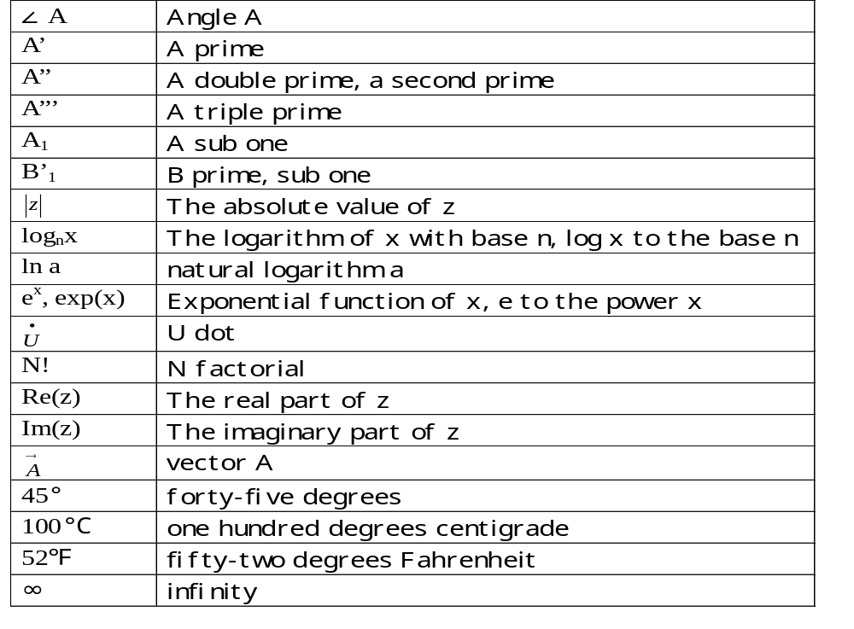
Symbol and Formula

Slide 6
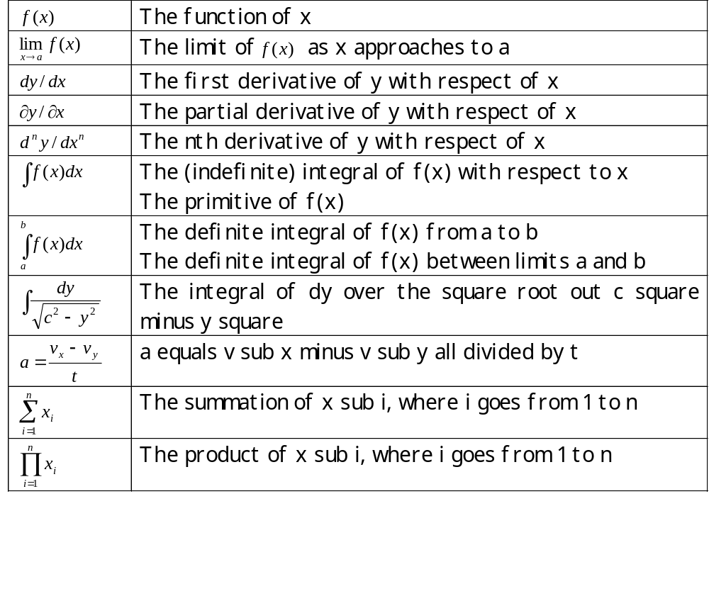
Symbol and Formula

Slide 7
Lecture 3 Features of Specialized English
语法特点、修辞特点、词汇特点
The Grammar, Rhetoric & Vocabulary Features

Slide 8
3.1 Grammar Features
客观性（Objectivity）、准确性（accuracy）和精练性(conciseness)。
(1) 广泛使用被动语态
(2) 广泛使用非谓语形式
(3) 省略句使用频繁
  (4) It句型和祈使句使用频繁
(5) 复杂长句使用频繁
(6) 后置形容词短语作定语多

Slide 9
3.1 Grammar Features
(1) 广泛使用被动语态
(客观性)
主体多为客观的事物、现象和过程，在叙述推理过程中切忌加进作者个人的主观臆断；
中心是客观现象及事物本身，而非动作的发出者，把论证说明的对象置于句子主语的位置，既能突出中心，又能吸引读者的注意。
1) Electricity can be measured in amount and quality.
电可以用数量和质量来度量。
2)Instrument transformers are installed on the high-voltage equipment.
互感器安装在高压设备上。

Slide 10
3.1 Grammar Features
3) Electric power is generated in power generating stations or plants.
电能是在发电站或发电厂产生的。
4) The meters are calibrated and the scale is designed to read the value of the desired unit.
这些仪表可以被校准并且设计了不同的量程 ，以便读出期望单元的数值。
5) Electrical energy can be stored in two metal plates separated by an insulation medium. Such a device is called a capacitor, and its ability to store electrical energy is termed capacitance. It is measured in ’Farads.
电能可以储存在被一绝缘介质隔开的两块金属板中，这样的装置被称为电容器，它储存电能的能力就被称为电容。电容的测量单位是法拉。

Slide 11
3.1 Grammar Features
(2)广泛使用非谓语形式
(精炼)
非谓语动词在句子中可以起到名词，形容词或副词作用，动词的非谓语形式分为动名词,分词,动词不定式。
① 动名词
用动名词短语取代时间从句或简化时间陈述句
The signal should be filtered before it is amplified.
The signal should be filtered before being amplified.
放大信号前，应先对其进行滤波
2) An object becomes hot. It is placed in the sun.
Once being placed in the sun, an object becomes hot.
物体放置在太阳下会变热。

Slide 12
3.1 Grammar Features
3) We must do various experiments before a new electronic product is designed.
Before designing a new electronic product we must do various experiments.
在设计一个新的电子产品之前，我们必须做各种实验。
用动名词短语做主语
4) Changing resistance is a method for controlling the flow of the current.
改变电阻是控制电流的一种方法
5) Conducting electricity means the flow of electrons through an object.
传导电流(导电)意味着电子在物体内的流动

Slide 13
3.1 Grammar Features
② 分词
过去分词短语替代从句中的被动语态
现在分词短语替代从句中的主动语态
The power supply, which is shown in block-diagram in Fig.1, is a single-phase switch-mode inverter.
The power supply shown in block-diagram in Fig.1 is a single-phase switch-mode inverter.
图1中用框图表示的电源是一个单相开关逆变器。

Slide 14
3.1 Grammar Features
2) A three-phase circuit, as it was pointed out above, is merely a combination of three single-phase circuits.
A three-phase circuit, as pointed out above, is merely a combination of three single-phase circuits.
正如上面所指出的那样，三相电路只不过是三个单相电路的组合。
3) The transistor, which is working with correctly polarities, can work as an amplifier.
The transistor working with correctly polarities can work as an amplifier.
工作于正确电源极性下的晶体管，作用就像放大器。

Slide 15
3.1 Grammar Features
③ 不定式
用不定式短语来替代表示目的和功能的从句或语句
(1) The capacity of individual generators is larger and larger so that the increasing demand of electric power is satisfied.
The capacity of individual generators is larger and larger to satisfy the increasing demand of electric power.
单台发电机的容量越来越大，目的就是满足不断增长的用电需求。
(2) What does a fuse do? It protects a circuit.
The function of a fuse is to protect a circuit.
保险丝的作用就是保护电路。

Slide 16
3.1 Grammar Features
③ 不定式
不定式可以放在系动词前做表语。
(1) To see is to believe.
眼见为实。
(2) Our task today is to work out the design.
我们今天的任务是把设计做出来。
不定式可以做主语。
(1) To know something about computer is important.
懂得一些计算机的知识很重要。

Slide 17
3.1 Grammar Features
(精炼)
(3) 省略句使用频繁
省略成分：状语从句中的主语、全部或部分谓语；定语从句中的关系代词which和that、从句中的助词等；还常用介词短语替代从句。
1) If it is possible, the open-loop control approach should be used in this system.
If possible, the open-loop control approach should be used in this system.
可能的话，这个系统应该使用开环控制方法。（全部谓语/形式主语省略）
2) As illustrated in Fig.1, there is a feedback element in the closed-loop system.
As in Fig.1, there is a feedback element in the closed-loop system.
就像图1所示的那样，这个闭环系统中有一个反馈元件。

Slide 18
3.1 Grammar Features
3) The device includes an instrument transformation and a relay system which has two circuits in it.
The device includes an instrument transformation and a relay system with two circuits in it.
这个装置包括一个互感器和一个有两个电路的继电器系统。
其他常用的省略形式：
As already discussed 前已讨论
As explained before 前已解释
As described above 如上所示
If possible (necessary)如果可能（必要）
If so 倘若如此
As previously mentioned 前已提到
When needed (necessary, feasible)必要时
Where feasible 在实际可行的场合
Where possible 在可能的情况下

