Slide 1
Subword Units Promote Open-vocabulary Translation
Primarily for rare and OOV unseen (English) words
Shuyue Jia
Notes:
Good morning and evening, everyone. If we are all here, let us get started.
First, it is a pleasure to welcome Vadi’s team, nice to meet you.
We are here today to share our current progress on the development of natural language processing applications.
There are two items on today’s agenda. First, Vadi’s team will share information about the current progress of the ISPM NLP Service. Then, I will have a short introduction about our Reference Architecture for Chinese clinical information Extraction (so-called RACE.) If anyone has questions during the presentation, you can put it in the chatbox. So, let us start with Vadi’s team. Hi Vadi, would you like to kick-off?
Thank you, Vadi, excellent presentation. Let us move to the second topic. (Please let me check how much time we left for the second part.) OK, we have XX min left. So, let me give a brief overview of RACE and what is going on so far.

Slide 2
NMT Problem
Fixed vocabulary VS Open vocabulary
Intuition
Various words are
translatable via smaller units
e.g., lower → low + er
Traditional Approach
(Word-level NMT model)
Large Vocabulary
and
Back-off Dictionary
Out-of-vocabulary (unseen) words, rare words
Limited vocabulary, typically 30,000 ∼ 50,000
Word embedding as a fixed-length vector VS variable-length vector
Not always 1-1 correspondence between source and target word
This work
Encode rare / unknown words
as sequences of
Subword Units
Notes:
Today’s learning objectives will consist of three parts.
First, I will briefly introduce some of the difficulties of Chinese natural language processing and the linguistics assumptions on which we design the RACE.
Then, I will present the general design of the RACE and the modules currently under development.
Finally, I will talk a little about the language model; for example, the entities and relations we should annotate in the texts. And how we use programmatic labeling to reduce human effort.

Slide 3
Neural Machine Translation of Rare Words with Subword Units (ACL 2016)
Motivation: “Transparent Translations”
Key: Morphemes (词素) and phonemes (音位) → can translate
Word → Subword Units
Named entities
Cognates (同源词) and Loanwords (外来词)
Morphologically complex words
and etc.
Subword Units
Notes:
Today’s learning objectives will consist of three parts.
First, I will briefly introduce some of the difficulties of Chinese natural language processing and the linguistics assumptions on which we design the RACE.
Then, I will present the general design of the RACE and the modules currently under development.
Finally, I will talk a little about the language model; for example, the entities and relations we should annotate in the texts. And how we use programmatic labeling to reduce human effort.

Slide 4
Byte Pair (2-gram) Encoding (BPE) Algorithm :
Word → Subword Units
Background
Philip Gage, 1994
Data Compression: iteratively replaces the most frequent pair of bytes in a sequence with a single, unused byte
This NMT task: merge characters or character sequences (generate unseen words)
Implications
Learn compounding and transliteration from subword representations
Generalize to translate and produce new words (unseen at training time)

Slide 5
Methods
Initialize symbol vocabulary with character vocabulary
vocab = {'l o w .': 5, 'l o w e r .': 2, 'n e w e s t .': 6, 'w i d e s t .': 3}
Find the most frequent 2-gram pairs (‘A’, ‘B’) from every word
{('d', 'e'): 3,('e', 'r'): 2, ('l', 'o'): 7, ('w', ‘.'): 5, ('w', 'e'): 8, ('e', 'w'): 6,('r', ‘.'): 2, ('w', 'i'): 3, ('e', 's'): 9, ('n', 'e'): 6, ('s', 't'): 9,('i', 'd'): 3, ('t', ‘.'): 9, ('o', 'w'): 7}
We find ('e', 's'): 9
Merge (‘A’, ‘B’) → (‘AB’) and repeat 2).
{' l o w -': 5, 'l o w e r -': 2, ' n e w es t -': 6, ' w i d es t -': 3}
Stop merging until reach the num(merge operation) or minimum frequency
Character 2-gram
Pros
Balance size(vocabulary) and num(tokens)

Slide 6
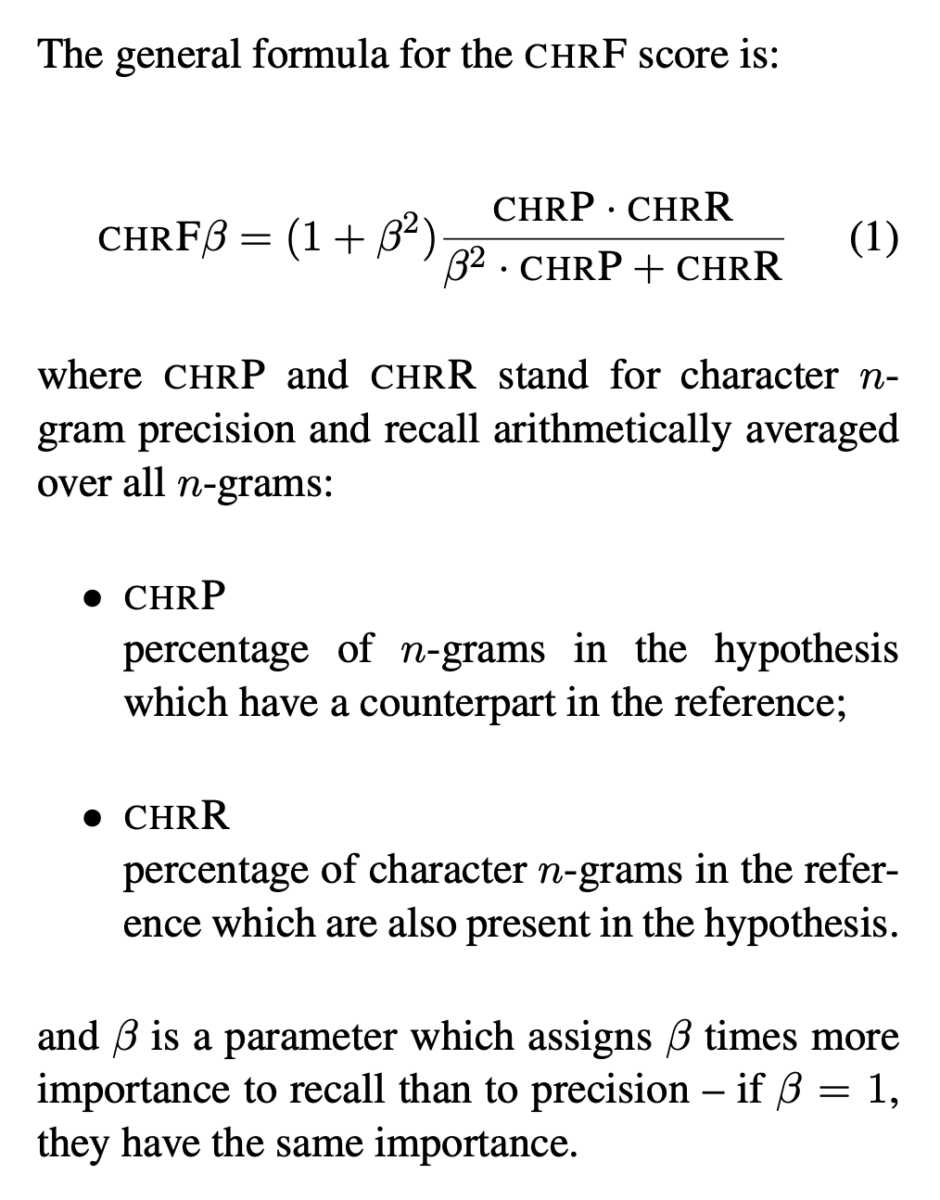
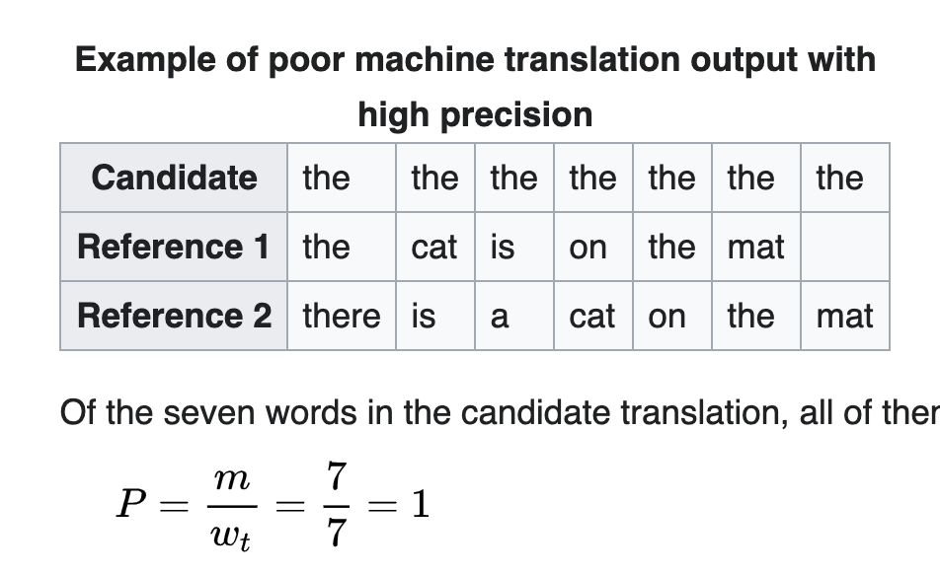

Neural Machine Translation of Rare Words with Subword Units
Model Architecture: Encoder-Decoder
Measurement & Results
BLEU (bilingual evaluation understudy)
ChrF3 (character n-gram F3 score)
Unigram F1
Input
Subword Units: x = (x₁, x₂, ……, x_{m})
ChrF3
Encoder Bi-GRU
Alignment Model
BELU
h_{j}
ꭤ_{ij}
Decoder RNN
Target Sequence
Candidate: y = (y₁, y₂, ……, y_{n})
NLL loss
Backprop
Conclusions
Outperform the back-off dictionary baseline.
More words to Subwords → better performance
Reference Sequence
Reference: $\hat{y}$ = ($\hat{y}$₁, $\hat{y}$₂, ……, $\hat{y}$_{n})

Slide 7
Other Algorithms for “Word → Subword Units”
1. Byte Pair Encoding: frequency of the words pair
2. WordPiece: probability of size(training set)
3. Unigram Language Model

Slide 8
Thanks and have a great weekends!

