Slide 1
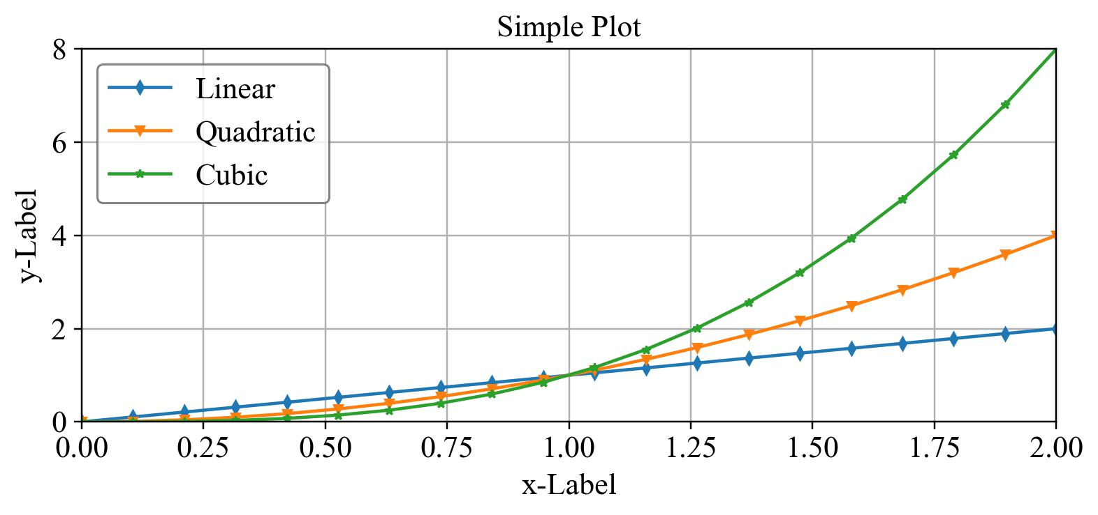
ytick
Legend
Title
Marker
Y Label
Line
Grid
xtick
yticklabel
X Label
xticklabel

Slide 2
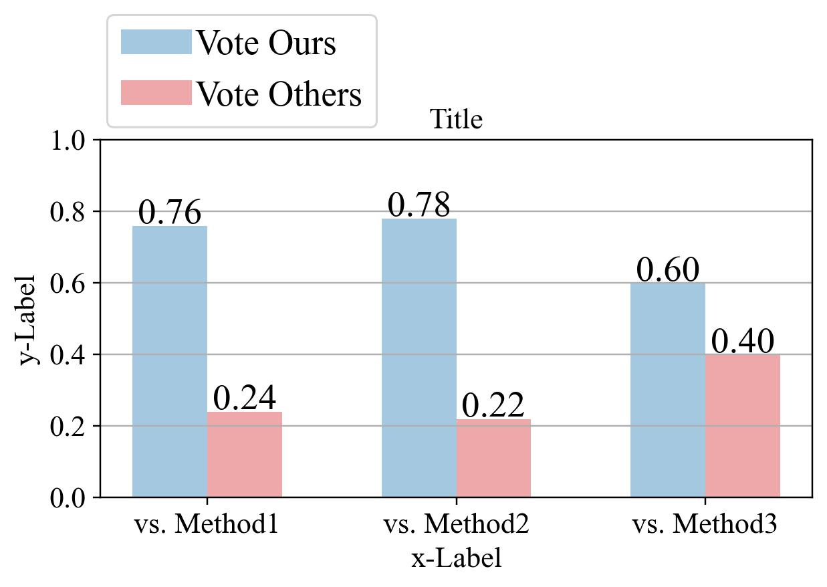
Legend
Title
ytick
Grid
Text
Y Label
Bar 1
Bar 2
Group 1
Group 2
Group 3
xtick
yticklabel
xticklabel
X Label

