Slide 1
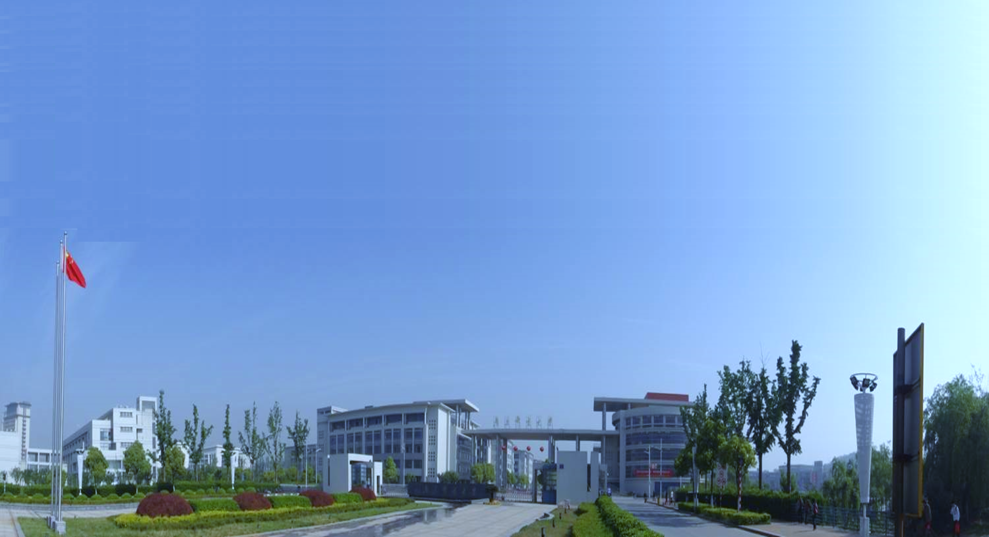

Technical Paper Writing

Slide 2
I
How to Write a Research Paper
II
Common Technical Written Issues

Slide 3
How to Write a Research Paper
3

Slide 4
Caveats
How to Write a Research Paper
01
Key research contributions DECIDE paper’s acceptance
02
NO single standard way of writing research papers
03
Quality/impact OVER quantity of papers
4

Slide 5
Before you write a research paper…
How to Write a Research Paper
I
Desirable Characteristics
II
Key Questions to Double Check
III
Know What Your Audience is
5

Slide 6
Desirable Characteristics
Before you write a research paper…
Element One
Element Two
Element Three
Interesting idea(s)
Interesting claim(s)
Valid evidence
Interesting? Interesting!
6

Slide 7
Desirable Characteristics
Before you write a research paper…
Type One
Type Two
Type Three
Interesting Research
Novel Research
Inspiring Research
Type Four
Type Five
Type Six
Impact Research
Significant Research
Validated Research
7

Slide 8
Desirable Characteristics
Before you write a research paper…
01
Ask interesting questions
Type One
Interesting Research
02
Have interesting ideas in solution
03
Have interesting findings in evaluation
8

Slide 9
Desirable Characteristics
Before you write a research paper…
01
New problem
Type Two
Novel Research
02
New solution
03
New findings
9

Slide 10
Desirable Characteristics
Before you write a research paper…
01
General ideas/solutions
Type Three
Inspiring Research
02
General/abstract problem definition could describe other concrete problems
03
General idea could be used elsewhere
10

Slide 11
Desirable Characteristics
Before you write a research paper…
01
Impactful problem and solution
Type Four
Impact Research
02
Real problem
03
Effective/efficient solution to well address the problem
11

Slide 12
Desirable Characteristics
Before you write a research paper…
01
NOT EASY problem to solve
Type Five
Significant Research
02
Technical challenges
03
Solution level
12

Slide 13
Desirable Characteristics
Before you write a research paper…
01
Clear and strong (empirical) evidence
Type Six
Validated Research
02
Validate/justify the claims
13

Slide 14
Key Questions to Double Check
Before you write a research paper…
Element One
Element Two
Element Three
Interesting idea(s)
Interesting claim(s)
Valid evidence
14

Slide 15
Know What Your Audience is
Before you write a research paper…
01
Explicitly explain how your paper is relevant
02
Explicitly explain some basic assumptions/concepts underlying your work
Ready? Ready!
15

Slide 16
Typical Paper Structure
How to Write a Research Paper
I
Title/Abstract
VI
Example
II
Introduction
VII
Approach/Framework
III
Background
VIII
Implementation
IV
Formal Problem Definition
IX
Evaluation and Discussion
V
Related Work
X
Conclusions and Future work
16

Slide 17
Typical Paper Structure
How to Write a Research Paper
I
Title/Abstract
VI
Example
II
Introduction
VII
Approach/Framework
III
Background
VIII
Implementation
IV
Formal Problem Definition
IX
Evaluation and Discussion
V
Related Work
X
Conclusions and Future work
17

Slide 18
Title
How to Write a Research Paper
01
Do not put uncommon buzzwords there
02
Be specific enough but not too specific
03
Name your approach with a cute name
18

Slide 19
Abstract
How to Write a Research Paper
Four-part Structure
Part One
Part Two
Part Three
Part Four
Short motivation (problem)
Proposed solution
EvaluationResults
Evaluation
01
DO NOT put unexplained or undefined terms
02
DO NOT get into too much detail of solutions
19

Slide 20
Introduction
How to Write a Research Paper
Part One
What is the problem?
Part Two
Why is it interesting and important?
Part Three
Why is it hard? (E.g., why do naive approaches fail?)
Part Four
Why hasn't it been solved before?
Part Five
What are the key components of my approach and results?
20

Slide 21
Introduction
How to Write a Research Paper
01
Do not over claim
02
Do not over criticize other’s work
03
Put unjustified points in conclusion or discussion section
04
Do not claim your own approach to be “NOVEL”
21

Slide 22
Introduction
How to Write a Research Paper
TIPS
01
Abstract and introduction section are very important
Tell a
Good Story
in Introduction
02
Need tell an interesting, intriguing, engaging story
03
Offer pleasant “surprise” (not boredom) to readers
22

Slide 23
Related Work
How to Write a Research Paper
TIPS
01
Do not simply list related work without RELATING to your own work!
Put in
PC members’ work if relevant
02
Do not make unjustified unobvious criticisms on related work
03
Do not overclaim your work without justification
04
Do not intentionally leave out your own very related previous papers
23
23

Slide 24
Approach/Framework
How to Write a Research Paper
TIPS
01
Generalize your work in an abstraction
Focus on the key techniques
02
Try to separate the ideas from (a particular) concrete implementation
03
Explain some details with examples
24
24

Slide 25
Implementation
How to Write a Research Paper
TIPS
01
What libraries you used
Reproducible Experiments
02
Detailed implementations of each step in your framework
03
List complications of implementation and how you get around them
04
Applicable to both approach/implementation
25
25

Slide 26
Evaluation
How to Write a Research Paper
TIPS
01
Write research question first
Experiments and Case Studies
02
Do not just describe the results
03
Do not use a simple alternative solution as the baseline for comparison
04
Construct a project web including the evaluation subjects, evaluation results
26
26

Slide 27
Discussion
How to Write a Research Paper
TIPS
01
Limitations and issues you currently cannot address
Do not hide limitations
02
Possible applications of your approach
27
27

Slide 28
Conclusions and Future work
How to Write a Research Paper
TIPS
01
Broader impacts of your approach and your vision
Often easy
to write
02
Describe limitations and future work here
28
28

Slide 29
Typical Paper Structure
How to Write a Research Paper
I
Title/Abstract
VI
Example
II
Introduction
VII
Approach/Framework
III
Background
VIII
Implementation
IV
Formal Problem Definition
IX
Evaluation and Discussion
V
Related Work
X
Conclusions and Future work
29

Slide 30
Logic Flow
How to Write a Research Paper
01
Logic flow between sentences within a para
02
Logic flow between paragraphs in a section
03
Logic flow between sections in a paper
04
Pay extreme attention to abstract and intro; Read aloud as a reading group
30

Slide 31
Common Barriers for Beginners
How to Write a Research Paper
01
Feel nothing to say…
02
Write too much low-level boring implementation details…
31

Slide 32
Common Technical Written Issues
Do not make readers a hard time in reading your papers. Your technical content is already hard enough.
32

Slide 33
Figure 1, Table 1, Section 1, …
Common Technical Written Issues
01
Bad examples
- ✗ the Figure 1
- ✗ figure 1
- 🤔 Figure one, Table one
02
Common usage
- 😁Figures 1-3, Tables 1 and 6
- 🤔the first figure, the first table
33

Slide 34
Avoid…
Common Technical Written Issues
01
Ambiguous words
- ✗ since ➭ ✓ because
- ✗ while ➭ ✓ although, whereas
02
Strong words
- ✗ always ➭ ✓often
34

Slide 35
Avoid…
Common Technical Written Issues
03
Informal or offensive words
01
- 😱 obviously, clearly, apparently
- ✗ though ➭ ✓ although
- ✗ above ➭ ✓ preceding
- ✗ very well ➭ ✓ satisfactorily, sufficiently
- ✗ enough ➭ ✓ sufficient
- ✗ as far as we know ➭ ✓ within our knowledge
- ✗ means ➭ ✓ indicates, represents
35

Slide 36
Avoid…
Common Technical Written Issues
04
Firstly, secondly,…
- ✓ First, Second, Third, Finally…
02
05
Abbrev n’t
- ✗ can’t, can not ➭ ✓ cannot
- ✗ don’t ➭ ✓ do not
02
05
06
Complicated words
36

Slide 37
Also, And …
Common Technical Written Issues
01
Also
- Beginning:
✗Also ➭ ✓ In addition, Additionally
- Middle:
✗ Also we implemented a tool…
✓ We also implemented a tool…
✓
02
And
- 😱Don’t put “And” in the beginning of the sentence
37

Slide 38
As below / as follows
Common Technical Written Issues
01
Examples
- ✗ The paper makes: first contribution as…
- ✓ We list the main contributions as follows / as below…
- ✗ They are described below:
- ✓ They are described as below:
38

Slide 39
Citations
Common Technical Written Issues
01
When mentioning others’ work…
- Two authors: ✓ Li and Yang [1] proposed…
- More than two: ✓ Li et al. [2] proposed…
02
Don’t use emotional word
- 🤔 Xie et al. [1] developed an excellent tool
- 🤔 JPF [2] is a famous model checker
- 😉 JPF [2] is a well-known model checker
39

Slide 40
Uncountable Words
Common Technical Written Issues
01
Software, research, work, …
02
Common usage
- ✗ several works, several researches, several softwares
- ✓ several research projects
- ✓ several pieces of work
- ✓ several lines of research
- ✓ several software programs
- ✓ several software applications
40

Slide 41
Abbreviation
Common Technical Written Issues
01
Remember to put a space before “(“
02
Common usage
- ✗ CBSE (Computer-based software engineering)
- ✓ Computer-Based Software Engineering (CBSE)
41

Slide 42
Article usage
Common Technical Written Issues
01
If a noun is countable (and singular), there must be a preceding “a”, “the”, or sth like “my”
02
Common usage
- ✗ following definition defines…
- ✓ the following definition defines…
- ✗ Machine learning is the subset of artificial intelligence…
- ✓ Machine learning is a subset of artificial intelligence…
42

Slide 43
The authors
Common Technical Written Issues
01
Better to use “We”…
- ✗ The authors also extract many requirements…
- ✓ We also extract many requirements…
02
But in acknowledgment…
- 😁 the authors would like to thank…
43

Slide 44
Redundancy
Common Technical Written Issues
01
The former already implies the list is incomplete
- such as / like / some examples include…
- etc. / and so on…
02
Examples
- ✗ problems like deadlocks, livelocks or others
- ✗ such as CMM, CMMI, ISO 9000 etc.
44

Slide 45
Using hyphen “-”
Common Technical Written Issues
01
Examples
- 🤔 third party libraries
- ✓ third-party libraries
- 🤔model checking algorithms
- ✓ model-checking algorithms
- 🤔test generation tools
- ✓ test-generation tools
45

Slide 46
Punctuation issues
Common Technical Written Issues
01
When listing more than three items…
- ✗ A, B and C ➭ ✓ A, B, and C
02
Common usage
- ✓ e.g., (for example)
- ✓ i.e., (in other words)
- ✓ In April and May, the profits grew 18% and 29%, respectively.
46

Slide 47
Noun Stacking / Verbal
Common Technical Written Issues
01
Examples
- ✗ We have proposed an approach for interoperable protocol performance comparison.
- ✓ We have proposed an approach for comparing interoperable protocol performance.
- ✗ … takes responsibility for business transaction completion and component failure recovery
- ✓ … for completing business transactions and recovering component failures
47

Slide 48
Explicitly write out things
Common Technical Written Issues
01
Don’t let readers guess
Example: I just got a pet and gave her a name. This is cute.
- ⁉️This pet is cute?
- ⁉️This name is cute?
- ⁉️This get acquirement process is cute?
- ⁉️This naming process is cute?
48

Slide 49
Dangling modifiers
Common Technical Written Issues
01
Examples
- ✗ To improve his approach, the experiment was done.
- ✓ To improve his approach, he did the experiment.
- ✗ To capture the new semantics, the tool is extended with…
- ✓ To capture the new semantics, we extend…
49

Slide 50
Repetition and Consistency is Good
Common Technical Written Issues
01
Repetition
- 🤔We conducted an experiment to do…This evaluation does provide insights…
02
Consistency
- 🤔Section 1 introduces…Section 2 gives…We also give an example in Section 3. Finally, we explain…in Section 4
- 👍…Section 3 gives an example. Finally Section 4…
50

Slide 51
Fixing long sentences
Common Technical Written Issues
✗In ABC, the Project Plan module responsible for making plan can access the Process Pattern Manager, which can choose proper process patterns from Process Pattern Base, utilize the value of estimated parameter vector in quantitive context models to assist the estimation in project plan, and build project plan skeleton based on the solution part of selected process patterns.😱😱😱
✓ which can ➭This manager can
51

Slide 52
Toolkits
Common Technical Written Issues
01
Use LaTeX, Use LaTeX, and Use LaTeX ‼️ ‼️ ‼️
02
Excellent Online Dictionary
- https://www.merriam-webster.com/
- Has good sample sentences
52

Slide 53
Thank you!

