Slide 1

Data Distribution Working Group
May 26 2021
Kevin Krieger¹, Kevin Sterne², Paul Breen³
SuperDARN Workshop
Virtual - SANSA
1 – University of Saskatchewan
2 – Virginia Tech
3 – British Antarctic Survey
<number>
Notes:
<number>

Slide 2
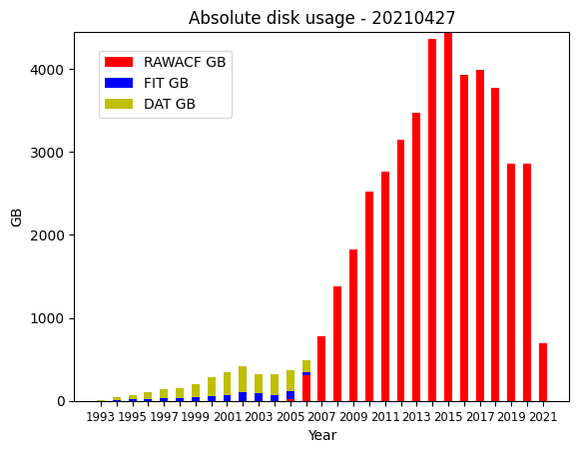
DDWG report SuperDARN Workshop 2021
Monthly data
<number>
Superdarn.ca
Notes:
<number>

Slide 3
DDWG report SuperDARN Workshop 2021
Access to Data
Globus mirror (endpoint: computecanada#cedar-dtn) –
Contact Kevin Krieger – kevin.krieger at usask dot ca
BAS mirror available via bslsuperdarnc.nerc-bas.ac.uk
contact Paul Breen - pbree at bas dot ac dot uk
* New mirrors in the future: PRIC and NSSC
<number>
Superdarn.ca
Notes:
<number>

Slide 4
DDWG report SuperDARN Workshop 2021
Major updates in the past year
rsync access provided to BAS to sync files from usask. Paul working to close the gap between Globus and BAS mirror differences
VT moved data servers to a temporary location in September 2020, they are expected to move to a more permanent home in the future, date TBD.
BAS started doing direct transfers from PI staging servers (see quarterly reports for a table of the progress)
Temporary mirror superdarn-cssdp.usask.ca decommissioned
<number>
Superdarn.ca
Notes:
<number>

Slide 5
DDWG report SuperDARN Workshop 2021
Major updates in the past year
File naming convention finalized. Backlog of Borealis (pgr, cly, sas) data now being uploaded one month at a time
DDWG landing page transitioned from VT to SuperDARN Github
https://github.com/SuperDARN/DDWG
2194 DAT files retrieved from optical media in storage
A list of failed files (DMAP issues, BZ2 issues, corrupt files, etc) was collated and placed on the Globus mirror.
Master list of all previously updated files placed on the Globus mirror
<number>
Superdarn.ca
Notes:
<number>

Slide 6
DDWG report SuperDARN Workshop 2021
Major updates in the past year
NSSC data mirror has copied 38TB of data (as of 20210513) from BAS, and ideally have all files copied by late May.
PRIC data mirror finished preliminaries, will be ideally open to community very soon
<number>
Superdarn.ca
Notes:
<number>

Slide 7
DDWG report SuperDARN Workshop 2021
Outstanding Issues & Discussions
Differences between mirrors – lack of human resources
Explicit, direct and clear communication when changes in data distribution are made will be appreciated
Data gaps resolution – is this still valuable?
Data flowing from each institution to both VT and BAS for redundancy
Delays/gaps in data distribution for some radars:
cly, han, jme, kap, pgr, sas, bpk, ker, sys, tig, unw
<number>
Superdarn.ca
Notes:
<number>

Slide 8
DDWG report SuperDARN Workshop 2021
Future
More mirrors coming online (PRIC & NSSC)
https://www.frdr.ca/repo/ for a place to publish ‘finished’ datasets
archiving for publications; version control; assigns DOI number to dataset to refer to in publication
Compute Canada will be transitioning to NDRIO (New Digital research Infrastructure Organization)
<number>
Superdarn.ca
Notes:
<number>

