Slide 1

Data Distribution Working Group meeting
May 17 12:00 UTC 2023
Virtual - zoom
<number>
Notes:
<number>

Slide 2
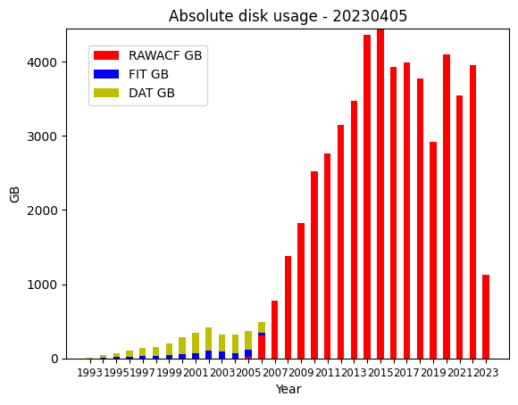
DDWG report SuperDARN Workshop 2021
Monthly data
<number>
Superdarn.ca
Notes:
<number>

Slide 3
DDWG report SuperDARN Workshop 2021
Activity in the past year
Data gaps emails sent to data managers for calendar 2020/2021
BPK files from 2020 retrieved
KAP files from 2020/2021 retrieved
HOK/HKW files from 2021 retrieved
DCE/DCN files from 2021 retrieved
FRDR repository for 2021 data published
FRDR repository for 2020 data published
<number>
Superdarn.ca
Notes:
<number>

Slide 4
DDWG report SuperDARN Workshop 2021
Activity in the past year
DDWG repository charter/membership and other docs updated
USASK storage allocation was applied for and received (100TB)
Monthly automated comparisons of USASK to BAS/NSSC implemented
Visual tool for comparisons built and on superdarn.ca
One unscheduled downtime in December 2022 for USASK mirror
One scheduled downtime in March 2023 for USASK mirror
<number>
Superdarn.ca
Notes:
<number>

Slide 5
DDWG report SuperDARN Workshop 2021
Activity in the past year: BAS
JME data are now transferred from the NSSC mirror to BAS, rather than the JME PI staging server, as there were differences
Updated BPK transfer to use new La Trobe staging server.
Removed moribund La Trobe transfers (TIG, UNW).
New transfers of Dartmouth ICE/ICW radar data.
Re-enabled Dartmouth CVE/CVW transfers.
Gaps in FIR data during October and December 2022, due to operational issues and radar maintenance.
<number>
Superdarn.ca
Notes:
<number>

Slide 6
DDWG report SuperDARN Workshop 2021
Update from Mikko: LYR
Re-commissioning of the radar started 12 May 2023 with the airport interlock system in place
The new dataflow from LYR to BAS will incorporate local quality checks (thanks for the scripts, btw.) We’ll need to discuss the staging of fresh data with Paul.
We will try to run the nominal schedules from June forwards, but may or may not distribute the data depending on what we find out during test runs. There will also be interrupts in the operation due to calibration, antenna repair, hardware troubleshooting etc.
Normal operations expected in August
<number>
Superdarn.ca
Notes:
<number>

Slide 7
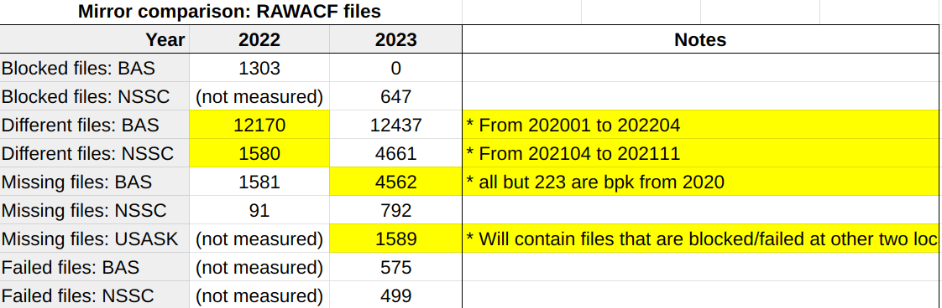
DDWG report SuperDARN Workshop 2021
Outstanding Issues & Discussions
Differences between mirrors: see https://superdarn.ca/server-status
<number>
Superdarn.ca
Notes:
<number>

Slide 8
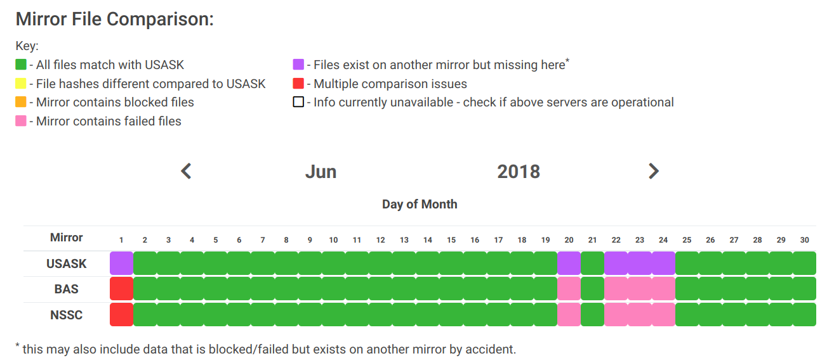
DDWG report SuperDARN Workshop 2021
Outstanding Issues & Discussions
<number>
Superdarn.ca
Notes:
<number>

Slide 9
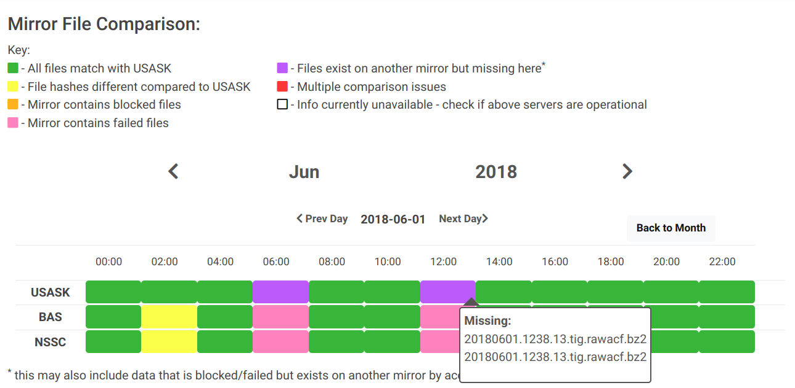
DDWG report SuperDARN Workshop 2021
Outstanding Issues & Discussions
<number>
Superdarn.ca
Notes:
<number>

Slide 10
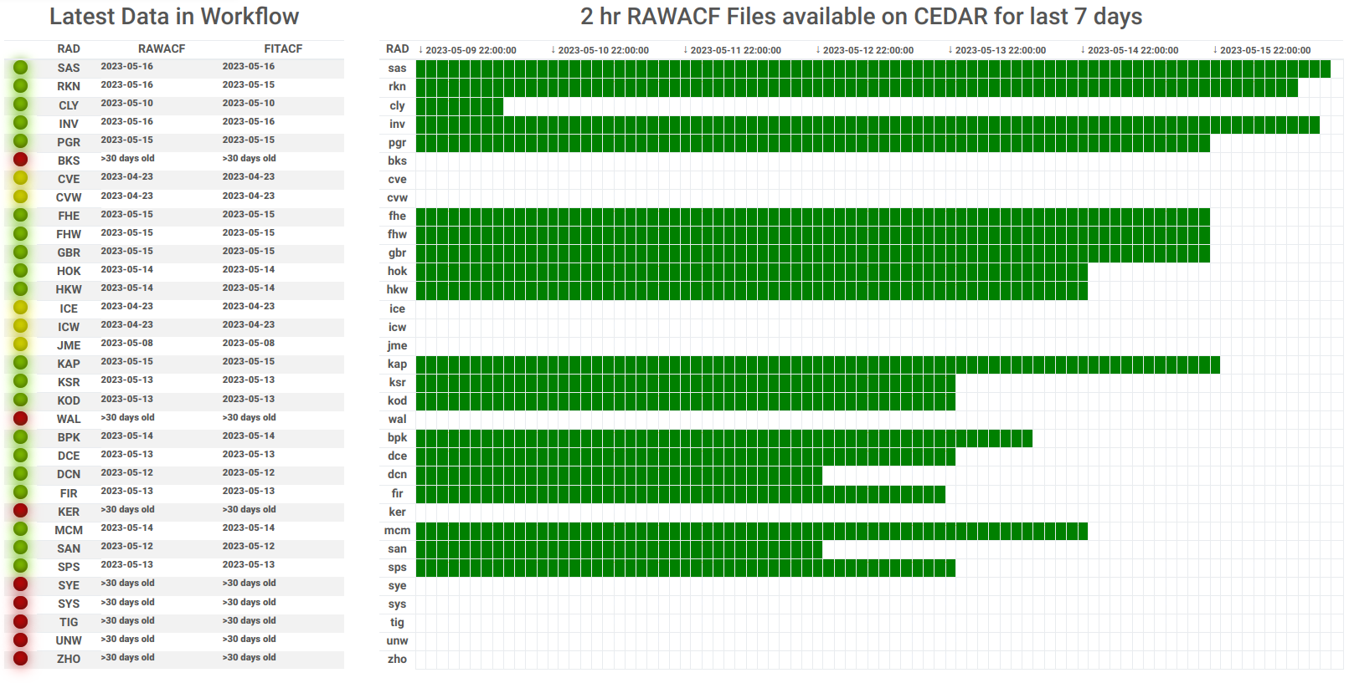
DDWG report SuperDARN Workshop 2021
Outstanding Issues & Discussions
<number>
Superdarn.ca
Notes:
<number>

Slide 11
DDWG report SuperDARN Workshop 2021
Outstanding Issues & Discussions
CVE/CVW bistatic files update: 1138 files from CVE/CVW need updating on mirrors
WAL file transfers need to be set up
<number>
Superdarn.ca
Notes:
<number>

Slide 12
DDWG report SuperDARN Workshop 2021
Outstanding Issues & Discussions
File inclusion standards
Bzip2 checks (can the file be decompressed?)
File size makes sense (is it 0?)
DMAP consistency (using pydarnio/backscatter/some other program)
USASK/NSSC use pydarnio
Pydarnio example passed to Mikko
<number>
Superdarn.ca
Notes:
<number>

