Slide 1

Data Distribution Working Group
June 3rd 2019
Kevin Krieger¹, Kevin Sterne², Paul Breen³
SuperDARN Workshop
Japan
1 – University of Saskatchewan
2 – Virginia Tech
3 – British Antarctic Survey
Notes:
‹#›

Slide 2
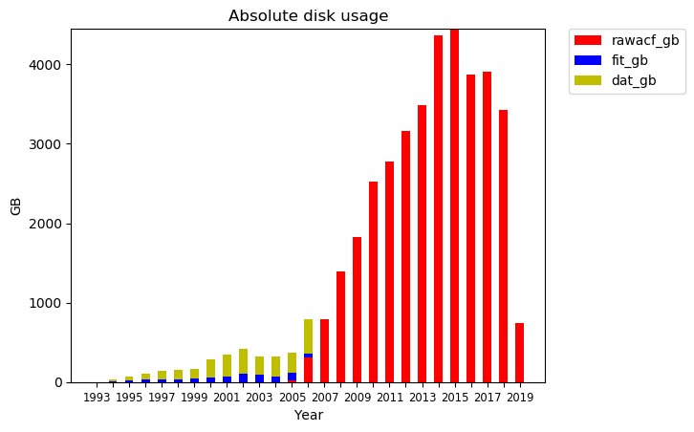
DDWG report SuperDARN Workshop 2018
Monthly data
Superdarn.ca
Notes:
‹#›

Slide 3
DDWG report SuperDARN Workshop 2018
DDWG: Summary
Online data distribution in 2018-19
No hard drives written or distributed
File loss and recovery on Globus Mirror in late 2018
Globus used for data transfer at usask, rsync at BAS
Continuing support for temporary (latest months only) data server superdarn-cssdp.usask.ca (SFTP/rsync/SCP) but you should really move to Globus
Virginia Tech’s SFTP server
Mid year checkup of questions/concerns given to PIs
Superdarn.ca
Notes:
‹#›

Slide 4
DDWG report SuperDARN Workshop 2018
Data Mirrors
Temporary mirror accessible superdarn-cssdp.usask.ca
Only last few months of data available
Globus mirror (endpoint: computecanada#cedar-dtn) –
Contact Kevin Krieger – kevin.krieger at usask dot ca
BAS mirror available via bslsuperdarnc.nerc-bas.ac.uk
contact Paul Breen - pbree at bas dot ac dot uk
Superdarn.ca
Notes:
‹#›

Slide 5
DDWG report SuperDARN Workshop 2018
Outstanding Issues & Discussions
Non sequential DAT file issue
timestamps not sequential or duplicated in two different files - not addressed yet
Missing Southern Hemisphere dat files from 1999
Corrupt DMAP files caught by backscatter package (https://github.com/SuperDARNCanada/backscatter)
Comparing BAS and USASK mirrors, are they the same?
Globus storage issues in 2018
External Data Distribution: example: VT SFTP server
Mid year checkup list sent to PIs
Superdarn.ca
Notes:
‹#›

Slide 6
DDWG report SuperDARN Workshop 2018
Issues & Discussions
Issue # | Date | Description
27 | July 13th 2018 | LYR data, new versions of several files
28 | July 24th 2018 | Blacklist DCE files from June 22nd 2018 onwards
29 | July 24th 2018 | Four HKW files blacklisted, incorrect beam nums
30 | Oct 22nd 2018 | Time offset for BKS files 2018050[3,4]
31 | Feb 20th 2019 | Blacklisted HOK file from 20181125
32 | Feb 28th 2019 | Two Replacement SPS files
33 | March 11 2019 | Blacklisting corrupt CVE file
Superdarn.ca
Notes:
‹#›

Slide 7
DDWG report SuperDARN Workshop 2018
Virginia Tech
Inception of davitpy: make acquisition of data easier to quickly plot data
VT operated (until Jan. 2019) “open” sftp server with username and password published on github and included with davitpy software
Abused to download and store massive amount of data
No easy ability to track who and how much data downloads
Superdarn.ca
Notes:
‹#›

Slide 8
DDWG report SuperDARN Workshop 2018
Virginia Tech
Number of users coming forward that are using this service
Andy Gisler (Astra Space) - one of the positive outcomes as able to provide better quick-grid/map files based on current rst code, Andy was using older RST Lite processing code.
Andy Gisler, Chad Fish - Looking for entire year of data for post-event assimilative ionospheric model
Alexey Oinats (Institute of Solar-Terrestrial Physics, Irkutsk) - interested in many years of fit-level data from mid-latitude radars
Superdarn.ca
Notes:
‹#›

Slide 9
DDWG report SuperDARN Workshop 2018
Virginia Tech
Dogacan Ozturk (NASA JPL) - Was using data access for PFISR/SuperDARN conjunction studies
Liam Kilcommons (Univ. of Colorado’s CCAR) - “most of our SuperDARN-related tools are in Python and have been written to use Davitpy” (for data access)
Integrated GeoScience Observatory (NSF funded EarthCube project) - provides a set of tools pre-installed for space physicists
Davitpy (and maybe pydarn?)
Superdarn.ca
Notes:
‹#›

Slide 10
DDWG report SuperDARN Workshop 2018
Virginia Tech
Jiaen Ren (Univ. of Mich.) - Monthly/seasonally accessing SuperDARN files for event data
Jiang Liu, Larry Lyons (UCLA) - Have used davitpy for event data plotting (and subsequent data retrieval)
Lasse Clausen - Event study access; had an old NFS access to VT that had to be blocked, but then tried davitpy to access data
Superdarn.ca
Notes:
‹#›

Slide 11
DDWG report SuperDARN Workshop 2018
Future
Usask developing a set of Data Policies/Procedures
Help from DDWG members
https://www.frdr.ca/repo/ for a potential place to publish ‘finished’ datasets
archiving for publications; version control; assigns DOI number to dataset to refer to in publication
Usask looking at possible alternative solutions for storage
Tuesday at 6PM - DDWG Meeting - 2 Hours -
Fuyou B1 floor
Superdarn.ca
Notes:
‹#›

Slide 12
SuperDARN Data Distribution WG Mid-Year Check 2019
Kevin Sterne, Kevin Krieger DDWG co-chairs
Here are a few items for the SuperDARN PIs to review and comment on prior to the SuperDARN
Workshop 2019 that relate to the DDWG in particular priority.
1.Continue to report data quality issues to ddwg listserv (if possible, re: listserv issues)
2. Do we have exact copies of complete SuperDARN archive between the Globus and BAS archives?
a. Hearing reports Globus and BAS datasets aren’t the same from PI-level, can the severity of this be quantified? How many files does one have that the other doesn’t?
b. What are the issues keeping the datasets from being exact copies?
3. Growing issues with supporting older data set (pre-20060701), do we continue to support this data?
a. See the issue Simon Shepherd has raise about timestamping of the records in these files.
b. Also unclear on functionality of data analysis routines (but that’s an outreach to Data Analysis WG need).

Slide 13
4. Globus access issues
a. Are extended downtimes on Globus data storage an issue? Has BAS been able to serve as a backup?
b. Do Chinese researchers have access to Globus? If not, are they able to access BAS system?
c. Globus status update: IT staff at University of Saskatchewan are still working with Globus to get it running properly, the core of the issue appears to be the file system in use (Lustre possibly?) does not play well with Globus gridftp software. As of Feb. 19, 2019, the hope is the Globus developers are building a new version of the gridftp software for the University of Saskatchewan, but cannot make any promises.
5.How do we do handle external data distribution? The core of this issue is open/ease-of access versus ability to track data users.
a. VT “open” sftp server (linked to davitpy) has been shut down due to complaints of not being able to track data users and quantity.
6. Resolving data quality issues
a. To operate quickly and smoothly, each SD institution should have a person (preferably not a PI) that manages data transfers and data quality for their institution’s radars. That way when file issues arise, a person can be contacted that can track down good copies of files or assess the need to blacklist a file.
7. Is there a need for a full time data manager? How does this person operate amongst all SD institutions?

Slide 14
6. Resolving data quality issues
a. To operate quickly and smoothly, each SD institution should have a person (preferably not a PI) that manages data transfers and data quality for their institution’s radars. That way when file issues arise, a person can be contacted that can track down good copies of files or assess the need to blacklist a file.
7. Is there a need for a full time data manager? How does this person operate amongst all SD institutions?

