Slide 1

Data Distribution Working Group
Summary
May 28 2021
Kevin Krieger¹, Kevin Sterne², Paul Breen³ & The DDWG
SuperDARN Workshop
Virtual - SANSA
1 – University of Saskatchewan
2 – Virginia Tech
3 – British Antarctic Survey
<number>
Notes:
<number>

Slide 2
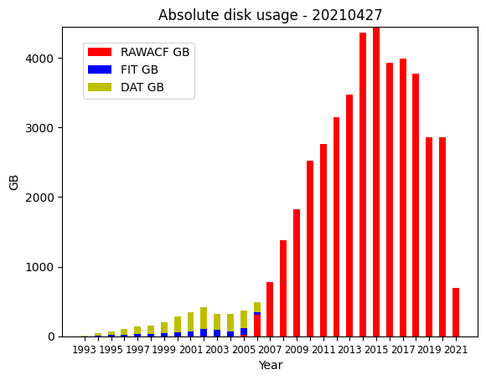
DDWG report SuperDARN Workshop 2021
Monthly data
<number>
Superdarn.ca
Notes:
<number>

Slide 3
DDWG report SuperDARN Workshop 2021
Access to Data
Globus mirror (endpoint: computecanada#cedar-dtn) –
Contact Kevin Krieger – kevin.krieger at usask dot ca
BAS mirror available via bslsuperdarnc.nerc-bas.ac.uk
contact Paul Breen - pbree at bas dot ac dot uk
* New mirrors in the future: PRIC, NSSC, ISEE
<number>
Superdarn.ca
Notes:
<number>

Slide 4
DDWG report SuperDARN Workshop 2021
Meeting discussion summary
Delays from various radar sites: There should be a faster feedback loop to data managers – automated Nagios emails can do this
Communication between Data managers and WG list: Send a message to let the list know when you expect delays in data
Gaps resolution – manual process once a year that is generally useful, we will try doing this twice a year going forward
<number>
Superdarn.ca
Notes:
<number>

Slide 5
DDWG report SuperDARN Workshop 2021
Meeting discussion summary
Redundant data paths to VT and BAS: Most radars now being uploaded to both institutions to prevent single-point-of-failure, better redundancy
Gaps from various radars: CDN files being uploaded one month at a time (2019 onward), others are decommissioned or off for repairs.
<number>
Superdarn.ca
Notes:
<number>

Slide 6
DDWG report SuperDARN Workshop 2021
Major updates in the past year
rsync access provided to BAS to sync files from usask. Paul working to close the gap between Globus and BAS mirror differences
VT moved data servers to a temporary location in September 2020, they are expected to move to a more permanent home in the future, date TBD.
BAS started doing direct transfers from PI staging servers (see quarterly reports for a table of the progress)
Temporary mirror superdarn-cssdp.usask.ca decommissioned
<number>
Superdarn.ca
Notes:
<number>

Slide 7
DDWG report SuperDARN Workshop 2021
Major updates in the past year
File naming convention finalized. Backlog of Borealis (pgr, cly, sas) data now being uploaded one month at a time
DDWG landing page transitioned from VT to SuperDARN Github
https://github.com/SuperDARN/DDWG
2194 DAT files retrieved from optical media in storage
A list of failed files (DMAP issues, BZ2 issues, corrupt files, etc) was collated and placed on the Globus mirror.
Master list of all previously updated files placed on the Globus mirror
<number>
Superdarn.ca
Notes:
<number>

Slide 8
DDWG report SuperDARN Workshop 2021
Major updates in the past year
NSSC data mirror has copied 38TB of data (as of 20210513) from BAS, and ideally have all files copied by late May.
PRIC data mirror finished preliminaries, will be ideally open to community very soon
<number>
Superdarn.ca
Notes:
<number>

Slide 9
DDWG report SuperDARN Workshop 2021
Future
More mirrors coming online (PRIC, NSSC, ISEE)
https://www.frdr.ca/repo/ for a place to publish ‘finished’ datasets
archiving for publications; version control; assigns DOI number to dataset to refer to in publication
Compute Canada will be transitioning to NDRIO (New Digital research Infrastructure Organization)
Automated emails from Nagios when data is delayed past a certain threshold
<number>
Superdarn.ca
Notes:
<number>

