Slide 1

Data Distribution Working Group
Meeting Summary
June 8th 2018
Kevin Krieger¹, Kevin Sterne², Paul Breen³
SuperDARN Workshop
Banyuls Sur Mer, France
1 – University of Saskatchewan
2 – Virginia Tech
3 – British Antarctic Survey
Notes:
‹#›

Slide 2
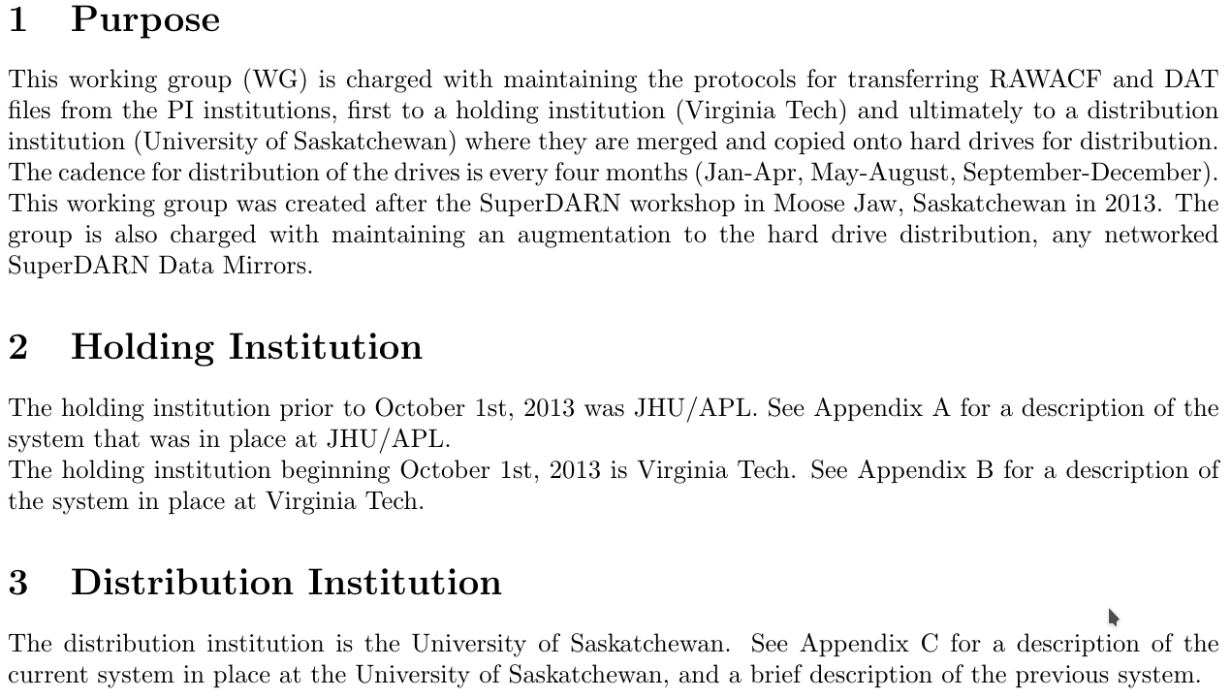
DDWG meeting summary SuperDARN Workshop 2018
Superdarn.ca
Notes:
‹#›

Slide 3
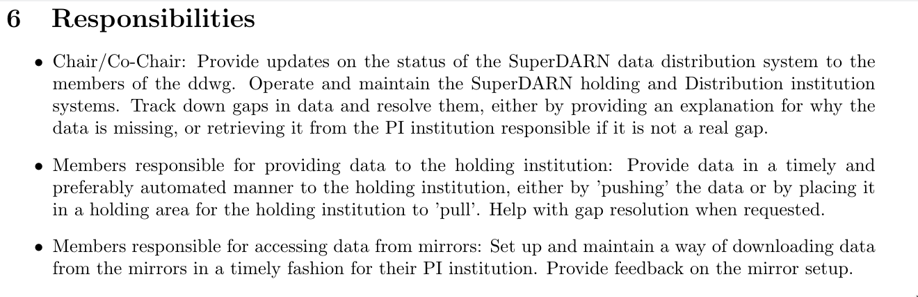
DDWG meeting summary SuperDARN Workshop 2018
Superdarn.ca
Notes:
‹#›

Slide 4
DDWG meeting summary SuperDARN Workshop 2018
Current issues
Globus appears to be firewalled in China
Currently no dmap/file integrity checking done before rawacfs are placed on mirror
Lack of person-power available for BAS mirror
Blacklisted files may only have one corrupt record? Throwing out more data than we need to?
Who is responsible for looking at file issues?
Superdarn.ca
Notes:
‹#›

Slide 5
DDWG meeting summary SuperDARN Workshop 2018
“Mirrors”
What if a hash file is corrupted?
Calculation of hashes takes a long time (~4 hours per year of data) Do it periodically?
Currently just comparing pre-computed hashes to determine differences between mirrors
Superdarn.ca
Notes:
‹#›

Slide 6
DDWG meeting summary SuperDARN Workshop 2018
Next steps
Contact with PIs with blacklisted files
Addition of dmap file integrity checking with backscatter https://github.com/SuperDARNCanada/backscatter
Calculation of blacklisted file statistics (how much? is it significant?)
Creation of a single file with blacklisted data - convenience so you only need to download one text file
BAS may have some exabyte tapes to digitize and place on mirror
sd-data1 at VT will have downtime this year!
Superdarn.ca
Notes:
‹#›

