Slide 1

Data Distribution Working Group
June 4th 2018
Kevin Krieger¹, Kevin Sterne², Paul Breen³
SuperDARN Workshop
Banyuls Sur Mer, France
1 – University of Saskatchewan
2 – Virginia Tech
3 – British Antarctic Survey
Notes:
‹#›

Slide 2
DDWG report SuperDARN Workshop 2018
DDWG: Summary
Full online data distribution in 2017-18
No hard drives written or distributed
Expect possible interruption in service on VT servers
more hard drive space required within next year
Globus used for data transfer
Attended Globusworld conference April 25-26
Continuing support for temporary (latest months only) data server superdarn-cssdp.usask.ca but you should really move to Globus
Superdarn.ca
Notes:
‹#›

Slide 3
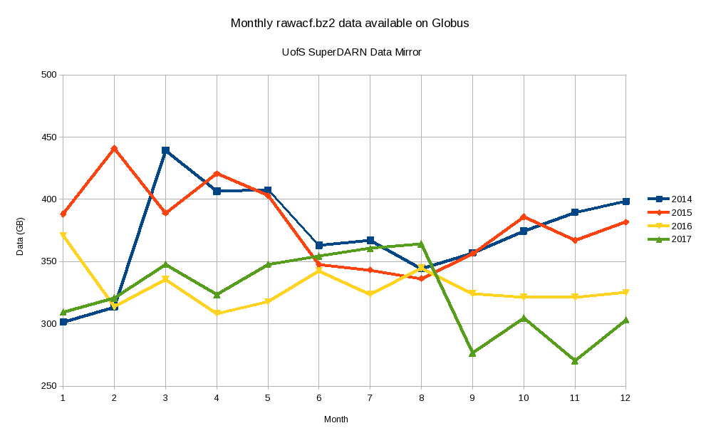
DDWG report SuperDARN Workshop 2018
Monthly data
Superdarn.ca
Notes:
‹#›

Slide 4
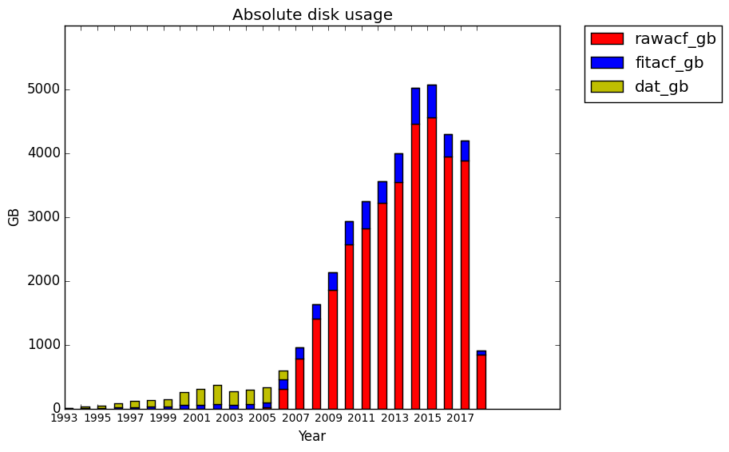
DDWG report SuperDARN Workshop 2018
Monthly data
Superdarn.ca
Notes:
‹#›

Slide 5
DDWG report SuperDARN Workshop 2018
University of Saskatchewan Data Mirror
Temporary mirror still accessible
Globus mirror with full dataset available – contact Kevin Krieger – kevin.krieger at usask dot ca
Data from 1993 – April 2018 available
Mirror downtimes over the past year:
April 26th 13:00 – 17:30 UTC 2017 – moved temporary server at University of Saskatchewan
December 3rd – December 4th 2017 – Server side credentials expired
Superdarn.ca
Notes:
‹#›

Slide 6
DDWG report SuperDARN Workshop 2018
Issues & Discussions
List of blacklisted files is available at:
~/sddata/.config/blacklist/ on data mirror
Known data problems listed on DDWG website
blacklist all files with known problems.
Non sequential DAT file issue
timestamps not sequential or duplicated in two different files - not addressed yet
Superdarn.ca
Notes:
‹#›

Slide 7
DDWG report SuperDARN Workshop 2018
Issues & Discussions 2
Issue # | Date | Description
12 | June 27th 2017 | LYR files prior to public release
13 | June 28th 2017 | Blacklisted hok files with no data 201701
14 through 22 | Mid July 2017 | Blacklisting files with known issues on DDWG page
23 | July 18th 2017 | Corrupted Stokkseyri file
24 | July 20th 2017 | Corrupted PGR file
25 | August 1st 2017 | SAN files with no minute in filename
26 | Nov 7th 2017 | 526 Corrupt rawacf files - see backscatter package: https://github.com/SuperDARNCanada/backscatter
Superdarn.ca
Notes:
‹#›

Slide 8
DDWG report SuperDARN Workshop 2018
Globusworld 2018
April 25th - 26th 2018, Chicago, IL
1/3 of R1 Universities use Globus now
Make sure we acknowledge Globus in journal articles/publications/websites
Future roadmap for Globus developers
trigger-action programming (automated secondary product generation?)
Improving performance
automation of publications/groups/web apps/etc…
Superdarn.ca
Notes:
‹#›

Slide 9
More Globus information
https://www.globus.org/
Script utilizing python SDK for SuperDARN data:
https://github.com/SuperDARNCanada/globus
New Command line interface: https://docs.globus.org/cli/
Python SDK: http://globus-sdk-python.readthedocs.io/en/stable/
Superdarn.ca

Slide 10
DDWG report SuperDARN Workshop 2018
Future
Globus storage currently moving from remora5.sharcnet.ca to graham.computecanada.ca
Holding up data uploads to Globus mirror
“Standard” set of Canadian FITACF files to be on Globus
https://www.frdr.ca/repo/ for a potential place to publish ‘finished’ datasets
archiving for publications; version control; assigns DOI number to dataset to refer to in publication
Globus web-applications
For more up to date information on the DDWG see:
http://vt.superdarn.org/tiki-index.php?page=Data+Dist+Working+Group
Superdarn.ca
Notes:
‹#›

