Slide 1
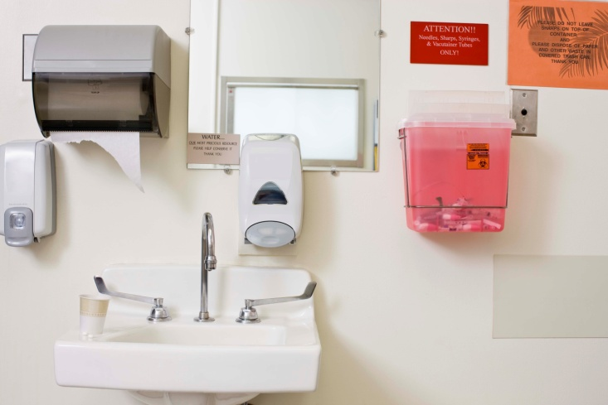
CDC Winnable Battles: Preventing Healthcare-Associated Infections (HAIs)
National Center for Emerging and Zoonotic Infectious Diseases
Division of Healthcare Quality Promotion

Slide 2
Healthcare-Associated Infections (HAIs)
1 out of 20 hospitalized patients affected
Associated with increased mortality
Attributed costs: $26-33 billion annually
HAIs occur in all types of facilities, including:
Long-term care facilities
Dialysis facilities
Ambulatory surgical centers
Hospitals

Slide 3
Outbreaks vs. Endemic Problems
Outbreaks are the tip of the iceberg…but provide useful information
Dialysis – manufacturing flaws; procedural errors
Laboratory personnel with tuberculosis
Transplant recipients – amoebae, viral encephalitis, hepatitis, HIV
Sterilization errors and failures – endoscopes
Syringe re-use transmitting hepatitis C virus
Multi-drug resistant organisms (MDRO)

Slide 4
Outbreaks vs. Endemic Problems
Endemic problems represent the majority of HAIs
Device-associated infections
Catheter-associated urinary tract infections (CAUTI)
Central line-associated Blood stream infections (CLABSI)
Ventilator-associated Pneumonia (VAP)
Procedure-associated infections
Surgical site infections (SSI)
Adherence problems
Antimicrobial stewardship, hand hygiene

Slide 5
Changing Landscape of Healthcare
Organizational factors affect HAI prevention
Administrative policies
Antimicrobial utilization
Staffing
Education
Increasing prevalence of antimicrobial-resistant pathogens

Slide 6
Changing Landscape of Healthcare
Growing populations at risk
Immunocompromised individuals
Low birthweight, premature neonates
Transplant recipients on immunosuppressive therapy
Special environments
Intensive care and burn units
Long-term care
Ambulatory surgery, endoscopy, and infusion services

Slide 7
Healthcare has moved beyond hospitals
Hospitals
Ambulatory Facilities
Long-term Care
Dialysis Facilities

Slide 8
Surgical procedures are increasingly performed in outpatient settings
All Outpatient Settings
Procedures (millions)
Hospital
Inpatient
Source: Avalere Health analysis of Verispan’s Diagnostic Imaging Center Profiling Solution, 2004, and American Hospital Association Annual Survey data for community hospitals, 1981-2004.
* 2005 values are estimates.

Slide 9
Outbreaks due to errors in outpatient settings
Endoscopy clinic (HCV): NYC 2001, NV 2008
Private medical practice (HBV): NYC 2001
Pain remediation clinic (HCV): Oklahoma 2002, NY 2007
Oncology clinic (HCV): Nebraska, 2002
State authorities notified and tested thousands of patients
Common themes
“Obvious” violations in standard procedures
Preventable with basic infection control practices
HCWs not aware that practices were in error

Slide 10
Examples of multidrug resistance in
HAI pathogens
Acinetobacter baumannii
About 75% are multidrug resistant*
10% increase from 2000
Pseudomonas aeruginosa
About 17% are multidrug resistant*
Staphylococcus aureus
MRSA causes about 55% of HAIs (Antimicrobial-Resistant Pathogens Associated with Healthcare Associated Infections, Annual Summary of Data Reported to the NHSN at CDC, 2006-2007)
* Percent Acinetobacter baumannii and P. aeruginosa in ICUs that are multidrug-resistant, NNIS and NHSN, 2000-2008. Includes ICUs only (MICU, SICU, MSICU) and device-related infections only (CLABSI, CAUTI, VAP).

Slide 11
Estimated Clostridium difficile cases by setting
Clostridium difficile hospitalizations
Hospital-acquired, hospital-onset cases
165,000, $1.3 billion excess costs, 9,000 deaths annually
Hospital-acquired, post-discharge
50,000, $0.3 billion excess costs, 3,000 deaths annually
Nursing home-onset cases
263,000, $2.2 billion excess costs, 16,500 deaths annually
Any listed diagnoses
Primary diagnosis
Campbell, Infect Control Hosp Epidemiol. 2009 Dubberke, Emerg Infect Dis. 2008
Dubberke, Clin Infect Dis. 2008 Elixhauser et al. HCUP Statistical Brief #50. 2008

Slide 12
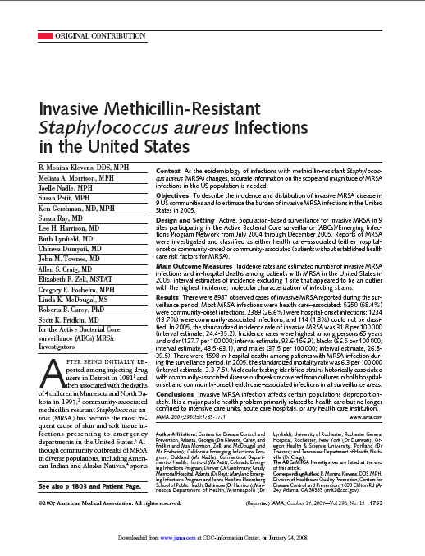

MRSA has moved beyond hospital settings
~100,000 invasive MRSA infections per year (normally sterile site)
25% were “nosocomial”
60% identified before or in first 2 days of hospitalization
But with contacts to healthcare settings; healthcare-associated community-onset
15% community-associated

Slide 13
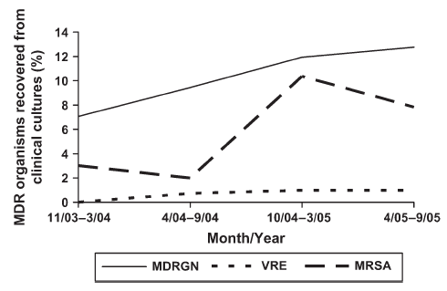
Multidrug-resistant gram negative infections in long-term care facilities
In one study of 1,661 clinical cultures from one LTCF (Nov. ’03-Sept. ’05)*
180 (11%) MDR GNR
104 (6%) MRSA
11 (1%) VRE
Number of reports of sporadic cases from as early as 2004 from LTAC and LTCF
Similar thing had been recognized with ESBLs (e.g., movement for acute care into LTCF)
* O’Fallon E, et al. J Gerontol 2009; 64:138-41.

Slide 14
CDC’s role in HAI prevention
Strengthen surveillance and epidemiology
Support to state and local health departments
Implement what works and identify gaps for prevention
Provide leadership in health policies

Slide 15
CDC’s role in HAI prevention Data for action
National Healthcare Safety Network (NHSN)
Internet based reporting system through CDC’s Secure Data Network
4500+ US healthcare facilities currently participate from all 50 states
Standard definitions, methods, and protocols used nationally
Data entry transitioning to automated electronic data capture

Slide 16

National system for tracking and comparing HAI rates
Minimize user burden
Streamlines data reporting
Uses existing electronic data (e.g., laboratory information systems, operating room, pharmacy, clinical, administrative databases)
Open to all: hospitals, health departments, ambulatory care, dialysis facilities, etc.

Slide 17
Hospitals using NHSN are preventing bloodstream infections
Trends in bloodstream infections* by ICU type, NHSN hospitals, 1997-2007
9
8
7
6
Medical
5
Medical/Surgical--Major Teaching
Pooled Mean Annual CLABSI Rate per 1,000 Central Line Days
Medical/Surgical--Non-Major Teaching
4
Pediatric
Surgical
3
2
Burton DC, et al. Methicillin-Resistant Staphylococcus aureus Central Line-Associated Bloodstream Infections in US Intensive Care Units, 1997-2007. JAMA. 2009;301(7):727-736.
1
0
1997
1998
1999
2000
2001
2002
2003
2004
2005
2006
2007

Slide 18
CDC’s role in HAI prevention Data for action
Emerging Infections Program
Population based surveillance in 9 states
Especially important for understanding the dynamic epidemiology of healthcare-associated infections due to MRSA and C. difficile, and other emerging multidrug resistant bacteria causing HAIs
HAI Prevalence Survey in 2011

Slide 19
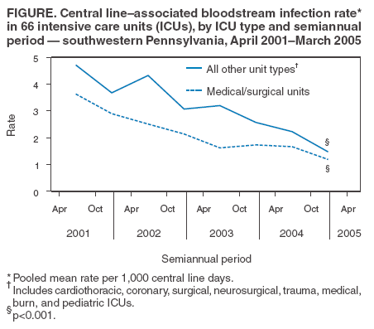
Adherence to CDC guidelines reduces HAIs Examples of Success: Pennsylvania, Michigan
ICUs at 103 Michigan
hospitals, 18 months
BSIs/1,000 catheter days
Pronovost P. New Engl J Med 2006;355:2725-32.
MMWR 2005;54:1013-16.

Slide 20
State of prevention knowledge and science
Guidelines developed for each type of infection and based on systematic reviews of medical literature
Prevention of central line-associated blood stream infections
Prevention of catheter-associated urinary tract infections
Prevention of surgical site infections
Prevention of healthcare-associated pneumonia
Management of multidrug-resistant organisms
Recommendations graded according to evidence
Guidelines contain many recommendations
Current efforts to help prioritize interventions that are most effective

Slide 21
Adherence to infection control guidelines is incomplete
Many HAIs are preventable with current recommendations
Failure to use proven interventions is unacceptable
Only 30%-38% of U.S. hospitals are in full compliance
Just 40% of healthcare personnel adhere to hand hygiene
Insufficient infection control infrastructure in non-acute care settings has allowed major lapses in safe care

Slide 22
Local success fuels national prevention
National
Regional
Facility
Unit
Local

Slide 23
CDC knowledge and data fuels local to national CLABSI prevention
National
National expansion of CLABSI prevention
60% Reduction in CLABSI between 1999-2009
State-based public reporting using NHSN
State/regional prevention collaboratives (CUSP, Recovery Act projects)
CMS/IPPS – hospitals report CLABSIs for full Medicare payment
Regional
Subsequent projects based upon CDC prevention:
Michigan Keystone
Institute for Healthcare Improvement
Others
Facility
Unit
Pittsburgh Regional Healthcare Initiative
First successful, large-scale CLABSI prevention demonstration project
Outbreak Investigations
NHSN Data
Prevention Research (e.g. chlorhexidine bathing)
CDC Guidelines
Inputs
Outputs

Slide 24
Increasing adherence to CDC guidelines Recent successes
58% reduction in central line-associated bloodstream infections (CLABSI) for ICU patients between 2001 and 2009
In 2009 alone: 3,000-6000 lives saved; $414 million in costs averted
Since 2001: 27,000 lives saved; $1.8 billion in costs averted
More needs to be done
41,000 CLABSI in non-ICU hospital patients
37,000 in dialysis centers
This is a model for other infections
MRSA, Clostridium difficile, surgical-site infections, catheter-associated urinary tract infections, ventilator-associated pneumonia

Slide 25
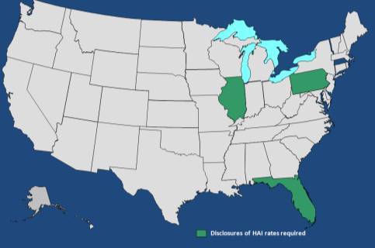
States with legislation for public
HAI reporting
2004
2011
DC*
States required to publicly report some healthcare-associated infections
States required to publicly report some healthcare-associated infections
Notes:
25

Slide 26
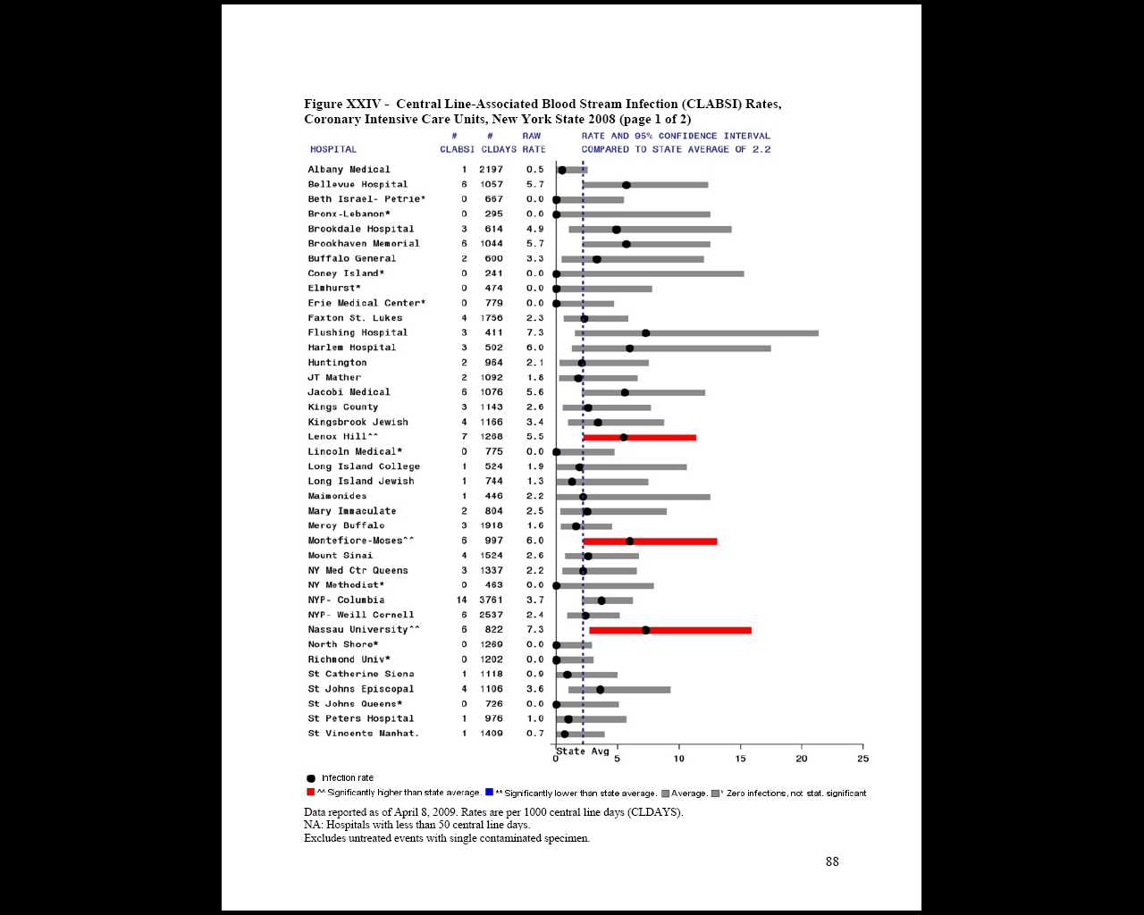
HAI in New York State hospitals, 2008
A state report utilizing NHSN
Report includes
Bloodstream infections in ICU patients
Surgical site infections
From 2007 to 2008
Bloodstream infection rates increasing
Surgical site infection rates decreasing
Targeted prevention efforts
http://www.health.state.ny.us/statistics/facilities/hospital/hospital_acquired_infections/

Slide 27
Health reform
Congress
Bills proposing mandatory national public reporting
HAI prevention tied to Medicare/Medicaid payment
Affordable Care Act
Section 3001 – Hospital Value Based Purchasing Program “…value-based incentive payments are made in a fiscal year to hospitals that meet the performance standards.”

Slide 28
CMS Inpatient Prospective Payment System (IPPS) Rule
Requires national public reporting of HAIs
CLABSI starting in 2011, SSI in 2012
Full HHS HAI Action Plan over time
NHSN – public health surveillance system
Links reduction of HAIs to federal payment
Uses NHSN to report quality measure data

Slide 29
HHS Action Plan 5-year Goals
Metric | National 5-year Prevention Target | Source
Central line-associated bloodstream infections | 50% reduction | NHSN
Adherence to central-line insertion practices | 100% adherence | NHSN
Clostridium difficile infections and hospitalizations | 30% reduction | NHSN, NHDS, HCUP
Catheter-associated urinary tract infections | 25% reduction | NHSN
MRSA invasive infections (population) | 50% reduction | EIP
Surgical site infections | 25% reduction | NHSN
Surgical Care Improvement Project measures | 95% adherence | SCIP
NHSN – CDC’s National Healthcare Safety Network EIP – CDC’s Emerging Infections Program
NHDS – CDC’s National Hospital Discharge Survey SCIP – CMS’s Surgical Care Improvement Project
HCUP – AHRQ’s Healthcare Cost and Utilization Project

Slide 30
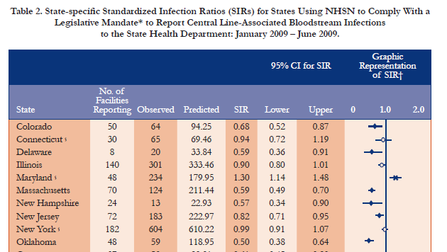
Tracking state-level progress

Slide 31
National impact of HAI prevention
18% reduction of standardized infection ratio (SIR) of central-line associated bloodstream infections in 2009 (NHSN data)
5% reduction of surgical site infection SIR in 2009 (NHSN data)
10% reduction per year of hospital-onset invasive MRSA incidence rate from 2005 through 2008 (EIP data)
March 2011 Vital Signs: CLABSI prevention between 2001 and 2009
58% reduction in ICU patients
In 2009 alone: 3,000-6000 lives saved; $414 million in costs averted
Since 2001: 27,000 lives saved; $1.8 billion in costs averted

Slide 32
The need for HAI prevention research
Prevented
Preventable
Need for complete implementation of practices known to prevent HAIs
Healthcare-associated Infection
Prevention Approach Unknown
Need for ongoing research to identify new strategies to prevent the remaining HAIs
Notes:
32

Slide 33
Culture change
“Many infections are inevitable;
some might be preventable”
“Each infection is potentially preventable, unless proven otherwise”

Slide 34
Consumers
Medical
Professionals
Public Health
Safe Healthcare is Everyone’s Responsibility
Patients
Payors
Government
Healthcare
Facilities

Slide 35
For more information:
www.cdc.gov/winnablebattles
National Center for Emerging and Zoonotic Infectious Diseases
Division of Healthcare Quality Promotion

