Slide 1
Slide 2 is the source for gd_example.eps.
Steps to regenerate gd_example.eps:
  Right-click the image in slide 2
  Select: Save As Picture
  Save as a temporary tif file.
  Use image magick convert to convert from tif to eps.
  Copy the gd_example.eps file to the images directory.
Slide 3 contains a an example of stochastic gradient descent (Robbins-Monro), but this image is not used in the manual.

Slide 2
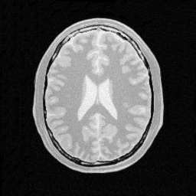
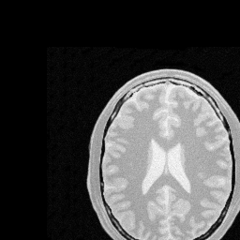
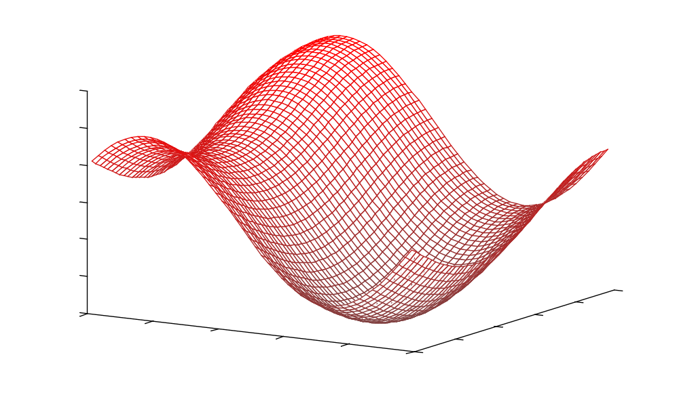
C
[1] = t_{y}
[0] = t_{x}

Slide 3
C
[1] = t_{y}
[0] = t_{x}

