Slide 1
TestCase.xiidm — Scenario Analysis
Merged IEEE 14 + IEEE 39 + HVDC — baseline / high RES + low demand / low RES + high demand

Slide 2
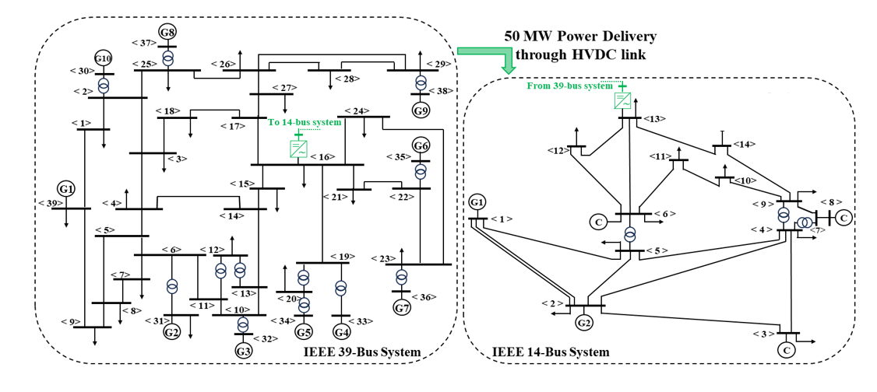
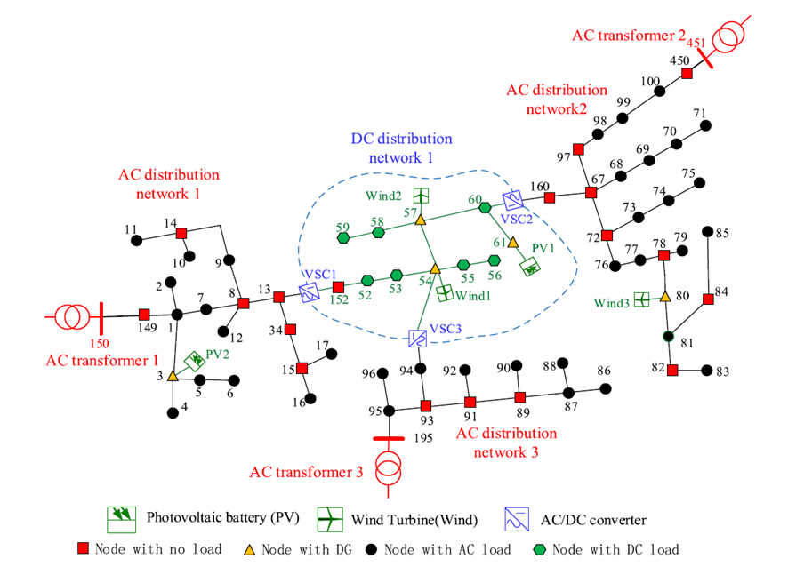
Task 3.2 coordination – Common Test Case
Objectives:
  Validate tools behaviour before the demos
  Compare similar tools
  Investigate tools complementarity
For transmission-level tools
#9
#4
#10
For distribution-level tools
#6
IEEE 39-Bus + HVDC link + IEEE 14-Bus
Modified IEEE 33-Bus
PSS/E format
CGMES
XIIDM

Slide 3
Generator metadata
15 generators — type, nominal P, marginal price (synthetic, editable)
Generator | Subnet | Type | Nominal P (MW) | Price (€/MWh)
B101-G1 | IEEE 14 | NUCLEAR | 350 | 8
B102-G1 | IEEE 14 | GAS | 60 | 70
B103-G1 | IEEE 14 | WIND | 50 | 1
B106-G1 | IEEE 14 | SOLAR | 30 | 0
B108-G1 | IEEE 14 | HYDRO | 25 | 5
B30-G1 | IEEE 39 | WIND | 250 | 1
B31-G1 | IEEE 39 | SOLAR | 570 | 0
B32-G1 | IEEE 39 | COAL | 975 | 45
B33-G1 | IEEE 39 | NUCLEAR | 950 | 8
B34-G1 | IEEE 39 | GAS | 762 | 70
B35-G1 | IEEE 39 | HYDRO | 650 | 5
B36-G1 | IEEE 39 | COAL | 840 | 45
B37-G1 | IEEE 39 | GAS | 810 | 70
B38-G1 | IEEE 39 | NUCLEAR | 1245 | 8
B39-G1 | IEEE 39 | NUCLEAR | 1500 | 8

Slide 4
Scenario: baseline
Reference operating point
How the scenario is built
Loads kept at their stored p0 / q0 (load_scale = 1.00).
HVDC link held at its file value: 50 MW from IEEE 39 -> IEEE 14.
Expected results after AC load flow
HVDC target: 50 MW (IEEE 39 → IEEE 14)
Generation per area: IEEE 14: MW | IEEE 39: MW
Load per area: IEEE 14: MW | IEEE 39: MW
Bus voltages:

Slide 5
Scenario: high_res_low_demand
RES at full output, demand depressed, HVDC at maximum
How the scenario is built
Loads scaled to 70 % (load_scale = 0.70).
All RES units (WIND, SOLAR, HYDRO) pinned at 100 % of nominal P.
HVDC forced to its maximum: 60 MW from IEEE 39 -> IEEE 14, to stress the small IEEE 14 system.
Goal: provoke voltage rise on the IEEE 14 side and test HVDC congestion.
Expected results after AC load flow
HVDC target: 60 MW (IEEE 39 → IEEE 14)
Generation per area: IEEE 14: MW | IEEE 39: MW
Load per area: IEEE 14: MW | IEEE 39: MW
Bus voltages:

Slide 6
Scenario: low_res_high_demand
RES collapsed, demand near peak
How the scenario is built
Loads scaled to 105 % (load_scale = 1.05).
All RES units curtailed to 10 % of nominal P (low wind / dawn solar).
Non-RES filled by merit order to meet the higher residual demand.
HVDC kept at the baseline 50 MW.
Goal: stress the thermal fleet and check that prices/dispatch can still cover demand.
Expected results after AC load flow
HVDC target: 50 MW (IEEE 39 → IEEE 14)
Generation per area: IEEE 14: MW | IEEE 39: MW
Load per area: IEEE 14: MW | IEEE 39: MW
Bus voltages:

