Slide 1
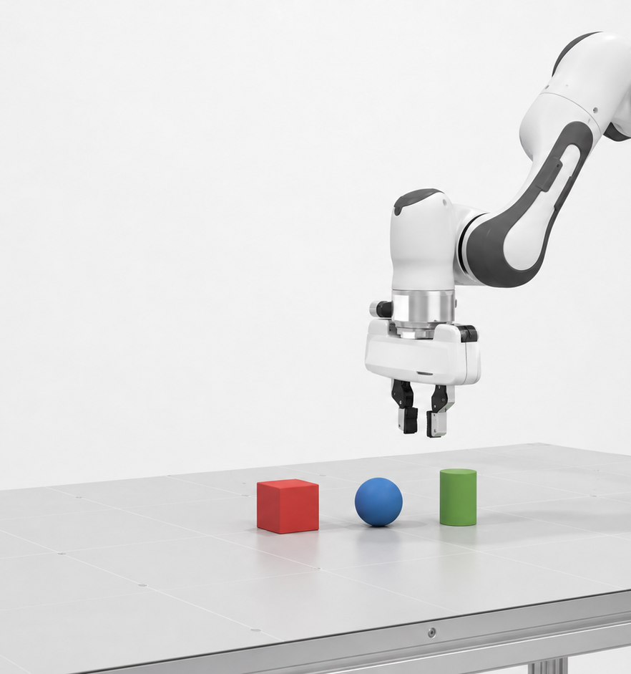
STAGE REVIEW · JULY 2026
MiniVLA
V3
Recovery-aware language-conditioned control with a validated clean baseline
MuJoCo / robosuite · Mac closed-loop evaluation · Cognition L40S training
Notes:
[Sources]
- Original deck asset: 2026-7-22-LiuYining.pptx, slide 1.
- README.md.
- results/hpc/v3_hpc_1349625/training_metadata_v3.json.

Slide 2
MINIVLA V3
Current system: recovery-aware multimodal control
1,800 demonstrations
1,200 clean + 600 targeted recovery trajectories
MULTIMODAL POLICY
CLOSED-LOOP CONTROL
TASK SPACE
Dual-view vision
7D OSC_POSE
Red cube
agentview + wrist
112 × 112 RGB
ΔXYZ + axis-angle + grip
Blue sphere
Language + state
20-step ACT
chunks
Green cylinder
DistilBERT · 5-step history
Replan every step · bounded history
Pick ×3 · Push ×3
Research goal
Measure clean performance and degradation under controlled visual, physical, scene and temporal perturbations.
02
Notes:
[Sources]
- results/hpc/v3_hpc_1349625/training_metadata_v3.json.
- results/hpc/v3_hpc_1349625/preflight_report_v3.json.
- models/mini_vla_v2.py.
- utils/evaluation_core_v2.py.

Slide 3
ENGINEERING EVOLUTION
Causal data and recovery drove the V2-to-V3 gains
Matched clean success
12.5%
75.8%
92.5%
protocol audit
97.92%
V2
V2.1
V2 Clean
Audit
V3
Correlated batches
Initial-state scarcity
BN instability
Interleaving + GroupNorm
Initial-state validation
Grounding rescue
Causal transitions
Interaction conditioning
Release gates
Pilot protocol defects
OOD grounding drift
Recovery gap exposed
Targeted recovery data
Language augmentation
HPC fine-tuning
Key lesson
Keep the proven policy, then add targeted recovery data and stricter evaluation.
03
Notes:
[Sources]
- results/v2_1/evaluation_clean_v2_1.json.
- results/v3_tests/clean_comparison/v2_20260714.csv.
- results/v3_tests/clean_comparison/v2_20261017.csv.
- results/v3_tests/clean_comparison/v3_20260714.csv.
- results/v3_tests/clean_comparison/v3_20261017.csv.

Slide 4
CODE ARCHITECTURE
Three files carry the current system
1 · collect_data_v3.py
2 · mini_vla_v2.py
3 · evaluation_core_v2.py
Target-displacement recovery
Language + dual-view tokens
Closed-loop inference
Forced miss-and-retry cases
5-step proprioceptive history
Bounded temporal ensembling
Live target re-localisation
20-step ACT decoder
Safety + action diagnostics
Rejects non-causal rollouts
Grounding + interaction heads
Failure taxonomy
Supporting modules
v2_schema.py · training_dataset_v2.py · perturbations_v2.py
04
Notes:
[Sources]
- scripts/collect_data_v3.py.
- models/mini_vla_v2.py.
- utils/evaluation_core_v2.py.
- utils/v2_schema.py.
- utils/training_dataset_v2.py.
- utils/perturbations_v2.py.

Slide 5
MATCHED CLEAN EVALUATION
V3 raises clean success from 92.50% to 97.92%
Success rate by task (%)
97.92%
235 / 240 V3 successes
+5.42 pp
absolute gain over V2
p=.0072
exact paired McNemar test
0.725 cm
mean V3 grounding error
240 matched episodes/model · identical seeds, scenes and evaluator
Remaining: Push-B distance · Push-C drift
05
Notes:
[Sources]
- results/v3_tests/clean_comparison/v2_20260714.csv.
- results/v3_tests/clean_comparison/v2_20261017.csv.
- results/v3_tests/clean_comparison/v3_20260714.csv.
- results/v3_tests/clean_comparison/v3_20261017.csv.
- Computed totals: V2 222/240; V3 235/240; exact paired McNemar p=0.0072.

Slide 6
ROBUSTNESS BENCHMARKING
Clean control is validated; robustness is now the research question
Paired target-displacement protocol
Protocol hardening
Teleport distance is excluded from push progress; every level shares one collision-safe direction and paired scene seeds.
0 cm
Clean
2 cm
Mild
4 cm
Core
6 cm
High
8 cm
Stress
TEMPORAL
bounded action history
LATEST-ONLY
newest prediction only
Success retention
Reacquisition latency
Failure category
Next stress tests
01 Dynamic target displacement
02 Visual noise and blur
03 Physics drift + OOD distractors
Same task · same seed · same collision-safe direction · paired execution modes
04 Camera extrinsic shift
Status: no robustness claim until paired degradation curves are complete.
06
Notes:
[Sources]
- scripts/benchmark_robustness_v2.py.
- utils/evaluation_core_v2.py.
- utils/perturbations_v2.py.
- The prior pilot curve was removed because its protocol was invalidated by later auditing.

