Slide 1
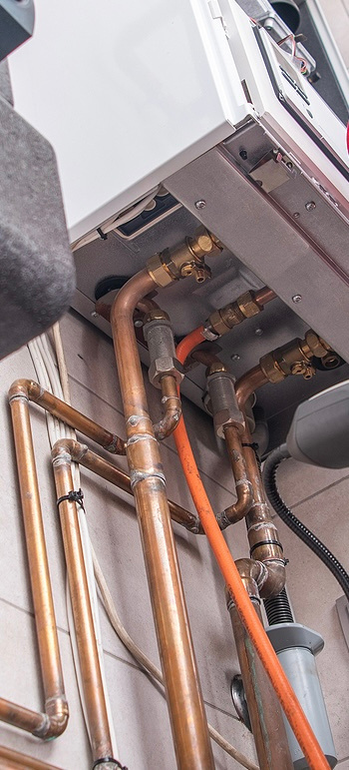
GasSentinel
Detecting Gas Leaks with IoT

Slide 2
Application context
Safety concern
Accident prevention
Prompt alerts can save lives and properties
Each device will be registered to an email and a certain address/location.

Slide 3
Requirements
Detection Accuracy: must detect gas concentrations accurately and reliably.
Real-Time Alerts: immediate alerting through buzzer and LED.
Data Communication: transmit data to a central server and nearby devices.
Compliance: must meet European safety standards for gas detection.

Slide 4
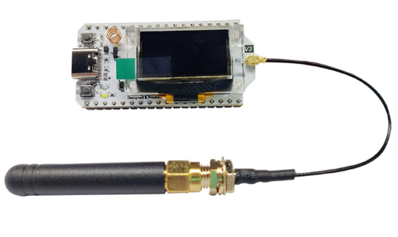
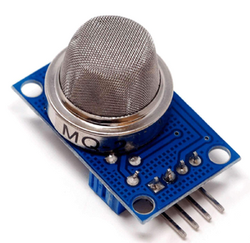


Components
ESP32S3 + antenna
MQ2 gas sensor
LEDs
Buzzer

Slide 5
LEDs
GREEN: the system is on and working.
YELLOW: peer gas leak.
RED: gas leak detected.

Slide 6
Technologies
ESP-NOW: edge devices communication.
MQTT: from edge to server communication (TLS).
PYTHON: server to store and analyse data.

Slide 7
Edge : monitoring, data collection (duration, sensor value), P2P communication , server communication.
Cloud : data storage, geographical trends of leakages, remote alert(email).

Slide 8
Challanges
Sensor calibration: meet the european costraints.
ESP-NOW: walls might be a problem.
Placement of the device: distance from gas source and peer.
Energy consumption: battery feasibility.

Slide 9
Sensor calibration
Voltage output: the sensor outputs a value between 0 to 5v
PPM : retrieve the part per milion of the gas
LEL : lower explosion limit of LPG is 20,000 ppm
Trigger : 10% of LEL (Key Requirements from EN 50194-1 and EN 50194-2)

Slide 10
ESP-NOW
Wi-Fi channel : using both Wi-Fi and ESP-NOW might lead to unreliable P2P communication.
Antenna : might not be enough to communicate through walls.

Slide 11
Device placement
Position of the sensor : distance from the source (e.g. gas stove, boiler, gas storage)
Position in respect to peer devices

Slide 12
Cloud computation
Position of the sensor : distance from the source (e.g. gas stove, boiler, gas storage)
Position in respect to peer devices

