Slide 1

GasSentinel
Detecting Gas Leaks with IoT

Slide 2
Introduction
Our aim is to develop an IOT based gas-detection and alert system.
Our system isn’t confined to a single point of detection.
Through intelligent communication between devices, our system can alert other people in the area.
Through interconnected alarms and notifications sent by email to nearby individuals, our project helps in creating a safety network where everybody is informed and alerted.

Slide 3
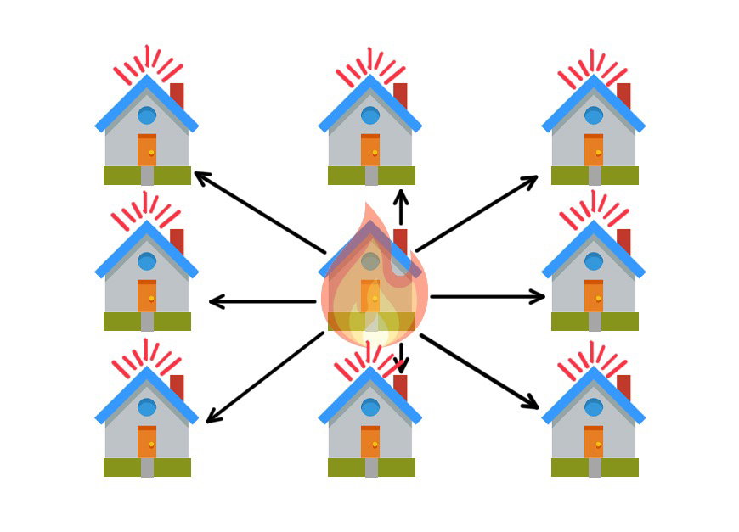

Slide 4
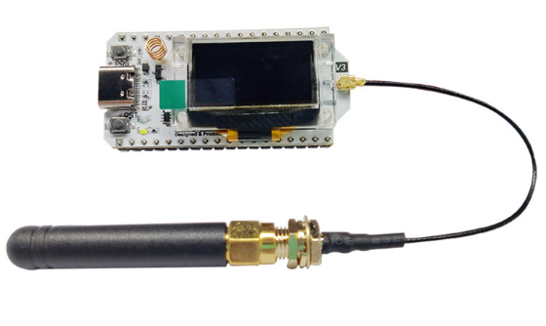



Components
ESP32S3 with bluetooth and wifi
MQ2 gas sensor
LEDs
Buzzer

Slide 5
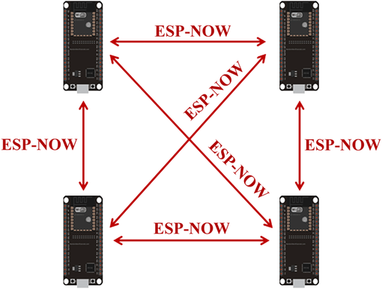

Technologies used
ESP-now: For communication between devices as it is a wireless communication protocol for quick responses and low-power control.
MQTT: to connect to AWS
AWS: to store, analyse and collect data

Slide 6
ESP-Now
P2P protocol
Low communication overhead
Low latency

Slide 7
DATA Collected
Gas leakage.
Position of the leakage.
Timing of the leakage.
Data aggregation provides authorities with a holistic understanding of gas levels, enabling the identification of trends and patterns. Such insights empower city planners and authorities to implement targeted measures and address potential threats more effectively.

Slide 8

Constraints
Our IoT project is designed to alert you and will provide appropriate measures.
For this to be enabled we need to be able to communicate with very low latency in order to give fast and reliable alerts.
The duty cycle must be around 70% atleast since we need very frequent monitoring to ensure safety.

Slide 9
Quantitative Metrics
Sensitivity
Response Time
Accuracy
False Alarm Rate

Slide 10
Thank you

