Slide 1

Workflow in RMarkdown

Slide 2
Workflow Info
Chapters Discussing Workflow
Chapter 2: Basics
Chapter 4: Rscripts
Chapter 6: Projects
Our Focus is on Workflow Within RMarkdown
Today’s Lecture on RMarkdown
Running R Code
Objects
Functions

Slide 3
Essential Reads
Highly Advised Reading
Chapter 21: RMarkdown
Basics
Text Formatting
Code Chunks
Chapter 22: More ggplot Info
Labeling
Annotating
Scaling
Zooming
Themes
Saving Graphics

Slide 4
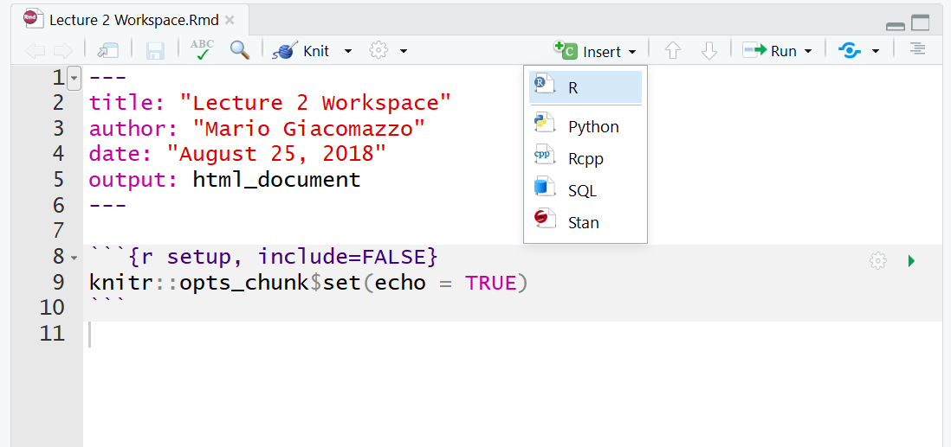
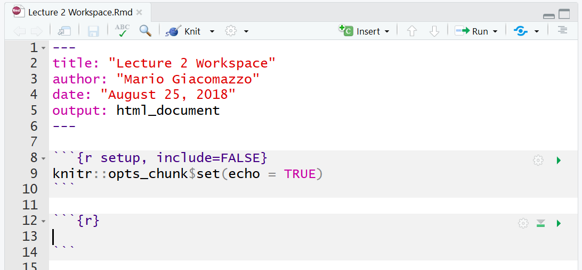
Placing Code in RMarkdown
Code Chunks (Mini Rscripts)
R, Python, SQL, Rcpp (C++)
Inserting R Chunks
Method 1:
Method 2: Ctrl+Alt+I

Slide 5
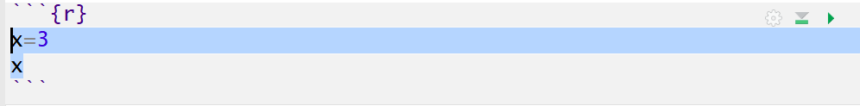
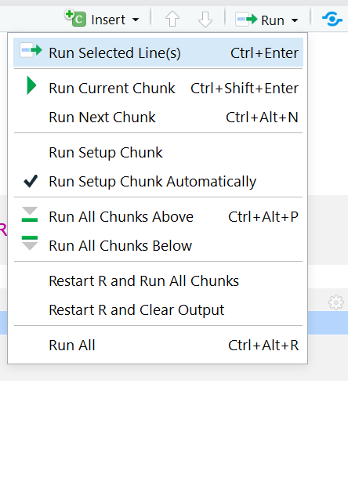
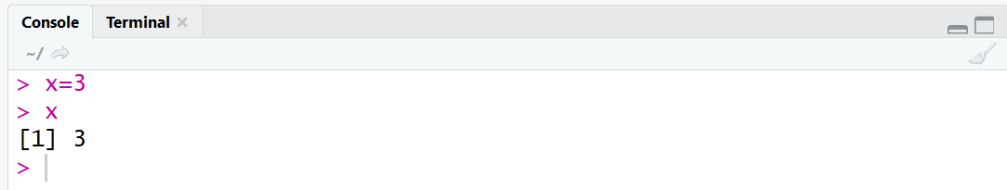
Running Code in RMarkdown
Various Ways
Highlighted Code
Ctrl+Enter

Slide 6
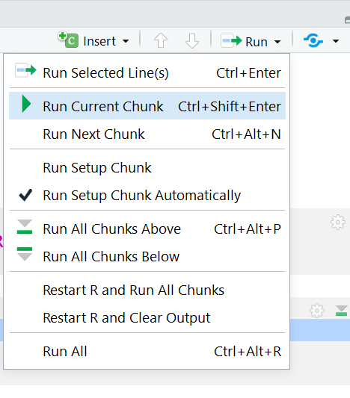
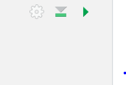
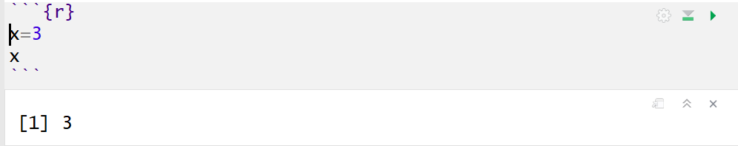
Running Code in RMarkdown
Various Ways (Cont.)
Chunking It (Recommended)
Press Play
Ctrl+Shift+Enter

Slide 7
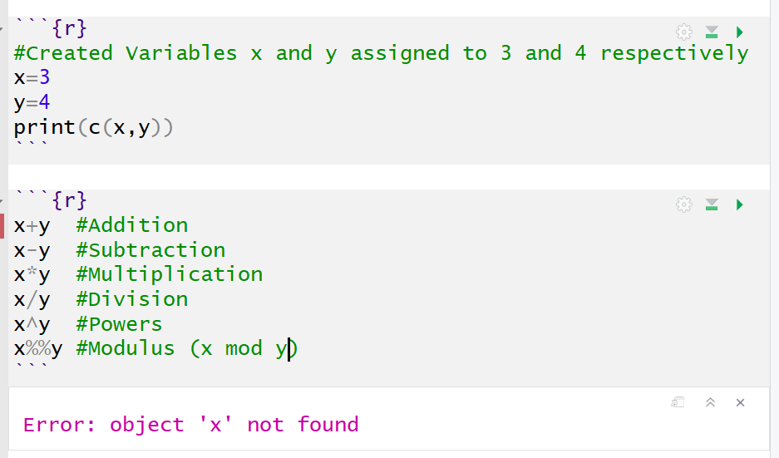

Running Code in RMarkdown
Order Matters
Why?

Slide 8
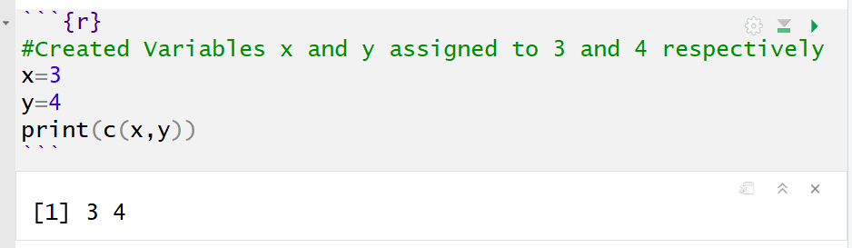
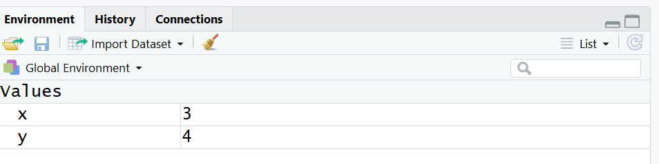
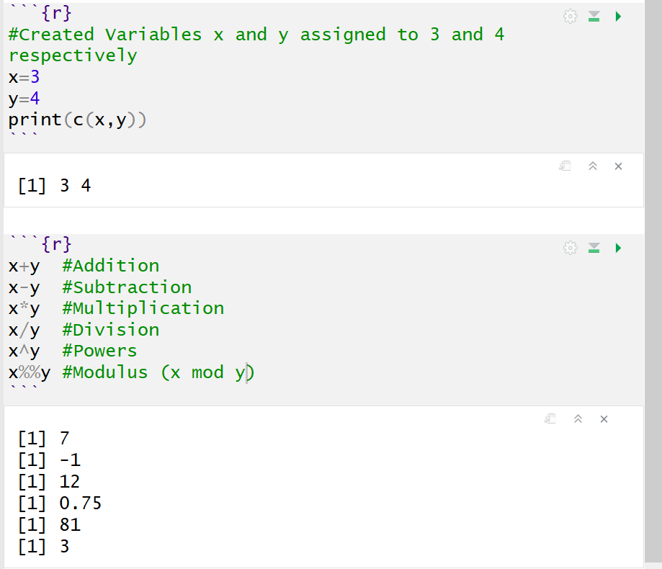
Running Code in RMarkdown
Order Matters (Cont.)
Run First Chunk
Then, Run
Second
Chunk

Slide 9
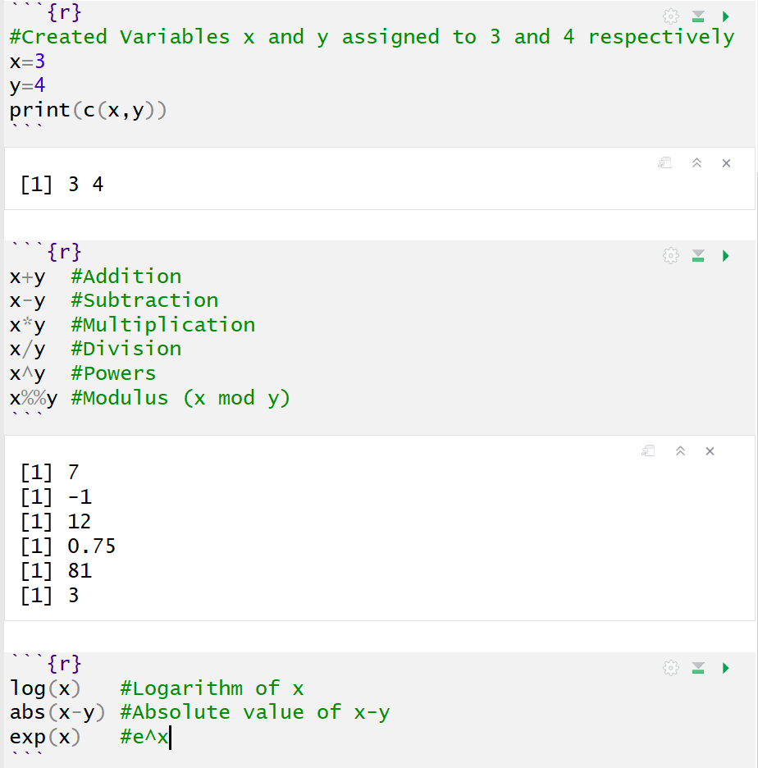
Running Code in RMarkdown
Order Matters (Cont.)
Super Chunky
Runs All Previous Chunks

Slide 10
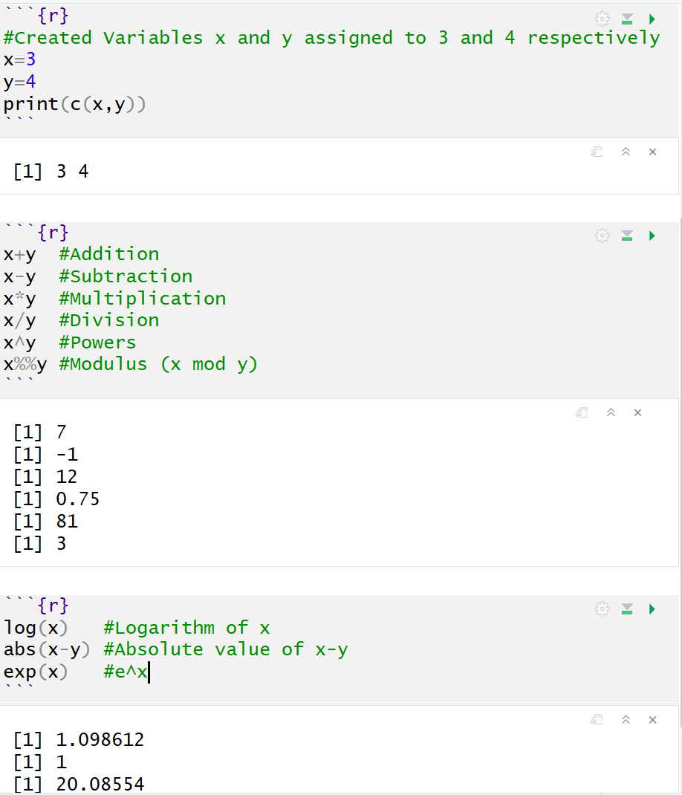
Running Code in RMarkdown
Order Matters (Cont.)
Super Chunky (Cont.)
Then, Run Current Chunk

Slide 11
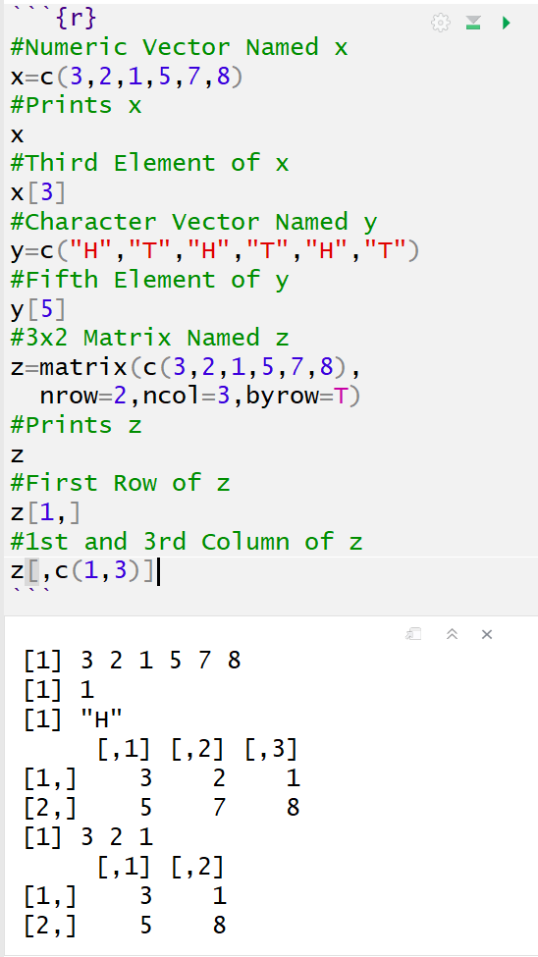
Objects in R
Many Types of Objects
Vector and Matrix

Slide 12
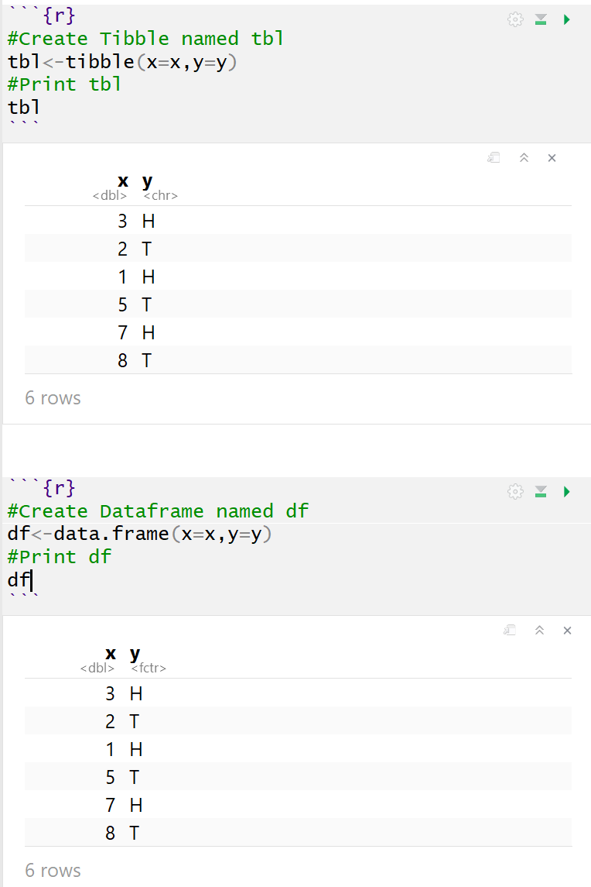
Objects in R
Many Types of Objects (Cont.)
Tibble/Dataframe

Slide 13
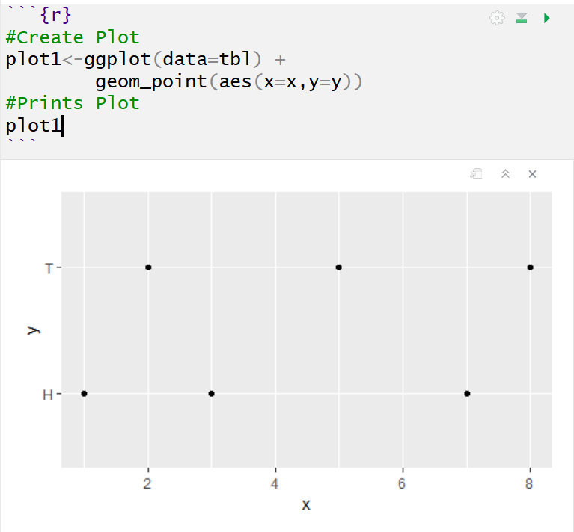
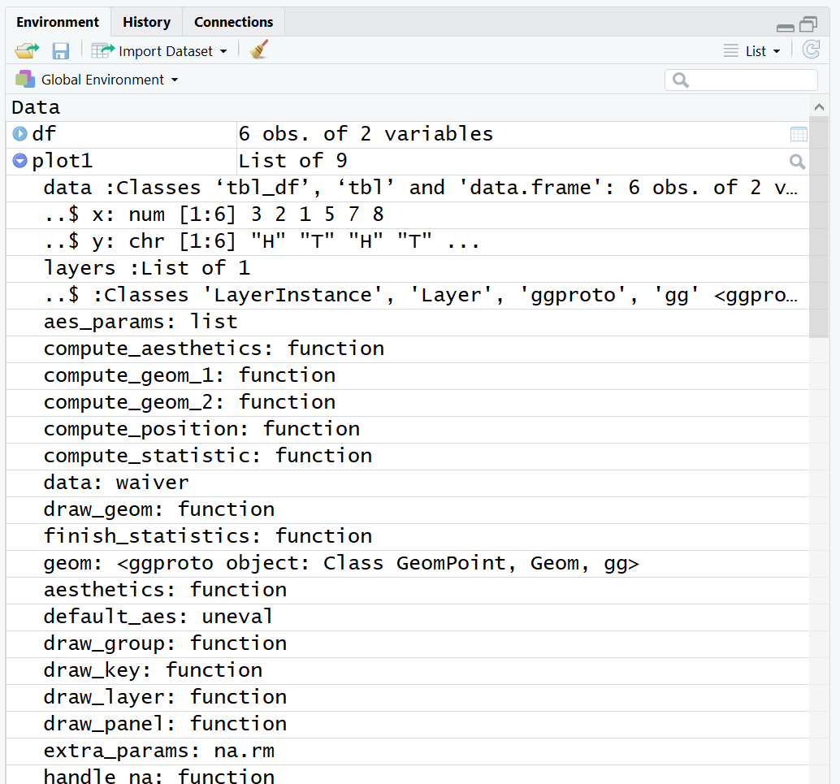
Objects in R
Many Types of Objects (Cont.)
Lists (Combines Different Objects)
Creates Long List

Slide 14
Functions in R
Many Types of Functions
You: Input Objects and Specify Arguments (Defaults Exist)
Function: Outputs Objects
Example
Input: Vector and Specified Percentiles
Output: Desired Percentiles
For online help,
> quantile()
> ?quantile

Slide 15
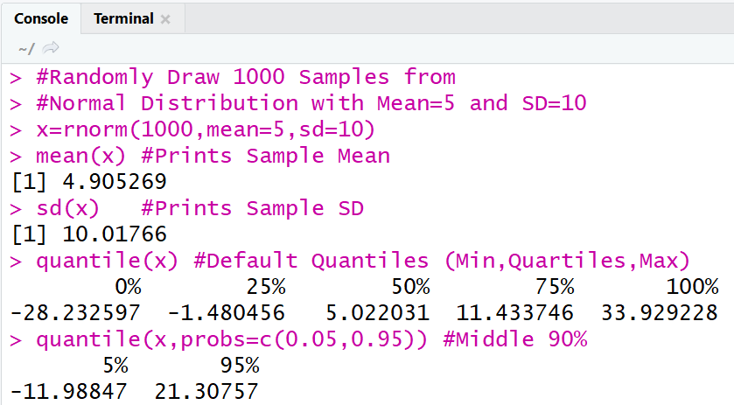
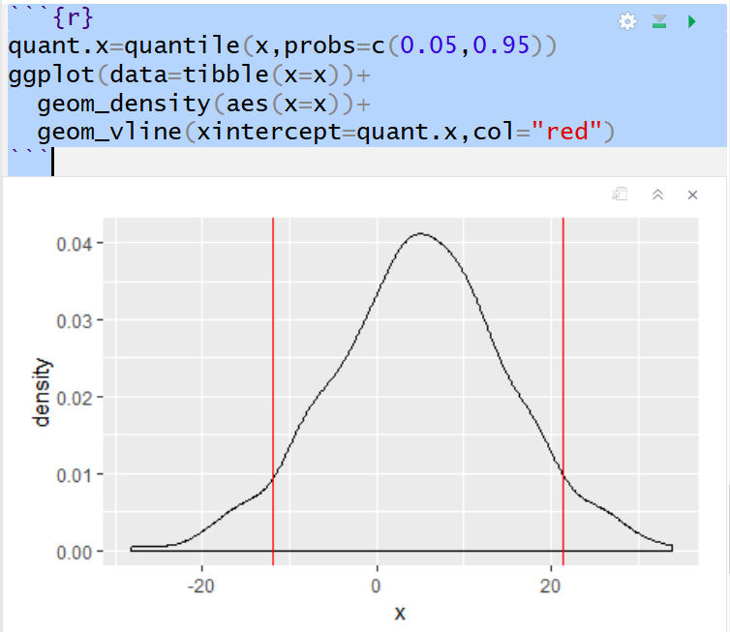
Functions in R
Many Types of Functions (Cont.)
Example (Cont.)

Slide 16
RMarkdown Training
Now, let us
PRACTICE
Download the Rmd for Tutorial 2 to Your Computer from the Course Website and open the file in RStudio

Slide 17
Closing
Disperse and Make Reasonable Decisions

