Slide 1
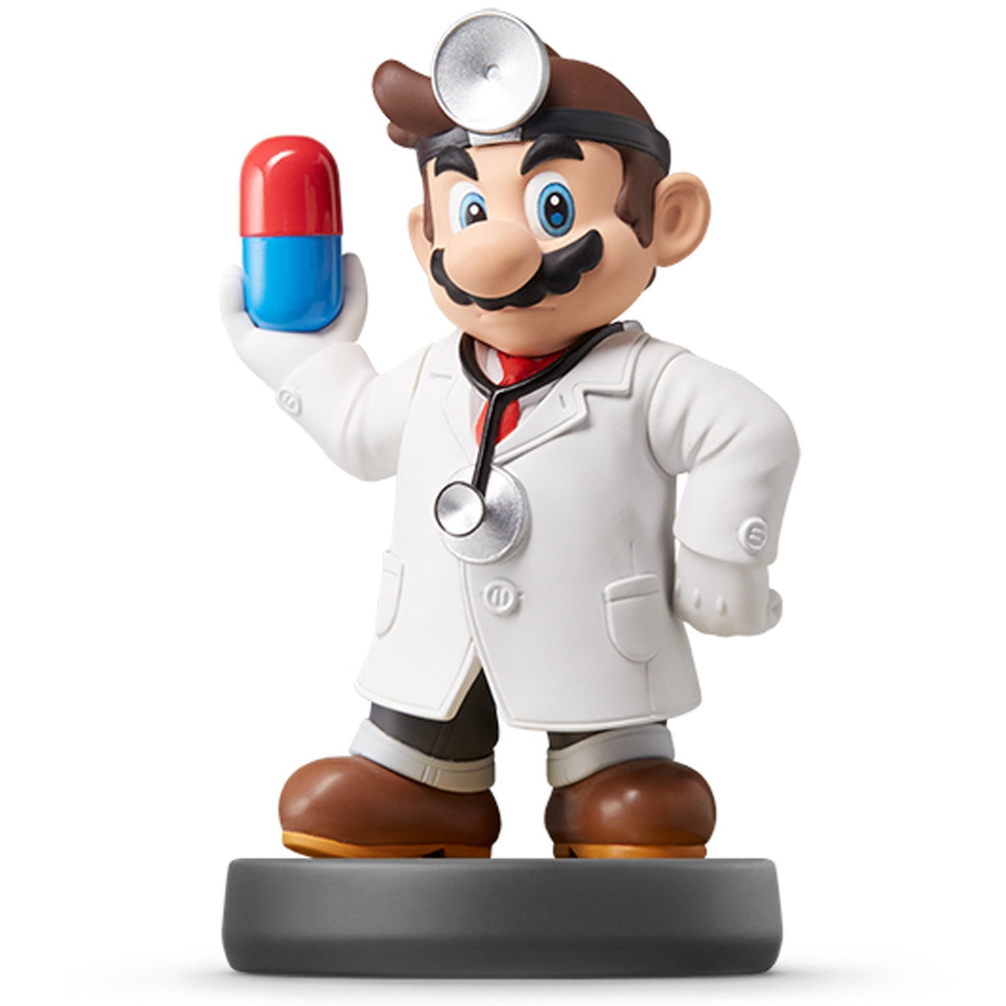
Welcome to the Show

Slide 2
Who Am I?
Name: Mario Giacomazzo
Origin: Cleveland, OH
Undergrad: Baldwin-Wallace
Grad: Arizona State University
Personal Website
Research Info

Slide 3
Who Are You?
Survey

Slide 4
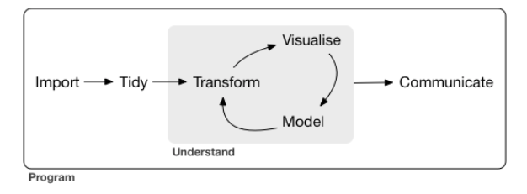
Why Are We Here?
Data Science
Definition: The easiest part of research

Slide 5

What is Needed?
Textbook:
Computer: We will actively use our laptops in every class.
R and RStudio Installed and Operational
High Tolerance for Pain and Agony

Slide 6
What Will We Do?
Course Website and Syllabus
In-Class Coding
Weekly Assignments
Lab Work
Homework
Data Analyses
Learn and Use Rmarkdown
Submit through Sakai
Submit as HTML Files

Slide 7
What Will We Do?
Develop Skills that Turn into $$$
Computer Programming
Statistical Analyses
Written and Verbal Communication Skills
Creativity and Innovation

Slide 8
What Should I Do?
Install R on Your Laptop
Install Rstudio on Your Laptop
Download the Textbooks
R4DS
RP4DS
AoRP
Read the Introduction to R4DS
Practice Programming with R for 10 minutes a day in RP4DS or AoRP

Slide 9
What Should I Do?
Run Your First RMarkdown File
Video of Rmarkdown
First Assignment: HW 1
Steps:
Watch Video and Read About Rmarkdown
Open HW 1 Rmd File in R
Attempt to Knit the File to an HTML File and View
Read Book and Finish HW 1

Slide 10
Closing?
Disperse and Make Reasonable Decisions

