Slide 1

Factors

Slide 2

Introduction
Joyfully Read Chapter 12
Additional Package
Not Part of the tidyverse
For Variables with,
Fixed Set of Values
Known Set of Values
Sophisticated Character Vector
Factors Are on a
New Level
> library(forcats)

Slide 3
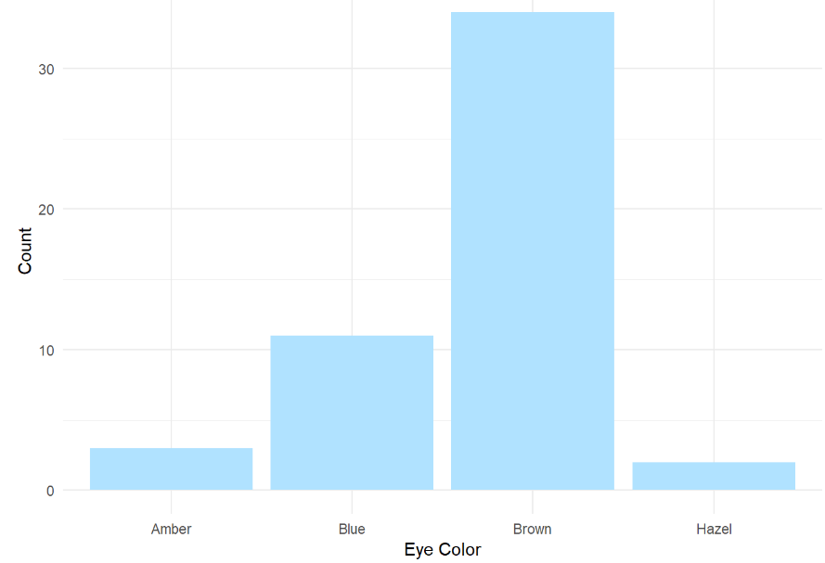
Level 1: Motivation
Eye Color Distribution
Randomly Sample 50 People
Distribution via Bar Plot
How to Make More Informative?

Slide 4
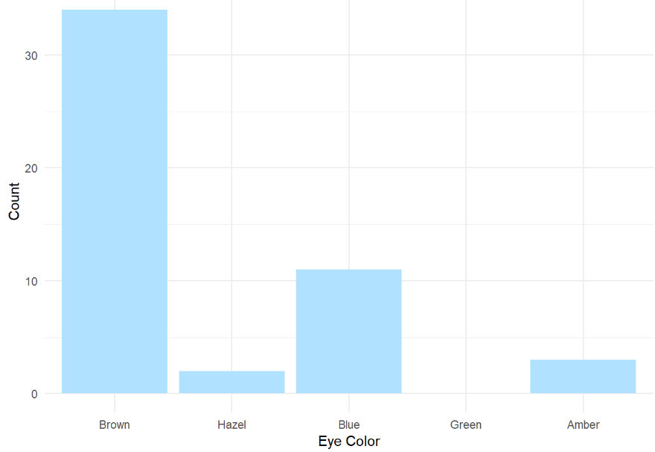
Level 1: Motivation
Eye Color Distribution (Cont.)
Display Eye Colors Absent From Sample

Slide 5
Level 1: Motivation
Survey Results
How Would You Describe
Dr. Mario’s Teaching?
Magical
Alright
Regular
Inferior
Offensive
Class of 80 Students Answer End-of-the-Year Survey

Slide 6
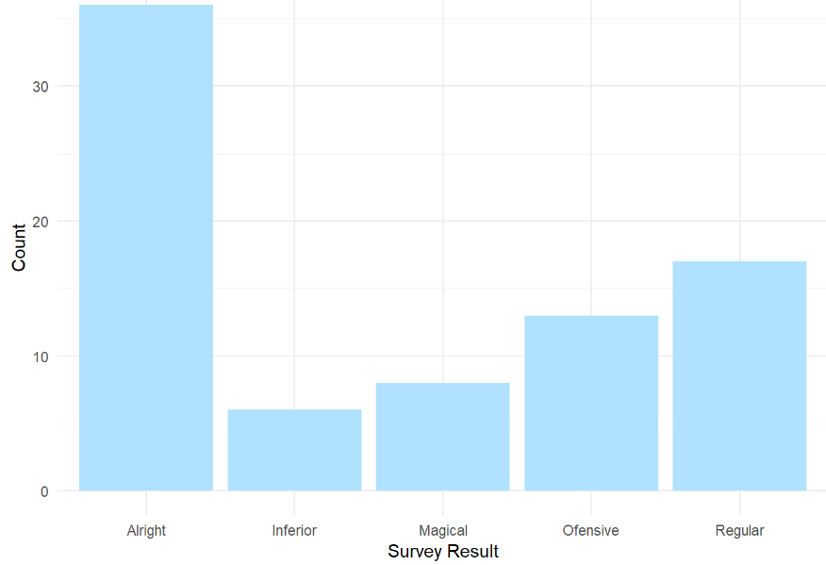
Level 1: Motivation
Survey Results (Cont.)
Distribution of Results
What is Wrong?

Slide 7
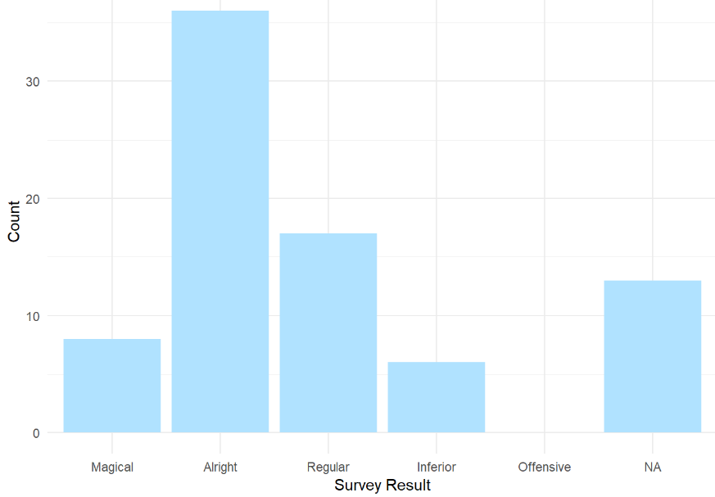
Level 1: Motivation
Survey Results (Cont.)
Misspelling “Offensive” is Offensive
Ordinal Categorical Variable

Slide 8
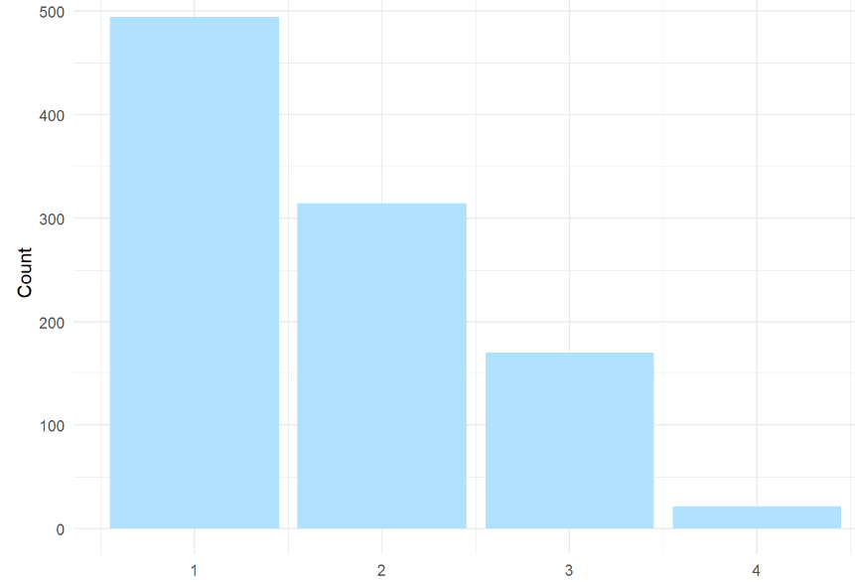
Level 1: Motivation
Urbanicity
Classification {1,2,3,4}
Sample 1000 Households and Record Their Urbanicity
What Would Make this Better?

Slide 9

Level 1: Motivation
Urbanicity
Data Dictionary
1 = Metropolitan
2 = Burbs
3 = Rural
4 = Isolated

Slide 10
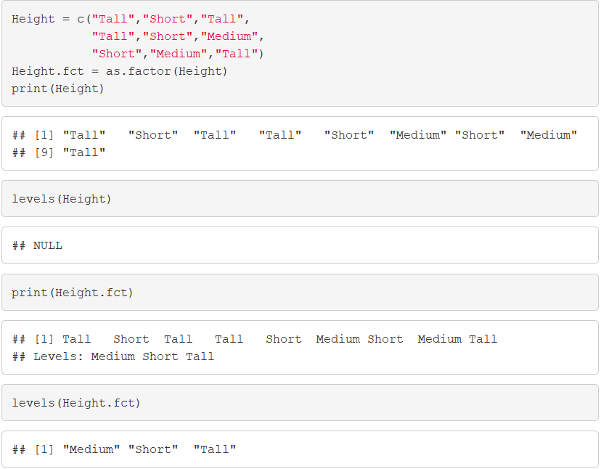
Level 2: Factor Variable Architecture
Factor Variables Have Levels
Default: Alphabetical

Slide 11
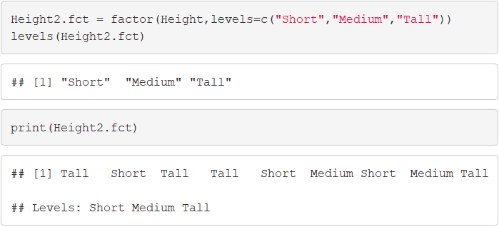
Level 2: Factor Variable Architecture
Level Order May Be Specified

Slide 12
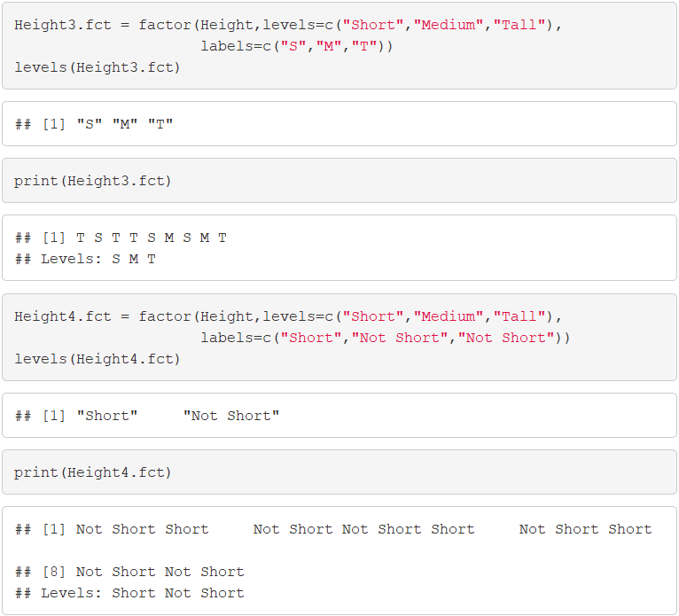
Level 2: Factor Variable Architecture
Levels May Be Labeled

Slide 13
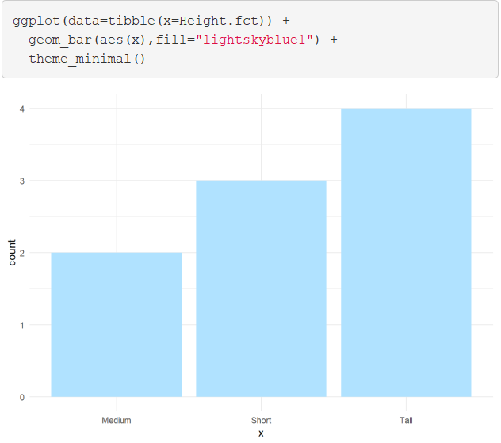
Level 2: Factor Variable Architecture
Graphic Comparison

Slide 14
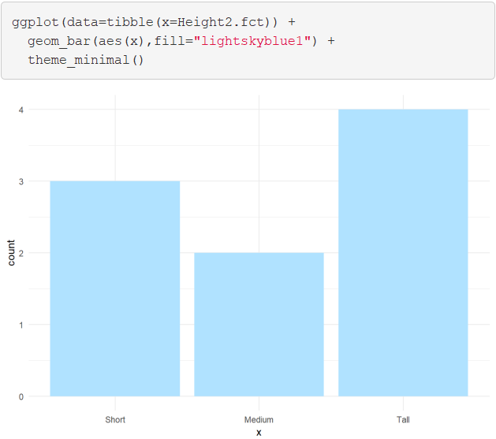
Level 2: Factor Variable Architecture
Graphic Comparison

Slide 15

Level 2: Factor Variable Architecture
Graphic Comparison

Slide 16
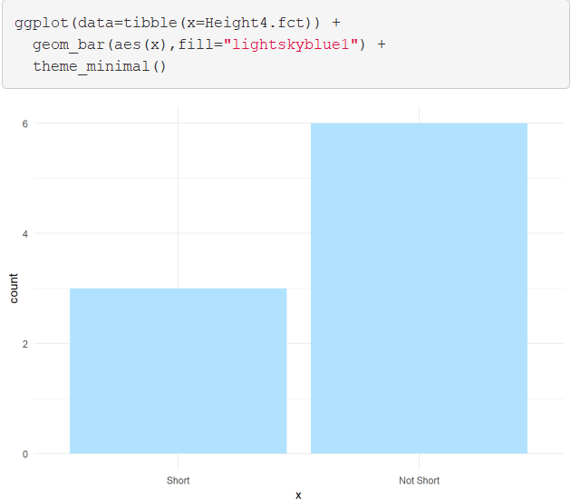
Level 2: Factor Variable Architecture
Graphic Comparison

Slide 17

Level 3: General Social Survey
University of Chicago

Slide 18
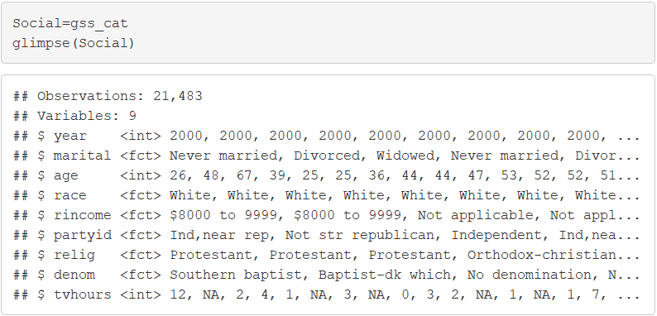
Level 3: General Social Survey
Sample Provided in forcats
Factor Variables Included
Marital
Race
Income Range
Political Party
Religion
Denomination

Slide 19
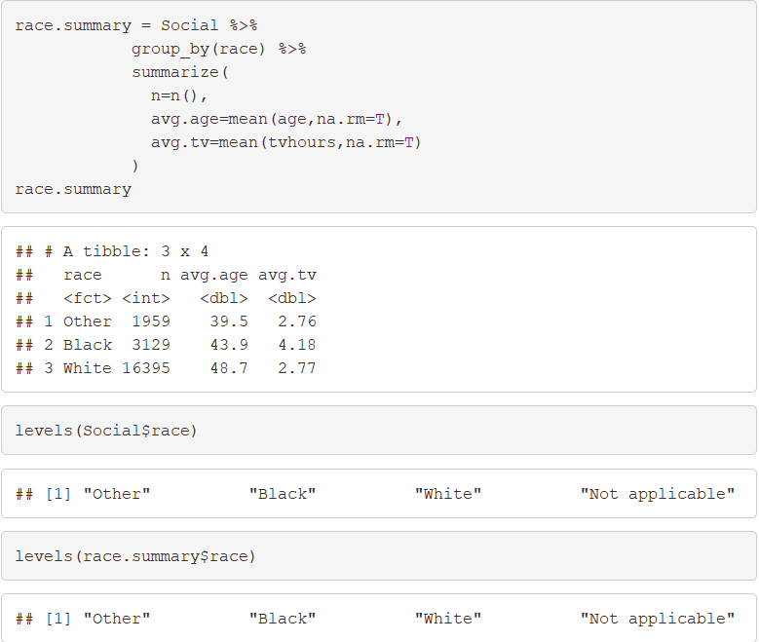
Level 4: Modifying Factor Order
Summary by Race

Slide 20
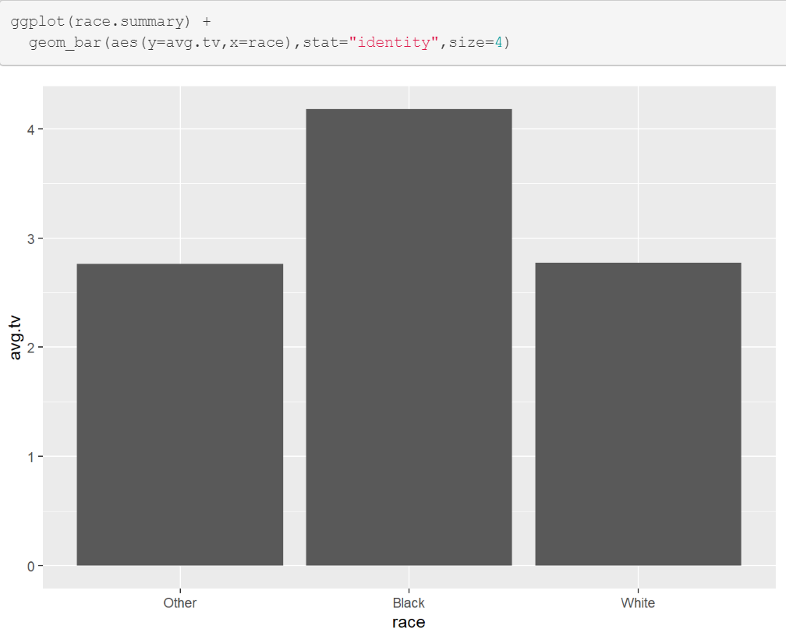
Level 4: Modifying Factor Order
Comparing TV Hours

Slide 21
Level 4: Modifying Factor Order
fct_reorder()
f = Factor Variable
x = Numeric Vector
fun = Optional Function If Multiple Values of x for Each Value of f (Default: Median)

Slide 22
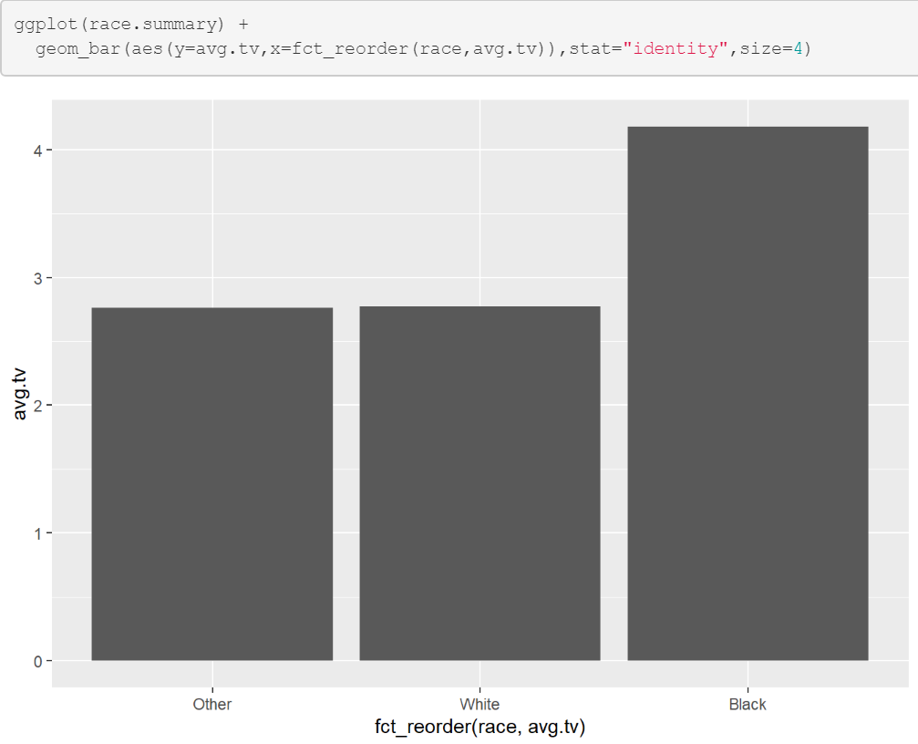
Level 4: Modifying Factor Order
Example 1: Reorder

Slide 23
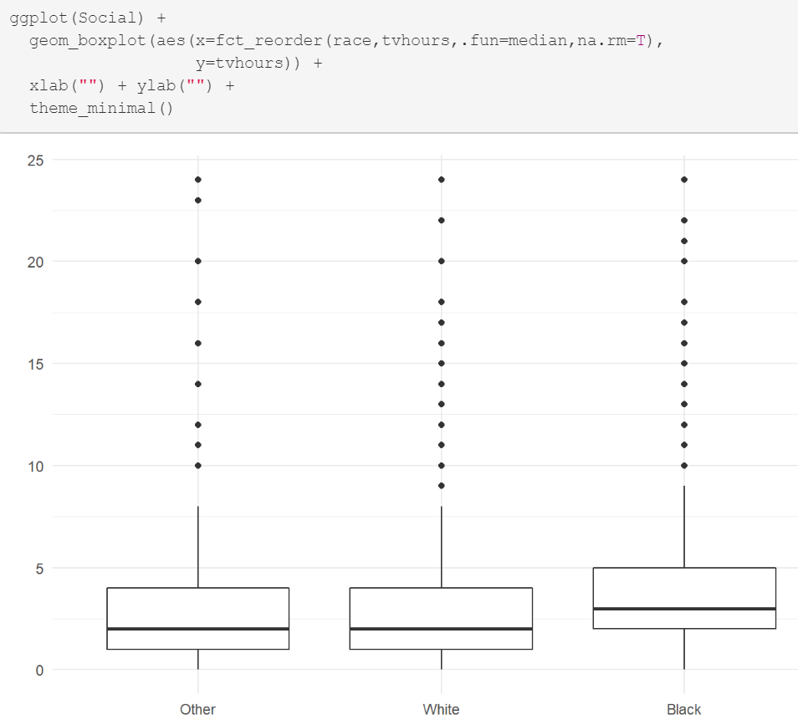
Level 4: Modifying Factor Order
Example 2: Reorder

Slide 24
Level 4: Modifying Factor Order
Different Types of Ordering
Nominal = “Arbitrary”
Ordinal = “Principled”
Example: Race vs Income
Race Levels are Arbitrary
Income Levels are Principled

Slide 25
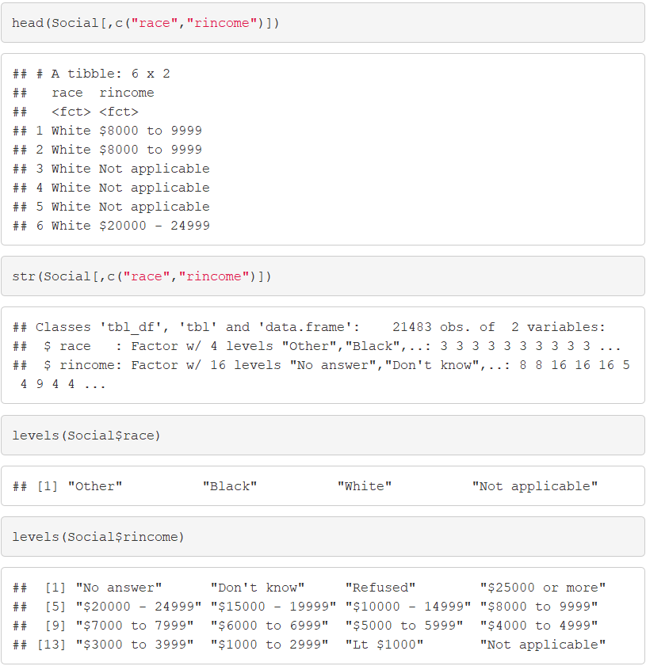
Level 4: Modifying Factor Order

Slide 26
Level 4: Modifying Factor Order
Other Useful Functions
fct_relevel() = Specify Variable and the Specific Levels You Want in The Front
fct_rev() = Specify Variable and Reverses the Level Order
fct_infreq() = Order Levels Based on Increasing Frequency
Combine Functions as Necessary

Slide 27
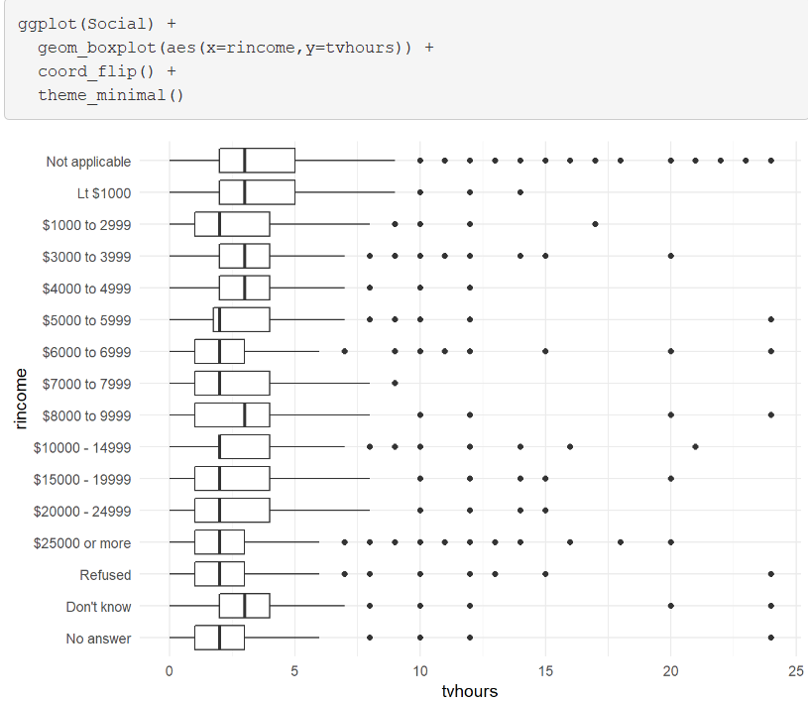
Level 4: Modifying Factor Order
Original Boxplot

Slide 28
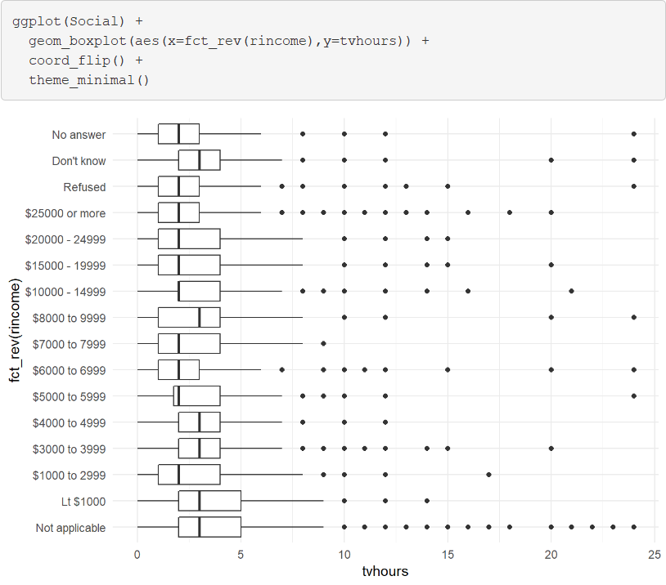
Level 4: Modifying Factor Order
Example 1: Reverse Income

Slide 29
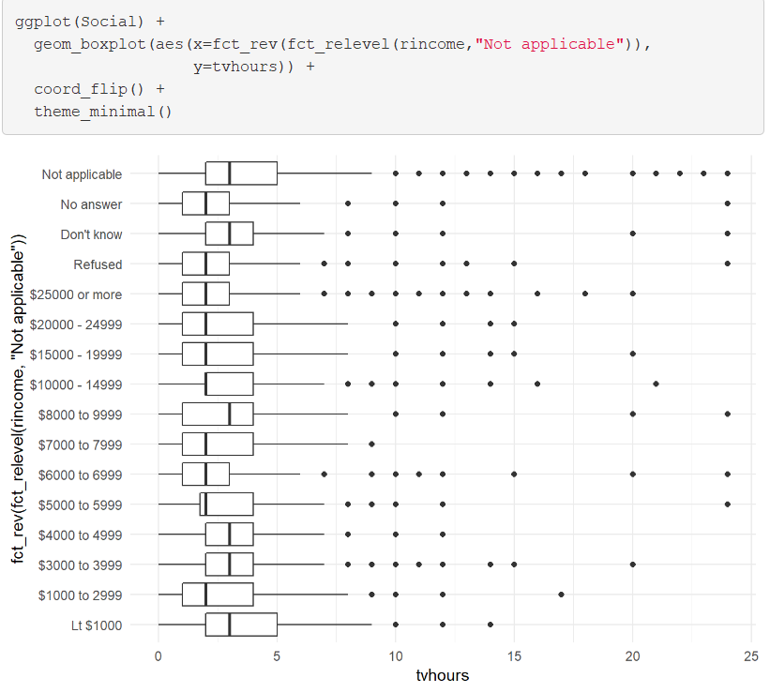
Level 4: Modifying Factor Order
Example 2: Level Change + Rev

Slide 30
Level 5: Modifying Factor Levels
Purpose for Modifying Levels
Abbreviate or Better Names
Collapse Unimportant Levels
Group Categories
Useful Functions
fct_recode() = Rename Levels
fct_collapse() = Collapse Levels
fct_lump() = Create Subgroups

Slide 31
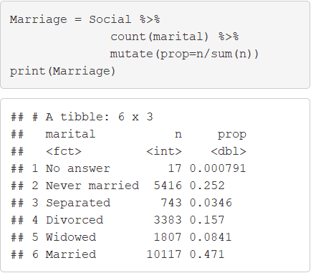
Level 5: Modifying Factor Levels
Marital Counts

Slide 32
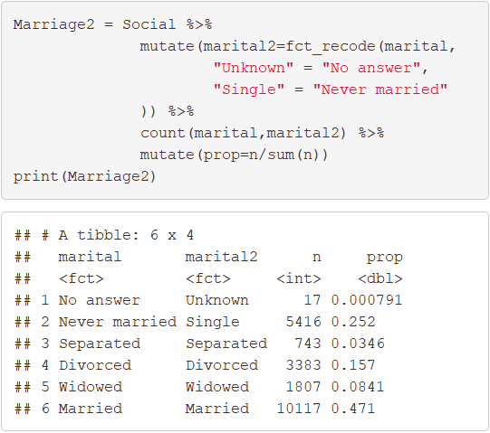
Level 5: Modifying Factor Levels
Example 1: Recode Levels

Slide 33
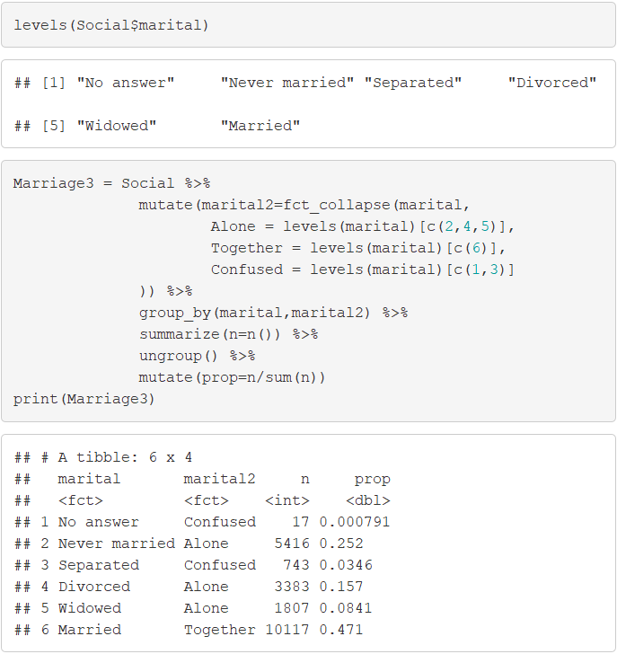
Level 5: Modifying Factor Levels
Example 2: Collapse Levels

Slide 34
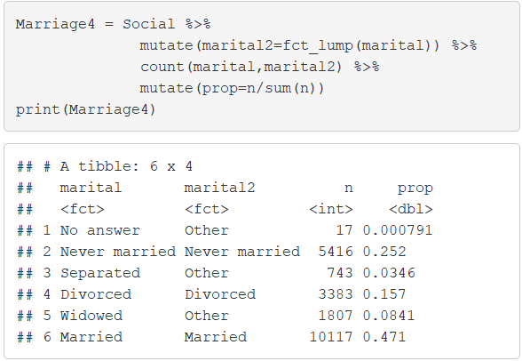
Level 5: Modifying Factor Levels
Example 3: Lumping Levels

Slide 35
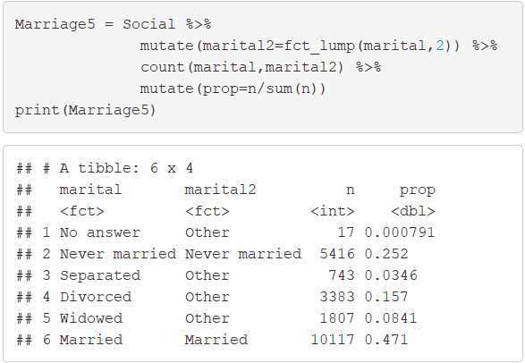
Level 5: Modifying Factor Levels
Example 3: Lumping Levels

Slide 36
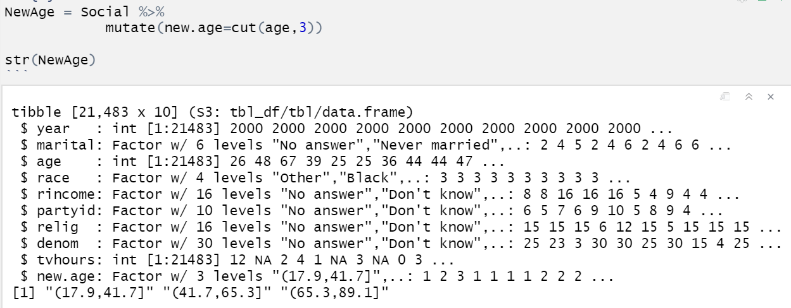
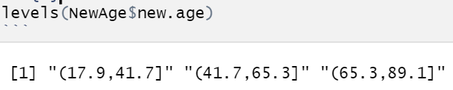
Level 6: Numeric to Factor
Cut Function
Convert Numeric to Factor
Syntax
Useful In Visuals and Summary
Example 1: New Age Variable
> cut(VARIABLE, # of Breaks)

Slide 37
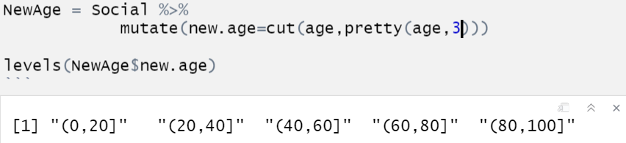
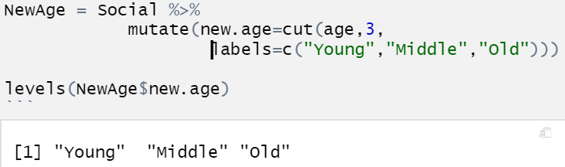
Level 6: Numeric to Factor
Example 2: Make It Pretty
Example 3: Label Levels
What Happened?

Slide 38
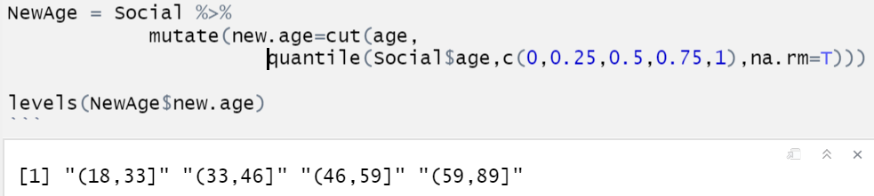
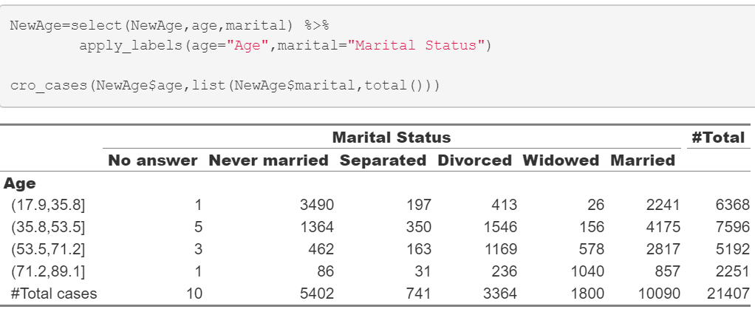
Level 6: Numeric to Factor
Example 4: Using Percentiles
Goal: Cut on the Quartiles
Use Quantile Function
Helpful Package
> library(expss)

Slide 39
Closing
Disperse and Make Reasonable Decisions

