Slide 1

Factors

Slide 2

Introduction
Joyfully Read Chapter 12 (R4DS) and Chapter 16 (R4DS2)
Additional Package
Not Part of the tidyverse
For Variables with,
Fixed Set of Values
Known Set of Values
Sophisticated Character Vector
Factors Are on a
New Level
> library(forcats)

Slide 3
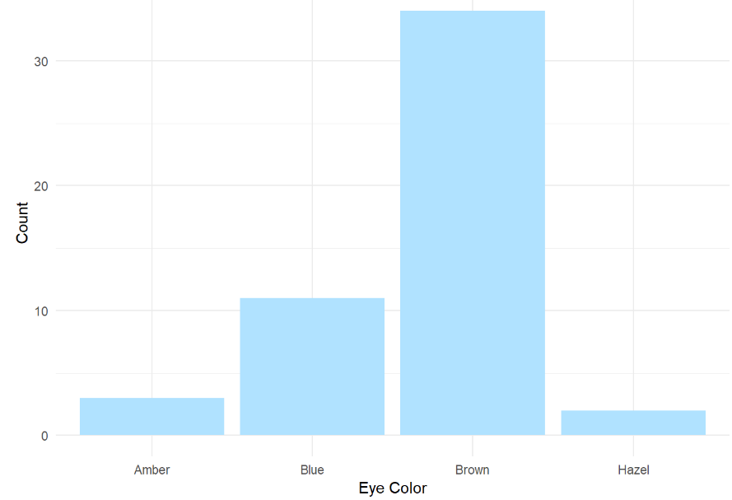
Level 1: Motivation
Eye Color Distribution
Randomly Sample 50 People
Distribution via Bar Plot
How to Make More Informative?

Slide 4
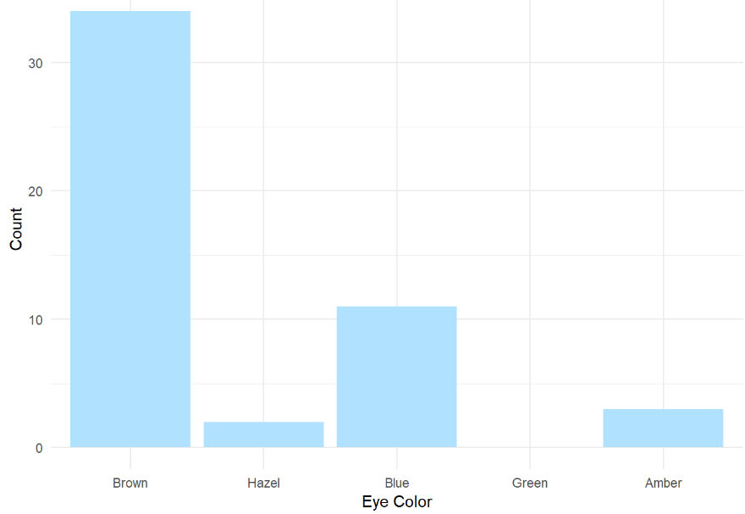
Level 1: Motivation
Eye Color Distribution (Cont.)
Display Eye Colors Absent From Sample

Slide 5
Level 1: Motivation
Survey Results
How Would You Describe
Dr. Mario’s Teaching?
Magical
Alright
Regular
Inferior
Offensive
Class of 80 Students Answer End-of-the-Year Survey

Slide 6
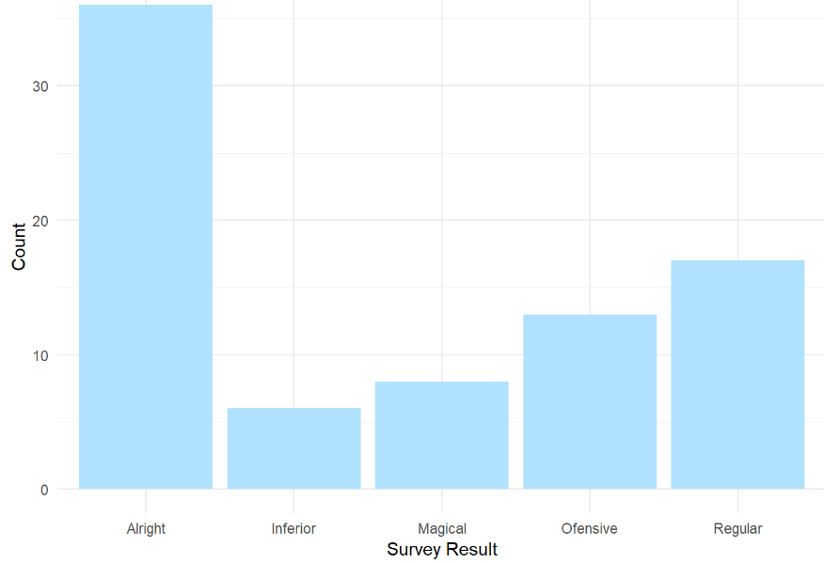
Level 1: Motivation
Survey Results (Cont.)
Distribution of Results
What is Wrong?

Slide 7
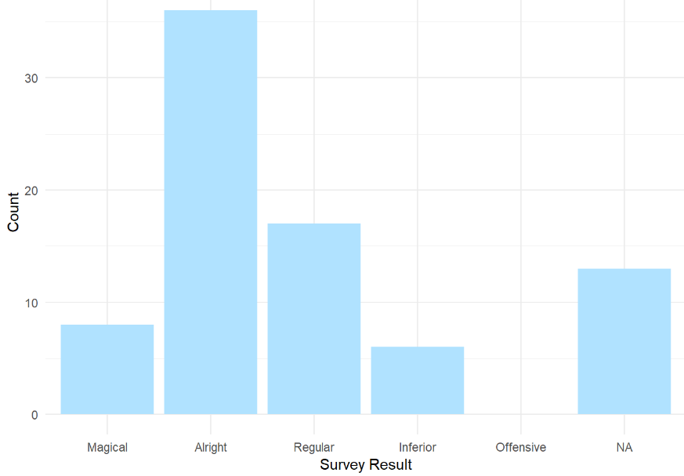
Level 1: Motivation
Survey Results (Cont.)
Misspelling “Offensive” is Offensive
Ordinal Categorical Variable

Slide 8
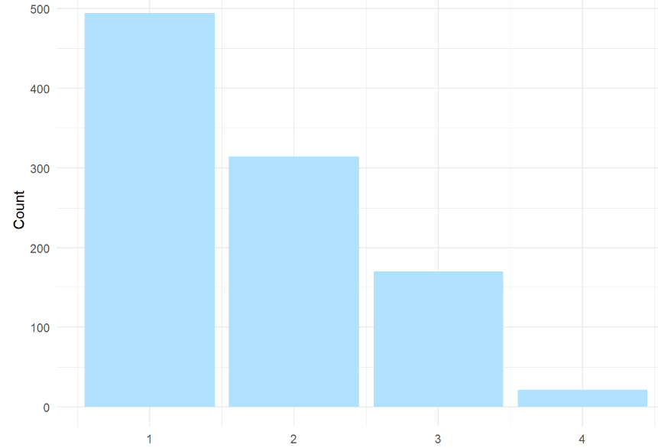
Level 1: Motivation
Urbanicity
Classification {1,2,3,4}
Sample 1000 Households and Record Their Urbanicity
What Would Make this Better?

Slide 9

Level 1: Motivation
Urbanicity
Data Dictionary
1 = Metropolitan
2 = Burbs
3 = Rural
4 = Isolated

Slide 10
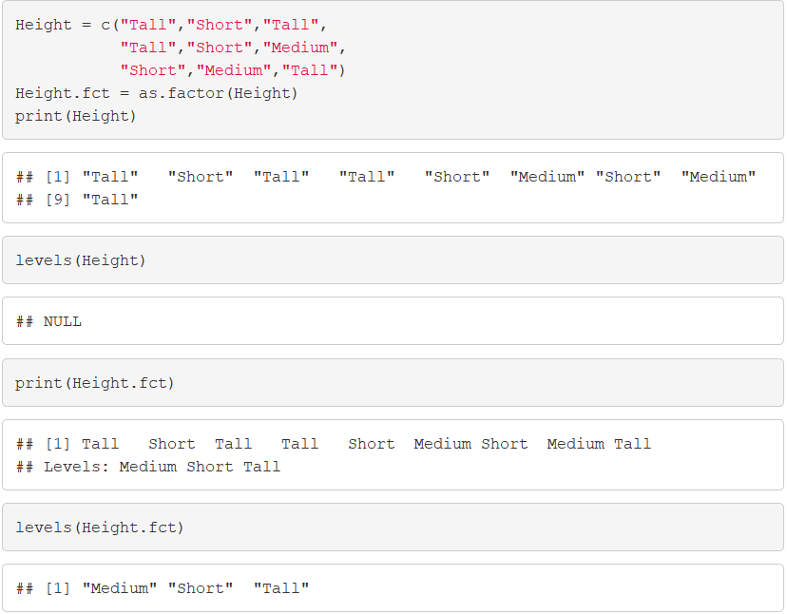
Level 2: Factor Variable Architecture
Factor Variables Have Levels
Default: Alphabetical

Slide 11
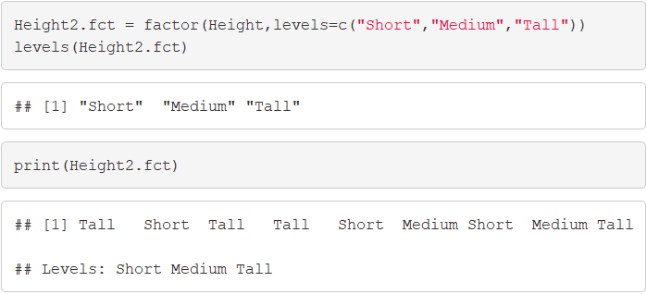
Level 2: Factor Variable Architecture
Level Order May Be Specified

Slide 12
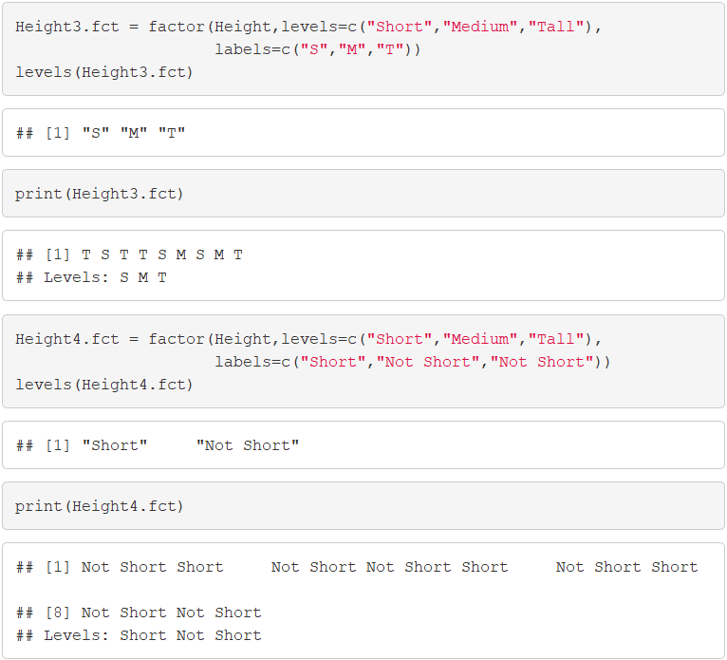
Level 2: Factor Variable Architecture
Levels May Be Labeled

Slide 13
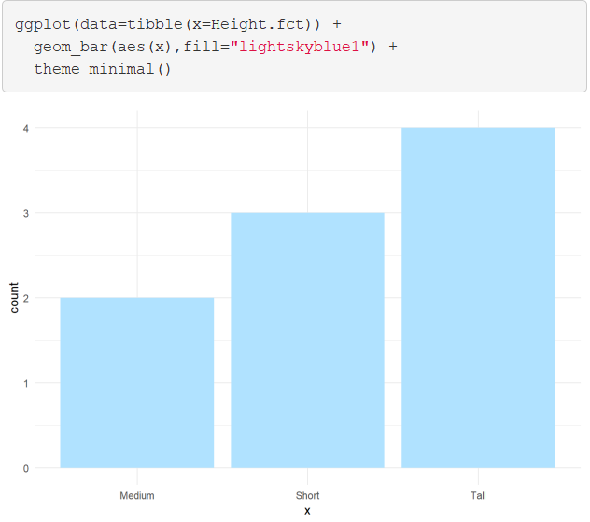
Level 2: Factor Variable Architecture
Graphic Comparison

Slide 14
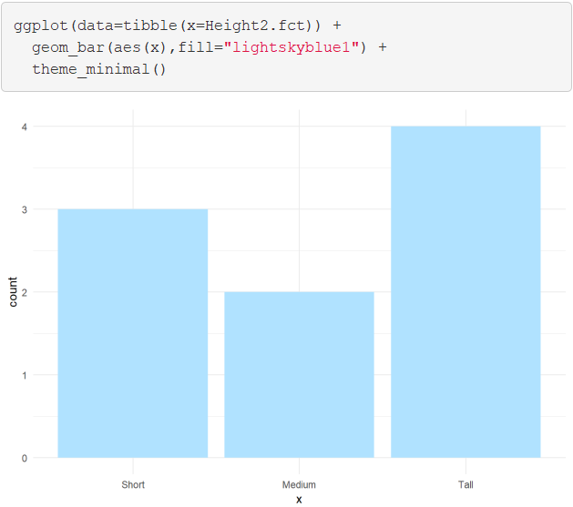
Level 2: Factor Variable Architecture
Graphic Comparison

Slide 15

Level 2: Factor Variable Architecture
Graphic Comparison

Slide 16
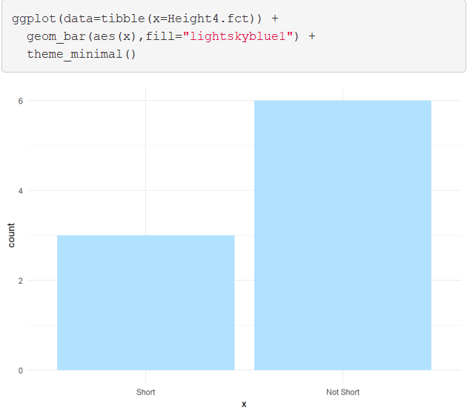
Level 2: Factor Variable Architecture
Graphic Comparison

Slide 17

Level 3: General Social Survey
University of Chicago

Slide 18
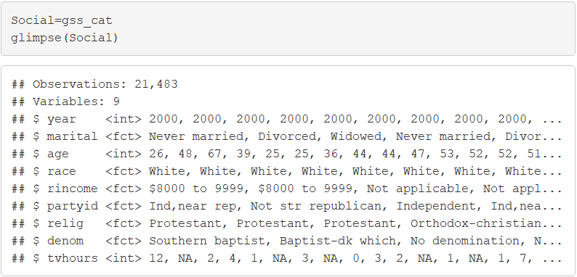
Level 3: General Social Survey
Sample Provided in forcats
Factor Variables Included
Marital
Race
Income Range
Political Party
Religion
Denomination

Slide 19
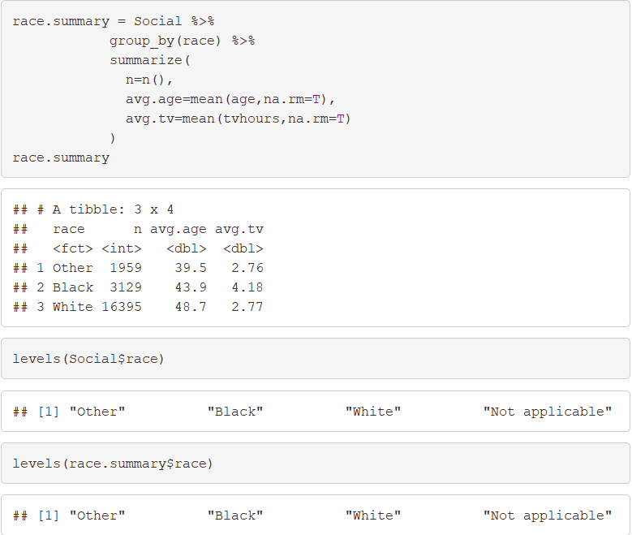
Level 4: Modifying Factor Order
Summary by Race

Slide 20
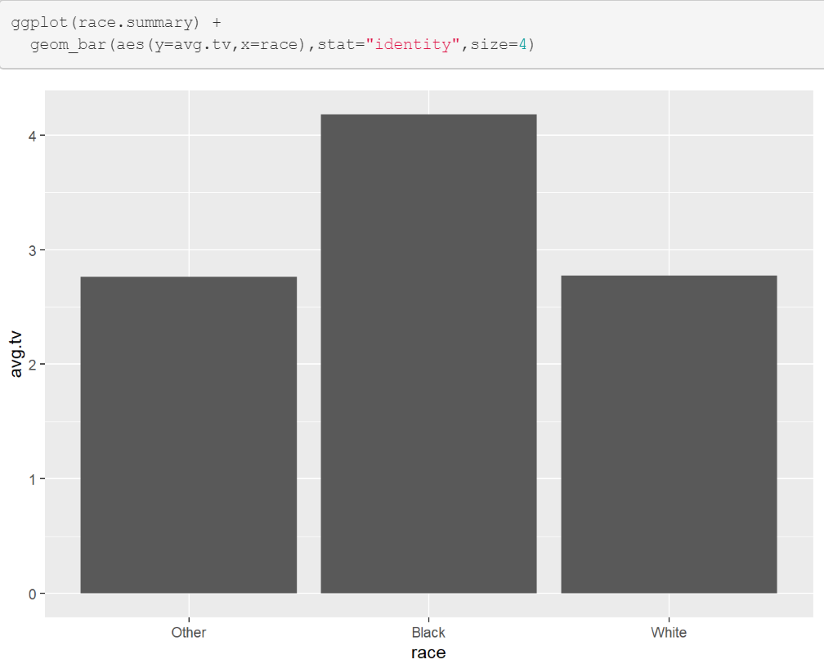
Level 4: Modifying Factor Order
Comparing TV Hours

Slide 21
Level 4: Modifying Factor Order
fct_reorder()
f = Factor Variable
x = Numeric Vector
fun = Optional Function If Multiple Values of x for Each Value of f (Default: Median)

Slide 22
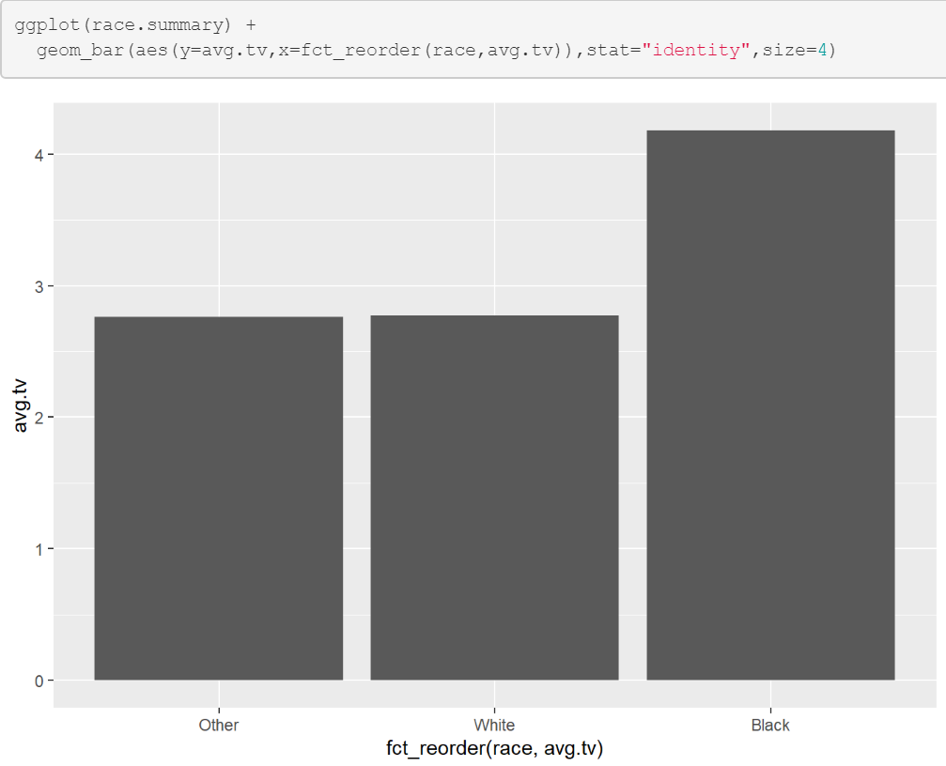
Level 4: Modifying Factor Order
Example 1: Reorder

Slide 23
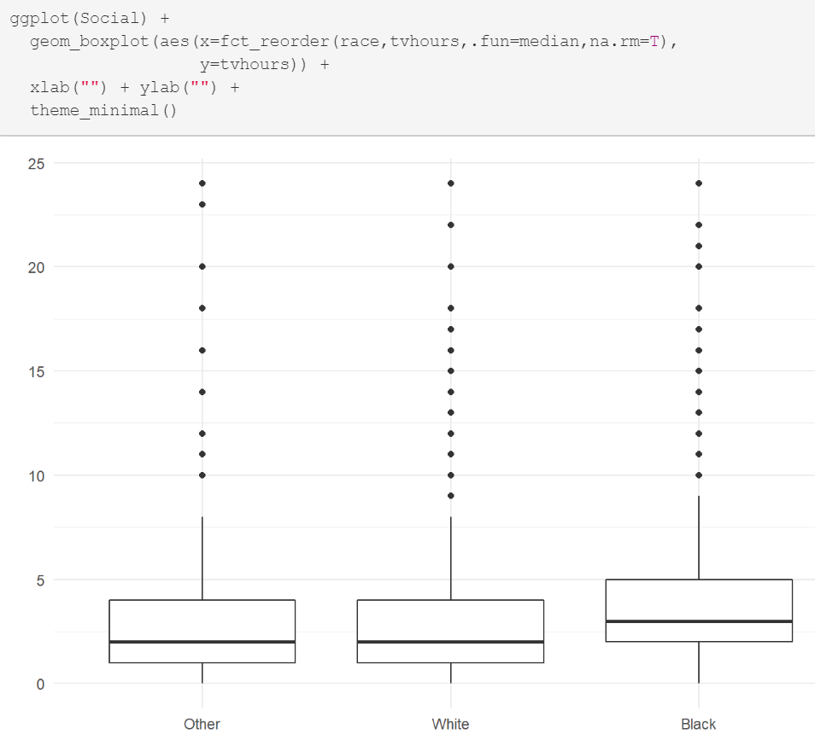
Level 4: Modifying Factor Order
Example 2: Reorder

Slide 24
Level 4: Modifying Factor Order
Different Types of Ordering
Nominal = “Arbitrary”
Ordinal = “Principled”
Example: Race vs Income
Race Levels are Arbitrary
Income Levels are Principled

Slide 25
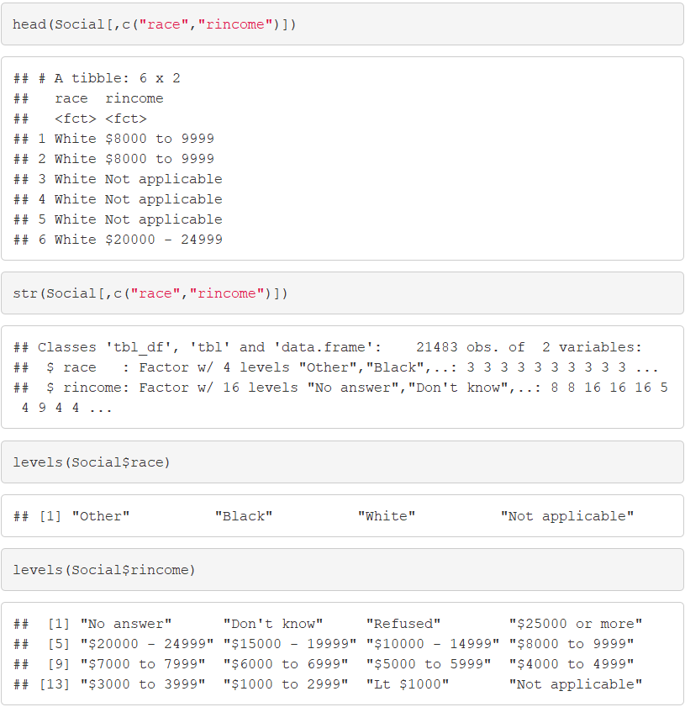
Level 4: Modifying Factor Order

Slide 26
Level 4: Modifying Factor Order
Other Useful Functions
fct_relevel() = Specify Variable and the Specific Levels You Want in The Front
fct_rev() = Specify Variable and Reverses the Level Order
fct_infreq() = Order Levels Based on Increasing Frequency
Combine Functions as Necessary

Slide 27
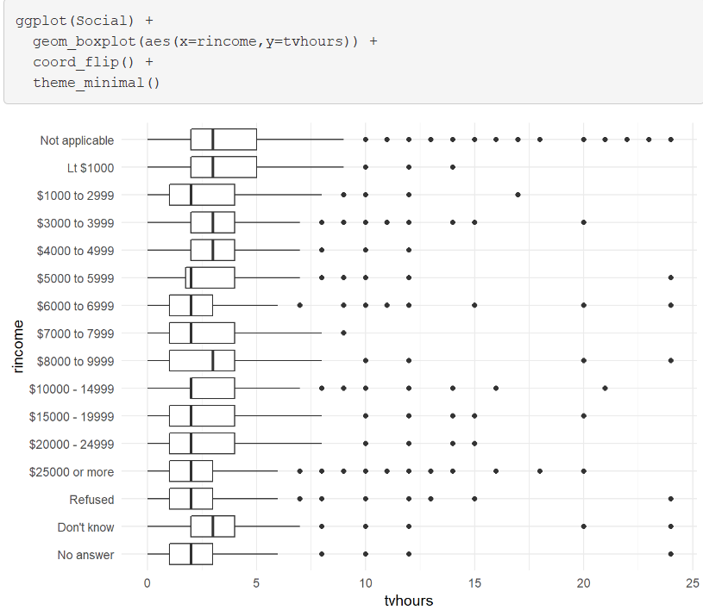
Level 4: Modifying Factor Order
Original Boxplot

Slide 28
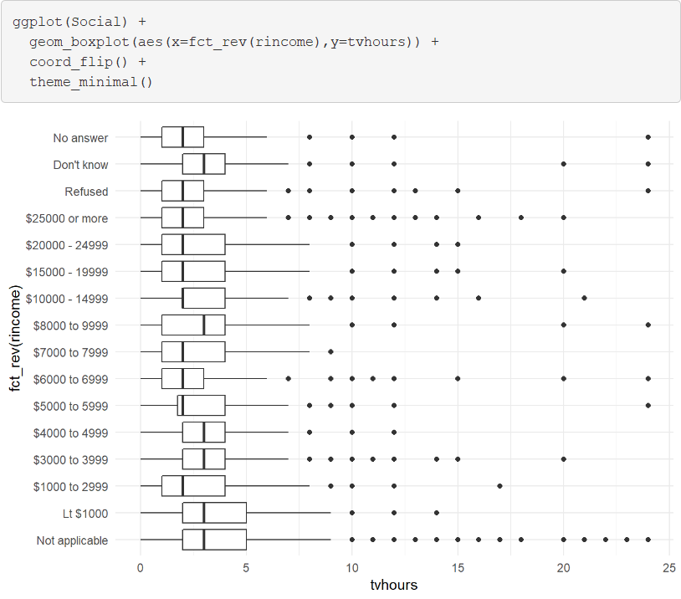
Level 4: Modifying Factor Order
Example 1: Reverse Income

Slide 29
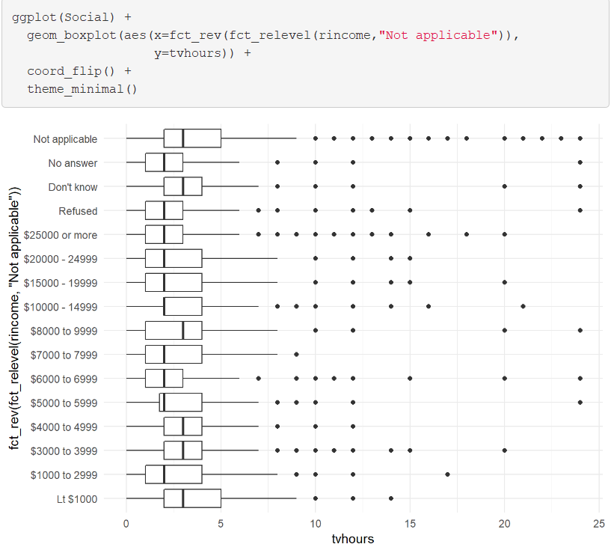
Level 4: Modifying Factor Order
Example 2: Level Change + Rev

Slide 30
Level 5: Modifying Factor Levels
Purpose for Modifying Levels
Abbreviate or Better Names
Collapse Unimportant Levels
Group Categories
Useful Functions
fct_recode() = Rename Levels
fct_collapse() = Collapse Levels
fct_lump() = Create Subgroups

Slide 31
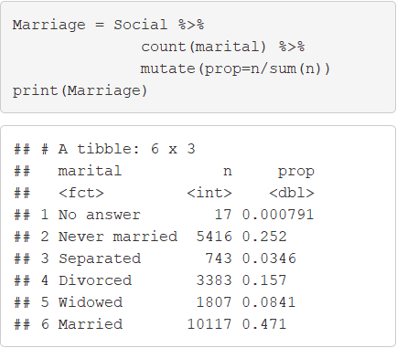
Level 5: Modifying Factor Levels
Marital Counts

Slide 32
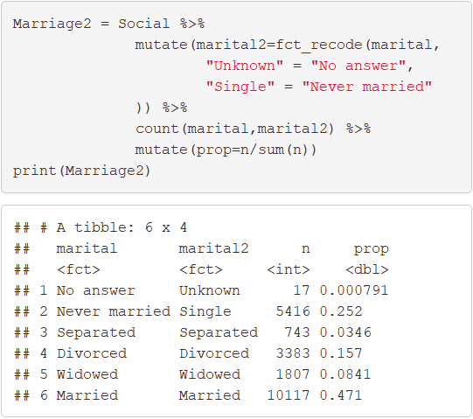
Level 5: Modifying Factor Levels
Example 1: Recode Levels

Slide 33
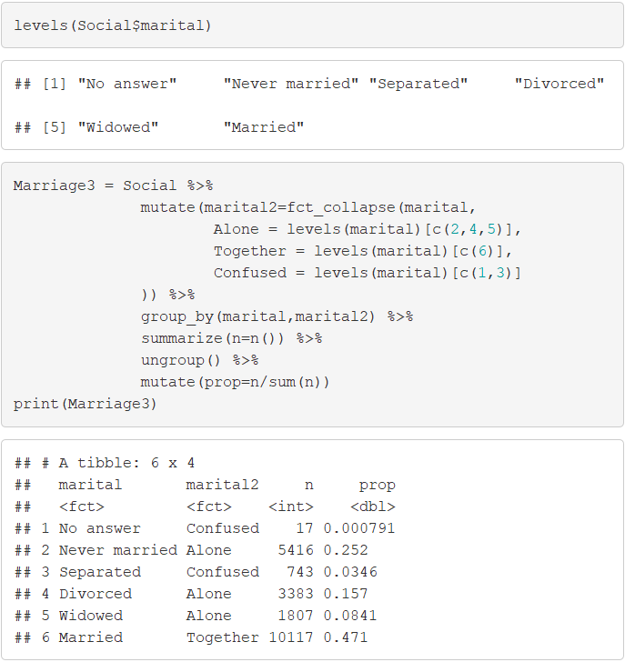
Level 5: Modifying Factor Levels
Example 2: Collapse Levels

Slide 34
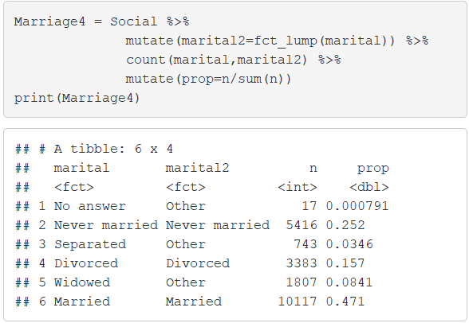
Level 5: Modifying Factor Levels
Example 3: Lumping Levels

Slide 35
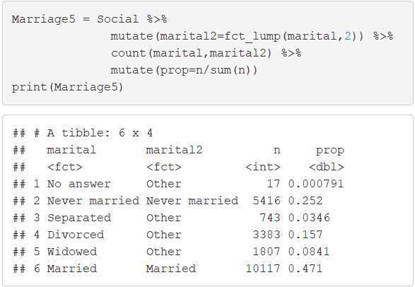
Level 5: Modifying Factor Levels
Example 3: Lumping Levels

Slide 36
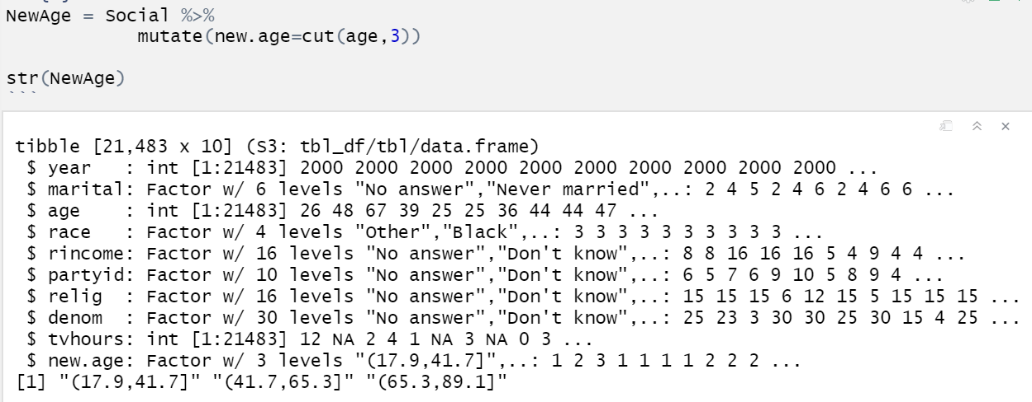
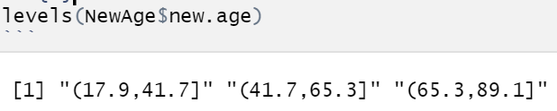
Level 6: Numeric to Factor
Cut Function
Convert Numeric to Factor
Syntax
Useful In Visuals and Summary
Example 1: New Age Variable
> cut(VARIABLE, # of Breaks)

Slide 37
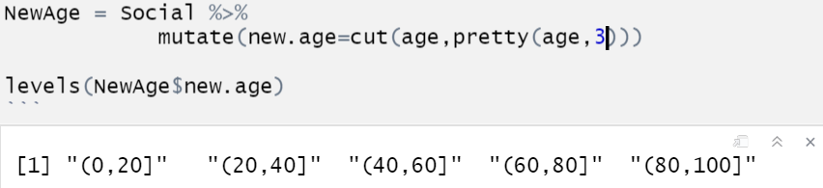
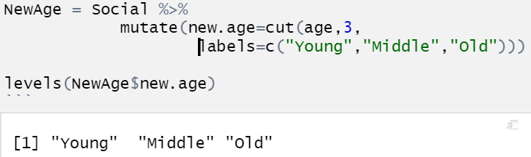
Level 6: Numeric to Factor
Example 2: Make It Pretty
Example 3: Label Levels
What Happened?

Slide 38
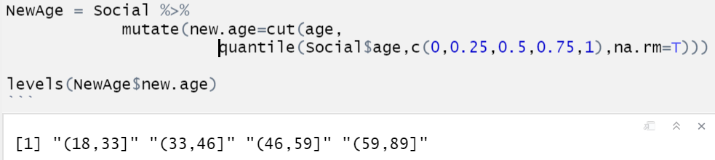
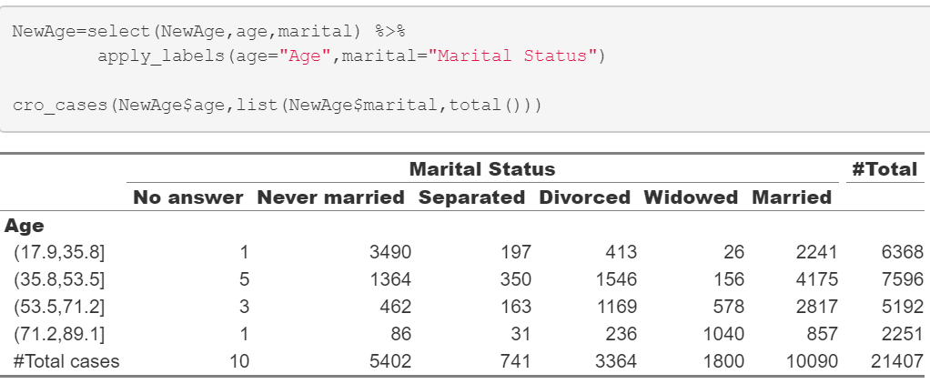
Level 6: Numeric to Factor
Example 4: Using Percentiles
Goal: Cut on the Quartiles
Use Quantile Function
Helpful Package
> library(expss)

Slide 39
Closing
Disperse and Make Reasonable Decisions

