Slide 1

Simplifie Presents SIMPLIFIQUE
Radulescu Marius & Vacaru Stefania

Slide 2






Problem & Solution
Solution
Simplifique app streamlines and organizes students' academic responsibilities. By offering a user-friendly interface and a range of features, Simplifique ensures students can stay organized, meet deadlines, and excel in their studies.
Problem
Students today face numerous challenges when it comes to managing their academic lives. Scheduling conflicts, overwhelming assignments, missed deadlines, and scattered study materials often lead to stress and reduced productivity.

Slide 3
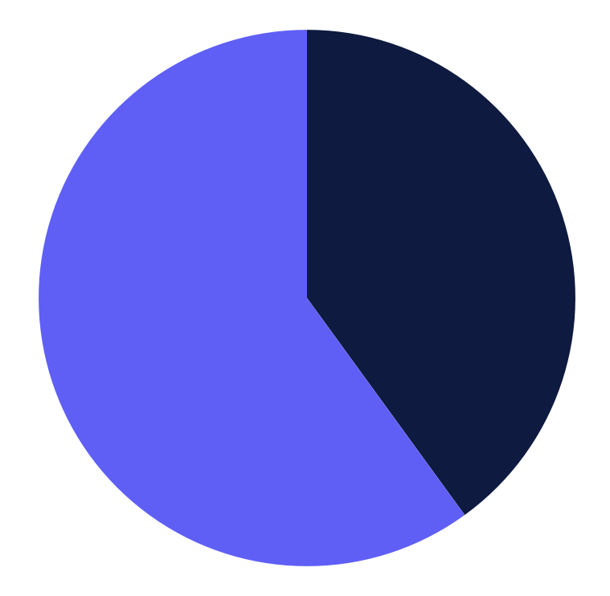
Target Market
Benefits
With Simplifique,
students can enjoy enhanced productivity, reduced stress, and improved academic performance. Our app is designed to simplify their lives and make the most of their educational journey.
40%
Normal people even old people can use this app
60%
Students of all types worldwide, regardless of age.

Slide 4

Monetization
Initial Monetization
Initially, Simplifique will be monetized through advertisements, allowing us to reach a wide user base. This model ensures accessibility and familiarity to our target audience.
Freemium Model
The app gains traction and transitions to a freemium model. Essential features are free, ensuring accessibility, while premium features require a subscription plan or in-app purchases.

Slide 5
Promotion Strategies
Social Media Advertising
50%
Reach a broader audience through targeted ads on platforms like YouTube and Instagram.
30%
Influencer Marketing
Partner with popular influencers to promote our app to their followers.
20%
App Store Featuring
Strive to have your app featured on the Google Play Store to gain increased visibility and organic downloads.

Slide 6
Project Goals
Goal 1
Goal 2
Enhance app performance by optimizing code, reducing loading times, and addressing any currently unavailable features, ensuring a seamless user experience that surpasses expectations.
Integrate social media sharing capabilities to facilitate effortless content sharing and enable users to promote Simplifique among their networks, fostering wider app usage and engagement.

Slide 7

—Nelson Mandela
“Education is the most powerful weapon which you can use to change the world, and Simplifique equips students with the tools for that change.”

