Slide 1

First Aid
International
Workshop
Empowering Citizens to Save Lives

Slide 2
Contents
01
Primary Survey, Recovery Position & Reassessment
02
Adult CPR
03
Alternative Ventilation Procedures
04
Introduction to Automated External Defibrillation
05
Adult Choking

Slide 3
1.A Primary Survey – DR ABC
DANGER
D
Before approaching, make sure that it is safe to do so.
RESPONSE
R
As you approach, check the casualty is
AIRWAY
A
Get a modern PowerPoint Presentation that is beautifully designed.
BREATHING
B
Get a modern PowerPoint Presentation that is beautifully designed.
CIRCULATION
C
Get a modern PowerPoint Presentation that is beautifully designed.

Slide 4

1.A Primary Survey – SCENE
STOP
S
Look, Listen and Think.
CHECK FOR DANGER
C
ENVIRONMENT : Consider your limitations
HAZARDS: Gas, Chemical, Fire, Electrical, Confined Space, Unstable Surroundings
MOVING EQUIPMENT: Vehicles, Plant and Machinery
EXPOSURE PROTECTION
E
Use Gloves and Faceshields
NO OBVIOUS RISK
N
If it is safe to do so, approach the patient and begin first aid.
ESTABLISH PRIORITIES
E
Treat patients with life-threatening conditions first. Patients making the most noise may not be the most seriously injured.

Slide 5

2. Adult CPR
Cardiopulmonary Resuscitation
Adult CPR
A problem with the electrical function of the heart can cause someone to suffer a cardiac arrest. It can cause the heart to stop pumping blood to the brain and body.
CPR needs to be performed immediately.
CPR is a combination of chest compressions and rescue breaths that manually circulates oxygenated blood around the body.
Only perform CPR if the victim is UNRESPONSIVE and NOT BREATHING.
Call the emergency services and begin CPR.
Make sure the victim is on a flat surface. Make sure their airways are clear. Breathe into the mouth whilst holding the nose for 2 breaths. Interlace fingers and press firmly on the chest.
Sudden cardiac arrest is the leading cause of death around the world.

Slide 6
3. Alternative Breathing Methods
Sometimes, performing mouth-to-mouth is not possible. There are other ways to perform life-saving rescue breaths.
Mouth to Nose Using a pocket mask, you can give rescue breaths via the victims nose
Mouth to Stoma If a victim has a stoma (a surgical opening at the front of the neck to the trachea) you can give rescue breaths via the stoma
Mouth to Pocket Mask A Pocket Mask provides a barrier between the the rescuer and the victim. You can enhance rescue breaths by using one as it allows oxygen to travel through both the nose and the mouth of the victim. A Pocket Mask has a valve in the top of the mask that needs to be fitted. Follow the isntructions on the mask to ensure that the positioning and fitting is correct.

Slide 7
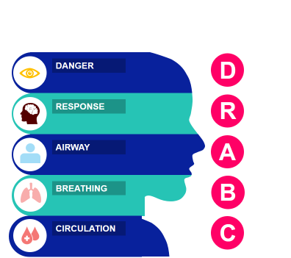
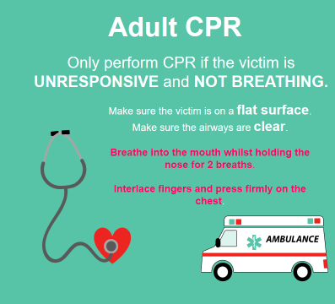
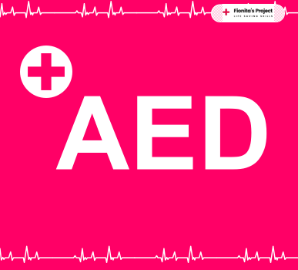
4 Automated External Defibrillation (AED)
It may be necessary to use an AED.
You have performed CPR and used alternative ventilation methods if necessary, whilst calling the emergency services.
AED = Automated External Defibrillation
You have conducted a primary survey, having checked the scene and assessed the condition of the victim

Slide 8
4 Automated External Defibrillation (AED) – An introduction
AED
In most cardiac arrest cases…
The heart stops beating effectively because of an electrical disturbance. This disturbance change the rhythm of the heart.
This is called
Ventrical Fibrillation (VF)
An AED is
A compact device that can be used to analyse the victim’s heart. Through electrodes, a shock can be sent to the victim to correct the heart’s rhythm, allowing it to start beating properly again.
Defibrillation is when a shock stops the disturbed rhythm.
AED’s dramatically improve the chance of survival!

Slide 9

5 – Adult Choking
Signs of Choking
Providing first aid can remove the foreign body, allowing the airways to be clear.
Sometimes, a foreign body can get lodged in the throat and cause an obstruction to the airways.
Although it is largely uncommon, many lives are lost each year because of this. Recognising a choking event is therefore key to intervention.
The most obvious sign is a victim clutching at their neck.
Asking the victim “Can you cough?” can help to identify the severity of the situation.
An inability to cough suggests a severe obstruction.

