Slide 1

Mental Health International Workshop
Empowering Citizens Saves Lives

Slide 2

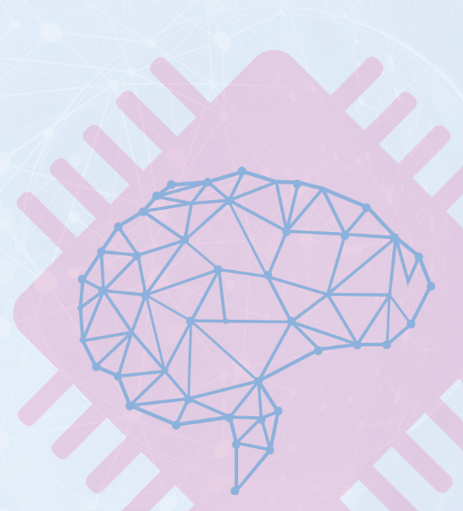
Contents
01
What is ‘Mental Health’?
What is it and what factors surround it
02
The Mental Health Continuum
How we travel up and down
03
Mental Wellbeing
The different states of Wellbeing
04
Improving Your Wellbeing
Ways of improving or maintaining good mental health and wellbeing
05
Seeking Help
Benefits of seeking help early

Slide 3
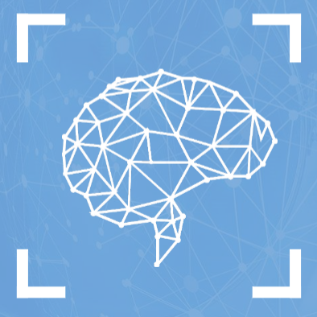
What is it?
What is mental health?
The health of our mind is as important as the health of our body, and is experienced by everybody. It is affected by certain factors in our lives such as our DNA, our childhood experiences, life events, and stresses that we come under in our lives. We all experience moments where we feel particularly stressed, anxious, sad, anger. This is normal. But when these feelings are severe enough to impact the ability of someone to function daily, and these feelings persist over time, then a mental health problem might arise.
“a state of wellbeing in which every individual realises his or her own potench, can cope with the normal stressors of life, can work protuctively and fruitfully, and is able to make a contribution to his her community” – The World Health Organisation
What affects it?
Why is it important?

Slide 4




The Mental Health Continuum
Poor Mental Wellbeing
Good Mental Wellbeing
Our mental health can be described using a continuum. We are all in the continuum, and we move up and down throughout life. At one end, we have mental disorders, and on the other we have states of positive mental health.
STATES OF POSITIVE MENTAL HEALTH
e.g. Thriving, content, fulfilled.
We all experience moments where we feel particularly stressed, anxious, sad, or angry. This is normal. But when these feelings are severe enough to impact the ability of someone to function daily, and these feelings persist over time, then a mental health problem might arise.
MENTAL DISORDERS
e.g. Depression, anxiety

Slide 5
Mental Wellbeing
We all have mental health and experience different states along the continuum.
Poor Mental Wellbeing
Good Mental Wellbeing
I have not been diagnosed with a mental health disorder, but I am unhappy and not coping.
I have a mental health diagnosis but I am coping well and enjoying my life
I have a mental health diagnosis, but I am not coping and I am not happy
I have no diagnosis. I am well and enjoying my life.
With the right support, a person can learn to manage or fully recover from a mental health problem and experience very good mental wellbeing

Slide 6
Improving Your Wellbeing
Ways to improve your wellbeing and unlock your potential
Mindfulness
Making a habit of having a good routine to wind down, including yoga practice or turning off mobile devices early
Contributing
Assisting others or helping with causes you care about
We all have ways of helping us to cope with certain stresses in life. Remember, being mentally healthy means being resilient and able to cope with difficult times, and we have a personal responsibility to learn how we can improve and maintain our own.
Creating
Expressing yourself through something practical or physical, e.g music, art, or writing
Learning
Introducing yourself to a new thing, like learning a new skill
Talking
Opening up to people you feel you can trust with how you are feeling
Exercising
Looking after your physical wellbeing, by playing a sport, doing exercise, or eating healthy.

Slide 7
Seeking Help
Effective treatments and interventions are available to those who develop symptoms of a mental illness
Despite this, few people actively use the treatment services. This may be due to reasons such as:
The stigma attached to seeking help
The lack of understanding of mental health problems
Uncertainty of where or how to get help
A fear of disclosing mental health problems
Untreated mental disorders may cause;
a significant impact on daily functioning
a frequent interference with Family, Social and Work responsibilities
Research shows that stigma remains one of the biggest factors preventing people from seeking help early for their mental health problems and getting appropriate support they need.
There are many different types of mental disorders. When left untreated, mental disorders can be long-lasting.

