Slide 1

Note: The data and information in this document is reflective of a hypothetical situation and client. This document is to be used for KPMG Virtual Internship purposes only.
Sprocket Central Pty Ltd
Data analytics approach
Presenter: NZH, Junior Consultant

Slide 2
Note: The data and information in this document is reflective of a hypothetical situation and client. This document is to be used for KPMG Virtual Internship purposes only.
Agenda
Introduction
Data Exploration
Model Development
Interpretation

Slide 3
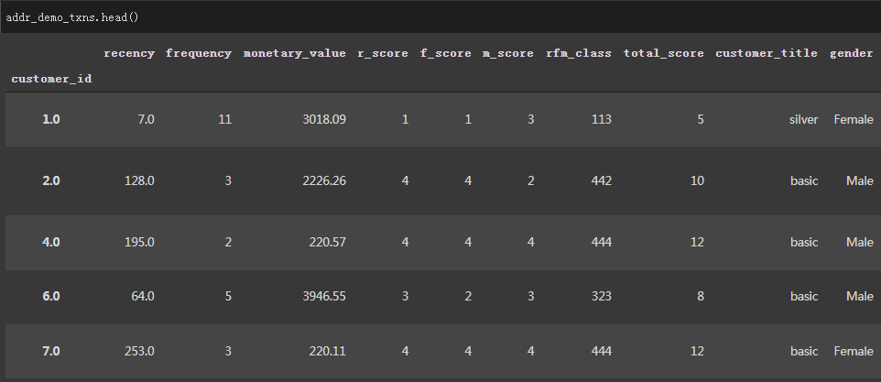
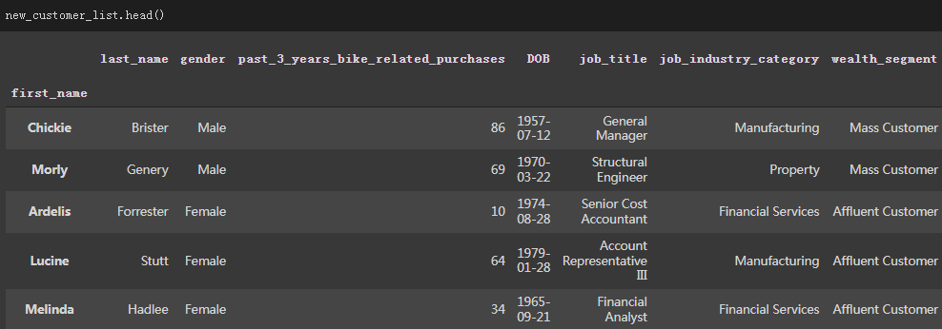
Note: The data and information in this document is reflective of a hypothetical situation and client. This document is to be used for KPMG Virtual Internship purposes only.
Introduction
Steps for whole progress
2 Parts of our analytics progress
Insight of the existing transactions
Data Analytics Output for the new customer list

Slide 4
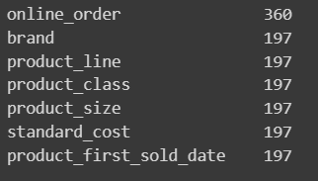
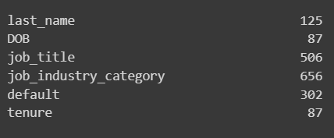
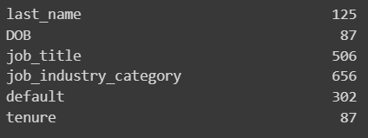
Note: The data and information in this document is reflective of a hypothetical situation and client. This document is to be used for KPMG Virtual Internship purposes only.
Data Exploration
EDA of Transaction from Existing Customers
Existing transaction & customers dataset with missing values
Meaningless garbled data
A few extreme values

Slide 5
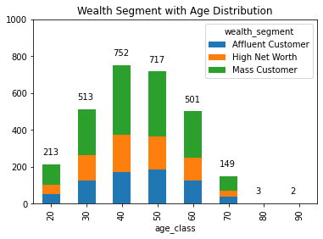
Note: The data and information in this document is reflective of a hypothetical situation and client. This document is to be used for KPMG Virtual Internship purposes only.
Data Exploration
Wealth Segment With Age Distribution(Existing Customers)
Customers aged 30-60 class account for a large share of the total purchases
Customer aged 40-50 have the strongest purchasing power
For the best benefit, our sales should be aimed at people aged 30-60
Different sales strategies should be adopted for their age groups.

Slide 6
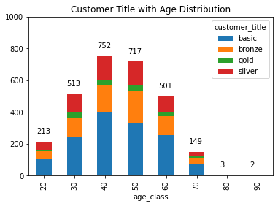
Note: The data and information in this document is reflective of a hypothetical situation and client. This document is to be used for KPMG Virtual Internship purposes only.
Data Exploration
Customer Title with Age Distribution(Existing Cutomers)
Silver customers mainly appear in the 30-60 year old group
The 40-50 year old group has the largest number of silver customers
Gold customers mainly appear in the 30-60 year old group
The differences between disparate levels of customers reflect the distribution of purchasing power

Slide 7
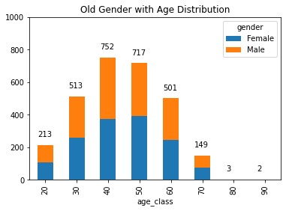
Note: The data and information in this document is reflective of a hypothetical situation and client. This document is to be used for KPMG Virtual Internship purposes only.
Data Exploration
Gender with Age Distribution(Existing Cutomers)
There is little difference between male customers and female customers ratio in all ages
Slightly more men than women
Differentiated marketing strategies for men and women are unnecessary

Slide 8
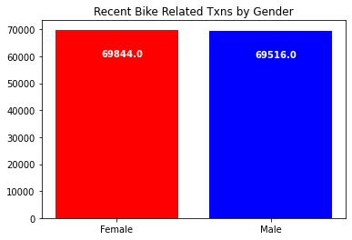
Note: The data and information in this document is reflective of a hypothetical situation and client. This document is to be used for KPMG Virtual Internship purposes only.
Data Exploration
Rencent Bike Transaction by Gender(Existing Cutomers)
There is only a small difference in the ratio of male to female in recent bike purchases
Recent purchases were around 140,000

Slide 9
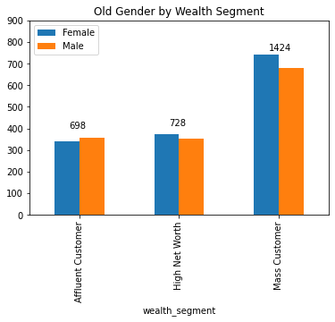
Note: The data and information in this document is reflective of a hypothetical situation and client. This document is to be used for KPMG Virtual Internship purposes only.
Data Exploration
Gender by Wealth Segment(Existing Cutomers)
The number of female customers in the Mass Customer and High Net Worth is slightly higher than that of male customer
The number of male customers in the Affluent Customer is slightly higher than that of female customer
The number of Mass Customers occupies the majority, the marketing strategy should pay more attention to this group of customers

Slide 10
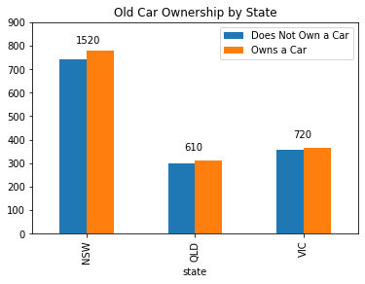
Note: The data and information in this document is reflective of a hypothetical situation and client. This document is to be used for KPMG Virtual Internship purposes only.
Data Exploration
Car Ownership by State(Existing Cutomers)
NSW has the largest customer base and the largest potential customer
The current market of QLD and VIC is not obvious
The company should adopt relevant promotion policies to expand the QLD and VIC market

Slide 11
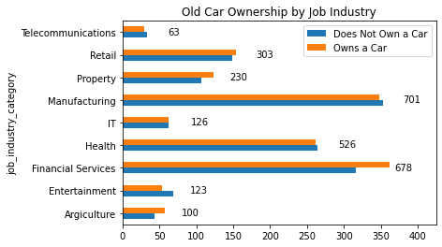
Note: The data and information in this document is reflective of a hypothetical situation and client. This document is to be used for KPMG Virtual Internship purposes only.
Data Exploration
Car Ownership by Job Industry(Existing Cutomers)
The market in the Manufacturing, Financial Services and Health is larger than other industries
The focus of promotional policies should be on Telecommunications, IT, Entertainment and Agriculture

Slide 12
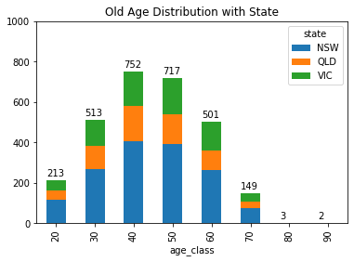
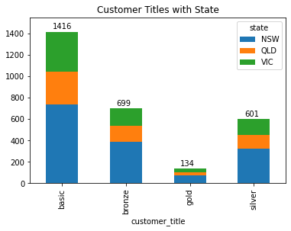
Note: The data and information in this document is reflective of a hypothetical situation and client. This document is to be used for KPMG Virtual Internship purposes only.
Data Exploration
Related Distribution with State(Existing Cutomers)

Slide 13
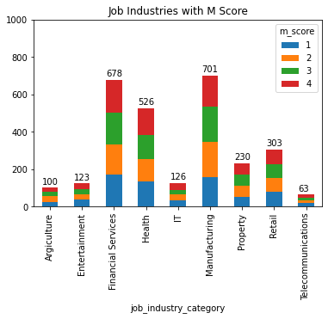
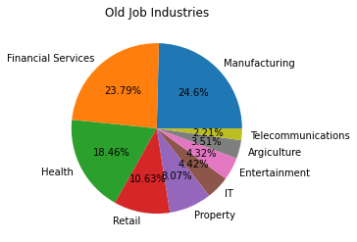
Note: The data and information in this document is reflective of a hypothetical situation and client. This document is to be used for KPMG Virtual Internship purposes only.
Data Exploration
Related Distribution about Industries(Existing Cutomers)

Slide 14
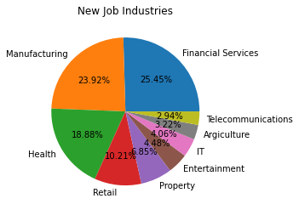
Note: The data and information in this document is reflective of a hypothetical situation and client. This document is to be used for KPMG Virtual Internship purposes only.
Model Development
Job Industries Distribution of New Customer
Manufacturing and Financial Services account for the largest proportion of potential customers (Around 50%)
It was followed by the Health industry (Around 19%)
The company can increase their exposure to industries that account for less than 10%

Slide 15
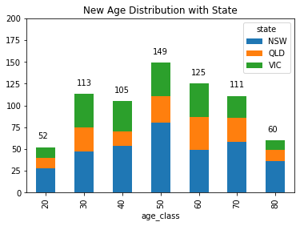
Note: The data and information in this document is reflective of a hypothetical situation and client. This document is to be used for KPMG Virtual Internship purposes only.
Model Development
Job Industries Distribution of New Customer
NSW provided the largest number of new customers at every age group
VIC > QLD at 30, 40 and 50 age group
QLD > VIC at 20, 60, 70 and 80 age group

Slide 16
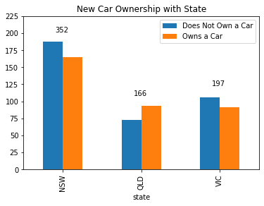
Note: The data and information in this document is reflective of a hypothetical situation and client. This document is to be used for KPMG Virtual Internship purposes only.
Model Development
Car Ownership of New Customer with State
There are more potential new customers without cars in NSW and VIC
There are more new customers with cars in QLD than without cars
A total about 350 new customers in these 3 regions do not have cars

Slide 17
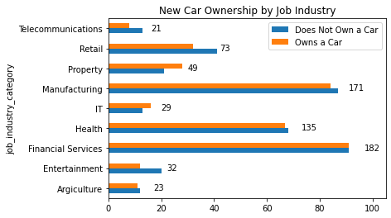
Note: The data and information in this document is reflective of a hypothetical situation and client. This document is to be used for KPMG Virtual Internship purposes only.
Model Development
Car Ownership of New by Job Industry
Manufacturing and Financial Services have the largest potential customer base, with large numbers of people both owning and not owning cars
The number of customers in the Health industry is still the second tier, regardless of whether they own a car or not

Slide 18
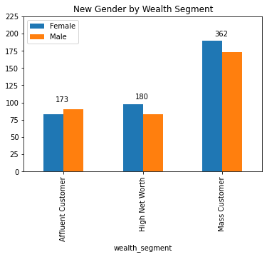
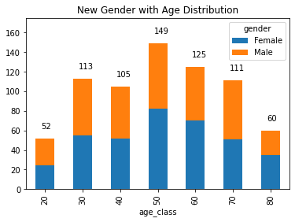
Note: The data and information in this document is reflective of a hypothetical situation and client. This document is to be used for KPMG Virtual Internship purposes only.
Model Development
Other Information about the Gender

Slide 19
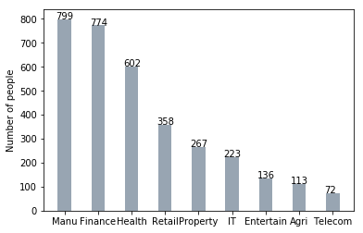
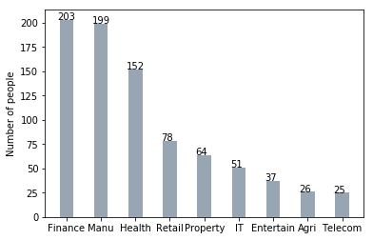
Note: The data and information in this document is reflective of a hypothetical situation and client. This document is to be used for KPMG Virtual Internship purposes only.
Interpretation
Job Industry
Most of the new customers belong to the Financial Services industry and Manufacturing customers still stands among the top two positions.
Rest of the industries seem to remain in the same positions

Slide 20
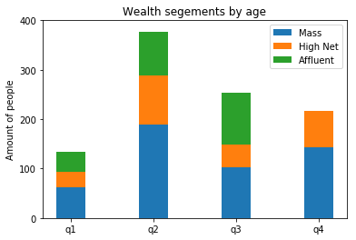
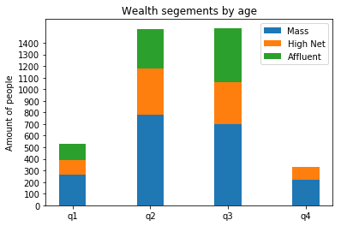
Note: The data and information in this document is reflective of a hypothetical situation and client. This document is to be used for KPMG Virtual Internship purposes only.
Interpretation
Job Industry
We notice that in all the age groups, the number of Mass Customers remains the highest, so it would be wise to provide extra focus to this area
The next are of focus should be High Net Customer Category, then followed by the Affluent Customers

Slide 21
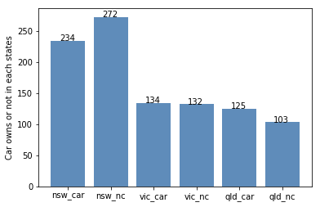
Note: The data and information in this document is reflective of a hypothetical situation and client. This document is to be used for KPMG Virtual Internship purposes only.
Interpretation
Job Industry
VIC and QLD cars seem to have more customers that own car, so NSW should be considered
NSW cars category should be prioritized the most for now, since numbers of customers that don’t own a car is significantly larger than the number of customers who own one

Slide 22
Note: The data and information in this document is reflective of a hypothetical situation and client. This document is to be used for KPMG Virtual Internship purposes only.
Appendix

Slide 23
Note: The data and information in this document is reflective of a hypothetical situation and client. This document is to be used for KPMG Virtual Internship purposes only.
Appendix
GitHub Code
https://github.com/SuperNZH/KPMG_DataAnalytics_Consulting_Program/blob/main/2_Data_Insights/data_insight_pureDS.ipynb
LinkedIn: Ni ZheHan
https://www.linkedin.com/mwlite/in/nizhehan

Slide 24
Note: The data and information in this document is reflective of a hypothetical situation and client. This document is to be used for KPMG Virtual Internship purposes only.
THANK YOU

