Slide 1
CSCI465:Principals of Translations
UND School of Aerospace Sciences
Department of Computer Science
Dr. Hassan Reza

Slide 2
Objectives
Discuss
A compiler design and How theory meets practice
Abstraction
Different types of architecture
Introductory discussion of traditional compilers and phases
Lexical analysis
Syntactic analysis
Semantic analysis
Code generation
etc

Slide 3
The waterfall model of Software life cycle
Req. analysis
& specification
Software Architecture
& design
Coding &
unit testing
Integration &
system testing
maintenance

Slide 4
Software Architecture: Design at large
Good software engineering techniques are relevant in creating modern compilers
Architecture ?
Refers to the style and method of design and construction of buildings and other physical structures.

Slide 5
From software design to architecture
Design
Mid-1960’s ⇒ present
Architecture
Mid-1990’s ⇒ present
Structured design, information hiding, abstract data types, aspect-orientation, …
Architectural styles, architecture description languages, patterns, frameworks, …

Slide 6
Two primary objectives of Software Architecture
Capturing, cataloguing and exploiting experience in software designs
Allowing reasoning about classes of designs

Slide 7
Comparison: Building Architecture vs. Software Architecture
the construction of building
Requirements gathering and analysis
Design of blueprint
Constructing the building based on blueprint
Residing in the building
The construction of Software intensive system
Requirements elicitation and analysis are performed
Specifications are created
Architectural design and low level design are performed
Code is written to implement low-level design
The system is deployed and used

Slide 8
Abstraction
Abstraction?
The process of picking out (abstracting) common features of objects and procedures
The study of software architecture is the study of intermediate abstraction that connects the characteristics of system users need to the characteristics of systems that software engineers can build
This intermediate abstraction then enables the engineer to capitalize on codified principles and experiences to specify and verify the system under construction

Slide 9
Level of Abstractions
High-level architecture (highest level of abstraction)
What pieces? Components/subsystems
How connected? Connectors/communication protocol
Low-level design
Should I use a hash table or binary search tree?
Very low-level design
Variable naming, specific control constructs, etc.
About 1000 design decisions at various levels are made in producing a single page of code
Almost never a key part of architecture

Slide 10
Software architecture? Complexity

Slide 11
Compiler: 1
ASCII source program text
Lexical Analyzer
token stream
Syntax Analyzer
abstract syntax tree
Semantic Analyzer
program
Intermediate Code Generator
optimized program (Machine independent)
Code Generator
optimized program(Machine dependent)

Slide 12
Some examples of Software Architecture
Architectural styles

Slide 13
Examples of software architectures (styles)
Blackboard
Client-server
Database-centered architecture
Distributed computing
Event-driven architecture
Peer-to-peer
Pipes and filters
Service-oriented architecture
Three-tier model
…

Slide 14
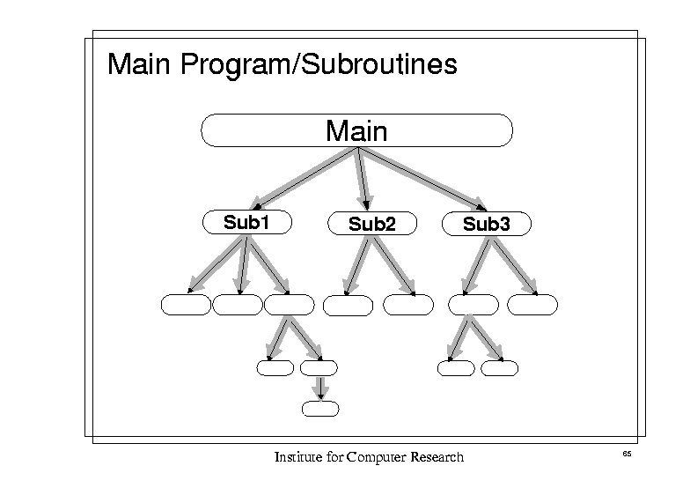

Slide 15
Object-Oriented/Abstract Data Style:2
Object
Object
Object
Object
Object

Slide 16
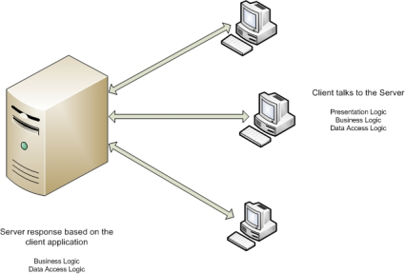

Slide 17
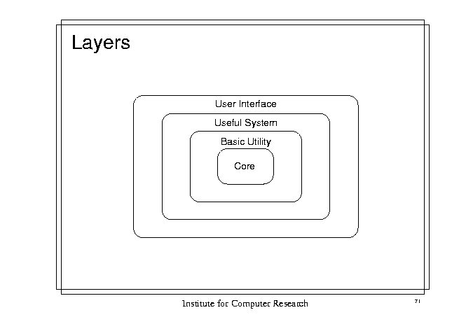

Slide 18
Importance of diagrams
Can be found all over the web, in textbooks, in technical documents, in research papers, over whiteboards in your office, on napkins in the cafeteria, etc.
Drawings help people to work out intricate relationships between parts
“Christopher Alexander”

Slide 19
Compilers: A program
Source Program
Compiler
Target Program
Error Msg

Slide 20
Compilers: 1
The first compilers had ad hoc designs
Over time, as a number of compilers were built, the designs became more structured
Experience yielded benefits
Compiler phases, symbol table, etc.
Plenty of theoretical advances
Finite state machines, parsing, ...

Slide 21
Compilers: 2
Compilers are the known example of shared experience in design
Undergraduate courses build compilers
Most compilers look pretty similar in structure
the perception of a shared design gives leverage:
Reuse at high level design
Communication among programmers

Slide 22
Compiler Architectures: 1
Compilers can differ significantly with regard to their software architecture
Two architectural questions dominate the scene
granularity of the data that is passed between the compilers modules:
Is it bits and pieces or is it the entire program?
Narrow architecture vs. wide architecture
the flow of control between the compilers modules
Which of the modules is the boss?

Slide 23
Compiler Architecture 2: P/F
compiler
scanner
parser
codegen
pipes
filters

Slide 24
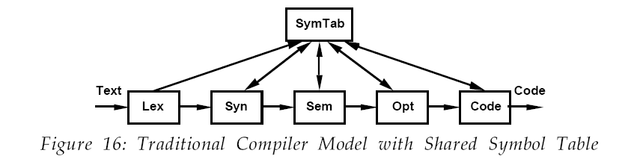

Slide 25
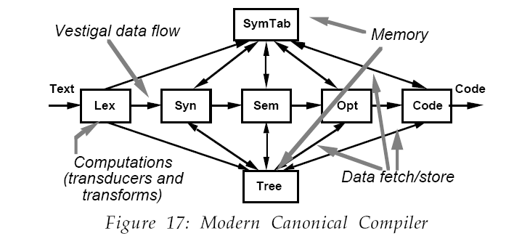
Emphasizes on intermediate representation of the program using attribute tree.

Slide 26
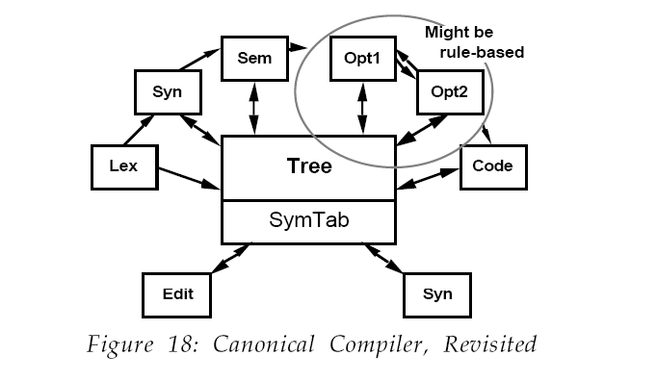

Slide 27
Why do we need translations?
Hardware
One has the needed resources (i.e., Hardware)
Usability
One likes to use a friendlier language than assembler

Slide 28
Compilers: A program
Source Program
Compiler
Target Program
Error Msg

Slide 29
Target Program
In case target program is executable
Input
Executable target Program
Output

Slide 30
Interpreter
Another Language processor
Directly execute the instructions specified in the source program using input
Better error diagnostics
Slower than compiler
Source Program
Interpreter
Out put
Input

Slide 31
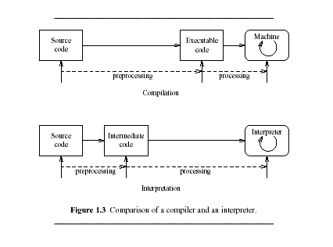
Figure 1.3 (comparison)

Slide 32
Why study compiler Construction?
Compilation is well-established branch of Computer science
Proper structuring of the problem
Analysis-synthesis model
Use of well-developed formalisms and models
Context-free grammars
Regular expressions
Finite State Machines
Use of program-generating tools
Parser generated from grammar
Lexical analyzer generated from regular expressions

Slide 33
Cont’
Applicability (e.g., SQL and file conversions)
Contains many useful algorithms
hashing
recomputed tables
graph algorithms
garbage collections
.
.

Slide 34
A Typical Phases of a Compiler
Lexical Analyzer
Syntax analyzer
Semantic Analyzer
Intermediate code generator
Code optimizer (machine independent)
Code Generator
Code optimizer (machine dependent)

Slide 35
Other important Elements of a Compiler
Symbol-Table
Used to keep track of the identifier in the source program
consulted by semantic and code generator
Error Handler
Used to deal with the errors

Slide 36
Lexical Analysis: 1
Also known as linear analysis or scanning
Input:
position = initial + rate * 60
Output:
ID Position
AssignSym =
ID initial
Plussign +
ID rate
MultSign *
Num 60
Records tokens into the symbol table

Slide 37
Syntax Analysis: 2
Groups the tokens of the resource program into grammatical phrases of the compiler with hierarchical structure
The hierarchical structure of a program is specified by recursive rules

Slide 38
Syntax analysis:2
Example
Expression can be defined by the following rules
Any ID is an expression
Any Number is an expression
If expression1 and expression2 are expressions, then so are
expression1 + expression2
expression1 - expression2
(expression)

Slide 39
Semantic Analysis: 3
Collects type information for the code-generation
Represents meaning
What does the program mean?
Checks the source program for semantic errors and/or language consistency
Saves and maintains type information in Data structure called symbol table

Slide 40
Intermediate Code generation: 4
Generate an explicit intermediate representation of the source program
Easy to produce
Easy to translate

Slide 41
Code Optimization: 5
Generates faster-running machine code
Machine independent
Machine dependent

Slide 42
Code Generation:5
Generates the target code
Example: position = initial + rate * 60
Using registers R1 and R2
MOVF id3, R2
MULF #60.0, R2
MOVF id2, R1
ADD R2, R1
MOVF R1, id1

Slide 43
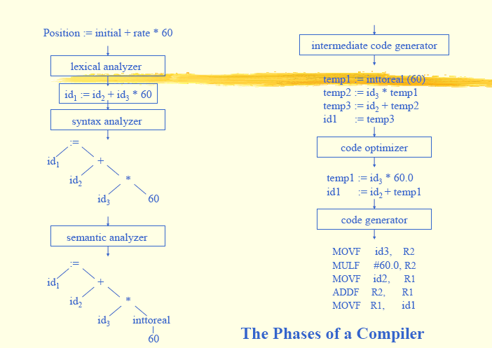

Slide 44
Symbol Table
Data Structure used to record
the variables names defined in the source program
Attributes and other information regarding these variables
E.g.,
Location of variable (storage)
Type
Scope
Arguments
…
Provide two operations
Insert()
Lookup()

Slide 45
Tools
Tools include
Parser generators
Scanner generators
Syntax-directed translation engines
Code-generator
…

Slide 46
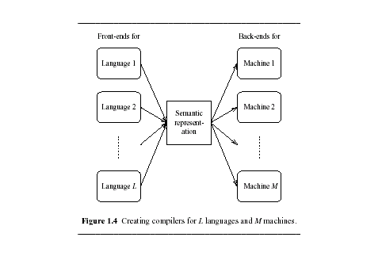
Figure 1.4 (portable and retarge-table)
Portable?
The ease with which the compiler itself can be made to run on different machine
Retarget-able?
The ease with which the compiler itself can be made to generate code for another machine

Slide 47
Properties of a good compiler
Generate Correct Code (CORRECTNESS)
Conforms exactly to the source language grammar (CONFORMACE)
Performance (FAST)
Able to handle programs of arbitrary size (SCALABILITY)
Error handling (FEEBACK)

Slide 48
Quiz 1
List a typical phases of a compiler. Moreover, what are the essential properties of a compile?

