Slide 1
Csci465: Principals of Translations
Chapter 2
UND College of Engineering and Mines
Department of Computer Science
Dr. Hassan Reza

Slide 2
Objectives
Overview of front-end compiling technique
Context-free grammar
Parse Trees
Intermediate code generation
Syntax-Directed Translation (SDT)
A simple grammar-oriented compiling/ translating technique
Show how to use SDT to map infix arithmetic expression into postfix expression

Slide 3
Overview
Analysis/Synthesis (revisited)
Analysis phase breaks up a source program into tokens
Generates intermediate code
Analysis part concern with syntax of PL
A Programming Language can be defined
Syntax (precise form)
Semantics (informal and difficult to specify)
Syntax can be represented BNF (EBNF)
Semantics can be specified
Informal description
Or Formal description
Examples: Operational Semantics, Axiomatic Semantics, and Denotational Semantics

Slide 4
translation
Translation phases
Analysis phase
Synthesize phase
Analysis phase works with “syntax” of the language

Slide 5
A model of a compiler front-end
Lex
parser
Intermediate Code
Generator
3-address code
Char stream
tokens
Syntax
tree
Symbol Table

Slide 6
Syntax: Context-free grammar (CFG)
How to specify syntax?
Context Free Grammar (BNF)
CFG
Used to guide the translation
e.g., Syntax-directed translation
describe the structure using hierarchical construct
E.g. ,
If (expression ) statement₁ else statement₂
Stmt →if (expr) stmt else stmt

Slide 7
Lexical analyzer
Lex
Breaks down the stream of characters (e.g., identifiers) into tokens
E.g., Position+ 1

Slide 8
Intermediate Code generators (IC)
Two forms of Intermediate code representations
Syntax-tree which represents the hierarchical syntactic structure of the source program
Three-address code, which is Linear representation of the three-address instructions
It carries ONLY one operators and takes the following form
X = Y OP Z
Where OP is binary operator
Y and Z are addresses for operand
X is the address of the result

Slide 9
IC: syntax Tree and 3-address code
Do I = I +1; while (a[i] < v);
do-while
1: i = i + 1
2: t1 = a [i]
3: if t1 < v goto 1
body
<
B: 3-address code
assign
[ ]
v
i
+
a
i
i
1
A: syntax tree

Slide 10
Syntax Definition
Context-free grammar is used to specify the syntax or grammar
E.g., if-else in Java
If (expression) statement else statement
Its presentation in CFG
stmt→ if ( expr) stmt else stmt

Slide 11
Context Free Grammar?
A context-free grammar consists of
A set of tokens known as terminals
A set of non-terminals
A set of production rules
A Start symbol
The grammars are specified by listing their productions

Slide 12
Example 2.1 : Productions
CFG for lists
list →list + digit
list →list – digit
list →digit
digit →0|1|2|3|4|5|6|7|8|9
Terminals = { +, -, 0, 1,2,3,4,5,6,7,8,9}

Slide 13
Example 2.2: Expressions
For example, using the langue defined by the grammer, Expressions can be defined as a sequence of digits and plus and minus signs
E.g.,
9-5+2
3-1
7

Slide 14
Derivations
A grammar derives strings (or input) when starting from the goal symbol and rewriting a left-hand –side(LHS) by the right-hand –side (RHS)
The process generates terminal strings conforms to the language specification
E.g., 9 -5 + 2 is a list by derivations
9 is a list
9 – 5 is a list
9 -5 + 2 is a list

Slide 15
Example: Productions for Procedure call
CFG for list of Procedure call
call → id (optparams)
optparams → params | φ
params →params, param| param

Slide 16
Parse Tree (PT)
Parsing?
It is a process of showing how to take a string of terminals (input) and derives it from start symbol using rules
Parse Tree (PT)?
PT shows how the start symbol of a grammar derives a string in the language
PT consists of :
the root (start symbol)
Interior nodes (non-terminal)
leaf nodes (terminals)

Slide 17
PT for input 9-5+2
CFG for lists
list →list + digit
list →list – digit
list →digit
digit →0|1|2|3|4|5|6|7|8|9
Terminals = { +, -, 0, 1,2,3,4,5,6,7,8,9}
list
list
digit
list
digit
digit
9
5
2
-
+

Slide 18
Ambiguous grammar?
Ambiguity?
Two or more PTs for the same strings can be generated
Suppose we have the following grammar
string→ string + string| string – string| 0|…|9

Slide 19
Input = (9-5)+2
string→ string + string| string – string| 0|…|9
string
string
+
string
string
-
string
9
5
2

Slide 20
Input = 9-(5+2)
string→ string + string| string – string| 0|…|9
string
string
-
string
9
string
+
string
5
2

Slide 21
PT: Associatively of Operators
Associatively of Operators
9+5+2 ≡ (9+5) +2 (left associate)
9-5-2 ≡ (9-5) -2 (left associate)
Example of left associate operators
(+,-,*,/)
Example of right associate operators:
Exponential
Assignment statements in C
(a=b=c=d)

Slide 22
Precedence of Operators
For 9+5*2, two interpretations:
(9+5)* 2
9+(5*2)
Associatively rules do not help us because operators are not the same
Need rules for Precedence of Operators
Use expr and term for two levels of precedence
expr → expr + term| expr – term | term
term → term * factor | term/factor | factor
factor→ digit | (expr)
N number of precedence levels requires N+1 non-terminals

Slide 23
Syntax-Directed Translation (SDT)
SDT
A compiling implementation method in which the translation is driven by the parser
Parsing process and parse trees are needed to guide semantic analysis, code generation, etc.
To translate a programming language construct, a compiler need to know the attributes (values) associated with constructs
Attribute?
Refers to any quantity or characteristics associated with a programming constructs (e.g., type, size, etc.)

Slide 24
Example: Postfix Notation
The postfix notation for expr E can be defined
If E is a var or constant, then E is its postfix
If E is an expression of the form E₁ op E₂, then
E’₁ E’₂ op
If E is an expr of the form (E₁), then the postfix for E₁ is also the postfix notation for E

Slide 25
Syntax-Directed Definitions (SDD)
Uses a CFG to specify the syntax of the input
Associates a set of attributes to each grammar symbol without any order
Associates a set of semantics rules with each production rule
Uses Depth-first traversal to evaluate the tree
Translation is an input-output mapping using synthesized attributes
Creates annotated Parse Tree

Slide 26
SDD for infix to postfix translation
Production Rules | Semantics Ruless
expr→expr1 + term expr→expr1 - term expr→term term→0 term→1 term→2 term→3 … term→9 | expr.t := expr1 || term.t ||’+’ expr.t := expr1 || term.t ||’-’ expr.t := term.t term.t := ‘0’ term.t := ‘1’ term.t := ‘2’ term.t := ‘3’ … term.t := ‘9’

Slide 27
Step 1: Use a CFG to create the syntax of the input
Expr
Expr
Term
Expr
Term
Term
9
5
2
-
+

Slide 28
Step 2: Attach attributes to each grammar symbol
Expr.t
Expr.t
Term.t
Expr.t
Term.t
Term.t
9
5
2
-
+

Slide 29
Step 3: Use semantic rules to compute the output using attribute values at each node n (bottom up approach)
Expr.t =95-2+
Expr.t =95-
Term.t = 2
Expr.t =9
Term.t.= 5
term.t =9
9
5
2
-
+

Slide 30
Translation Schemes (TS)
Procedural specification method for defining a translation
TS = CFG + Semantic actions
Imposes order
Semantics actions are embedded within the right sides of productions (R.H.P)
Braces are used to show the position at which an action to be executed
Example of actions:
Print
procedure call
Code
etc

Slide 31
Example
rest → + term { print (‘+’)} rest₁
PT for the above production
rest
+
rest1
term

Slide 32
Example
TS
rest
+
rest1
term
{print(‘+’)}

Slide 33
Emitting a code (generating code)
The semantic actions in TS generates the output of the translation into a file
E.g.,
Infix expression of 9-5+2 translated into postfix 95-2+

Slide 34
Simple Translation Scheme for infix-postfix
expr→expr1 + term {print (‘+’) }
expr→expr1 - term {print (‘-’) }
expr→term
term→0 {print (‘0’) }
term→1 {print (‘1’) }
term→2 {print (‘2’) }
term→3 {print (‘3’) }
…
term→9 {print (‘9’) }

Slide 35
Actions Translating 9-5+2 into 95-2+: 1
expr
expr
+
term
expr
term
term
-
5
2
9

Slide 36
Actions Translating 9-5+2 into 95-2+: 2
expr
{Print(‘+’)}
expr
+
term
expr
term
{Print(‘-’)}
-
term
2
5
{Print(‘2’)}
9
{Print(‘9’)}
{Print(‘5’)}

Slide 37
Parsing Methods
Top-down
Begin with non-terminal start symbol A
Uses the lookahead symbol to select an applicable production rule for A
Lookahead symbol?
Current token being scanned in the input
Practical only where backtracking can be avoided completely
Bottom-up
Construction starts at the leaves and proceeds towards the root
Can handle a large class of grammars using tools

Slide 38
Top Down Method: Recursive Descent
Recursive Descent Parsing Method?
A top-down parsing technique to parse and to implement syntax-directed translators
Uses a set of recursive procedures to process the input
Each non-terminal is implemented by one procedure call
E.g., Procedure expr ()

Slide 39
Predictive Parsing
Predictive Parsing
A recursive descent parsing that uses one lookahead symbol to unambiguously select proper production rule

Slide 40
Top-Down Parsing
Consider the following type Grammar:
type -> simple | ↑id | array [ simple ] of type
simple-> integer | char | num dotdot num
Top Down Parsing
Process starts with the root (goal symbol)
Constantly performs two steps:
At node n labeled by A, selects one of the productions for A and expands it children
Finds the next node at which a subtree can be built

Slide 41
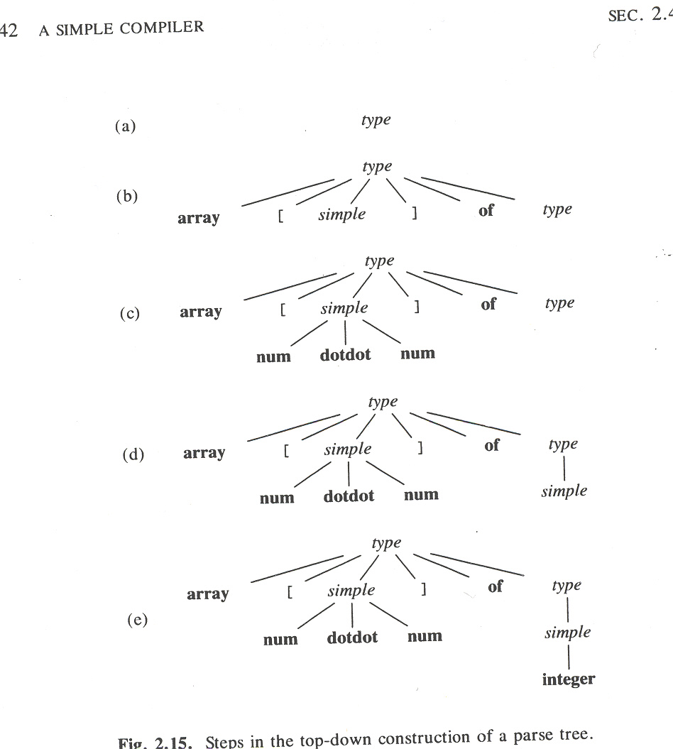
Steps in the top-down construction of a PT
Example: Parsing of the input string = array [ num dotdot num ] of integer
Start symbol

Slide 42
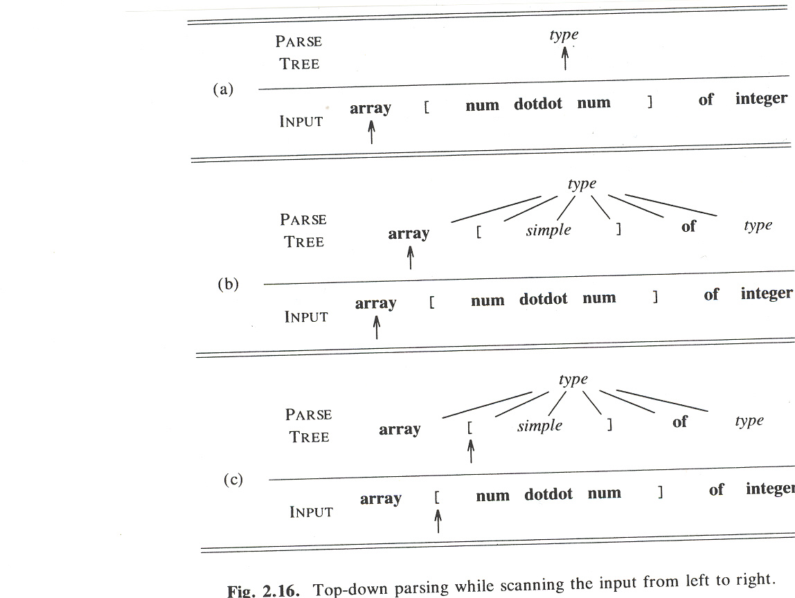
Top-down parsing scanning the input from left to right

Slide 43
Example: Trial and Error
The selection of a production for a non-terminal may involve trail and error
Example
The following grammar defines the language {cabd, cad}
S → c A d
A → a b | a
Suppose a parser is presented with input “cad”
S ⇒ c A d ⇒ c a b d
parser is stuck because b does not match the input d
Parser must backtrack
Second attempts: Parser backtracks and selects another rule
S ⇒ c A d ⇒ c a d

Slide 44
More on Predictive Parsing (PP)
Special form of recursive-descent parsing,
Uses the lookahead symbol to call the routine
Begins with a call to the routine for starting symbol (or goal symbol)
No backtracking is needed (good)
Does not handle left-recursive grammar (bad)

Slide 45
Designing a Predicative Parsing (PP)
Predictive parser (PP) is a program
Consists of a routine for every non-terminal
Each routine decides which production to use based on the look-ahead symbol in FIRST(α)
where
α refers to R.H.S (Right Hand Side) of a production
FIRST(α) = a set of tokens (terminals) appearing as the FIRST symbols of one or more strings generated from α
Examples: simple-> integer | char | num dotdot num
FIRST (simple) = {integer, char, num}

Slide 46
More on FIRST(α)
The FIRST sets must be used if there are two or more productions
A→α
A→β
Recursive-descent parsing without backtracking demands FIRST(α) and FIRST(β) to be disjoint
FIRST(α) ∩ FIRST(β) ≡ ∅
Lookahead symbol can be used to decide which production must be used
If a lookahead symbol is in FIRST(α), then α can be used
If a lookahead symbol is in FIRST(β), then can be used

Slide 47
Guidelines for implementing top-down parsers
Write a routine for each non-terminal in the Grammar
Call that routine whenever a production for the non-terminal is to be applied
See the example for type grammar
type -> simple | ↑id | array [ simple ] of type
simple-> integer | char | num dotdot num

Slide 48
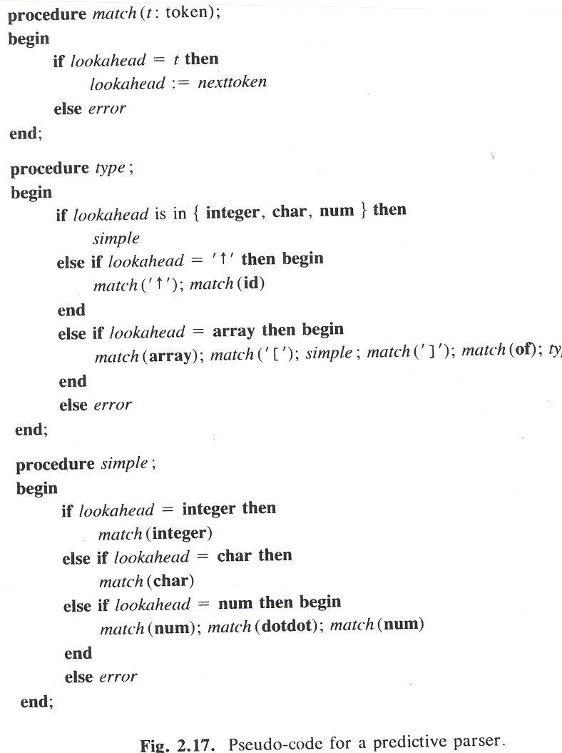
Pseudocode for PP

Slide 49
Left Recursion
It is possible for a recursive descent parser to loop forever
Example
expr-> expr + term

Slide 50
Eliminating Left Recursion
E.g.
A -> Aα |β
into
A-> β R
R-> αR|∈
The left-recursion elimination can be applied to Translation Scheme

Slide 51
General technique for eliminating left recursion
Suppose
A -> Aα |Aβ|ρ
Into
A-> ρR
R-> αR| βR| ∈

Slide 52
Elimination of let recursion infix-postfix
expr→ expr + term {print (‘+’) }|expr - term {print (‘-’) } |term
term→0 {print (‘0’) }
term→1 {print (‘1’) }
term→2 {print (‘2’) }
term→3 {print (‘3’) }
…
term→9 {print (‘9’) }

Slide 53
Figure 2.21 (eliminate left recursion)

Slide 54
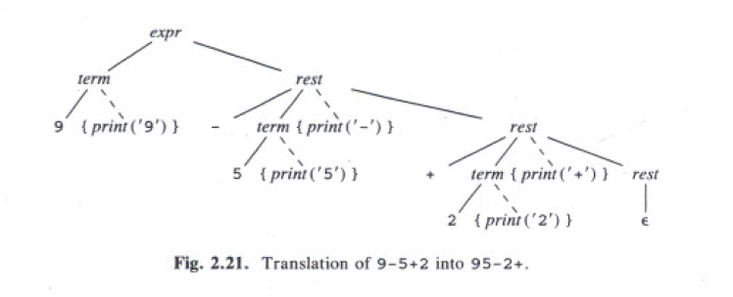
1
3
2
5
4

Slide 55
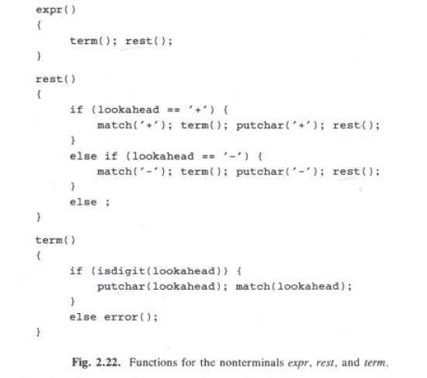

Slide 56
Optimizing the translator: Jump statement

Slide 57
Optimizing the translator: Iteration

Slide 58
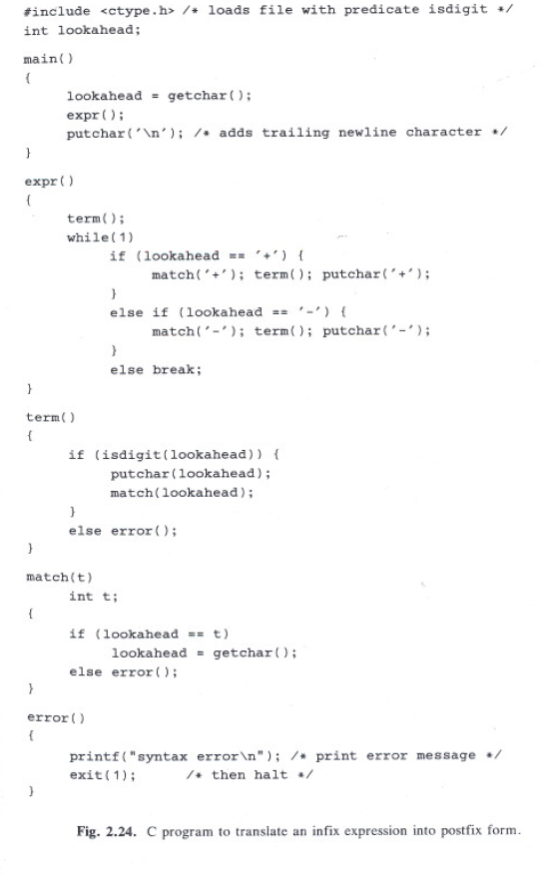

Slide 59
// expr →expr + term {print (‘+’) } | expr – term {print (‘+’) } | term
// term→0 {print (‘0’) }

Slide 60
Adding Lexical Analysis
Add lexical analysis to the translator
Reads and converts the input into a stream of tokens
These tokens will be analyzed by parser
Key features provided by lexical analyzer
Token Recognitions
Identifiers (e.g., count)
Keywords (e.g., IF/THEN, etc.)
Numbers (2222, etc.)
Space Removal
White space (blanks, etc.)
Comments

Slide 61
Symbol table

Slide 62
c = getchar(); // call to getchar to assign the next input char to c
ungetc (c, stdin); // call to ungetc pushes back the value of c onto the //standard input stdin

Slide 63
Modified grammar to handle numbers

Slide 64
Extending the grammar for the expression with factor:
factor→(expr) | {print (num.value)} num

Slide 65
How to handle comments and white space (blank)
Most Programming languages allow arbitrary numbers of white space or comments appear between tokens
To handle white space and comments, the following pseudocode can be used
for (;; t = next input char ) {
If (t is a blank or a tab) do nothing
Else if (t is a newline) lineno = lineno + 1;
Else break;
}

Slide 67
The symbol-table interface
Used for saving/retrieving lexemes
Two operations
Insert (s, t); // returns index of new entry for string s, token t
Lookup (s); // returns index of entry for string s, or if s is not found
Where
S = string (e.g., position)
t = token (e.g., IF-symbol, MOD-symbol, etc.)

Slide 69
Handling Reserved Keywords
Symbol-table can be used to deal with any collection of reserved keywords
E.g.,
tokens div and mod with lexems div and mod respectively
initialize symbol table with keywords using the calls
Insert (“div”, div);
Insert (“mod”, mod);
Any lookup (“div”) will return div meaning that div cannot be used as an identifier

Slide 70
A simple symbol-Table Implementation in C
to handle identifier

Slide 71
Putting All together for infix to postfix translator

Slide 72
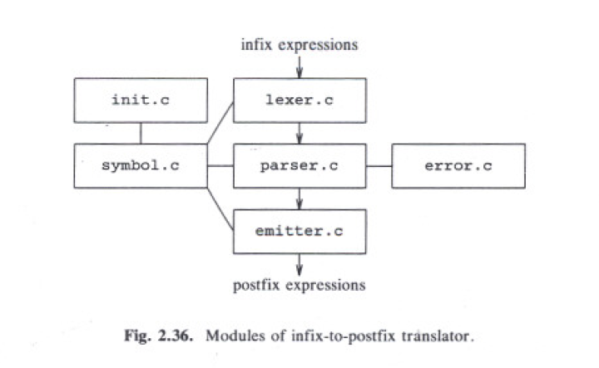
All the modules

Slide 73
Improved specification of infix-postfix translation

Slide 74

For Input source:

Slide 75
Intermediate Code: Abstract Stack Machines is used to generate intermediate code
Front-end part of compiler builds an Intermediate Code (IC)
Abstract stack machines can be used to generate IC
Stack is a LIFO storage with two abstract operations :
push
pop

Slide 76
How to use stack to generate IC?
Stack has
Set of Instructions
Data memories
Instructions:
Integer arithmetic
E.g., +, -
Stack manipulation
E.g., push/pop
Control flow
Branch (IF/THEN, etc)

Slide 77
Arithmetic Instructions
Support basic operations
Addition
Subtraction
Complex operations?
Can be implemented as a sequence of abstract machine instructions

Slide 78
Simulation of postfix using stack
The evaluation for postfix starts from
Left-to-right
push each operand onto stack
When k-ary operator has been located
Its-leftmost-argument = k-1 positions below the top of stack
Its-rightmost-operand = the top of stack
Apply the operator to the top k values by
Popping the operands
Pushing the result onto stack

Slide 79
Example: 1 3 + 5 *
Evaluation of 1 3 + 5 *
Stack 1
Stack 3
+ (pop the two topmost elements and add them)
Stack back the result (4)
Stack 5
* (pop the two topmost elements and multiply them)
Stack result 20 (the value of the entire expression)

Slide 80
L-values and R-values
There is distinction between the meaning of identifier on the left and right sides of assignment statement
i := 5;
i := i + 1;
The right side corresponds values (e.g., integers)
The left side corresponds to address (i.e., the locations where the value should be saved)

Slide 81
Stack Manipulation
Generic operations to access the data memory
Push v // pushes value v (constant) onto the stack
Rvalue L // pushes contents of data location L
Lvalue L // pushes address of data location L
Pop // pops up the value on top of stack
:= // the r-value on top is placed in the l- value below it and both are popped
Copy // push a copy of the top value on the stack

Slide 82
Translation of Expressions
Stack-machine code to evaluate expression E+F
code to evaluate E || code to evaluate F || applies add operation
Example: a+b
rvalue a // push the contents of the data location a
rvalue b // push the contents of the data location b
+ // add their values by popping the two top most values // from stack and pushing their result back into the // stack

Slide 83
Control Flow: IF/THEN, WHILE
The stack machine executes instructions in linear fashion unless told to jump
Several options exist for specifying the targets of jumps:
The operand provides the target address
The operand specifies the relative distance, positive, negative
Labels can be used for targets

Slide 84
The control-flow instructions
Label L //jump target
Goto L //next instruction is a label L
Gofalse L // jump if the popped value is //zero
Gotrue L //jump if the popped value is //nonzero
Halt // stop

Slide 85
Translation of Statements
stmt→if exp then stmt1
{ out := newlable;
stmt.t := exp.t||
‘gofalse’ out||
stmt1.t ||
‘lable’out}
Code for expr
gofalse out
Code for stmt1
lable out

Slide 86
Emitting a Translation
stmt→if expr { out:=newlable; emit (‘gofalse’, out);}
then stmt₁ { emit (‘lable’, out);}
Note: emit is an example of semantic action
newlable is function which generates new label (e.g., L1, L2,etc).
The order of execution is from left to right on R.H.S as follows
1. Perform actions during parsing of expr
2. Out to be set by newlable
3. Emit gofalse stament
4. Perform actions during parsing of stmt1
5. Print label instruction

Slide 87
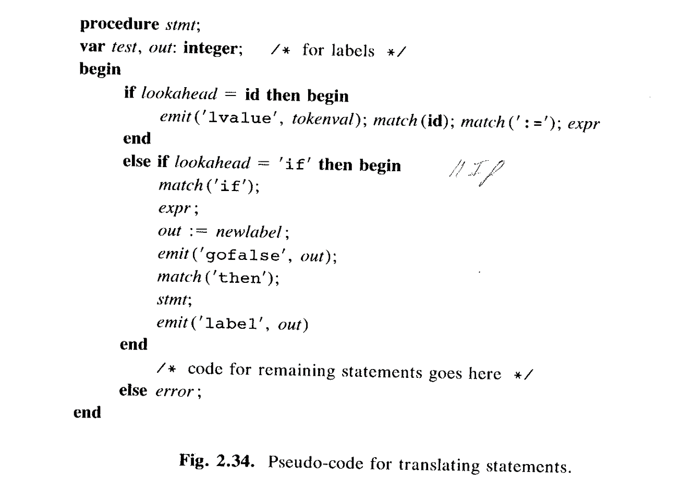
Putting them together
The actions during parsing of expr and stmt₁ should emit the code for these non-terminals

Slide 88
Quiz/answer
Consider the CFG
S→ SS + | SS * | a
A) show how the string aa+a* can be generated by this grammar
B) built a parse tree for this string
s
S
S
*
+
a
a
a

