Slide 1
Chapter 3: Lexical Analysis
CSCI 465
Dr. Hassan Reza
UND College of Engineering and Mines

Slide 2
Objectives
Discuss techniques for specifying/implementing Lexical analyzers
Examines methods to recognize lexemes (or words) in a stream of characters
Tokens, Patterns, Lexemes
Attributes for Tokens
Input Buffering (buffer pairs)
Finite Automata (intermediate step)
DFA Faster but bigger
Implementing a Transition Diagram

Slide 3
Lexical
Lex-i-cal: of or relating to words or the vocabulary of a language as distinguished from its grammar and construction
Webster’s Dictionary

Slide 4
Lexical analyzers features
Reads characters from the input file reduces them to manageable tokens
Strips out comments/white space from input
Interacts with parser
Generates error messages
Main features include
Efficiency
Correctness

Slide 5
Lexical Analysis vs. Parsing
Main reasons for separating the analysis phase
Compiler simplicity of design (separation of concerns)
Compiler efficiency (specialized buffering)
A large amount of time is dedicated for reading the source program and tokenization
Parser is harder than lexical analysis because the size of parser grows as the grammar grows
Compiler Portability
Input peculiarities and device specific-anomalies can be limited to the lexical analyzers
Special symbols (e.g., ↑) can be isolated in the LA
Lexical analysis can be fully automated
Tool Supports
Specialized tools have been implemented to automate the implementation of laxer and parser

Slide 6
Token, Pattern, Lexemes
Three closely related concepts used in the discussion of LA are:
Token (syntactic category)?
Terminal symbols in the grammar of the source languages
A pair:
token name
optional attribute value
E.g., < ID, Mycounter>
Lexeme
An actual spelling or a sequence of characters in the source program
E.g., MyCounter
Pattern
possible forms that the lexemes of a token may take
E.g., an identifier can be specified as a regular expression: L⁺D*

Slide 7
Token classes
The following classes cover most or all of the tokens:
One token for each keyword
IF, THEN. WHILE, FOR, etc.
Tokens for operators
+, -, /, *
One token for identifier
Mycounter, Myclass, x, y, p234, etc.
Tokens for punctuation symbol
@, #, $, etc.
One or more tokens representing constants (numbers) and strings literals
“mybook”

Slide 8
Tokens of Programming Languages
TOKEN TYPE | TOKEN VALUE
ID | My-counter
INT_CONSTANT | 99
REL_OP | <
ADD_OP | +
Keyword | IF, THEN, etc

Slide 9
Examples of tokens
Token | Description or pattern | Sample lexemes
If_symbol | Characters I follows by F | if
Else_symbol | e, l, s, e | else
Id | Letterer followed by letters or digits | D2, MyCounter
Number | Any numeric number | 377.1400, 1234
Relational _OP | <, <=, <>,… | <, <=, or <>,…

Slide 10
Lexical: examples of Non-Tokens
Examples of non-tokens
comment: /* do not change */
preprocessor directive: #include <stdio.h>
preprocessor directive: #define NUM 5
White space
blanks
tabs
newlines

Slide 11
Attributes for Token
Attributes are used to provides additional information when one or more lexemes matches a pattern
LA uses attributes to document the needed information because tokens influence parsing decisions
Attributes influence the translation of token

Slide 12
Example: tokens and related attributes
E = M * C ** 2
Written as
< ID, ptr to symbol-table for E>
< Assignsym>
< ID, ptr to symbol-table for M>
< Multsym>
< ID, ptr to symbol-table for C>
< ExpSym>
< num, integer value 2>

Slide 13
Lexical Analyzer and source code errors
LA cannot detect syntax or semantic errors
Leaves it up to parser or semantic analyzers
E.g., LA cannot detect the following error
fi (a == f(x))…
fi?
Could be undeclared function call
Could be misspelled keyword or ID
LA will be treated it as a valid id

Slide 14
Error Recovery and Error handling by LA
Case where no pattern matches the current input
Delete successive characters from input till the LA finds the next well-formed token (panic mode)
Deleting an extraneous chars
Inserting a missing char
Replacing an incorrect char by corrected one
Transposing two adjacent char

Slide 15
Input Buffering
To find the end of token, LA may need to go one or more characters beyond the next lexeme
E.g.,
to find ID or −>, <=, ==
Buffer Pairs
Concerns with efficiency issues
Used with a lookahead on the input

Slide 16
Using a pair of input buffers
 |  |  | E |  | = |  | M | * | C | * | * | 2 | eof
N (4096 byte)
N (4096 byte)
lexemeBegin
Forward ptr

Slide 17
Using a pair of input buffers
 |  |  | E |  | = |  | M | * | C | * | * | 2 | eof
N (4096 byte)
N (4096 byte)
lexemeBegin
Forward ptr

Slide 18
Using a pair of input buffers
 |  |  | E |  | = |  | M | * | C | * | * | 2 | eof
N (4096 byte)
N (4096 byte)
lexemeBegin
Forward ptr

Slide 19
Using a pair of input buffers
 |  |  | E |  | = |  | M | * | C | * | * | 2 | eof
N (4096 byte)
N (4096 byte)
lexemeBegin
Forward ptr

Slide 20
Using a pair of input buffers
 |  |  | E |  | = |  | M | * | C | * | * | 2 | eof
N (4096 byte)
N (4096 byte)
lexemeBegin
Forward ptr

Slide 21
Specification of Token
Regular Expression are used to specify forms or patterns
Each pattern matches a set of strings
Where
Strings refers to finite sequence of symbols over alphabet denoted by Σ
ASCII and EBCDIC are two examples of Computer Alphabets
Language?
Denotes any set of strings over some fixed alphabet
Where alphabet denotes any finite set of symbols
E.g.
set {0,1} represents binary numbers
Set of all well-formed Pascal programs

Slide 22
The Chomsky Hierarchy of languages

Slide 23
Operations on Languages
Important operations that can be applied to languages are:
Union of R and S written as R∪S
R∪S = {x| x ∈ R ∨ x ∈ S}
i.e., Language L(R) ∪L(S)
Concatenation of RS
RS=R.S = {xy|x ∈ ∧ R y ∈S}
i.e. Language L(R)L(S)
Kleene Closure of R
R* = { } | R | RR | RRR|…
i.e., (L(R))*
Positive closure of R written R⁺
R⁺ = R | RR | RRR|…

Slide 24
Examples
Suppose:
L = { A, B,…Z,a,b,…z} and
D = {0,1,…,9}
New languages can be created from L and D by applying the operators
L∪D = the set of letters and digits (62 string where each|si|=1)
E.g., a, A, 1, b, …
LD is the set of strings consisting of a letter followed by a digit
E.g., a1, a2, a3, b9, etc.
L⁴ is the set of all four-letter strings
Aaaa, aadd, axcv,…

Slide 25
More examples
L* is a set of ALL strings of letters, including ∈
L(L∪D)* is the set of all stings of letters and digits beginning with a letter
E.g., a, aa, a1, …,a211111
D⁺ is the set of all strings of one or more digits

Slide 26
Regular Expression: Formal Definition
A regular expression is a formal expression that can be specified according these rules
if ∈ is a RE that denotes {∈ }, which means the set containing the empty string
If a is a symbol in ∑, then a is a regular expression and L(a) = {a}
If r and s are RE denoting the language L (R) and L(s) then
(r)|(s) is RE denoting L(r)∪L(s)
(r)(s) is a RE denoting L(r)L(s)
(r)* is a RE denoting (L(r))*
(r) is a RE denoting L(r).
Notes:
A language denoted by a RE is said to be a regular set. If the meaning of a RE is the language L, then we say that a defines or describe L.

Slide 27
RE: Precedence rules
Unnecessary parentheses can be avoided if we adopt the following rules
* has the highest precedence and is left associate
Concatenation has second highest precedence and is left associative
Union has the lowest precedence and is left associative

Slide 28
Some examples
Let Σ={a, b}
The RE a|b denotes the set {a,b}
The RE (a|b)(a|b) denotes
{aa, ab, ba, bb} (i.e., the set of all strings of a’s and b’s of length two
The RE a* denotes the set of all strings of zero or more
{ε, a,aa,aaa,…}
The RE (a|b)* denotes the set of all strings zero or more instances of an a or b
{ε, a,aa,aa,b, bb, ab,ba,…}

Slide 29
More examples of RE
using symbols, alternation, concatenation, and Epsilon, and Kleene star (i.e.,*), we can specify the set of ASCII char
(b*(abb*)*(a|∈)
strings of a’s and b’s with no consecutive a’s
(a|b)*aa (a|b)*
strings of a’s and b’s containing two consecutive a’s

Slide 30
Regular Language
A language L is regular iff
there exists a regular expression that specifies the strings in L
If S and R regular expressions, then R and S define the Regular Language L(R) and L(S)

Slide 31
Examples
Examples
L(abc) = {abc}
L(hello | Bye)= { Hello, Bye}

Slide 32
Algebra of RE (see fig. 3.7)
Regular set?
A language that can be defined by RE
If two REs r and s generate the same set, then they are equivalent and can be represented by s = r
E.g.,
(a|b) = (b|a)

Slide 33
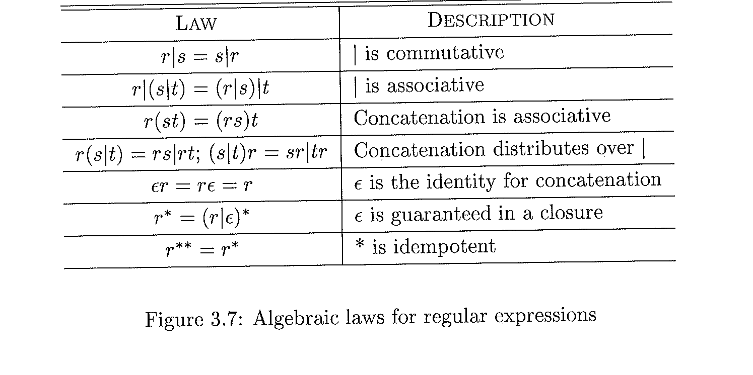
Algebraic laws can be used to show two REs are equivalent

Slide 34
Regular Definitions
For notational convenience, we may give names to RE and define RE using these names d_{i}→r_{i}
Where:
Each d_{i} is a new symbol, which is not in ∑, and not the same as any other of the d’s
Each r_{i} is a RE in { ∑ ∪ {d₁,…,d_{i-1}} }

Slide 35
Example.3.5 (pg 123)
E.g.,
C identifiers are strings of letter, digits, and underscore
They can be defined by following regular definitions:
letters → A|B|…|Z|a|b|…|z|-
digit →0|1|…|9
C_Identifier → letter_ (letter_ | digit)*

Slide 36
Example: Unsigned numbers in Pascal
Unsigned numbers in Pascal are strings
5280
78.90
6.336E4
1.89E-4
Regular definitions
digit →0|1|…|9
digits →digitdigit*
optional_fractions →. digits |ε
optional_exp →(E(+|-| ε) digits| ε
number →digits optional_fraction optional_exp

Slide 37
Shorthand Notation
Character classes
[abc] where a, b, and c are alphabet
Shorthand symbol to denote: RE a|b|c
E.g.,
[a-z] is shorthand for a|b|…|z

Slide 38
Limitation of RE
RE cannot be used to describe some programming constructs
E.g.,
Balanced parentheses
Repeating strings
L1= {wcw|w is a string of a’s and b’s(or (a|b)*)}
L1 consists of all words composed of a repeated strigs of a’s and b’s separated by a c, such as aabcaab
The language abstracts the semantics of define/usage
RE can be used for fixed or unspecified number of repetitions (arbitrary)

Slide 39
Recognition of Tokens
RE are used to specify pattern
Used mainly to specify pattern for ALL possible tokens in language
How to recognize tokens are totally different issues

Slide 40
Example
Consider the following grammar
Stmt→if exp then stmt
|if exp then stmt else stmt
|ε
exp →term relop term
| term
term →id
| num

Slide 41
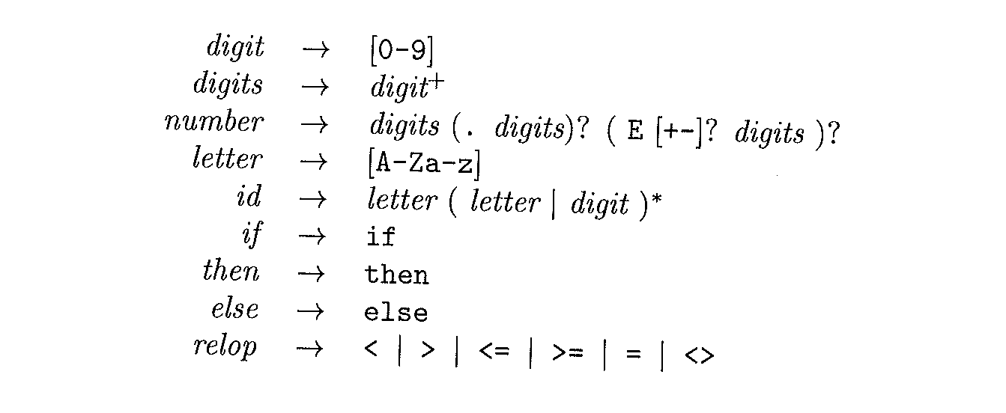
Using RE to specify patterns for the tokens

Slide 42
Goal: Building lex (LA)
Our goal is to build a LA that will identify the lexeme for the next token in the input buffer and generates as output a pair consisting of :
the token name
attributes
E.g.
Id: RE specifies Id and passes token id with its attributes to Parser

Slide 43
Transition Diagram
State Transition Diagram (STD)
An intermediate step but important step in implementing the LAX
Represents the actions that must take place when a LAX is called by the parser
Used to keep track of information about characters as scanned by forward pointer AND beginning pointer

Slide 44
Transition Diagram for relop

Slide 45
Recognition of Reserved words and Identifies
Recognizing key words and IDs can be a problem
Diagram can be used to recognize both IDs and Keywords

Slide 46
Approaches to handle reserved words
There are two ways to handle served words:
Install the reserved words in the symbol table initially
Figure 3.14
A call to InstallID() insert the new ID in the table if it is not already exist
A call to return GetTtoken() consults the symbol table and returns TOKEN NAME for the lexeme (ID or Keywords)
Create separate transition diagram for each key board

Slide 47
Complete Diagram for unsigned numbers

Slide 48
Transition Diagram for Whitespace
Where delim = {blank, tab, newline, etc.}

Slide 49
Simulation of TD for relop in C++

Slide 50
Simulation of TD for relop in C++
Sets the pointer forward and starts the next TD each time it is called
Works for TD of individual keywords

Slide 51
Lexical Analyzer: Implementation Approaches
General Approach to implement Lexical Analyzer (LA)
1. Tool such as Lex (easy)
2. Write the LA using Programming Language(moderate)
3. Write LA in assembly language (difficult)

Slide 52
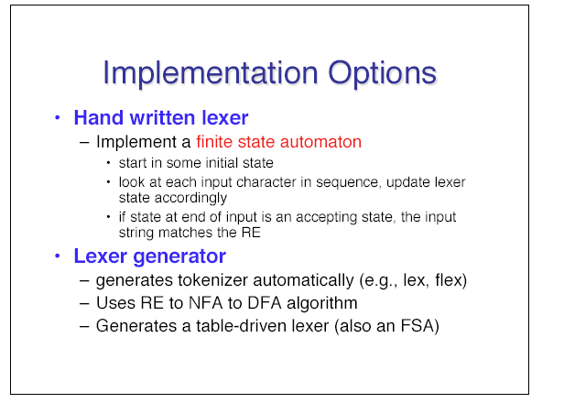
Main Approach

Slide 53
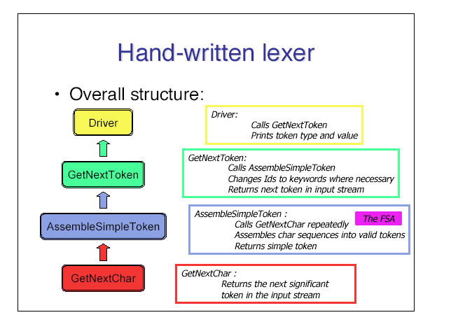
Hand written approach

Slide 54
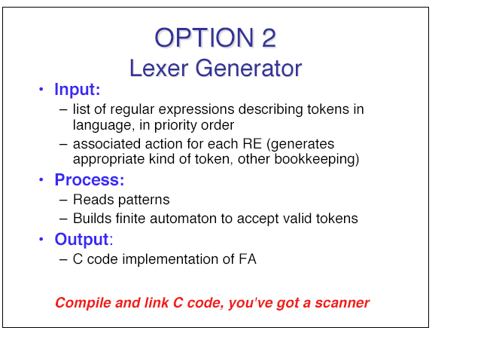
Option two: Using Tool to generate Lex

Slide 55
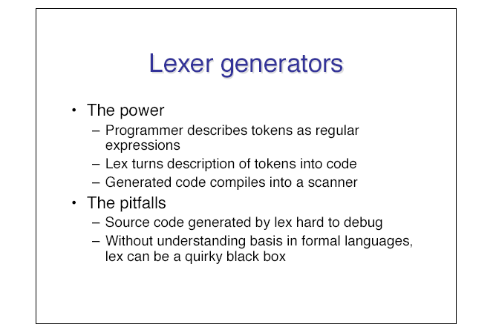
More on Lexer generators

Slide 56
Generating the Lexical Analyzer using LEX

Slide 57
The Lexical Analyzer LEX

Slide 59
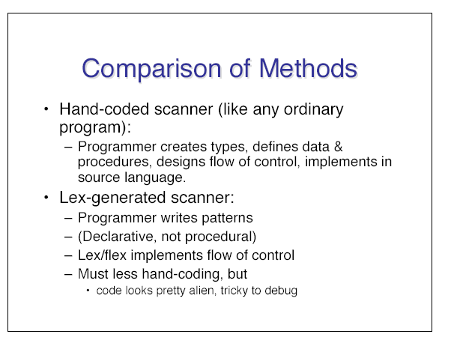
Some comparison

Slide 60
Finite Automata
Lex converts input program into a lexical analyzer using finite automata (FA)
FAs are recognizers
They say “yes” or “no” to each possible input string
FA comes in two flavors
Nondeterministic finite automata
Deterministic finite automata

Slide 61
Deterministic Finite Automata (DFA)
For every language defined by a RE, there exists a DFA to recognize the same language
FSA can be defined
M = (∑,Q,T,q₀, F)
∑: alphabet
Q: a finite set of states
T: Q×∑→Q a finite set of transition rule {partial function}
q₀: start state
F: final/halting states

Slide 62
Simple DFA
Input symbols
a d
a
A B
states
A
B
B B B
a
d

Slide 63
Simulating a DFA
INPUT: An input string x terminated by eof character. A DFA D with start state s₀, accepting F, and transition function move
OUTPUT: Answer “yes” if D accept string x; “no” otherwise

Slide 64
Simulating a DFA: Apply algorithm

Slide 65
DFA accepting (a|b)*abb
Input: string abaab,
Processing: the machine enters the sequences of states: 0,1,1,1,2,3.
Output: The answer is “yes”

Slide 66
Nondeterministic FSA (NDFA)
NDFA
- Differs from deterministic model in two ways
1) For any given state and input symbol, there may exist more than one transition
2) State transition can occur without reading an input token– this is called empty transition

Slide 67
RE= (a|b)*abb
NDFA
DFA

Slide 69
Quiz1:
Draw simple FA to recognize the following regular expression:
a(a|d)*

Slide 70
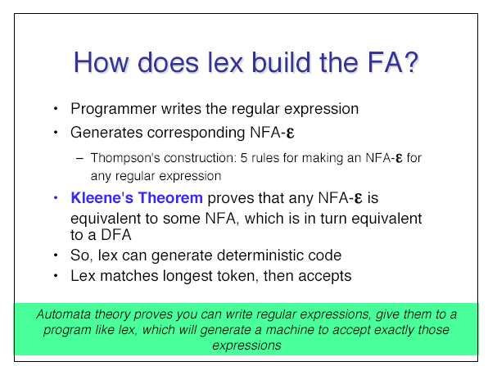
More

Slide 71
All kind of Transformation
There is all kind of transformation from
Automata to grammars
RE to grammars
RE to automata

Slide 72
Transforming Grammars to Automata and
We write scanner using regular grammars
An NDFA can be generated directly from the grammar using the following steps
The alphabet is the same
For each nonterminal in the grammar maps to a state in the NDFA with same name
Add the goal symbol maps to S as the start state S
Add one new state and make it the only final state

Slide 73
Example
For each production of the form A→ xB
Generate a transition in the NDFA: ϕ(A,x) =B
For each production in the grammar A→ x
Generate a transition in the NDFA: ϕ(A,x) =F
The resulting automation could be NDFA because it is possible to have two different productions in Regular grammar with same nonterminal on LHS

Slide 74
Transforming RE to CFG
RE production | CFG
R1: A→ xy | A→xB; B→ y
R2: A→x* y | A→xA|y
R3: A → x|y | A→x; A→y
R4: A→ B; B→x | A→x; B→x
R5 A→e ; B→ xA | B→xA; B→ x
R6: S→e {S is goal symbol) | G→S; G→e

Slide 75
Example: a(a|d)*
RE a(a|b)* to Grammar
S→ a (a|d)* <R6>

Slide 76
Example: a(a|d)*
RE a(a|b)* to Grammar
S→ a (a|d)* <R6>
Now the outer is concatenation
S→ a A
A→ (a|d)* <Apply R2: A→x*y where x = (a|b) and y = empty>

Slide 77
Example: a(a|d)*
RE a(a|b)* to Grammar
S→ a (a|d)* <R6>
Now the outer is concatenation
S→ a A
A→ (a|d)* <Apply R2: A→x*y where x = (a|b) and y = empty>
A→ (a|d) B
A→e
B→ (a|d) B
B→ e

Slide 78
Cont’
Apply distributive law to production
S → a A
A→ aB
A→ dB
A→e
B→ aB
B→ dB
B→ e

Slide 79
Cont’
Now eliminate the empty productions by R5
S → a A
A→ aB
A→ a
B→ aB
B→a
S→a
A→dB
A→d
B→ dB
B→ d

Slide 80
Transforming Regular Grammar to RE
Grammar Productions | RE Productions
R.1: A→xB; B→ y | A→ xy
R.2: A→xA|y | A→x* y
R.3: A→x; A→y | A → x|y

Slide 81
More

Slide 82
Implementing FSA on a Computer
Compilers are implemented as programs
How to implement FSA as program?
One Possible way
One variable of enumerated type to list all possible states
Use table representation of FSA
Store table as an array with state and symbol as indexes
Use a Boolean variable to signal termination of the FSA
Use Temporary variables to keep track of the current state and input

Slide 83
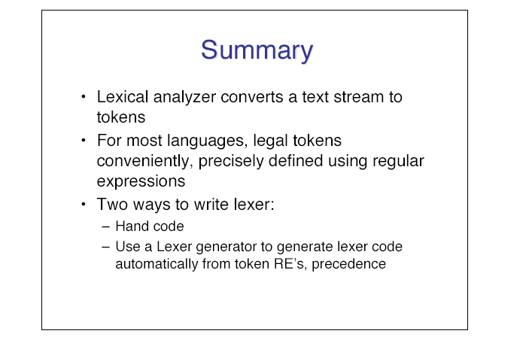
Summary

Slide 84
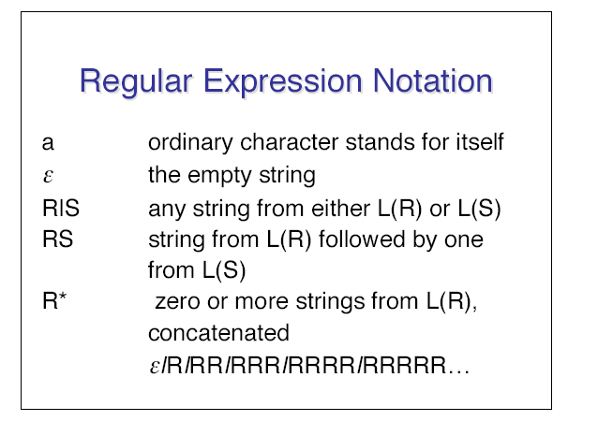
RE: Review

Slide 85
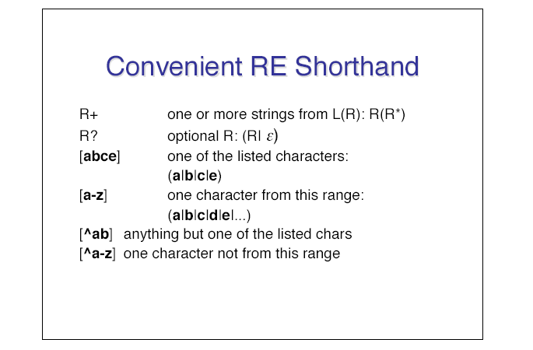
Short Hand notations

Slide 86
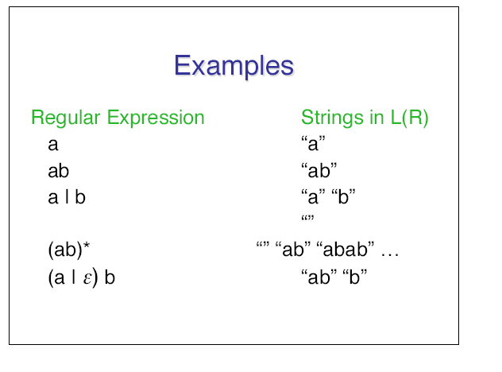
More and More Example

