Slide 1
Csci465: Chapter 5 Syntax Directed Definition/Translation
UND Colleague of Engineering and Mines
Department of Computer Science
Hassan Reza, Ph.D.

Slide 2
Objectives
Syntax directed definitions (readability)
Syntax directed translation (implementation)
L-attributes
S-attributes
Dependency graph
Attribute Grammar
Brief overview of Pascal
Applications of SDD/AG to translations
Type Checking
Code generations
Symbol Tables (scopes)
Nested tables

Slide 3
Semantic Processing
Given CGF
Easy to check the syntax (GOOD)
Difficult to check the semantic (BAD)
Scope resolution
Type checking
Array-bound checking
Define/usages
….

Slide 4
Syntax Directed Definitions (SDD)
SDD?
SDD = CFG+ Attributes+ Semantics Rules
Attributes are associated with grammar
Two type of attributes
Inherited
Synthesized
Rules are associated with productions
Ordering of the tree obtained by dependency graph using topological sort

Slide 5
Inherited and Synthesized Attributes?
Inherited
L-attributed grammars
Each attribute on L.H.S depends on attributes immediate to its left or Inherited attribute associated with head of A
Where A --> X₁ X₂ X₃... X_{n}. ;
X₂.a = f(X₁.a) or
X₂.a =f( A.a) or
X₂.a =f(A.a, X₂.a, X₃.a, X_{4.}a... X_{n.}a )
Notes:
Inherited attributes are used to represent dependency of programming construct (e.g., LV:= RV) on the context in which they appear.

Slide 6
SDD-S-attributed
S-attributed
The evaluation is from bottom-to-top
Can be implemented during bottom-up parsing (LR parsing)

Slide 7
S-attributes

Slide 8
S-attributes

Slide 9
Inherited Attributes (L-attributes)

Slide 10
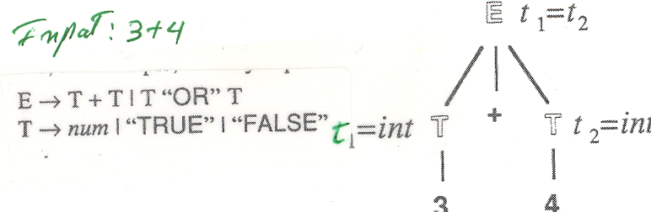
Example S-attribute: Type checking
E type is computed from the types of T1 and T2
Input: 3 + 4

Slide 11
Evaluating an SDD
How do we construct an annotated parse tree?
In what order do we evaluate attribute?

Slide 12
Annotated Parse Tree Desk Calculator

Slide 14
Order or Evaluation: Desktop
The order by which values are computed are important
How to order? dependency graph can be used to show how the values are computed

Slide 15
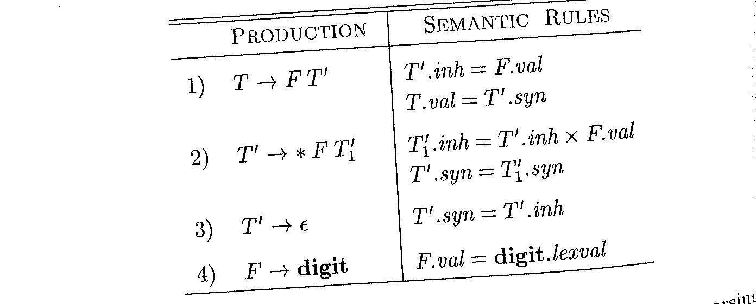
Example 5.3

Slide 16
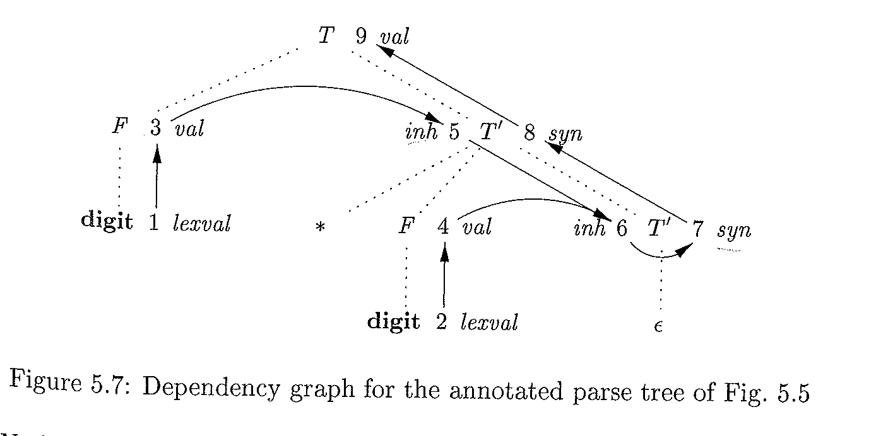
Input: 3 * 5
Notes:
Using both Synthesized and Inherited attributed

Slide 17
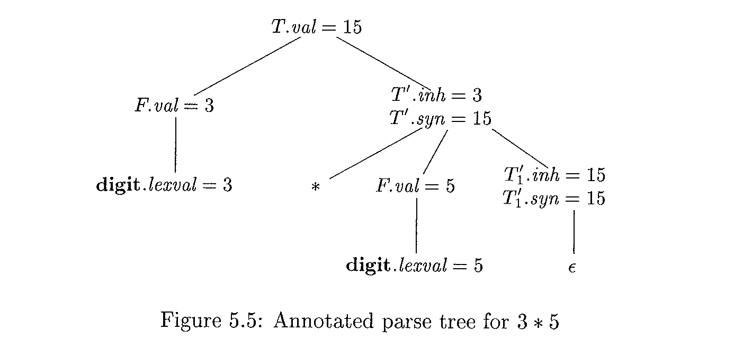

Slide 18
The Circular Dependency Problem (CDP)
it is difficult to guarantee that for any SDD having both inherited and synthesized attributes there is even ONE ORDER
Circular Dependency Problem (CDP)?
No efficient algorithm exists to show if there exists any circularities in any of PARSE TREE given by SDD
Notes:
CDP cannot be solved by a polynomial-time algorithm because it has exponential time complexity

Slide 19
Example
Production | Semantics Rule
A→B | A.syn = B.inh; B.inh = A.syn +1
A
A.syn
B.inh
B
Cycle in Dependency Graph

Slide 20
Attribute Grammar
Fully formed by D. Knuth [1968]
Adds semantics to the parse tree
Specifies the flow of context information through the grammar

Slide 21
AG: Formal Definition
AG is formally defined by
AG = (G, V, F)
Where
G = Context Free Grammar (CFG)
V = A finite set of attributes where each attribute associated with a single NT
F = A finite set of semantic actions (e.g., assertions and functions)

Slide 22
Attributes?
Attributes of an entity or object describe some features or characteristics
e.g.,
sense of humor,
size,
type,
color,
location,
Scope
…
If X = non-terminal symbol, then X.a denotes the value of a at a specific node X in Parse Tree

Slide 23
Knuth’s example of attribute evaluation
Consider the following CFG defined for fixed-point binary number
N→S “.” S
S→SB
S→B
B→ “0”
B→ “1”

Slide 24
Knuth’s example of attribute evaluation: 1
Consider the following CFG defined for fixed-point binary number
N→S “.” S [v=v₁+v₂; f₁=1 f₂= 2 ^{–L2} ]
S→SB [f₁ = 2*f; f₂=f; v=v₁+v₂; L= L₁+ 1]
S→B [L=1]
B→ “0” [v=0]
B→“1” [v=f]
Where
f : scale factor of power 2;
L: length
v: value

Slide 25
Knuth’s example of attribute evaluation: 3
Production Rules | Semantic Rules
N↑v →S↓f₁ ↑v₁ ↑L₁ . S↓f₂ ↑v₂ ↑L₂ | [v = v₁ +v₂; f₁ =1; f₂ = 2 ^{–L}₂ ]
S↓f ↑v ↑L → S↓f₁ ↑v₁ ↑L₁ B↓f₂ ↑v₂ | [f₁=2*f; f₂ =f; v =v₁+v₂; L= L₁ + 1]
S↓f ↑v ↑L → B↓f ↑v | [L = 1]
B ↓f ↑v → “1” | [ v =f]
B ↓f ↑v → “0” | [v = 0 ]

Slide 26
Adding S and L attributes
The N represents the entire binary number
N↑v :
representing the numerical value v of the number generated by the N
S↑L↓f ↑v
L = the length of string
B↓f ↑v
f = scale factor and is inherited from its parent S
represents the value of digit scaled by a power of 2; it depends on how far from the binary point it is.
v is the value
If digit is “1”, then v= f
If digit is “0”, then v=0
Notes:
About scale f: It represents the value of digit scaled by a power of 2; it depends on how far from the binary point it is (for integral part goes to left, for fractional part starts from the point and goes to right)

Slide 27
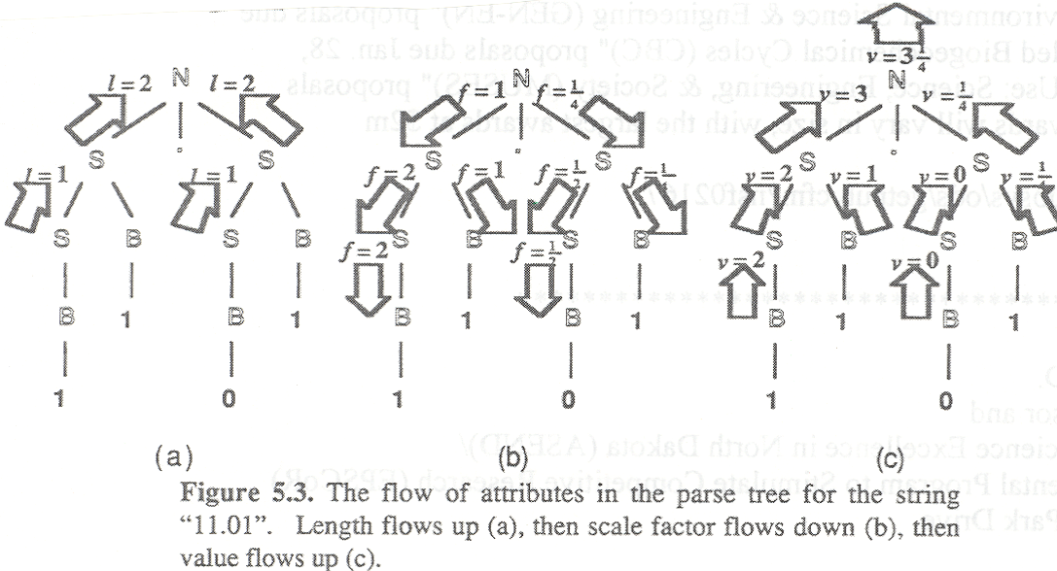
Fig.3 (G1)
f₁=1;
f₂ = 2^{-L2}=1/4
First compute Length (L)
Second, compute F using L, pass F down the tree
Using F, compute V (value) and pass it up to the root.

Slide 28
Fig.3 (G1)
First compute Length (L)
Compute L using the following semantics rules:
S → S B [f₁ = 2*f; f₂=f; v=v₁+v₂; L= L₁+ 1]
S→B [L=1]

Slide 29
Fig.3 (G1)
compute f using L, pass f down the tree
f₁=1;
f₂ = 2^{-L2}=1/4
First compute Length (L)
Using F, compute V (value) and pass it up to the root.

Slide 30
Fig.3 (G1)
Using f, compute v (value) and pass it up to the root.
First compute Length (L)

Slide 31
Attribute Value Flow
Evaluation can be done
Bottom-up (purely S-attributed)
Top-down (flow of global information and context information)
Left-to-Right (define/usage)
Right-to left (optimization how next time a variable can be used)

Slide 32
Example Left-to-Right evaluation
Consider the following Grammar: B→A
A→A A
A→’0’
A→’1’
A→∈
Input: 10011
B
A
A
A
A
A
A
A
A
A
A
A
A
∈
0
1
1
∈
0
1

Slide 33
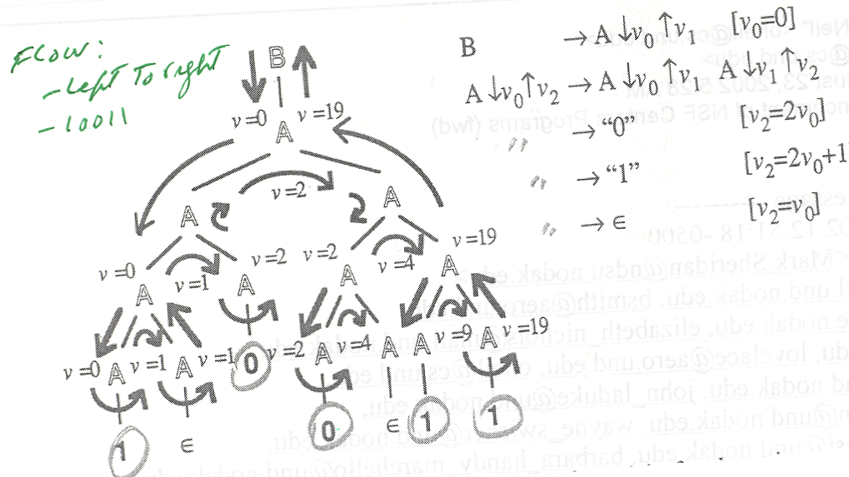
left-to-right Evaluation (top-to bottom)
Grammar:
B→A
A→A A
Input: 10011

Slide 34
left-to-right evaluation: bottom-to-top
Production | Semantic actions
D→T↑ L↓ | {L.In := T.type}
T → int | {T.Type := integer}
T → real | {T.Type := real}
L → L₁, id | {L₁.In := L.In} {Addtype (id.entry, L.in)}
L → id | {Addtype (id.entry, L.in)}

Slide 35
Parse Tree for L-attributes bottom to top
Type=real
D
Type=real
L.in =real
T.Type = real
L₁.in =real
,
r
real p, q, r
L₁.in =real
q
,
real
p

Slide 36
Rules using Inherited and Synthesized attribute
Having both Inherited and Synthesized
An inherited attribute for a symbol on R.H.S of the rule must be computed by the semantic action before that symbol
A semantic action must not refer to a S-attribute of a symbol to the right of the action
S-attribute for non-terminal on the L.H.S can only be computed after ALL attributes it references have been computed

Slide 37
Example of Non-L-attribute
Any SDD containing the following production and rules cannot be L-attributed:
Production Semantic Rules
A→ B C A.syn = B.val; //OK
B.inh = F (C.val, A.syn) // Not OK

Slide 38
SDD’s (AG) Applications
The evaluation of the semantic rules can be used for
Inferring expression type
Saving information into a Symbol Table
Generating Code (intermediate and final code)
Emitting Error messages

Slide 39
SDD vs. AG
In a syntax-directed definition (SDD), a semantic rule may just evaluate a value of an attribute or it may have some side effects (e.g., printing values or modifying some values)
Used where the attribute evaluation order can be determined from the semantic action inserted within the R.H.S (schema translation)
The evaluation order of semantic actions are based on Depth First Search (DFS) walk
An attribute grammar is a syntax-directed definition in which the functions in the semantic rules cannot have side effects (i.e., they can only evaluate values of attributes).
Also, it is not practical computing all of the attribute dependencies from the tree is hard

Slide 40
Symbol Table & Attribute Grammar (AG)
AG
constrain those syntactically corrected strings to meet the required semantics (meaning) in the strongly typed language
Example of constraints (rules) include:
type compatibility (type checking/type violation)
declared type of any variable or expression be consistent to its usage
define/usage (pre-declaration)
identifier must be defined before it can be used
…

Slide 41
Symbol Table: 1
How to enforce PLs constraints and context?
Adding attributes to programming constructs
Keeping these information in the symbol table
Maintaining the information properly
Example of information added to Symbol table:
Names /variables
types, scope of declaration, etc.
Array
number of dimensions, upper/lower bound, type
Procedures/functions
number of parameters, their types, and return type
Structures/records
list of fields

Slide 42
Symbol table: 2
Symbol table?
Data structure used to associate a set of identifiers (IDs) with their values/attributes
IDs’ information are modelled as record
E.g., information (type name, var name, procedure/function, constant, location in memory, etc.
Each symbol must be unique in the Symbol-table
think of Symbol table as a dynamic function F(ID)=unique name
The implementation of symbol table requires attention to details because every aspect of translation refers to the table.
The efficiency of access is very important

Slide 43
Symbol table: Operations
Two main mode of accesses
To add (write) a new ID and verify that the ID is not already exist
To find (read) a specific ID and retrieve its value
These two operations can be defined as functions
Other operations using Symbol tables can be
Is-Type-Ok()?
Is-ID-There()?
Is-ID-Unique()?
…

Slide 44
Symbol Table: Implementation
Can be implemented
Array
simple and inefficient
Linear List
simple and slow O(n)
Binary search Tree
fast and costly in space and time
O(log2 ^{n}) (e.g., O(log2 ¹²⁸ = 7)
Worst case may take n time
Hashed table
Elegant
Uses a hash function h, to map names to integers (index)
E.g. h(n): stores information about n in the table at h(n)
Quite fast
O(1) , O (n)

Slide 45
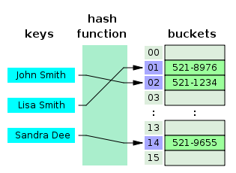
Hash Table

Slide 46
Potential Fields of symbol table
Typical attributes kept in symbol table
Name
the symbol’s identifier
Offset
the offset of symbol’s storage from value in base register (or beginning of arrays)
Register
name of register containing the symbol’s value
Scope
indicates where the variable’s name refers to a particular instance of the name

Slide 47
Symbol Tables and ID
Example of data associated with IDs
Type name
e.g., Real, Integer, etc.
Variable name
e.g.,myarray
Procedure name
e.g.,Quicksort
function name
e.g., myhash
Constant
e.g., UPPER_LIMIT
Etc.

Slide 48
Mode of operations
Two fundamental mode of access
to insert a new identifier with its value and to verify that the identifier is not already there
into: Symtable × ID × Value → Symtable
[into ↓oldsymtab ↓ ident ↓ value ↑newsymboltab] //i.e., add ID.value to the old symbol table and return new symbol table with no conflicting identifier
to query the identifier and retrieve its value
from: Symtable×ID →Value
[from↓Symtab ↓ident ↑ value ] //i.e. lookup for identifier in the symbol table and return its value

Slide 49
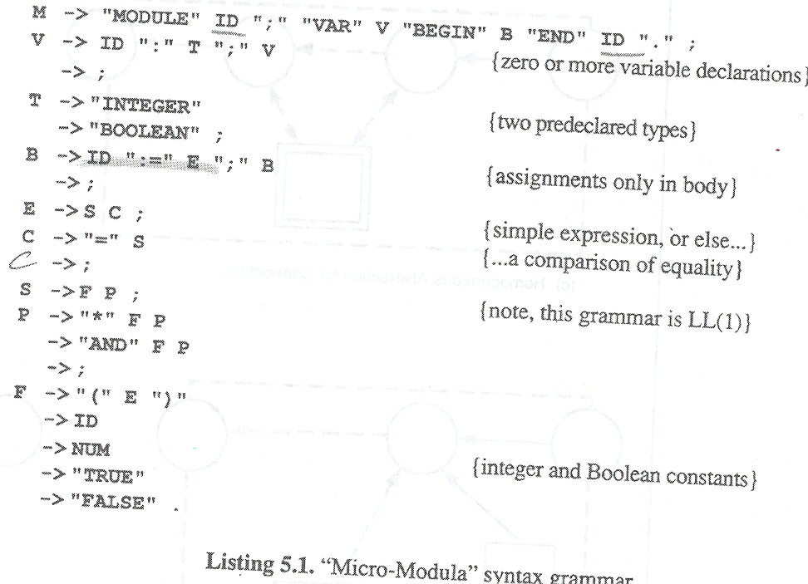
Listing 5.1
C

Slide 50
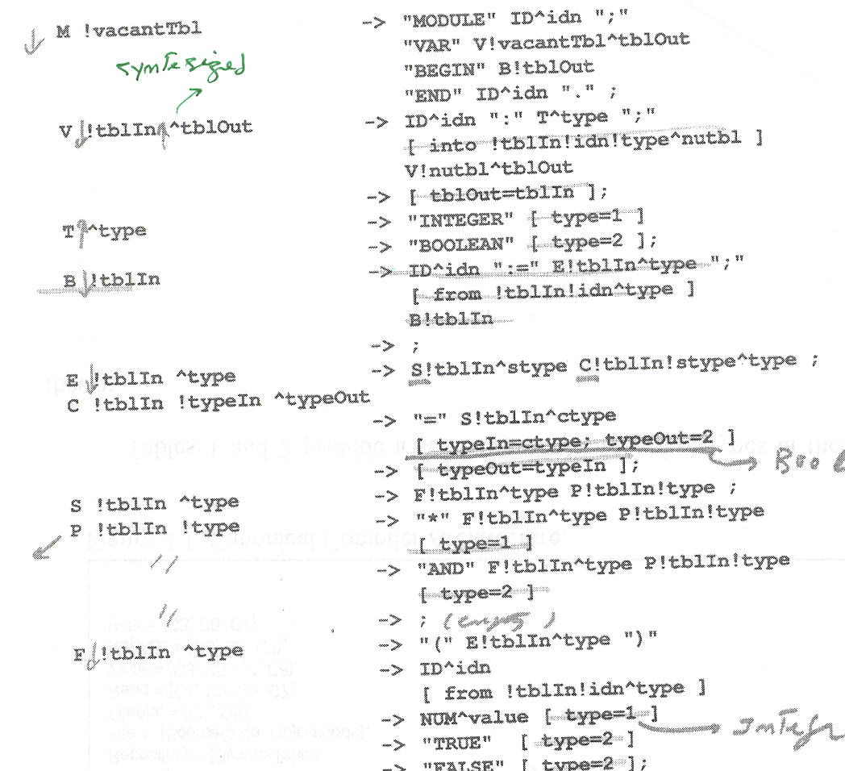
Listing 5.2 (type checking)
[typeIn=typeOut]

Slide 51
Overview of Pascal
Pascal
imperative and procedural programming language,
designed in 1968/9 and published in 1970 by Niklaus Wirth
enforces strong typing,
Supports block structured programming, and nested procedure and function calls
provides a syntax which is easy to read
Used as a high-level language for development in the Apple Lisa, (early years of the Mac).
In 1986, Apple Computer released the first Object Pascal implementation
Derivations include
Object Pascal (object oriented programming)
Concurrent Pascal (concurrent programming)

Slide 52
Example of BNF for Pascal
These are like the following:
Program::=PROGRAM identifier (identifier more_identifiers) ; block .
more_identifiers::= , identifier more_identifiers | ε
block::= Heading Body
Heading::= variables|constants|Functions|Procedures
Body::= BEGIN statement more_statements END
Statement ::=do_statement | if_statement | assignment | …
if_statement ::= If logical_expression THEN statement ELSE …
…

Slide 53
Program Outline in Pascal
The outline of a program
program heading
constant definitions
variable declaration
procedure/function declaration
body (Begin…End.)

Slide 54
Pascal code example
program GCD (input, output)
var i, j : integer;
begin
read (i , j)
while i <> j do
if i>j then i := i – j;
else j := j – i ;
writeln (i);
end .

Slide 55
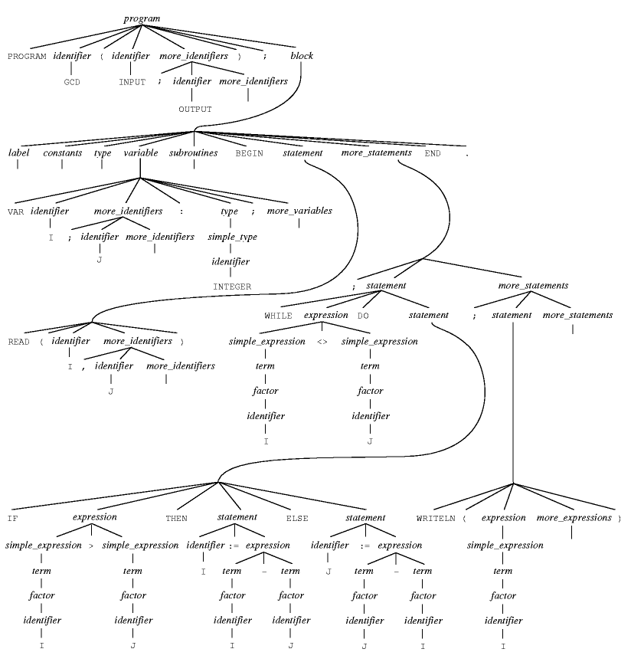
Example: parse tree

Slide 56
HelloWorld Program
program HelloWorld(output);
begin
Writeln('Hello world!') ;
end.

Slide 57
Functions
program MyFunctions; var Answer: Integer; function Add(i, j:Integer): Integer; begin Add := i + j; end; begin Answer := Add(1,2); Writeln( Add(1,2) ); end.

Slide 58
Procedures
program MyProcedures; procedure GetName; var Name: String; begin Writeln('What is your name?'); Readln(Name); if Name = '' then Exit; Writeln('Your name is',Name); end; begin GetName; end.

Slide 59
Scope in block oriented programming: 1
Scope?
Describes the realm of an identifier where the identifier is visible
The scope of an identifier (ID)
refers to the portion of a program (a block) in which ID continues to represent a particular value or action
Block structure

Slide 60
Scope in block oriented programming: 2
Program A
Procedure B
function D
begin [D]
….
End; [D]
begin [B]
…
end; [B]
procedure C
procedure E
begin[E]
..
End; [E]
function F
begin [F]
…
end; [F]
begin [C]
..
End; [C]
begin {A}
..
End. {A}
Program A
Procedure B
Function D
Procedure C
Procedure E
Procedure F

Slide 61
More on Scope
Identifiers defined in:
program A
procedure B
Procedure C
function D
procedure E
function F
Their scope is blocks:
A, B, C, D, E, F
B, D
C, E, F
D
E
F

Slide 62
Identifiers in block-oriented language
Identifiers in block-oriented language
must be unique if declared at the same level (or at same scope)
Same identifier can be used at different levels
identifier can be
Local variables
Global Variables
Formal parameters
identifier can be
Functions names
Procedures names

Slide 63
PASCAL: Adding Procedure Call
M → “Program” ID ProgramPar ‘;’ “Var” V H “Begin” B “End” “.”;
H → “Procedure” ID FP ; Var V H “ BEGIN” B “END” “;” H | ∈;
A → “(“ IDLT “)” “;” | “;” // Function call or Variable reference
V → ID “:” T; V | ∈
B →ID “:=“ E “;” B| “RETURN” E | ∈;
E → S C;
C → “=“ S | ;
S → F P;
P → “*” F P | “AND” F P | ;
F → “(“ E “)” | ID A | NUM| “True” | “False”
T → Integer| Boolean
FP → ‘(‘ OneFP { ‘;’ OneFP} ‘)’ // Formal Parameters
OneFP → Var V | V

Slide 64
More on Functions
The H defines the syntax of a functions by
Having a name and type
Having its own local variable
Having possible nested function declaration
Body statements

Slide 65
Example: A typical Function in Pascal
Function Call
a statement that represents a value
Function definitions
Statements that define a function
function Addtwo (First, Second:Integer): integer;
{represents the sum of its arguments.}
begin
Addtwo:=First + Second { return value}
end; {add}
The following line demonstrates how to call the function,
result := Addtwo(10, 20 ); // correct call
Addtwo(10, 20 ):= result // incorrect call

Slide 66
Example: A typical Procedure in Pascal
Procedure Call
a statement that represents a sequence of actions
Procedure AddInput; {read two numbers, print their sum.}
var First, Second: Integer; { local var }
begin
Readln (First, Second);
writelen(First + Second);
end; {addinput}

Slide 67
Subprogram scope
Once a procedure/function has been declared, its name has meaning in other parts of the program:
the main program’s statement part
the statement parts of subprograms declared after the procedure/function we’re concerned with
the statement parts of the procedure/function itself (recursion)

Slide 68
Symbol Table AND Function Call (FC)
One way to support Function/procedure call is to add Lexical level (lex) to symbol table
Add Open (evaluation function)
opens a new scope by raising the current lexical level of symbol table
i.e., adding a new level
Distinguish between variables, and procedure/function calls
E.g.,
FcCall(.. ):= Exper //wrong
Functions call cannot be used on L.H.S of assignment statements

Slide 69
Scope and symbol table:1
Need to introduce two types of entities:
Type (used to distinguish type information)
Kind (to distinguish between function calls and variables)
Type of information
Integer = 1
Boolean = 2
Kind of identifier
Variable = 3
Function = 4

Slide 70
Scope and symbol table:2
ID information can be
packed by multiplication “*”
unpacked by division “/”
Kind and Type can be encoded into identifier using packed values
Packed value = (kind * 10) + type
Some examples of packed values:
31: Integer variable
3*10+1=31
41: integer function
4*10 +1=41
32: Boolean variable
3*10 +2=32
42: Boolean function
(4*10 +2=42)
Unpacked
Kind = packedvalue/10
e.g., Kind=41/10=4
Type = packedvalue – (Kind * 10)
e.g., type=41-(4*10)=1

Slide 71
Scope and Symbol Table
Need to add the following functions (attribute evaluation Function)
OPEN
To add the scope
To check that the return type value is compatible with the type of function

Slide 72
Listing 5.1
C

Slide 73
Partial PASCAL Syntactical Rules
M → “Program” ID ProgramPar ‘;’ “Var” V H “Begin” B “End” “.”;
V → ID “:” T; V | ∈ { zero or more variables}
H → “Procedure” ID FP ; Var V H “ BEGIN” B “END” “;” H | ∈;
B →ID “:=“ E “;” B| “RETURN” E | ∈;
E → S C;
C → “=“ S | ;
S → F P;
P → “*” F P | “AND” F P | ;
F → “(“ E “)” | ID A | NUM| “True” | “False”
A → “(“ IDLT “)” “;” | “;” // Function call or Variable reference
T → Integer| Boolean
FP → ‘(‘ OneFP { ‘;’ OneFP} ‘)’ // Formal Parameters
OneFP → Var V | V

Slide 74
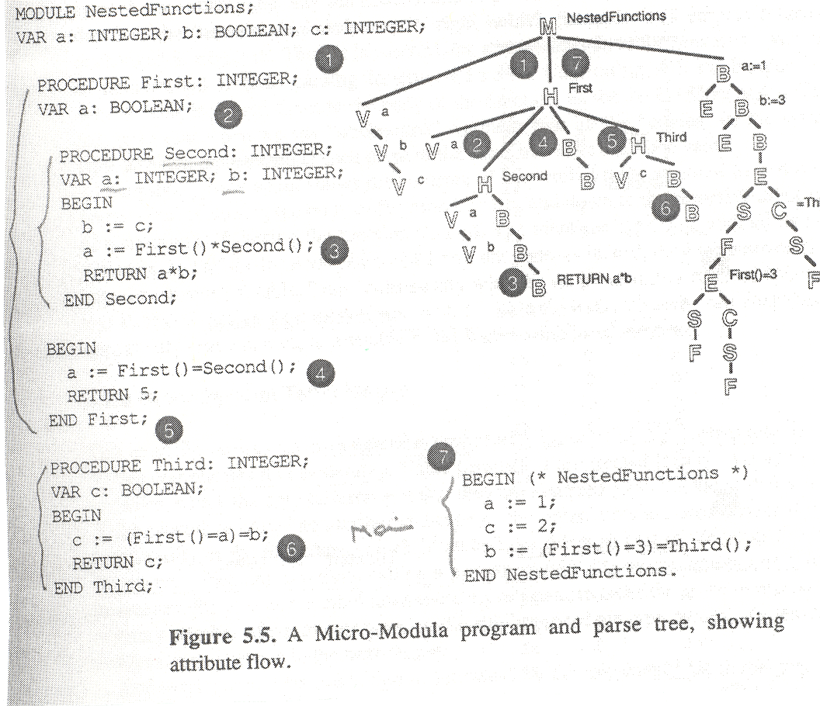

Slide 75
Current Lex=0; Snapshot 1
Symbol | Lex | Value
a | 0 | 31 (Integer variable)
b | 0 | 32(Boolean variable)
c | 0 | 31

Slide 76
Current Lex=1; Snapshot 2
Symbol | Lex | Value
a | 0 | 31
b | 0 | 32
c | 0 | 31
First | 0 | 41
a | 1 | 32

Slide 77
Current Lex=2; Snapshot 3
Symbol | Lex | Value
a | 0 | 31
b | 0 | 32
c | 0 | 31
First | 0 | 41
a | 1 | 32
second | 1 | 41
a | 2 | 31
b | 2 | 31

Slide 78
Current Lex=1; Snapshot 4
Symbol | Lex | Value
a | 0 | 31
b | 0 | 32
c | 0 | 31
First | 0 | 41
a | 1 | 32
second | 1 | 41

Slide 79
Current Lex=0; snapshot 5
Symbol | Lex | Value
a | 0 | 31
b | 0 | 32
c | 0 | 31
First | 0 | 41

Slide 80
Current Lex=1; snapshot 6
Symbol | Lex | Value
a | 0 | 31
b | 0 | 32
c | 0 | 31
First | 0 | 41
Third | 0 | 41
c | 1 | 32

Slide 81
Current Lex=0; snapshot 7
Symbol | Lex | Value
a | 0 | 31
b | 0 | 32
c | 0 | 31
First | 0 | 41
Third | 0 | 41

Slide 82
One symbol table or Many?
There are two common approaches to implementing block-structured symbol tables
A symbol table may be associated with each scope
All symbols may be entered into a single, global table
A single symbol table must accommodate multiple, active declarations of the same symbol
Could be very messy but searching is fast!!!

Slide 83
Individual Table
Individual table for each scope
Stack data-structure can be used for name scope with scope-opened/closed in last-in-first-out (LIFO)
The scope stack of symbol tables can be maintained with one entry in the stack for each opened-scope with innermost scope on top of the stack
When scope is closed, Scope-closed, the top symbol table is popped
Problem: we may need to search for a name in a number of symbol tables before the symbol can be found

Slide 84
Top of the Stack
Z: float
X float
X:int
W:int
F: function
G: procedure
A stack of symbol tables, one per scope

Slide 85
Other Symbol Tables Issues
Some issues related to parameters and typed languages
subroutine calls must adhere to the number and/or types of parameters
the syntax of subroutine calls must be parsed differently (PASCAL)
Variable parameters using VAR (reference call in C)
Value parameters (call by values in C)

Slide 86
A Simple Type checking Using SDD
Consider the following syntax grammar
E → S C
C→ “=“ S | ;
S → F P
Productions Rules | Attributes | Semantics Rule
C → “=“ S | C.inh.tableIn:Symtab; C.inh.Stype:Integer; “=“ S₁.inh.tableIn; S₁.inh.typeIn= C.inh.Stype; S₁.sys.Ctype:integer | if C.inh.Stype = C.syn.Ctype, then C.syn.typeout = 2
C → ; |  | C.typeout = C.Stype

Slide 87
Implementation of Attribute Grammar: C.Code
Procedure C (tablIn : Symtab; typeIn: Integer; Var typeout: Integer);
Var ctype: Integer { ctype local variable used to capture the type of compared operand}
Begin
if lookahead = ‘=‘ then
match (‘=‘);
S(tblIn, ctype) { Call S}
if Intype <> ctype then Error() end; { type checking}
typeout := 2
else
typeout := typeIn
end
End ; { end C}

Slide 88
How to Implement AG/SDD in Predicative Parsing
Create function/procedure for each Non-terminal
In arguments to the procedure/function include
each inherited attribute is passed as value parameter in the procedure call that implements the non-terminal
each synthesized attribute is passed as reference (VAR) parameter in the procedure call
each function is implemented as an assignment statement
each assertion is implemented as a conditional test whose alternative is “Error”

Slide 89
Translation During Recursive-Descent Parsing: 1
Input: A syntax-directed translation scheme with underlying grammar suitable for predictive parsing
Output: Code for the a syntax-directed translator (AG)
Method: A recursive-descent parser having a procedure A for each non-terminal A
The arguments for function/procedure A are the inherited attributes of non-terminal A
The return-value of function A is the collection of synthesized attributes of non-terminal A
the code for non-terminal A decides what production to be used based on the current input symbol

Slide 90
Translation During Recursive-Descent Parsing: 2
In the body of function A
Check that each terminal appears on the input when it is required
May need some local variables to preserve the values of all attributes needed to compute inherited and synthesized attributes
Call functions corresponding to non-terminals in the body of the selected production, providing them with the proper arguments.
Since the underlying Syntax Directed Definition (SDD) is L-attributed, we have already computed these attributes and stored them in local variables
For action, copy the code into parser, replacing each reference to an attribute by corresponding variable

Slide 91
Summary of Chapter
Attribute grammar or SDD
Dependency graph
Values at the head of edges computed in terms of values at the tails
S-attributes definitions
All attributes are synthesized
L-attributes
Attributes can be inherited or synthesized; inherited attributes depends only on inherited attributes of parents or sibling
Implementation based on recursive-descent LL(1)
Scope and modified symbol tables
Function/procedure calls

Slide 92
Acknowledgments and References
Guo Yao’s lecture at School of EECS Peking University, Advanced Compiler Techniques, Fall 2011.
Thomas Pittman/James peters. The art of Compiler Design, (Discussion of Attribute Grammar), Prentice Hall, 1992.

