Slide 1
Csci465: Principals of Translations Chapter 6: Intermediate Code Generations and Type checking
UND College of Engineering and Mines
Department of Computer Science
Hassan Reza, Ph.D.

Slide 2
Important Announcements: Nov.30.2017
Project Presentation (Date and Time)
The presentation has been scheduled on Tue. Dec.12 from 9:30 to 11:30a
The presenters are scheduled alphabetically according to their last names
The presentation length is 10 minutes, which include both PowerPoint and the project demonstration
The final exam
It will be take-home exam
The exam will be on the CSCI465’s course-website by Dec.7
The exam must be turned in by Dec.12!!!

Slide 3
Objective
The objectives are
Semantic analysis
Type systems
Static Type checking
Intermediate code generations
Translation using SDD or SDT

Slide 4
Type checking
Compilers ultimate job is to translate the input program into a form that can be executed on the target machine
Thing complier need to perform
check that the source program adheres to syntactic and semantics
know how the values are represented
know how the values flow between variables (flow-of-control) check
Uniqueness checks
…

Slide 5
A simple scenario
Consider a simple variable x and its corresponding executable code.
To emit the code, compiler needs to answer these questions:
What kind of value must be kept in x?
How big is x?
Is x an ID?
Is it a function name?
Is it a local variable ?
Is it a global variable?
Compiler uses declaration (e.g., C)

Slide 6
Checking?
Type Checking ?
The processes of identifying errors in a program based on explicitly or implicitly stated type information
Kind Checking?
The processes of identifying errors in a program based on kind of information
Variables
Functions/procedures
Static (Compile time) vs. Dynamic (Run-time) checking
Strongly typed language vs. weakly type language

Slide 7
Examples of static checking
Examples of static type checking
Type checks
Control flow checking
Uniqueness checking
Name-related checking
…

Slide 8
Type systems?
Type?
Refers to a se of common properties associated with each value of that type
Type systems?
Specifies the semantics of a valid program
Creates a knowledge base for both structure and behavior
Ensure run-time Safety (run-time errors using type checking)
Improve expressiveness (operator overloading/polymorphisms)
Improve Run-time efficiency by generating better code (e.g., addition when one of the operand is zero)
Type checker?
Verify that the actual type (or found) matches the expected type
e.g.,
Mod operation in Pascal expects the found types of operands to be integers

Slide 9
Example of Type checking:1
Type compatibility checks compatibility between operands
e.g., a[i] + a[i+1]
Flow-of-control checks
if a statement results flow of the control, then there must be a place where the flow can be transferred
e.g., break statements in C and enclosing statements

Slide 10
Type checking: names checking
uniqueness checks
When an object must be defined exactly once
e.g., an identifier in Pascal
named-related checks
When the same name must appear more than one times
e.g., a loop or program names in Modula-2

Slide 11
Type checker: Position
Some compilers combine type checking/checker and Intermediate Code (ICG) Generation with Parsing
E.g., Pascal
Parser
AST
Type checker
AST
ICG
ICG
Tokens

Slide 12
Why do we need type information?
Type information is needed by code generator
Examples:
Operator overloading (different implementation /ad hoc polymorphism)
A symbol that represents different operators in different context
e.g., “+” operators can be applied to Integers, real, and strings
Polymorphism(multiform)
Differs from overloading
A body of function is executed with arguments of different types
Notes:
In programming languages, ad hoc polymorphism^{[1]} is a kind of polymorphism in which polymorphic functions can be applied to arguments of different types, because a polymorphic function can denote a number of distinct and potentially heterogeneous implementations depending on the type of argument(s) to which it is applied. It is also known as function overloading or operator overloading. The term ad hoc in this context is not intended to be pejorative; it refers simply to the fact that this type of polymorphism is not a fundamental feature of the type system. This is in contrast to parametric polymorphism, in which polymorphic functions are written without mention of any specific type, and can thus apply a single abstract implementation to any number of types in a transparent way. This classification was introduced by Christopher Strachey in 1967.

Slide 13
The Idea behind Type Systems
Design of type checkers depends on
information about the syntactic constructs
the notion of types and type compatibility
the rules for assigning and/or computing types to language constructs (e.g., expressions)
Mapping between operand types and the result type
e.g., assignment-stmt :RV-type →LV-type
Where this information comes from?
reference manual

Slide 14
Example of using reference manual
Examples:
If both operands of the arithmetic operators of ‘+’, ‘-’, ‘*’ are type Integer, then the result is of type integer
The result of the unary “&” operator is a pointer to the object referred to by the operand.
If the type of the operand is integer, then the type of the result is pointer to integer

Slide 15
Type expressions?
The type of a language constructs will be denoted by a “type expression”
Type expressions could be
Basic (e.g., Integer, real, etc.)
Formed by applying type constructor to other type expressions
Where type constructor can be defined as an n-ary type operator taking as argument zero or more types, and returning another type.
Type expressions?
All basic types are considered type expressions

Slide 16
Type constructor: Example of Pointer
Type constructors make new types using existing ones.
The idea is familiar from C Language:
Pointer (B) (i.e., a pointer to a B)
Pointer (B) constructor has one input, B
Let B be the primitive type int , then Pointer(B) will return a type, namely, int pointer
In C, we write int* (i.e., a pointer to an object type integer)

Slide 17
Type Systems: 1
A type system
A set of rules for constructing new types from the existing types
A method for determining if two types are equivalent (or compatible)
Set of base types, or built-in types
Char, integer, void (or null), Real,
Specification using AG or SDT

Slide 18
Type Systems: 2
Two types
Basic types
Constructed types
Basic types (atomic types with no internal structure)
Boolean (AND/OR/XOR)
Characters (STRING OPERATIOSNS)
Numbers (Arithmetic operators)
Void (null value)
Constructed types (user-defined types)
types that constructed from basic types and other constructed types
Var A: Array [1..10] of integer

Slide 19
More on Type Constructors
Type constructors :
Type name (ident)
Type name (or ident) is a type expression denoting a type variable named ident (e.g., Class in C++)
Array:
if T is a type expression, then Array (I, T) is a type expression (where I is index and T is type)
E.g., Var A: Array [1..10] of integer; // associate the type expression array (1..10) with A
Pointer:
If T is a type expression, then Pointer (T) is a type expression denoting the type “pointer to an object of type T”
E.g., var p:↑row (i.e., declares var p to have type pointer row)
Record:
A type expression can be created by applying the record type constructor to the filed names and their type
E.g., if T1, T2, …,Tn are type expressions, then record T₁×T₂ …×T_{n} is a type expression representing the type of records s whose elements belong to types T1 … T_{n} respectively
Functions:
maps elements of one set (domain) to anther set (range)
E.g., mod: int × int →int
Function f (a, b:char): ↑ integer;
Type of f: char × char → pointer (integer)
Notes:
Type have structure, which can be represented by tree structure or graph.
Type constructors applied to type expressions to create type expressions

Slide 20
Example: Type expression for int [2][3]
The array int [2][[3] can be read as “array of 2 arrays of 3 integers each”, and written as a type expression of:
array (2, array (3, integer))
array
2
array
3
intgr
Notes:
Type expression and representation for 2d array. Array:
if T is a type expression, then Array (I, T) is a type expression (where I is index and T is type)
E.g., Var A: Array [1..10] of integer; // associate the type expression array (1..10) with A

Slide 21
Type checker
Type checker
implements a type systems
different type system can be used by different compilers
Main Type checking approaches
Static typing checking: checking done by a compiler
Dynamic type checking: checking done when the target program runs
A good type system attempts to eliminates dynamic checking as much as possible!
A language is strongly typed
if the compiler can guarantee that the programs it accepts will be executed without type errors
Notes:
Static typing [1]
A programming language is said to use static typing when type checking is performed during compile-time as opposed to run-time. In static typing, types are associated with variables not values. Statically typed languages include Ada, C, C++, C#, JADE, Java, Fortran, Haskell, ML, Pascal, Perl (with respect to distinguishing scalars, arrays, hashes and subroutines) and Scala. Static typing is a limited form of program verification (see type safety): accordingly, it allows many type errors to be caught early in the development cycle. Static type checkers evaluate only the type information that can be determined at compile time, but are able to verify that the checked conditions hold for all possible executions of the program, which eliminates the need to repeat type checks every time the program is executed. Program execution may also be made more efficient (i.e. faster or taking reduced memory) by omitting runtime type checks and enabling other optimizations.
Because they evaluate type information during compilation, and therefore lack type information that is only available at run-time, static type checkers are conservative. They will reject some programs that may be well-behaved at run-time, but that cannot be statically determined to be well-typed. For example, even if an expression always evaluates to true at run-time, a program containing the code
The conservative behavior of static type checkers is advantageous when evaluates to false infrequently: A static type checker can detect type errors in rarely used code paths. Without static type checking, even code coverage tests with 100% code coverage may be unable to find such type errors. Code coverage tests may fail to detect such type errors because the combination of all places where values are created and all places where a certain value is used must be taken into account.

Slide 22
Dynamic type checking
Dynamic Type checking
Refers to checking that can be done only dynamically
E.g.,
Table : array [1..255] of char;
i: integer;
Compute Table [i]?
Compiler cannot guarantee that during execution, the value of i will be in the rang 1..255
Error recovery
What if errors are caught during type checking?
It is a reasonable expectation that a type checker do something about them
send type checking error messages
report the nature and the location of errors
A desirable feature of type checker to recover from error!
Notes:
Dynamic typing [1]
A programming language is said to be dynamically typed, or just 'dynamic', when the majority of its type checking is performed at run-time as opposed to at compile-time. In dynamic typing, types are associated with values not variables. Dynamically typed languages include Groovy, JavaScript, Lisp, Lua, Objective-C, Perl (with respect to user-defined types but not built-in types), PHP, Prolog, Python, Ruby, Smalltalk and Tcl. Compared to static typing, dynamic typing can be more flexible (e.g. by allowing programs to generate types and functionality based on run-time data), though at the expense of fewer a priori guarantees. This is because a dynamically typed language accepts and attempts to execute some programs which may be ruled as invalid by a static type checker.
Dynamic typing may result in runtime type errors—that is, at runtime, a value may have an unexpected type, and an operation nonsensical for that type is applied. This operation may occur long after the place where the programming mistake was made—that is, the place where the wrong type of data passed into a place it should not have. This makes the bug difficult to locate.
Dynamically typed language systems, compared to their statically typed cousins, make fewer "compile-time" checks on the source code (but will check, for example, that the program is syntactically correct). Run-time checks can potentially be more sophisticated, since they can use dynamic information as well as any information that was present during compilation. On the other hand, runtime checks only assert that conditions hold in a particular execution of the program, and these checks are repeated for every execution of the program.
Development in dynamically typed languages is often supported by programming practices such as unit testing. Testing is a key practice in professional software development, and is particularly important in dynamically typed languages. In practice, the testing done to ensure correct program operation can detect a much wider range of errors than static type-checking, but conversely cannot search as comprehensively for the errors that both testing and static type checking are able to detect. Testing can be incorporated into the software build cycle, in which case it can be thought of as a "compile-time" check, in that the program user will not have to manually run such tests.

Slide 23
Runt-time Safety
Strongly typed languages (e.g., Pascal, Java)
Safety is a strong reason for using typed languages
Language implementation that guarantees to catch most type-related errors before they execute can simplify the design/implementation
Weakly typed languages
Variables don’t have specific types
conversions between unrelated types are done implicitly
E.g., C
Un-typed languages
E.g., Assembler
Notes:
The difference between a strongly typed language and a weakly typed one is that a weakly typed one makes conversions between unrelated types implicitly, while a strongly typed one typically prevent implicit conversions between unrelated types.
:
/* PHP code */
<?php
$foo = "x";
$foo = $foo + 2; // not an error echo $foo;
?>

Slide 24
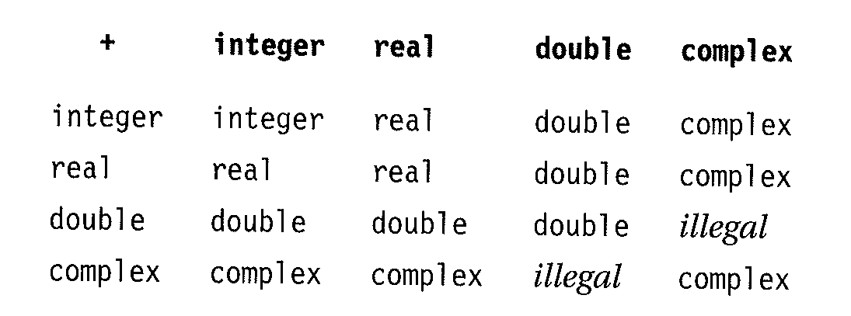
Ensuring Run-time safety
To eliminate run-time errors, the compiler must infer a type for each expression
e.g., Addition operation in FORTRAN 77 (a + b)

Slide 25
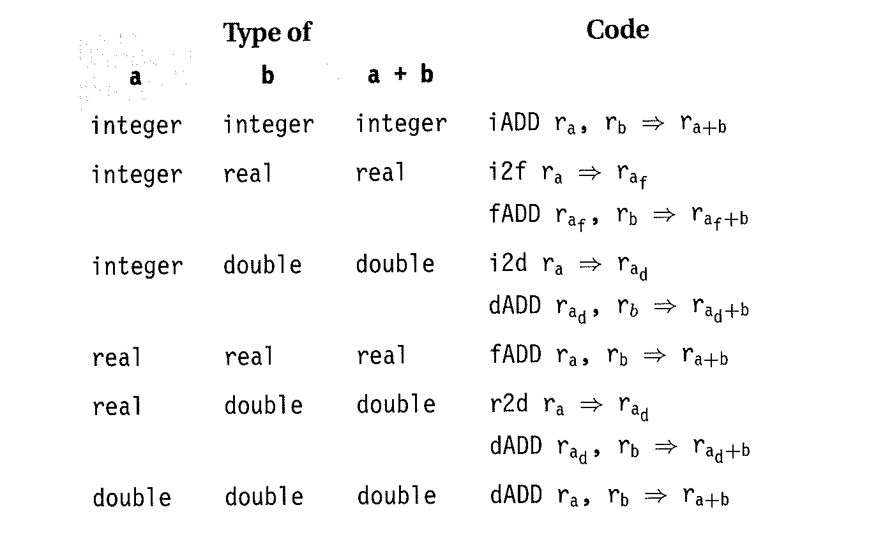
Generating Better CODE (Implementation of + in FORTARN 77)
The code on the right shows example of IC operation for addition operation together with conversion for mix-typed expressions
Intermediate Code
Intermediate Code

Slide 26
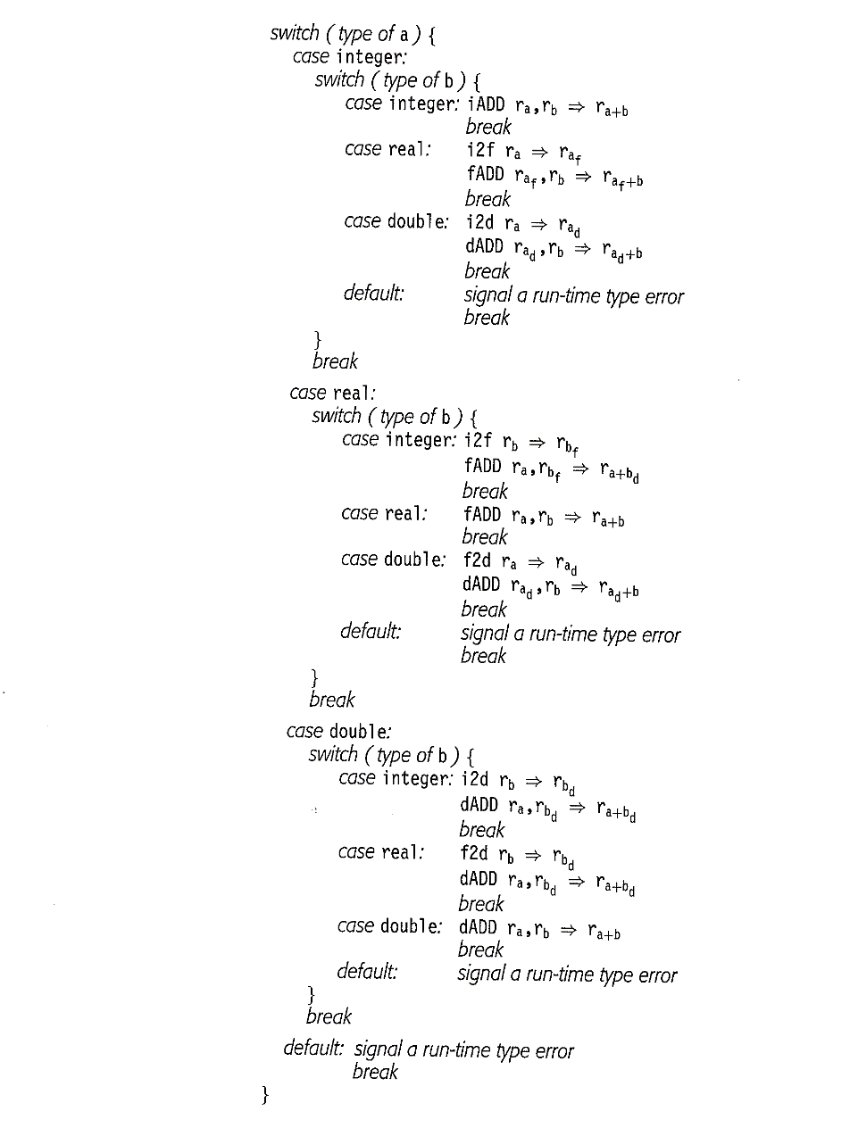
RUN-Time Checking and Conversion for + in FORTAN 77
Example of code for the language in which type checking differed until run-time

Slide 27
Compile-time vs. Run-time
In Strongly typed languages
All inferences and checking are done at compile time
Statically typed and statically checking refer to the implementation that perform all these work at compile time
Dynamically typed and dynamically checked

Slide 28
Type equivalence:1
Types MUST be checked for compatibility and equivalent
Examples include
Assignment statements
Formal and actual parameters of procedure/function calls
Compilers must detect and report any situation that violates the type incompatibility
e.g., found integers but compilers expected real

Slide 29
Type equivalence:2
An important element of any type system is the mechanism to decide if two different type declarations are equivalent
To compare two types, need to understand the notion of type equivalence
two types are equivalent iff
values of their types have the same representations
(i.e., one can be used where the other is required, and vs.)

Slide 30
Type equivalence:3
There are two notations of type equivalence
Name equivalence (used for almost all languages)
Structural equivalence (difficult to implement)

Slide 31
Name equivalence
Two types are name equivalent if they have the SAME NAME
e.g.
Type t1 = Array [1..10] of integer;
Type t2 = Array [1..10] of integer;
Are they name equivalent?
No, because they have distinct type definitions (names)
Java, and Ada use name equivalence

Slide 32
Name equivalence: 2
TYPE t3 = Array [1..10] of Integer;
TYPE t4=t3; Are they equivalent?
YES!
Name equivalence check is easy by compiler by just comparing the pointers

Slide 33
Structural equivalence
Two types are structurally equivalent iff
they have the same structure
same set of fields
same order
corresponding fields having the equivalent types
e.g.,
TYPE t5 = RECORD c: integer; p:↑t5; END
TYPE t6 = RECORD c: integer; p:↑t6; END
Examples of languages supporting structural type include
C, C++, and Algol 68
Difficult to implement because parallel parsing of two type descriptors is needed!

Slide 34
The applicability of types?
Types can be applied for
Type checking in which rules are used to reason about the behavior of the program at run time to ensure the types of the operands matches the type of expected by an operator
E.g.,
&& (AND Operator) requires both operands be defined as Booleans
Translation application in which the type of an identifier can be used to compute the storage needed for that identifier during program execution

Slide 35
Type checking (revisited)
To do type checking a compiler needs
to assign a type expression to each element of the source program
to determine if these type expressions conforms to rules for the source language
A sound type system eliminates the need for dynamic checking for type errors!!
Notes:
Ideas from type checking have been used to improve the security of the systems that allows software components to be imported. E.g., imported java code is check first before it can be executed to prevent both malicious behaviors or unwanted errors

Slide 36
Rules for type checking
Type checking can be done in two ways
Synthesis (computing)
Inference (context)
Synthesis
Compute the type of an expression using its sub-expressions
Requires define/use semantics
E.g. X + K

Slide 37
Type Inference
Type inference
computes the type of a language constructs from the context
E.g., function null(x) that tests if the list is empty
Used in the languages that do not require define/use
E.g., ML

Slide 38
Example of Inference Rules using functions
For each operator (e.g., +), type inference rules specify
The mapping from the operands type(s) to the result type
Simple mapping using assignment statement
Requires one operand (Lv) and one result (Rv)
Type of Lv must be compatible with Rv

Slide 39
Compiler and type error
Any type error must result in
REPORT error messages
INSERT conversion operation
E.g., In FORTRAN 77,
addition of integer and floating-point requires conversion of integer to floating-point before the addition

Slide 40
Type of declarations
Types are introduced in two ways:
Type declaration (explicit)
Anonymously (implicit)
Example of type declaration (explicit)
Type MyArray = Array [1..10] of Integers
Example of anonymously
Var a: Array [1..10] of real;
For anonymous declaration, compiler will expand the above by inserting
TYPE #type01_in_line_77 = Array [1..10] of real;
Var a : #type01_in_line_77

Slide 41
Type conversions
How about when we expect a value of type T1 but we find a value of type T2.
is this OK?
Type expected vs. type found
If T1 ≡ T2, then no problem
Else the rules are language-dependent
type Coercion
Implicit type conversion
type Casting
Explicit type conversion

Slide 42
Coercions (implicit type conversion)
The language definition specifies what conversions are necessary
In assignment statement:
The conversion is always to LV
In expression (x + k),
where x is real
and k is integer:
the compiler has to convert one of the operands of + to the other to ensure both having the same type
E.g.,: double d; long l; int i;
if (d > i) d = i;
if (i > l) l = i;
if (d == l) d *= 2;

Slide 43
Casting (explicit type conversion)
When programmers are required to convert type explicitly
Explicit conversion looks like function applications to type checker
double da = 3.3;
double db = 3.3;
double dc = 3.4;
int result = (int)da + (int)db + (int)dc; //result == 9
if implicit conversion would be used (as with "result = da + db + dc"), result would be equal to 10

Slide 44
Specification of a simple type checker
A simple type checker for a simple language using define/usage semantics
The type checker is specification of translation scheme
it synthesizes type of each expression using the type of its sub-expressions
P→D; E
D→ id:T | D; D |Ԑ
T→ char |integer| array [num] of T )|↑T
E→ literal | num | id | E mod E | E ( E )|E↑

Slide 45
Example of SAMPLE program generated
Program generated with grammar include
Key : integer
Key mod 2011
Array [256] of char
Key : ↑integer

Slide 46
Translation scheme to save variable declaration
P→D; E
D→D; D
D→ id: T {addtype(id.entry, T.type)}
T→ char {T.type := char}
T→ integer {T.type := char}
T→ array [num] of T {T.type :=array (1..num.val, T₁.type) }
T→ ↑T₁ {T.type := pointer (T₁.type)}

Slide 47
Type checking of expressions
E→literal {E.type:= char} // type of constant literal is char)
E→num {E.type:= integer} // type of constant number is integer)
E→id {E.type:= lookup (id.entry)} // get type and assigned to attribute type)
E→ E₁ mod E₂ {E.type:= if E₁.type = integer and E₂.type = integer then integer else type_error}
E→E₁ ↑ {E.type:= If E₁.type = pointer(t) then t else type_error}
// i.e., type of E is the same as type t of the object pointed to by the pointer E₁

Slide 48
Type checking of Programming Statements
PRODUCTION | SEMANTIC RULE
S → id := E | {S.type:= if id.type = E.type then void else type_error}
S → If E then S1 | {S.type:= if E.type = Boolean then S1.type else type_error}
S → While E do S1 | {S.type:= if E.type = Boolean then S1.type else type_error}
S → S1; S2 | {S.type:= if S1.type = void and S2.type = void then void else type_error}

Slide 49
Type checking of Statements (S)
Note: language constructs such as statements typically do not have values. The special basic type void is assigned to statements
S → id := E {S.type:= if id.type = E.type then void else type_error}
// checks that Lvalue and Rvaule of assignment are the same
S → If E then S1 {S.type:= if E.type = Boolean then S1.type else type_error}
//Checks that expressions in conditional statement is Boolean
S → While E do S1 {S.type:= if E.type = Boolean then S1.type else type_error}
//Checks that expressions in while statement is Boolean
S → S1; S2 {S.type:= if S1.type = void and S2.type = void then void else type_error}
// sequences of statements must have type void iff each sub-statment has type void; any type mismatch should generates type type-error

Slide 50
Type checking of functions
E→ E₁ (E₂) {E.type:= if E₂.type = s and E₁.type = (f(s)=t) then t else type_error}
Where f(s) := f: S→T for types S and T
Example
Root : (real →real) ×real →real
A function that takes as input a function from real to real, AND a real as arguments
Function root in pascal: (function f (real) : real; x: real): real;
Notes:
// expression is formed from the applying E₁ to E₂

Slide 51
Type-checking rules for coercion from integer to real
PRODUCTION | SEMANTIC RULE
E→num | E.Type := integer
E→num.num | E.Type := real
E→id | E.Type := lookup(id.entry)
E→ E1 op E2 | E.type:= if E1.type = integer and E2.type = integer then integer Else if E1.type = integer and E. type = real then real Else if E1.type = real and E2.type = integer then real Else if E1.type = real and E2.type = real then real Else type-error

Slide 52
How compute ID’s relative address using type
Using type of indenter, compiler can compute the storage and relative address of the identifier during compile
The address calculations can be specified in SDT
Width=the number of storage unit needed for the objects o type t

Slide 54
The storage computation for Int[2][3] using SDT
B

Slide 55
Csci465: Principals of Translations Chapter 6: Intermediate Code Generation
UND School of Aerospace Sciences
Department of Computer Science
Dr. Hassan Reza

Slide 56
Intermediate code generation(or Intermediate Representation)
Analysis-synthesis model of compiling
Front end
Parser
Static checker
Intermediate Code generation (IC)
Back end
Code generator
Combining front (N languages) and back (M machines)
N*M compilers

Slide 57
Back-end/Front-end

Slide 59
Benefits of IC
Advantages of using IC
Allows combining front and back into N+M compilers (i.e. retargeting)
A machine-independent code optimizer can be used for IC to produce more efficient code

Slide 60
Translating a program
The process of translation from source language to target machine may include as sequence of intermediate representation:
High level
Machine independent
E.g., C language
Low level
Machine-dependent
E.g., register allocation and instruction selection
Target code/machine code

Slide 61
Compiler and intermediate representations
In the process of translating a program from source language to target language, a compiler may built a sequence of intermediate representations
Examples of intermediate representations (languages) are
syntax tree,
postfix,
three-code addressing
C code
Java Bytecode

Slide 62
Intermediate representation (IR)
Three-address Code (3AC)
E.g., x = y op z
Where
y, z are operands
x is the result
Used for low level machine dependent tasks (register allocation, etc.)
Abstract Syntax tree
Represents hierarchical structure of the source program
Used for static type checking

Slide 63
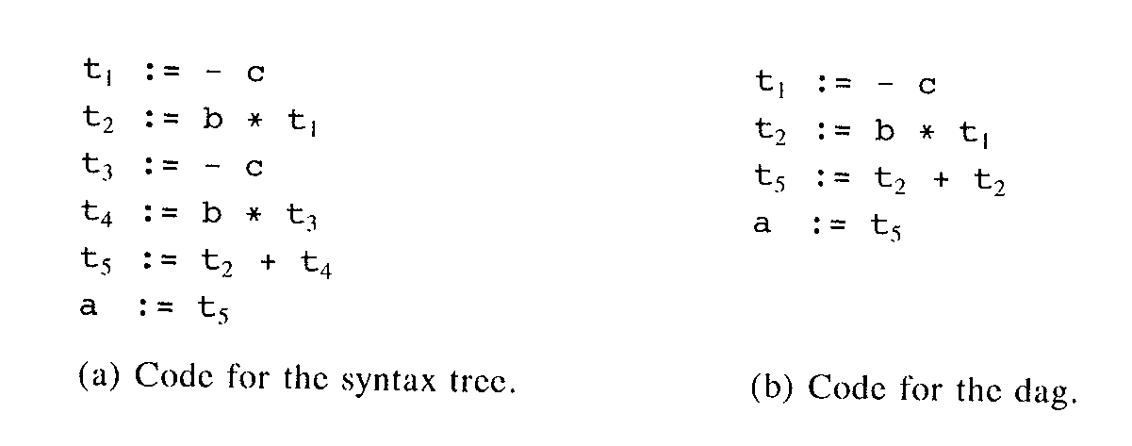
Three address code for EXPRESSION
Example: a:= b* -c + b* -c
a:= b* -c + b* -c

Slide 64
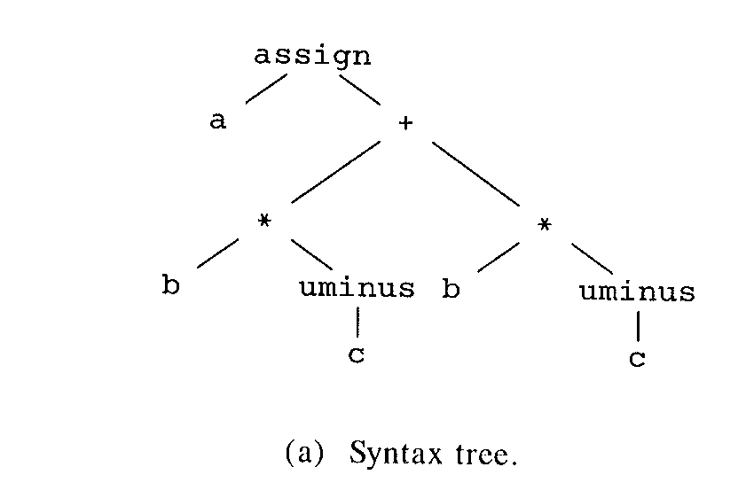
Syntax tree
Example: a := b * -c + b * - c

Slide 65
Variants of Syntax trees
Syntax tree
Nodes = constructs
Leaves = concrete/meaningful constructs
Directed Acyclic Graph (DAG)
A directed graph having no directed cycles
Used to represent expressions by identifying the common sub expressions (i.e., sub-expressions that may occur more than once)
Can be generated using the same technique as syntax trees
Read algorithm 6.3 on page 361

Slide 66
DAG (Directed Acyclic Graph) for expressions
DAG consists of
Leaves representing the atomic operands
Interior codes representing operators
A node N may have more than one parent iff N represents common sub-expressions
DAG
Used for generation of more efficient code when evaluating the expressions!

Slide 67
Example: a + a * (b – c) + (b - c) * d

Slide 68
Example of DAG
a + a * (b – c) + (b - c) * d
+
+
*
d
*
a
-
Common sub-expression Representing (b-c) twice
b
c

Slide 69
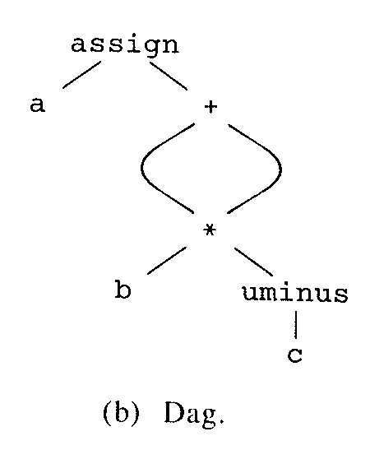
DAG
a := b * -c + b * - c

Slide 70
Three address code for EXPRESSION
a:= b* -c + b* -c
a:= b* -c + b* -c

Slide 71
SDD to generate syntax trees of DAGS
PRODUCTIONS
SEMANTIC RULES
E.node = new Node(‘+’, E₁.node, T.node)
E.node = new Node(‘-’, E₁.node, T.node)
E.node = T.node
T.node = E.node
T.node = new Leaf(id, id.entry)
T.node = new leaf( num, num.val)
E→E₁ + T
E→E₁ - T
E→ T
T→(E)
T→id
T→num

Slide 72
STEPS FOR CONSTRUCTING THE DAG FOR EXAMPLE a+a*(b-c) + d* (b-c)
P1 = Leaf (id, entry-a) //creates leaf node a
P2 = Leaf (id, entry-a) = P1 // reuse P1
P3 = Leaf (id, entry-b) // creates b
P4 = Leaf (id, entry-c) // creates c
P5 = Node (‘-’, p3, p4) //creates (b-c)
P6 = Node (‘*’, p1, p5) // creates a*(b-c)
P7 = Node (‘+’, p1, p6) // creates a+a*(b-c)
P8 = Leaf (id, entry-b)= P3 //reuse existing node
P9 = Leaf (id, entry-c) = P4 //reuse existing node
P10 = Node (‘-’, p3, p4) = P5 //reuse existing expression (b-c)
P11 = Leaf (id, entry-d) //creates d
P12 = Node (‘*’, p5, p11) // creates d* (b-c) using P5 & P11
P13 = Node (‘+’, p7, p12) // creates a+a*(b-c) + d* (b-c)

Slide 73
Nodes of A DAG
The nodes of syntax tree (DAG) can be stored in an array of records:
Each row is a record
In each record, the first field is an operation code
Operator s having two additional fields (left and right children)
Leaves have one additional field which holds the lexical value
Integer indexing is used to refer to the nodes

Slide 74
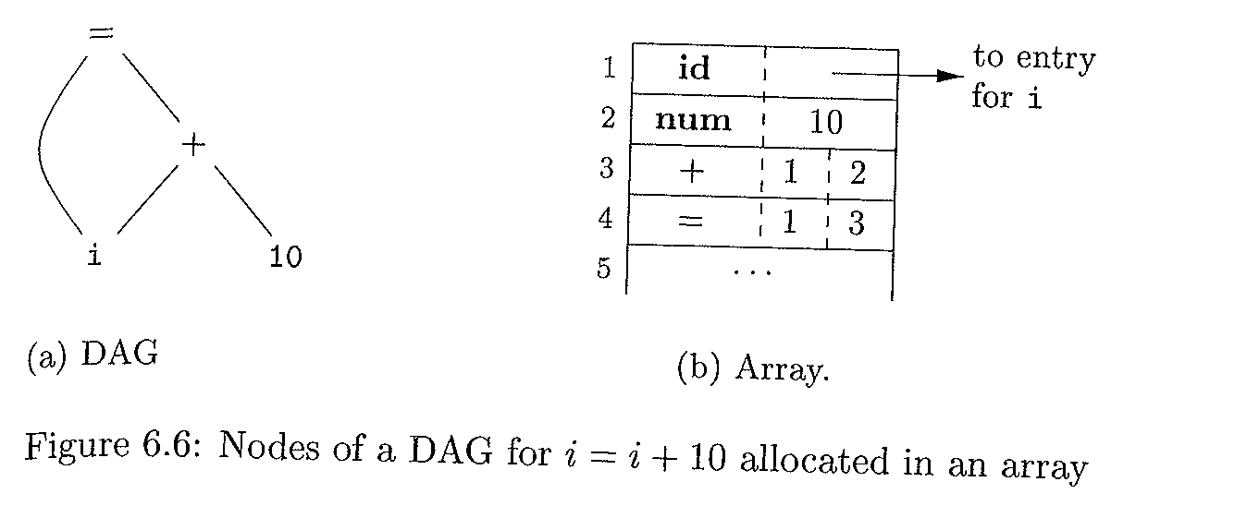

Slide 75
Three-address code (3AC)
In 3-address code
Linearized representation of syntax tree or DAG
At most one operator on the R.H.S of an instruction
No build-up arithmetic expression are permitted
Expression like x*y+z represented as
t1 = y * z
t2 = x + t1
Where t1, and t2 are compiler-generated temporary labels/names
3-address code suitable
Target-code generation (code can be reorder easily)
Optimization

Slide 76
Example 6.1: DAG (3AC)
Example: a + a * (b – c) + (b-c) * d
t1 =b –c
t2 = a * t1
t3 = a + t2
t4 = t1 * d
t5 = t3 + t4
+
+
*
d
*
Represents a twice
a
-
Represents b-c twice
b
c

Slide 77
3-address mode: addresses & instructions
Three-address code is built from two concepts
Addresses
Instructions
Can be implemented by Records with fields
e.g. quadruples:
op, arg1, arg2, results
An address can be
A name
Use source program names as addresses
In an implementation, a name is replaced by a pointer to its symbol-table entry
A constant
Different types of constants (e,g., integers and real numbers)
A compiler-generated temporary
Creates unique name each time a temporary is needed

Slide 78
3-address mode: Instructions SET ( 1)
Here is a list of the common 3-address instructions forms
Assignment: x = y op z // where op is binary operator
Assignment: x = op y // where op is unary operator
Copy instructions: x =y // where x gets the value of y
An unconditional jump goto L.
the 3-address statement with Label L is the next instruction
Conditional jumps such as if x relop y goto L, which uses a relational operators

Slide 79
3-address mode: Procedures
Procedure calls param x₁, param x₂, …, param x_{n}, call p, n
y = call p, n for function call
Indexed copy instructions
x = y[i] // sets x to the value in the location i-memory units beyond location y
x[i] =y // sets the contents of the location i- memory units beyond x to the value of y
Address and pointer assignments
x = &y // sets value of x to location y) ,
x = *y // copy the content of address pointed by y to x ,
*x =y // sets the rvalue of object pointed to by x to the rvalue of y

Slide 80
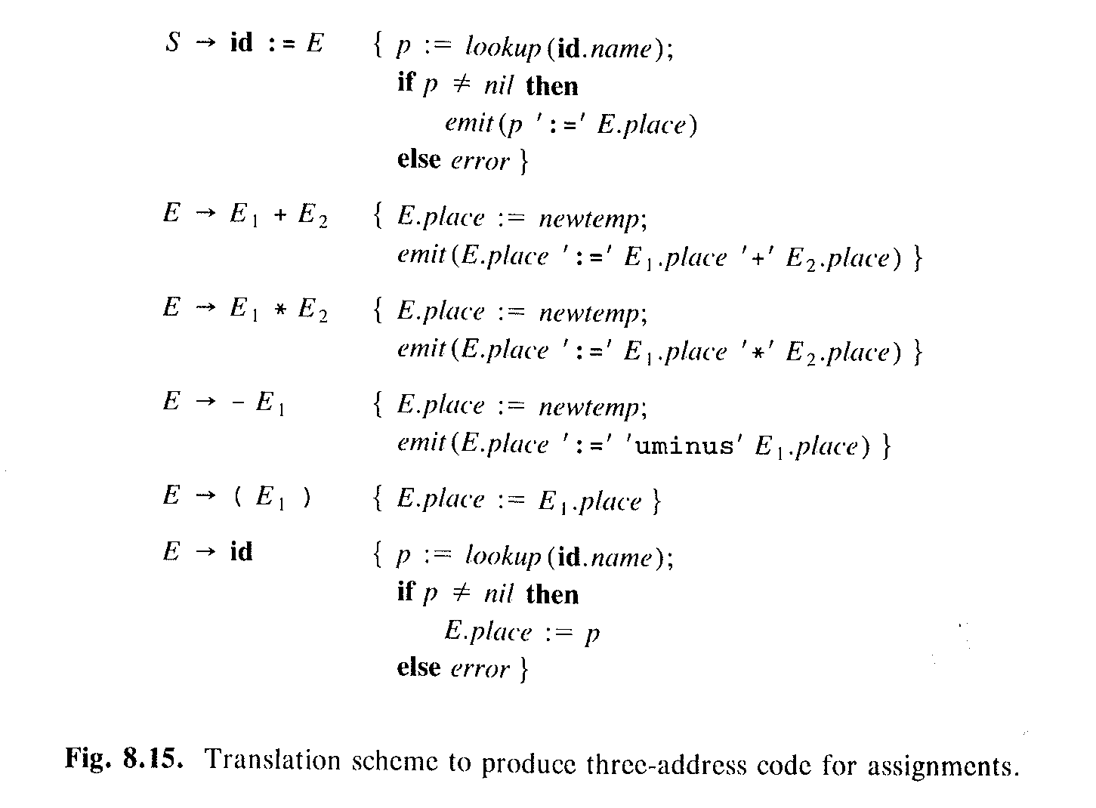
Translation scheme for 3-AC generation of assignment
Checks to see if there is an entry for id.name exists in symbol table
Emits three-address code to output file

Slide 81
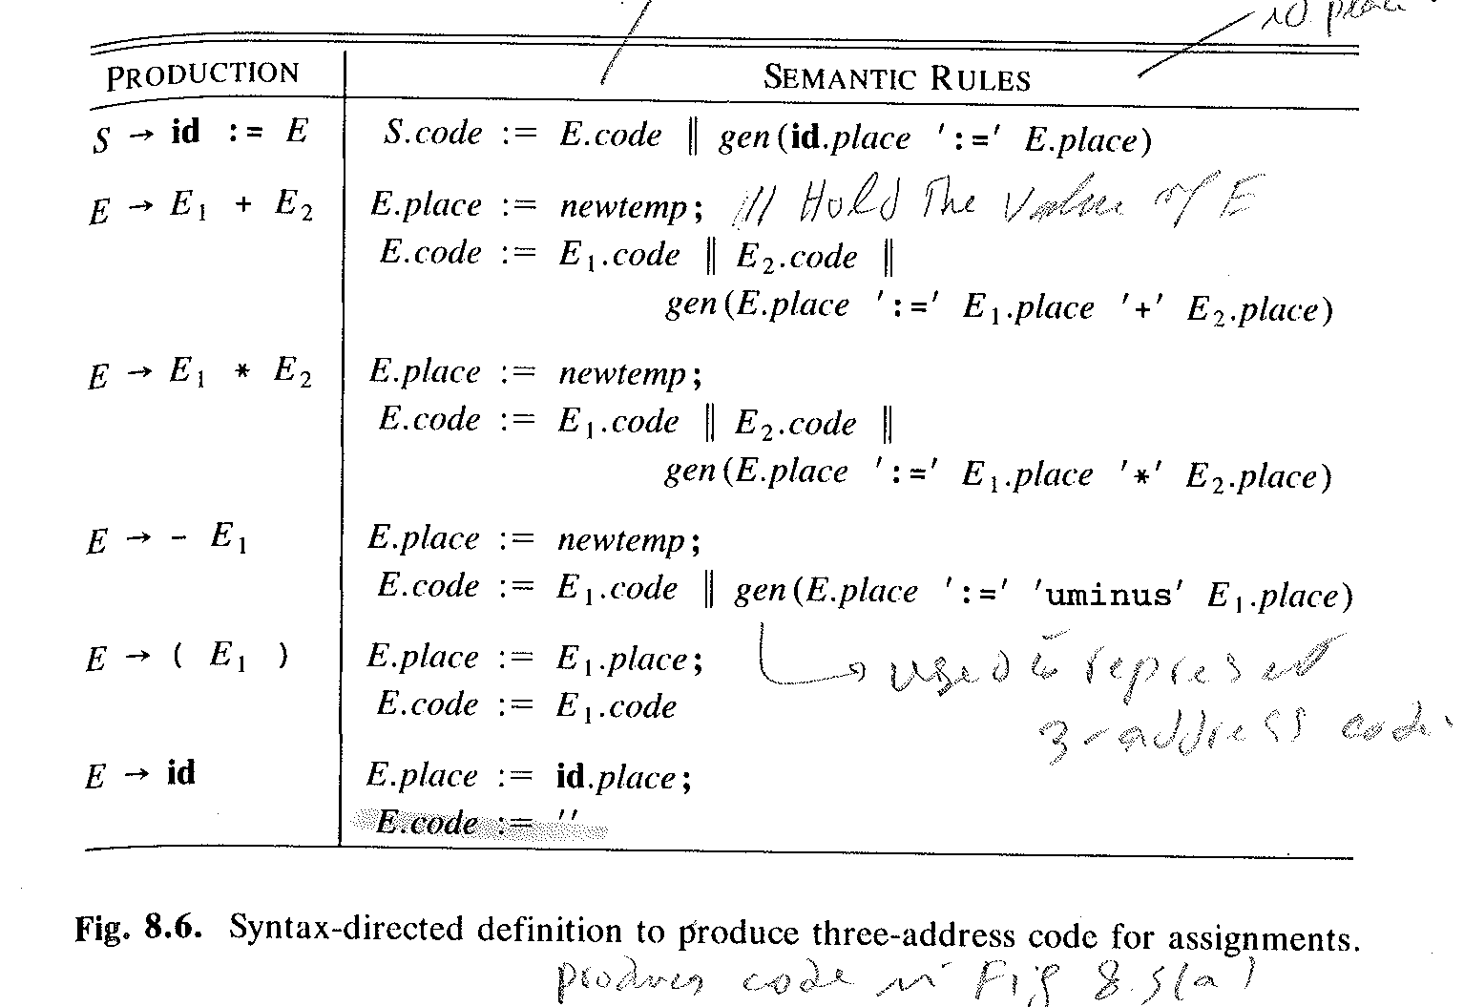
SDD to emit 3-AC for Assignment Statement

Slide 82
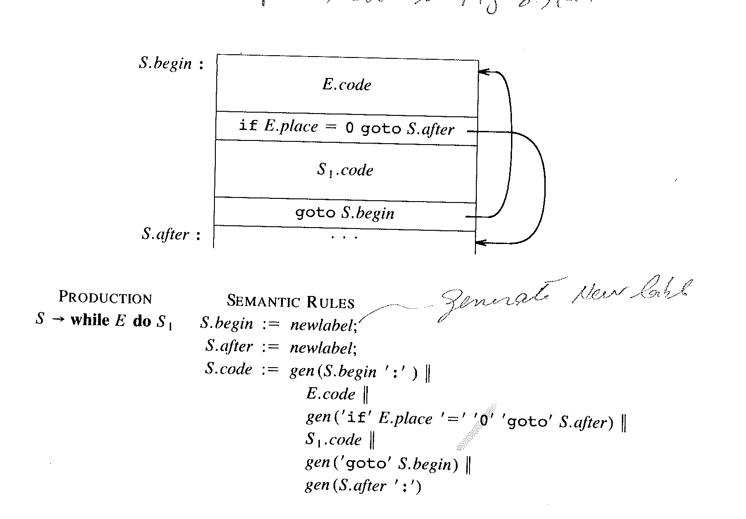
SDD to emit 3AC for While-DO

Slide 83
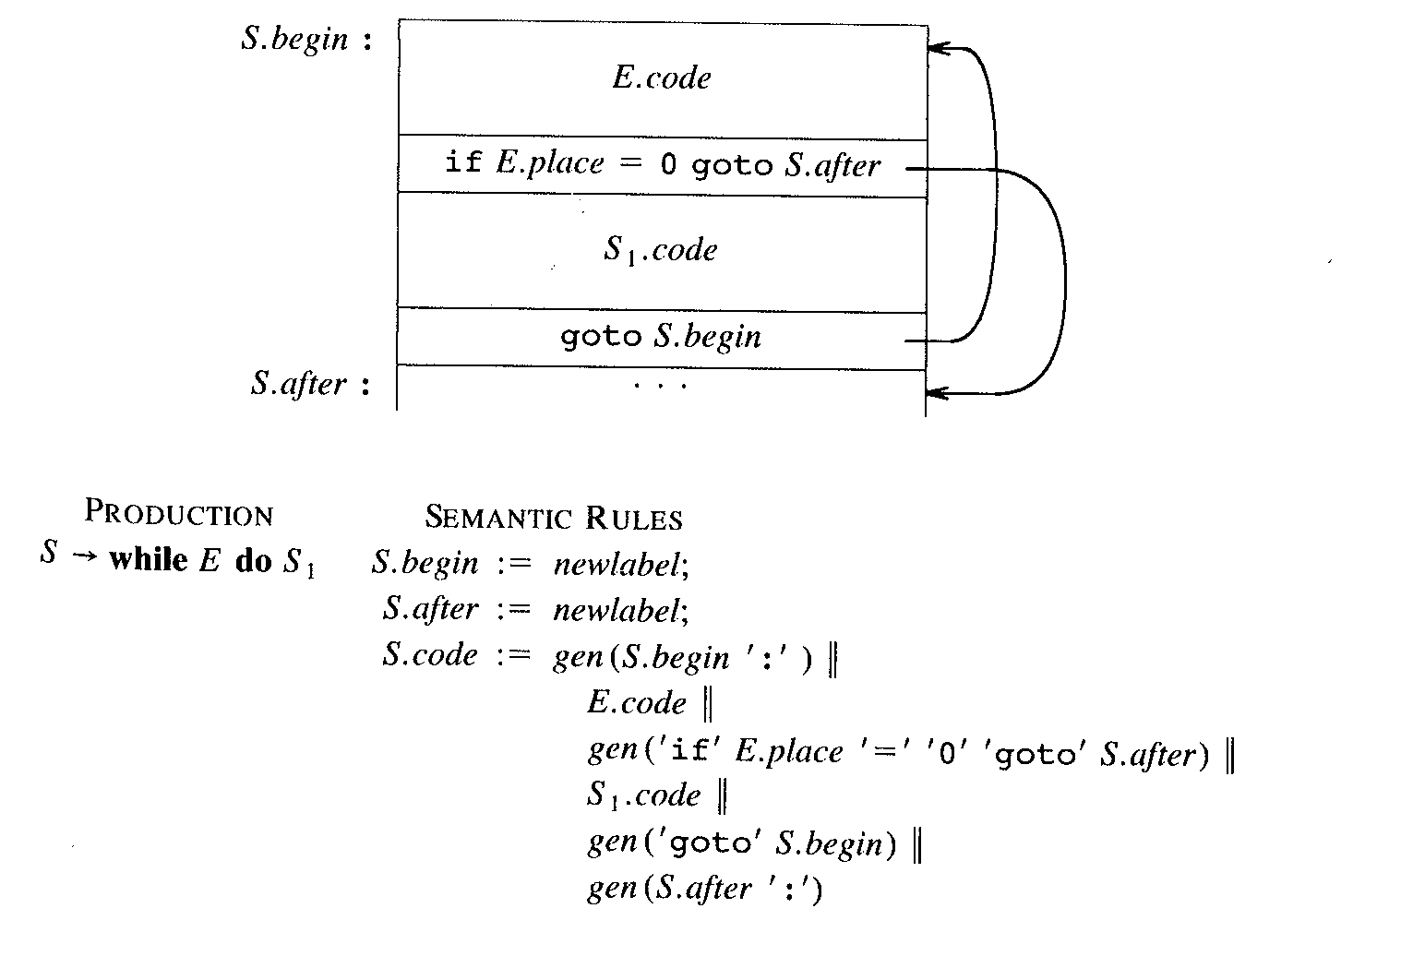
SDD to emit 3AC for While-DO (annotated)
E.Code is a synthesized attribute representing a 3-addree code for E
Encoding true or false using
numerical value 0 or 1
S.Code is a synthesized attribute represents a 3-addree code for S
E.place is the temp-name holding
the value of E

Slide 84
translating High level statement into 3-address code (3-AC)
Given the statement
do J = J+1; while (a[J] < v);
Can be translated using
symbolic label
position number
Symbolic Label version
L: t₁ = j + 1
j = t₁
t₂ = j * 8 //if each array element takes 8-bytes
t₃ = a [t₂]
if t₃ < v goto L

Slide 85
Using position numbers
100: t₁ = j + 1
101: j = t₁
102: t₂ = j * 8 //if each Array element takes 8-byte
103: t₃ = a [t₂]
104: if t₃ < v goto 100

Slide 86
Implementation of 3-AC: Quadruples
The three-address code
specifies the components of each type of the instruction but not their representation
These instructions can be implemented as objects or as records with fields for
Operators
Operands
The representations can be
Quadruples (op, arg1, arg2, result)
E.g.. x = y + z ( +, y, z, x)
Triples (op, arg1, arg2)
Refers to the results by position
E.g. refers to the result of x op y by its position instead of temporary

Slide 87
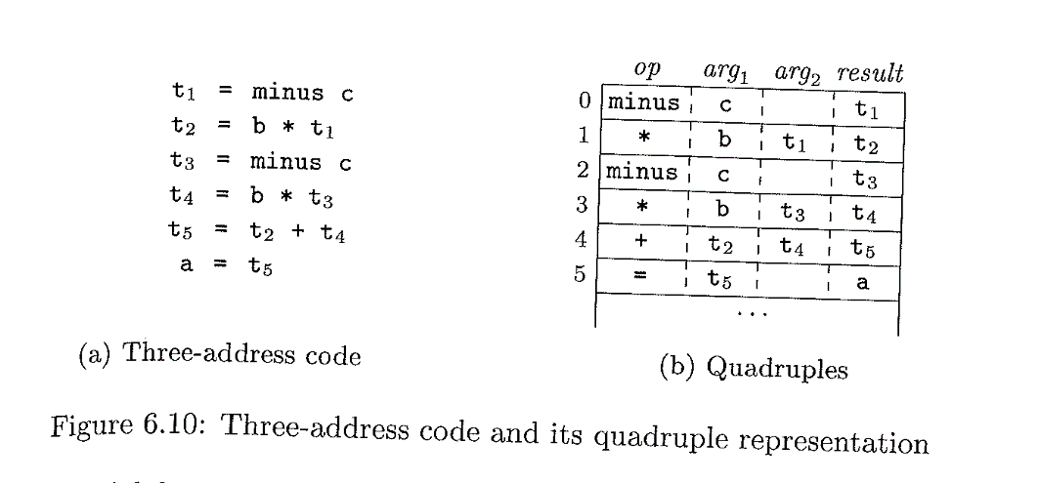
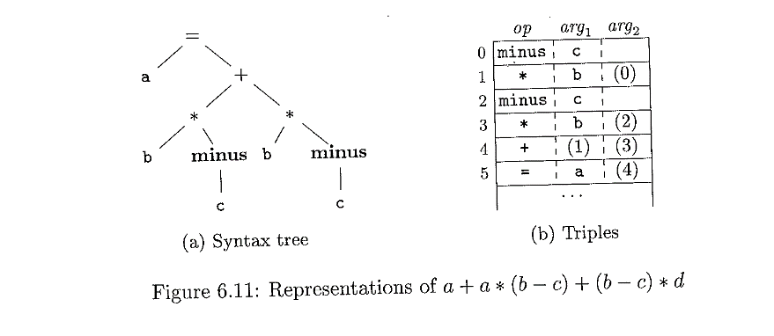
Two implementation of three-code instructions:
Instead of t1 it uses the position (0)
e.g., a:= b * -c + b* -c
Note about quad:
1- unary instruction like x minus or x = y do not use arg2
2-operators like param use neither arg2 nor result
3-Conditional and unconditional jumps put the target label in result

Slide 88
Boolean expressions
In programming languages, Boolean expressions serve two important purposes:
used to compute logical values (assignments)
used as conditional expressions in statements that change the flow of control
Examples of statements include
IF/THEN,
IF/THEN/ELSE,
WHILE/DO
Repeat/Until
Etc
Boolean expressions are combined using Boolean operators (AND/OR, NOT)

Slide 89
Boolean expression: 2
Boolean operators applied to Boolean operands such as Boolean values (True/False) or relational expressions
Relational expressions are of the form
E1 relop E
Where
E₁ and E₂ are arithmetic expressions
relop ∈ { <, <=, <>, >, =, >=}
E.g. x+2>y-3

Slide 90
Boolean expression: 3
E→ E OR E |E AND E| NOT E | (E) | E rel E |true| false |Id
Given E1 OR E2
if E1 is true, then E is true
Given E1 AND E2
If E1 false, then E is false

Slide 91
Methods of Translating Boolean Expressions
Two methods of representing the value of Boolean expression
Encode true and false numerically and treat them like numerical expressions
E.g.,
let
nonzero = true;
zero (or negative) = false ;
Use flow of control and their positions in the code to implicitly represent the Boolean value
Natural fit for control- oriented statements such as if-then and while-do
E.g.,
given E1 OR E2, if E1 is true, then using the properties of OR we can conclude that the entire expression is true; no need to evaluate E2

Slide 92
Numerical Representation
Consider implementation of Boolean expression using
1 = true
0 = false
Evaluating from left-to-right and using precedence rules fro NOT, AND, OR
E.g.,
a OR b AND NOT c ≡ (a OR (b AND (NOT c)))
Three address code
t1 := NOT c
t2 := b AND t1
t3 := a OR t2

Slide 93
Numerical Representation: Relational operators
For relational expression such as a<b, the method treats them like conditional statement
If a < b then 1 else 0
Three address code (3-AC)
100 if a < b goto 103
101 t := 0
102 goto 104
103 t:=1
104: …

Slide 94
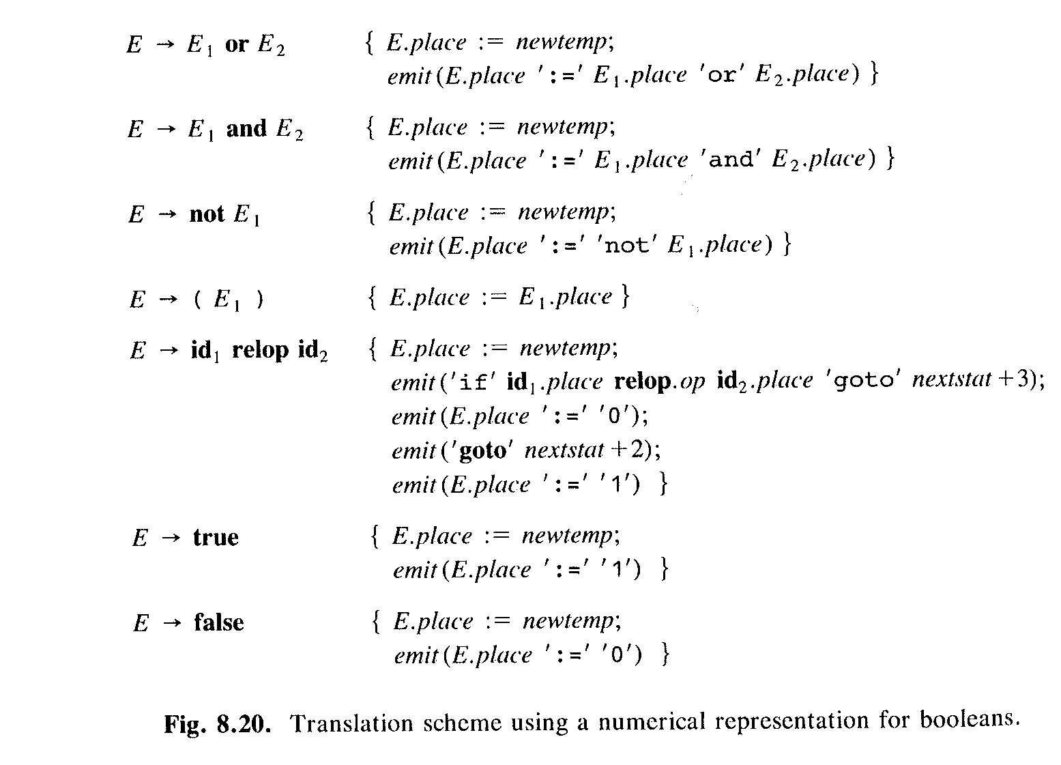
Translation schema to implement a numerical representation of Boolean

Slide 95
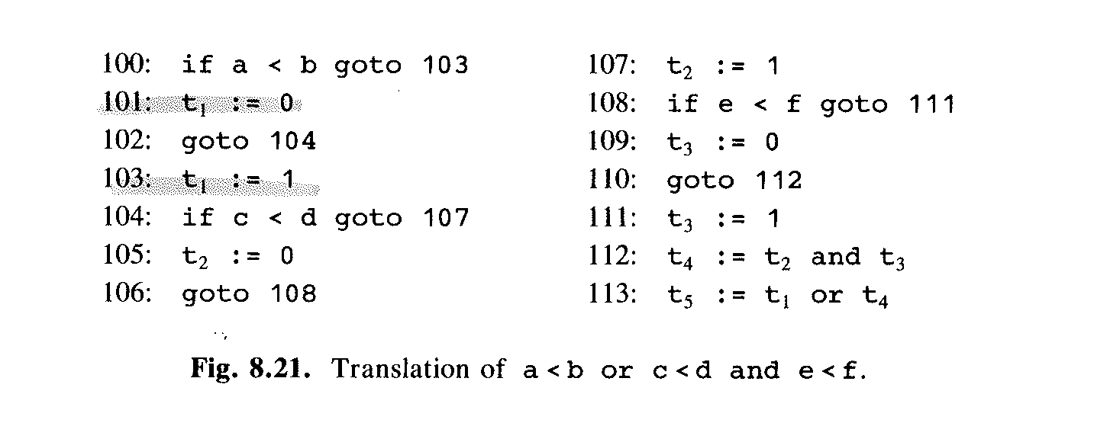
Example of evaluating 3-AC using Schema Translation

Slide 96
SUMMARY
STATEMENTS, WHILE-DO, IF/THEN/ELS/ BOOLEAN EXPRESSIONS

Slide 97
Summary of 3-AC instructions

Slide 98
Production Semantic Rules
S→if E then S1 E.true=newlabel();
E.false=S.next;
S1.next=S.next;
S.code=E.code ||gen(E.true ‘:’)
||S1.code
S→if E then S1 else S2 E.true=newlabel();
E.false=newlabel();
S1.next=S.next
S2.next=S.next
S.code=E.code ||gen(E.true ‘:’)
||S1.code||gen(‘goto’ S.next)||
gen(E.false ‘:’)||S2.code

Slide 99
Production Semantic Rules
S→while E do S1 S.begin=newlabel();
E.true=newlabel();
E.false=S.next;
S1.next=S.begin
S.code=gen(S.begin ‘:’)||E.code
||gen(E.true ‘:’)
||S1.code||gen(‘goto’ S.begin)

Slide 100
References
[1] Pierce, Benjamin (2002). Types and Programming Languages. MIT Press. ISBN 0-262-16209-1.
[2] Aho et al. Compilers, Principles and Tools. Addison Wesley, 2007

