Slide 1
Csci465: Principals of Translations Chapter 7: Run-Time Environment
UND School of Aerospace Sciences
Department of Computer Science
Dr. Hassan Reza

Slide 2
Announcement
Exam 2
Available on the course web site
Due Dec.15 at 1:pm
Presentation
Schedule is available on the course web-site
Length 10 Minutes
5 minutes PowerPoint discussing overall approach to design and implementation of Mini-Pascal
5 minutes to run the mini-pascal and Q&A

Slide 3
Objectives
Source Language issues
Activation record and activations trees
Control stacks (Frame)
The scope of a declarations
Storage organization
Symbol Table organizations (revisited)

Slide 4
Run-time environment
A compiler must implement the abstractions presented in the source language definition
Examples include
Names/ID
Scopes
Binding
Data types
Operators
Procedures/functions,
Control flow constructs
Compilers need to work with
OS (logical to physical address mapping)
Resource allocation subsystems (memory mgt)
etc

Slide 5
Procedures: 1 (revisited)
A Procedure definition (PD)
PD→ ID Body
ID: procedure name
Body: s₁,…, s_{n}
Function:
a procedure that returns a value
Example
Procedure Readarray;
Var j : integer; a: array [0..10] of integer
Begin
For j := 1 to 9 do read (a[j])
End;

Slide 6
More on Procedures: 2
Procedures
Being called means its name appears within an executable statements or expressions
Takes arguments (or identifiers)
Formal & Actual parameters
E.g. , formal arguments
Procedure myproc (a: integer; b: real); // formal arguments
…
myproc(m, j); // actual arguments and procedure call
…

Slide 7
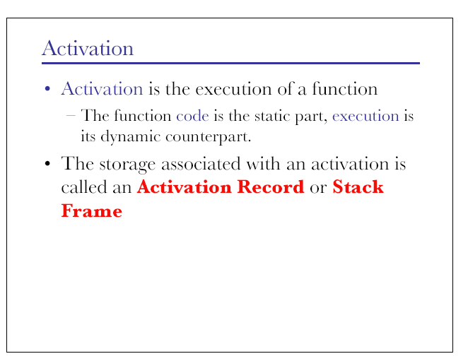

Slide 8
Activation Trees
Activation trees
Represents the activations of procedures during program execution using a tree
Activation of procedure
Execution of a procedure body
Lifetime of activation
Sequence of steps between first and last statements
Non-overlapping,
Nested activation,
Recursive
Notes:
Recursive
if a new activation can begin before an earlier activation of the same procedure has ended.

Slide 9
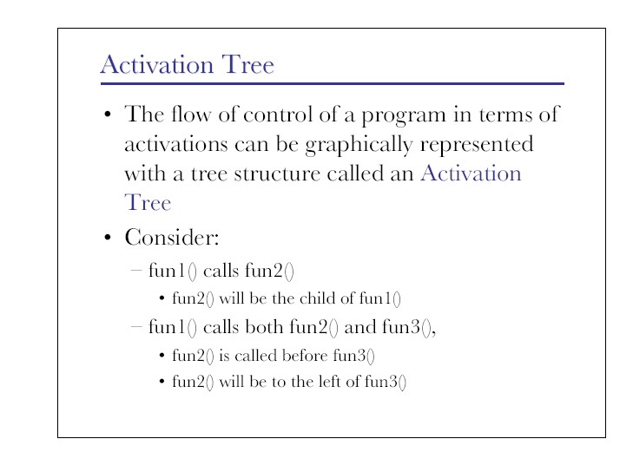

Slide 10
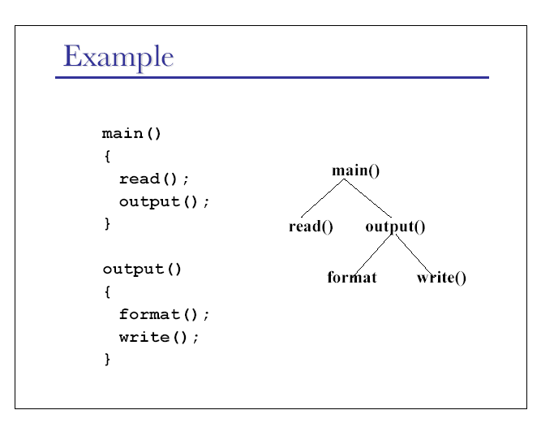
parent
Occurs
first
Notes:
From left to right

Slide 11
Control Flow
The control flow in a program P corresponds to depth-first traversal of activation tree
Starts at the root
Visits a node before its children
Recursively visits children at each node from left-to-right
The sequence of procedure calls corresponds to a preorder traversal of the activation tree
The sequence of return calls corresponds to postorder traversal of the activation tree

Slide 12
Sequences of Calls and Returns: 1
Procedures calls implemented by Calling Sequences
Calling sequences ?
consists of code that allocates an activation record on the stack by entering information into the fields
Return sequences ?
Same as code to calling sequences
restores the state of the machine in a way that the caller can continue its execution

Slide 13
Termination Scenarios
Code in calling sequences is divided between Caller and Callee
In general, if procedure P calls procedure Q
The activation of Q terminates normally
The activation of Q aborts and P ends at the same time
The activation of Q terminates due to some exception. The procedure P may or may not terminate

Slide 14
Activation Records: Control Stack (or runt-time Stack)
Control stack (or runt-time stack)
Keeps track of live procedure activation (or FRAME)
The root of the activation tree is at the bottom of the stack
Having node n_{j} on the top of the stack means
There exists a path in Activation tree from node n_{j} to the root
E.g,
<root,…,n_{i}, n_{j}>

Slide 15
control is here
e.g., If control is currently in the activation write() of the tree, then activation record for write() is at the top of the control stack.
Below it is the activation record for output(), and the bottom is the activation record for main()

Slide 16
Some issues about organizing storage by compiler
How to organize the storage depends on these issues?
Can procedures be recursived?
What happens to the values of local names when control returns from an activation of a procedure?
May a procedure refer to global or non-local names?
How are parameters passed when a procedure is called?
May the procedure return results?
May the storage be allocated dynamically under program control?
Must storage be de-allocated explicitly?

Slide 17
Storage organization for Pascal/C include
A organization of run-time storage the following sub-division of memory
Program code
Refers to static area used by the generated target code which is fixed at compile time
Static Global data
Refers to static area used by global constants and data generated by the compiler (e.g., info. Needed for garbage collector)
Stack (procedure activation info.)
Dynamic area used to store Activation Records
The area usually grows towards lower address
E.g., all local names for a procedure call
Heap (other program info.)
Dynamic area used to store data in some variable amount that won't be known until the program is running.
E.g., a program may accept different amounts of input from one or more users for processing and then do the processing on all the input data at once
Notes:
Assumptions: we assume the run-time storage comes in block. Each block consists of contiguous bytes, where a byte is the smallest unit of addressable memory. A byte is eight bits and four bytes from a machine word. Also important is the storage layout for data objects ; it is influenced by the addressing requirements of the target machine such as storage alignment. For example, add instructions on many machine require integer to be aligned (i.e, they placed at an address divisible by 4)

Slide 18
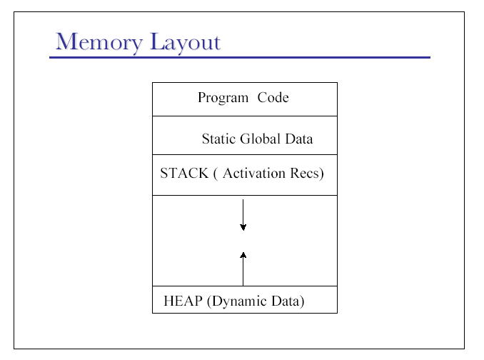
High memory
Low memory
Notes:
Any program you run has some memory which is divided into:
Code Segment
Data Segment (Holds Global Data)
Stack (the local variables and other temporary information are stored and grow downward)
Heap (upward growing)

Slide 19
Static vs. dynamic storage allocation
Static storage allocation
Compile-time notion referring to the decision made at compile time by the compiler by looking only at the program text and at its behavior
Dynamic storage allocation
Run-time notion referring to the decision made when the program is running

Slide 20
About Stack
Stack
natural and simple arrangement to share space between procedure calls
allows to compile procedure code in a such way that the relative addresses of its nonlocal variable are the same no matter how procedures are called

Slide 21
Stack: 2
Stack
Last-in First-out (LIFO)
Used to implement the behavior of function calls
Stack uses two operations
Push (or call) the node for an activation onto the stack when it begins
Pop (or return) the node when the activation ends

Slide 22
Stack Allocation of Space:1
Almost all compilers for languages supporting procedures/function call use stack to handle the run-time memory
E.g., Pascal/C use control stack (frame) to manage activation of procedures
Each time procedure call occurs
Space is pushed on stack
Execution of a program or a current activation is suspended
Information about the status of machine (e.g., PC, registers) are saved in stack
Each time a procedure call returns
Space is popped
Restoring the values of the registers, PC

Slide 23
Stack allocation of space: 2
Stack allocation would not be practical if procedures calls did not nest in time
Activation tree
used to establish the proper order in which activations appear along the path to Root
return the result in the reverse of that order

Slide 24
Activation records: Fields
the field of Activation Record (AR)
Temporary values:
values generated as the result of the expression evaluations which cannot be put in registers
Local data:
local data to belong to the procedure
Saved machine:
keeps the context or machine status (register, PC, etc.)
Access link:
points to non-local data in other AR
Control link:
points to the caller’s activation record
the return value space of the called function, if any
Actual parameters:
used by the calling procedure to pass parameters to called procedures.
Registers are used to pass these information

Slide 25
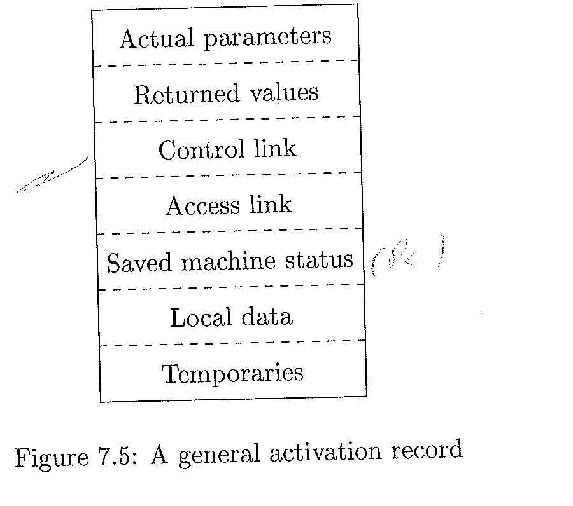
Activation Record layout

Slide 26
A Standard layout AR
arg n
.
.
arg 2
arg 1
Access/static link
High MM address
Incoming
arguments
Frame N-1 (previous)
Frame ptr(FP)
Local variable
return address
----------------------
Temporaries
----------------------saved registers
----------------------arg m
.
.
.
agr 2
arg1
Access/static link
.
.
Frame N (current)
Outgoing
arguments
Low MM address
Stack ptr (sp)
Frame N +1 (next)

Slide 27
The Frame Pointer (FP)
Frame pointer (A register)
Suppose a function g(…) calls function f(a1, …, an)
g is caller
f is callee
On entry to f, the stack ptr sp, points to the first argument that g passes to f
On entry, f allocates a frame (or activation record) using
sp’= sp –Frame-size // assume stack grows toward lower memory
Sp’ = new stack ptr
Sp = old stack ptr
Save fp (old Frame pointer)
Rn := fp // use a register to save FP
Set the current fp to old sp
fp := sp

Slide 28
On the exist from f
When f exists (or on the exit)
Set the current SP’ to SP using FP
sp’ := fp ( move sp’ to where fp is currently points)
Set the current frame ptr to old frame ptr
fp := Rn (restores Old Frame Ptr)
Note: For fixed frame, fp will always differ from sp by a known constant

Slide 29
Return address
When g calls f, f eventually must return
If the call instruction in g is at address A10, then the right place to return is at address A11
Return address is pushed on the stack by call instruction
Note: registers are used for efficiency reasons

Slide 30
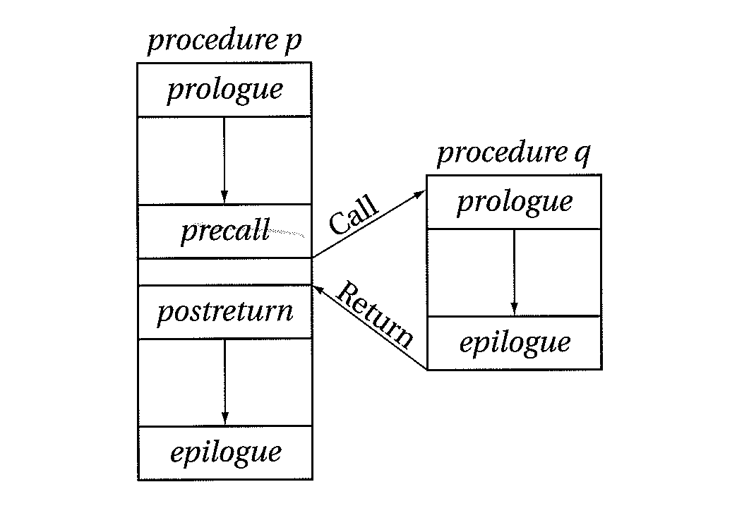
Standard procedure linkage

Slide 31
Access Links (visited)
A pointer is used to form a chain from the activation record at the top of the stack to a sequence of activations at lower nesting depths
Where Nesting depth one is used for procedures that are not nested
Access links used to provide access to non-local variable
E.g.,
Suppose p is immediately nested within q, then access link in any activation of p points to the most recent activation of q
q
P
p
Notes:
Nesting Depth: if procedure is defined right after a procedure at nesting depth 1, then p’s nesting depth is i+1. Suppose that the procedure P at the top of stack is at nesting np and P needs to access x, which is a variable within some procedure, say, q that surrounds P with nesting qn. Note that nq<= np with equality only if p and q are the same procedure. To get x, we start at the AR for p at the top of the stack and follow the access link np-nq times from AR to AR.
We should finally end up at an AR for q which must be the most recent (or highest) AR for q that is currently on the top of the stack. This activation record contains the x we are looking for. Because the compiler knows the layout and organization of AR, x will be located at some fixed offset from the position in q’s AR that we have reached by simply following the LAST access link.

Slide 32
Depth 1
Depth 2
Depth 3
Nesting Depth of write = 3

Slide 33
A typical Activation Records and access links
Main()
Access link
Read()
Access link
Output()
Access link

Slide 34
Access Links for finding non-local data
Main()
Access link
Read()
Access link
Output()
Access link
Write()
Access link
Note: Access links points to the beginning of AR

Slide 35
A typical Activation Records and access link
Returned value
Actual parameters'
Control link/access link
machine status
Local data
temporaries
Returned value
Actual parameters
Control link/access link
machine status
Local data
temporaries
callee
caller

Slide 36
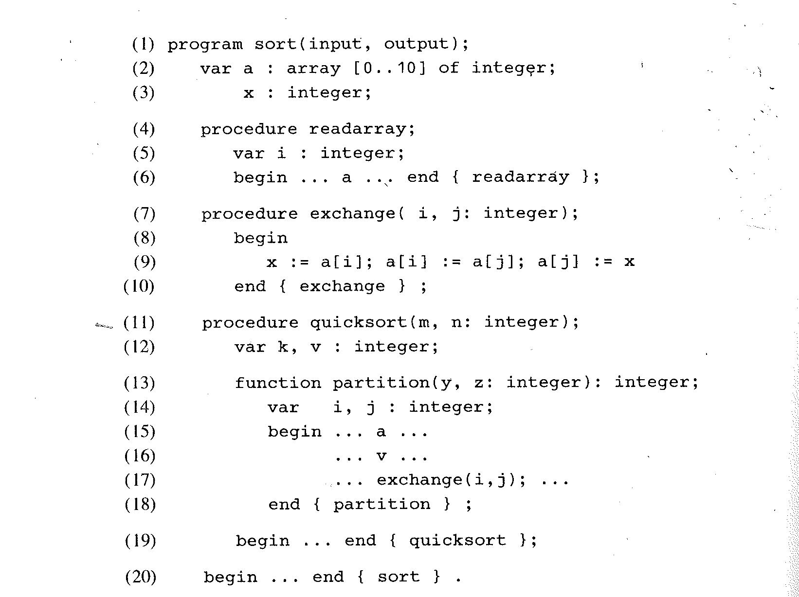
A Pascal Program with nested Procedures (nesting depth)
Nesting depth = 1
Nesting depth = 2
Nesting depth = 3
Nesting depth = 3
References a at nesting depth = 1
References v at nesting depth = 2

Slide 37
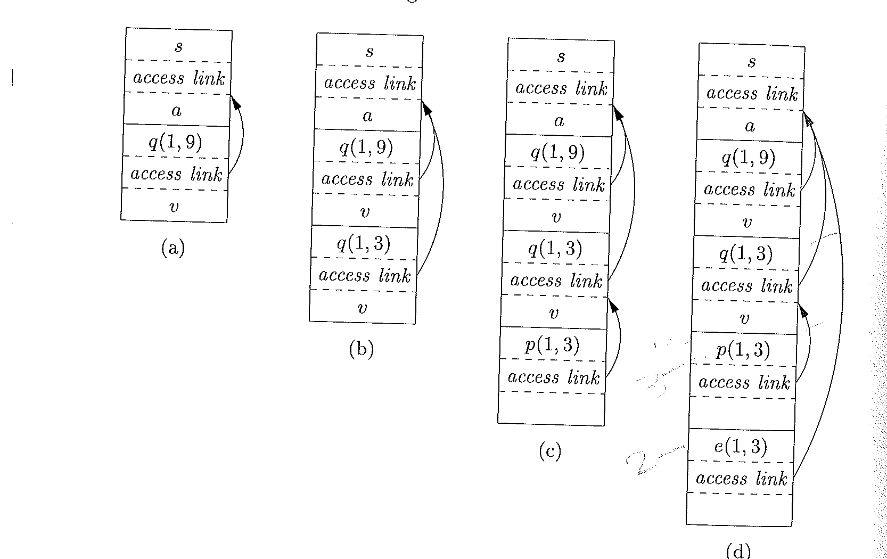
Access link for Nonlocal Data
No access link
S: sort;
q: quick;
e: exchange;
p: partition
Notes:
S: sort; q: quick; e: exchange; p: partition

Slide 38
Example
Suppose p at nesting n_{p} refers to nonlocal a with nesting depth n_{a} ≤ n_{p}.
The storage for a can be found as follows:
AR of P is at the top of the stack
Follow n_{p}-n_{a} access links from AR on the top of the stack
To access a, just follow n_{p}-n_{a} links
a is located at a fixed offset relative to AR
(n_{p}-n_{a,} Offset (AR))
See figure 7.22 lines 15-16

Slide 39
Code to set up access links
The code to set up access links is part of the calling sequences
Suppose P at nesting depth n_{p} calls x at nesting depth n_{x}:
There are three cases:
The code for setting up the access link in the callee depends on whether or not the callee is nested within caller:
Case 1: n_{p} < n_{x} which means x is nested more deeply than p
(see fig.7.11.a when sort calls quicksort )
Case 2: n_{p} = n_{x} which means the calling and called procedures must be the same (see fig.7.11b., when quicksort called itself)
Case 3: n_{p} ≥ n_{x} which means we need to follow n_{p}-n_{x}+1 access links from the caller to get to the most recent AR of the procedure that statically enclose both callee and caller.
(see fig.7.11.d, when partition calls exchanges)

Slide 40
The Scope of a Declaration
a declaration is a syntactic construct
used to specify the identifier, type, and other aspects of language elements such as variables and functions/procedures.
used to announce the existence of the element to the compiler in strongly typed languages (such as Pascal) that require variables and their types to be specified with a declaration before use
E.g.,
var K : integer
Scope?
The portion of the program to which a declaration is applied
Scope rules
Dictates which declaration applies to which names
At compile time, the symbol table is used to find the declaration that applies to an occurrence of a name/id

Slide 41
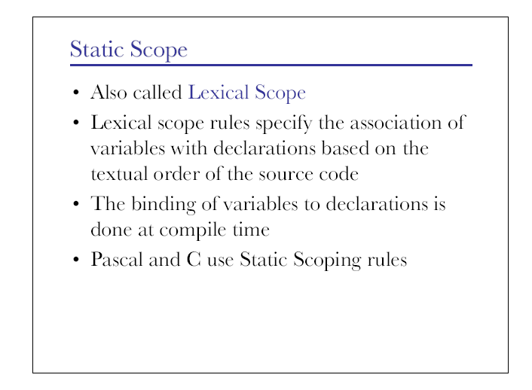

Slide 42
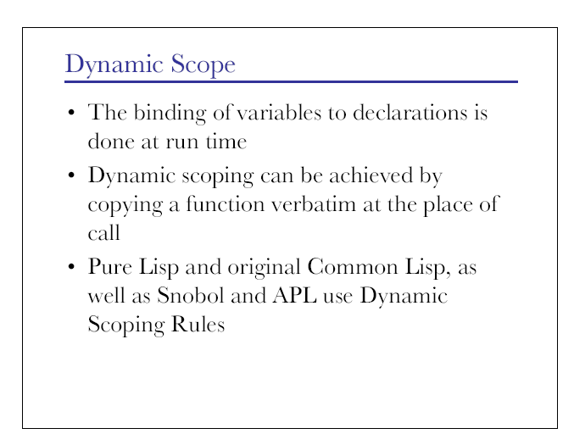
Notes:
In dynamic scoping, by contrast, you search in the local function first, then you search in the function that called the local function, then you search in the function that called that function, and so on, up the call stack. "Dynamic" refers to change, in that the call stack can be different every time a given function is called, and so the function might hit different variables depending on where it is called from.

Slide 43
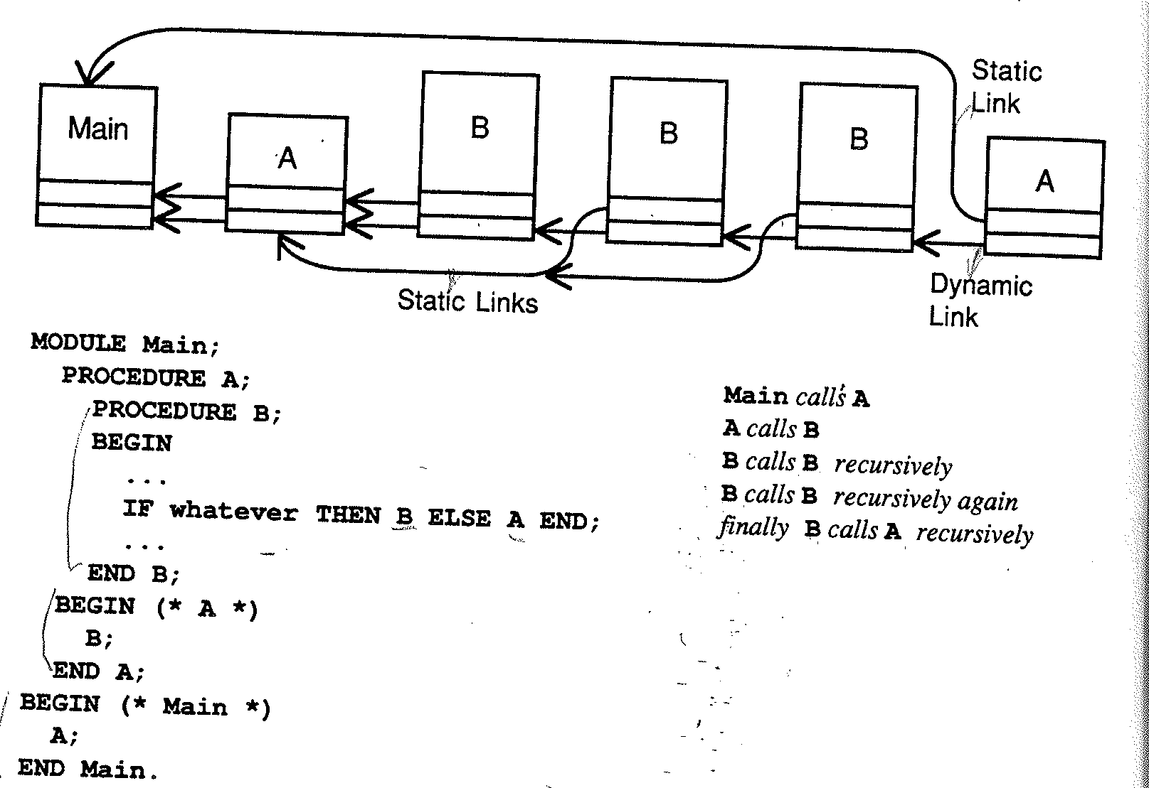
Static and dynamic links

Slide 44
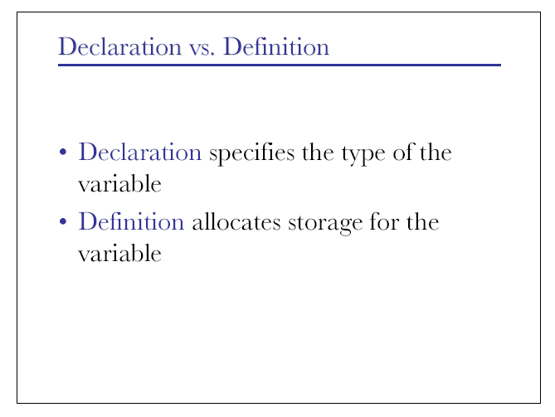

Slide 45
Binding of names
Same name may denote different data objects (i.e., locations) at runtime
Two mapping :
Environment
maps a name to a storage ( binding of a name to a storage)
State
maps a storage to a value
environment
state
name
location
value

Slide 46
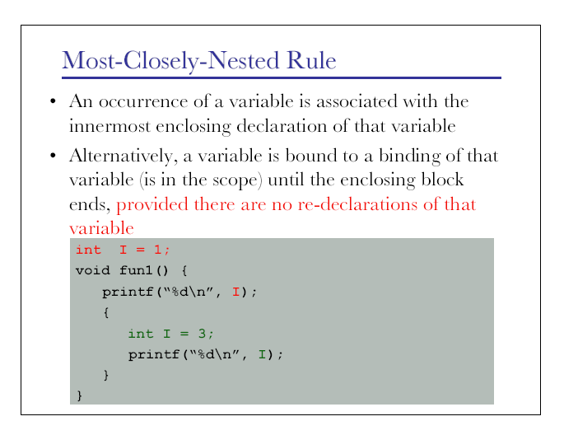

Slide 47
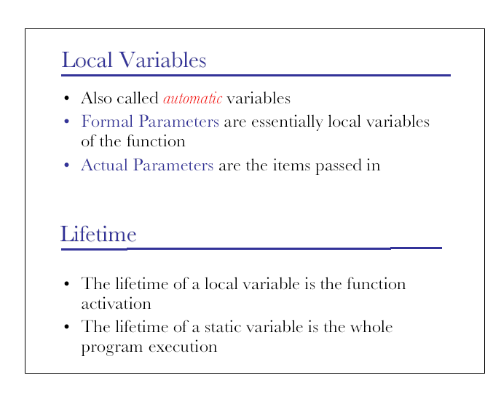
Notes:
Note: Static variables = global variables in PASCAL

Slide 48
Corresponding between static/dynamic
Static Notion | Dynamic Notion
Procedure definition | Procedure call
Var declaration | binding of names
Scope of a declaration | Lifetime of a binding

Slide 49
Displays: alternative to access link
Problem with access link
May need to follow a long chains of links (BAD)
Display (array of Frame Pointers)
A faster and better alternative to access links
An improved implementation that uses array of pointers
one pointer for each nesting depth
For example
Using display, the storage for nonlocal x at nesting K can be found in AR pointed by d[k]
In general, for array d, d[i] is a pointer to the highest AR on the stack for any procedure p at nesting depth i

Slide 50
Display: 1
d [1]
d [2]
Main ()
q (1, 9)
saved d[2]
null

Slide 51
Display:2
d [1]
d [2]
Main ()
q (1, 9)
saved d[2]
q(1, 3) saved d[2]
To maintain the display on call:
1) need to save previous values of display entries in new Frame
On return for p
1) its AR is removed from the stack
2) restores d[old-nesting-depth] to point to AR prior to call of p

Slide 52
Display: 3: On return
d [1]
d [2]
Main ()
q (1, 9)
saved d[2]
null

Slide 53
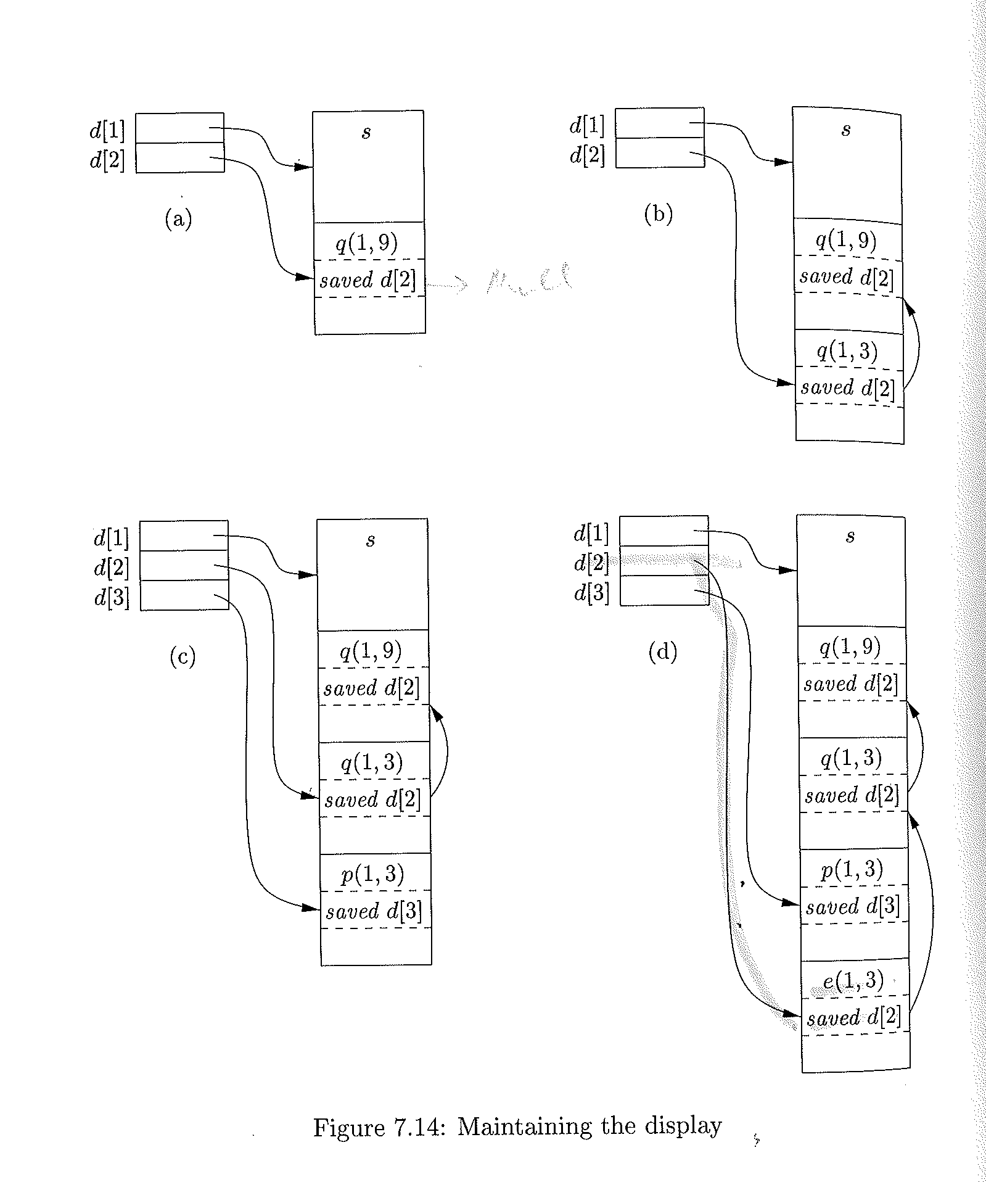
Display

Slide 54
A Pascal Program with nested Procedures (nesting depth)
Nesting depth = 1
Nesting depth = 2
Nesting depth = 3
Exchanged ,with np=2 called by partition np=3

Slide 55
Symbol Tables (Revisited)
At many of the stages of translation, you'll need to keep track of various attributes of the symbols that appear in the program.
Their type (variables/symbols)
Their memory location (for variables)
The size of their stack frames (for functions and procedures)
Their values (for constants)
...
The structure used to keep track of this information is called a symbol table
need to think carefully about the design of symbol tables

Slide 56
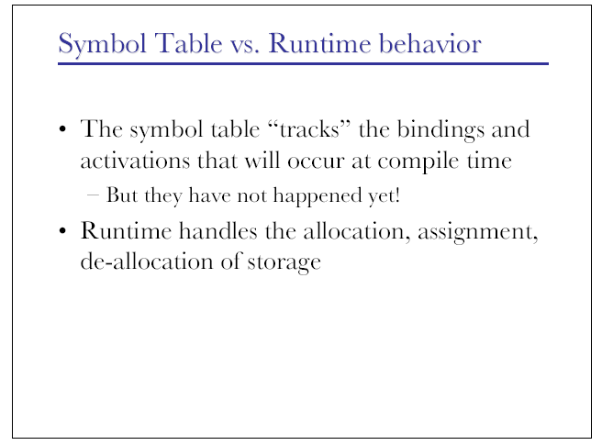

Slide 57
