Slide 1
Csci465: Principals of Translations Chapter 8: Code Generation
UND College of Engineering and Mines
Department of Computer Science
Dr. Hassan Reza

Slide 2
Objectives
Intermediate Code for control flow and Boolean expressions
Final phase of compilation
Issues in the design of code generations
using syntax-driven technique to generate code

Slide 3
Syntax-Directed Code Generation
The main goal of compiler is to translate the source program into the object code
Object code must have the same semantics as the source program
i.e., compute the same results with different syntax

Slide 4
Code Generation: Preview
Code Generator
the process of mapping some intermediate representation (IR) of the source program into assembly)
acts as a match maker between source and target language constructs
A single source concepts can be matched to more than one concept in target language
E.g., One UML class vs. Several java classes
Code generators (Round Trip Engineering)
From source to target language
From target language to source language
source is a new language
target is very well established (low-level) language

Slide 5
Important issues in designing the code generation (CC)
Design of the CC may depends upon many details such as
Intermediate code representations
Target language
Run-time system
Instruction selection
Register allocations and assignment
etc.
Bur the most important criterion for a code generator is that it MUST generate correct code

Slide 6
Input to code generators
Input to the code generator
Intermediate Code Representation of source program produced by front-end
E.g.,
Three-address code
Quadruples
Triples
Indirect triples
Virtual machine (bytecode, stack-machine code)
Linear representations such as postfix
Graphical representation (syntax tree, DAG)
…

Slide 7
Output of CG: Target Code
The most common target-machine architectures are
RICS (reduced instruction sat computer)
Uses many registers, 3-address instructions, simple modes, simple instruction-set
E.g., MIPS
CISC (complex instruction set computer)
Uses few registers, two-address instruction, many addressing modes, several register classes, variable-length instructions, etc.
IBM-370 Series
Stack-Based Architecture
Uses push/pop operations and operands pushed on stack

Slide 8
Approach to Code Generations
Two possible approaches
Formal Methods and Compiler (e.g., using Theorem prover)
Syntax-directed Code Generation (SDCG)

Slide 9
Formal Method driven
Theorem Prover approach
Describes the object code using Attribute Grammar
Use a Theorem- prover program to produce the correct translator to map the source program into object code
Not very successful!

Slide 10
Syntax-driven
Syntax-directed code generation
The code generation sequences are embedded in the grammar that specifies the syntax of the source
Parser decides which set of instructions to be emitted based on the syntax of the source code
Parser maps source syntax to code sequences

Slide 11
Computer Hardware Architecture
Language design
influenced by formal language design
Hardware design
influenced by market pressure
Code generation
influenced by addressing modes and scheduling (HPC)

Slide 12
Addressing modes
There are a variety of addressing modes
Memory-Memory (2-address)
Fetches data from memory
Stores the result into memory
Register-Memory (2-address)
ACC-Memory (1-address)
Eliminates one of the memory address in favor of an accumulator
loads a single value from memory into ACC
stores from ACC to memory
Stack-Memory (zero-address)
To add two numbers, need to specify two values fetched from memory
Put the addition result back into memory

Slide 13
The Stack Machine
Stack machines
have been around since the 1960s (e.g., Burroughs B5000 and their successors)
have an elegant architecture offering a lot to computer science,
Unfortunately, stack machine is viewed as outdated and slow
In stack machines, the arithmetic logic unit(ALU) and memory management unit operate at the top of the stack;
all ALU operands and memory writes are popped from the top of the stack and
all ALU results and memory loads are pushed to the top of the stack.
Called implicit-addressing machines since no explicit reference to operands are required.
This stack is implemented in hardware and finite, but it is conceptually infinite,
hardware or the operating system managing the movement of the lower parts of the stack to and from memory.

Slide 14
Advantages of Stack
stack machines do have a number of advantages:
low power requirements;
small size and cost;
fast, highly predictable interrupt performance.
work best with small program sizes, reducing memory cost and band-width requirements
A good choice for RT-Embedded Systems

Slide 15
Hypothetical Machine: ITTY BITTY Stack Machine (IBSM)
Engineering the compiler demands a complete understanding of the target computer machine
Some computers have a very complex instructions sets
CICS (Complex Instruction Set Computer)
Tutorial on any specific machine is very time-consuming
Using Hypothetical Stack based machine, “the Itty Bitty Stack Machine” or IBSM

Slide 16
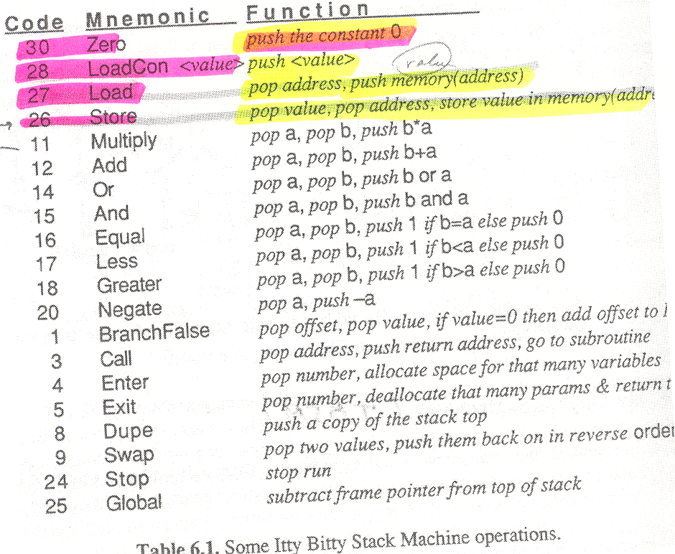

Slide 17
Stack Machine Expression Evaluation
Zero-address uses stacks
Stacks used for Parsing (PDA)
Stack simplifies expression evaluation
No need to save and/or compute intermediate results
Example
3*4+5*2
2
4
5
5
10
3
3
12
12
12
12
22
Load 3 Load 4 Multiply Load 5 Load 2 Multiply Add

Slide 18
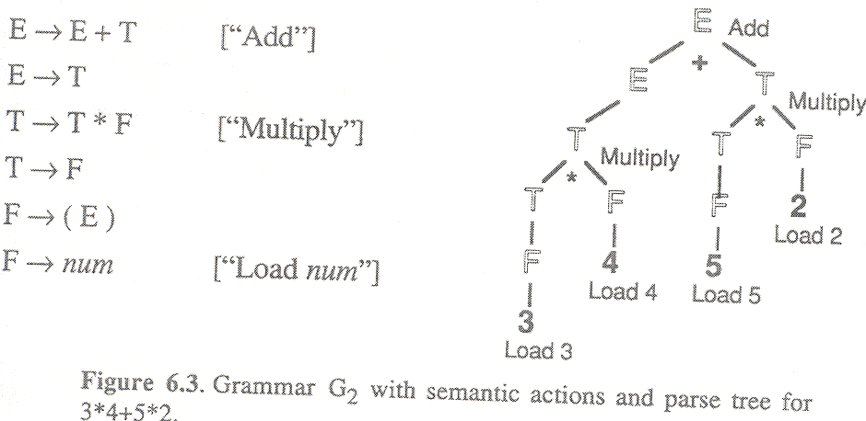
Left-to-right post-order tree walk for 3*4+5*2 (i.e., 3,4,*,5,2,*,+)

Slide 19
Instruction Stack
Load 3 3
Load 4 4, 3
Multiply 12
Load 5 5, 12
Load 2 2, 5, 12
Multiply 10, 12
Add 22
Execute 3*4 + 5*2

Slide 20
Code Generator
Example: 7 + (8 * y) / 2
Load R1, y
Mult R1, 8
Div R1, 2
Add R1, 7

Slide 21
Stacks evaluation
Why Stack?
Simplicity
direct mapping to post-order tree walking and context-free parse

Slide 22
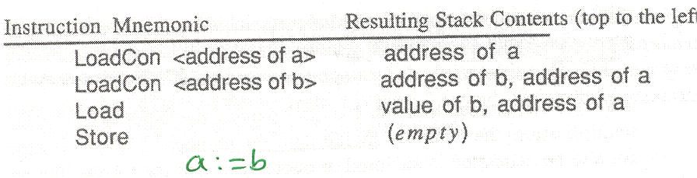

Slide 23
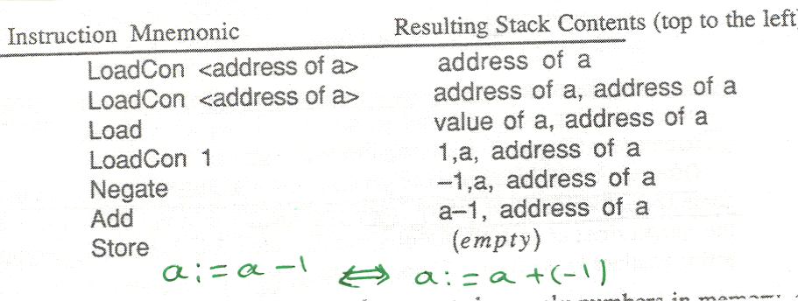
Execute: a:=a-1 ⇔ a:=a + (-1)

Slide 24
SDD and code generation
To emit the code, we can use SDD
For example
P→ “*” F [ “print Multiple”] P
It means after parsing F, emit number 11(i.e., opcode for multiplication into output file)

Slide 25
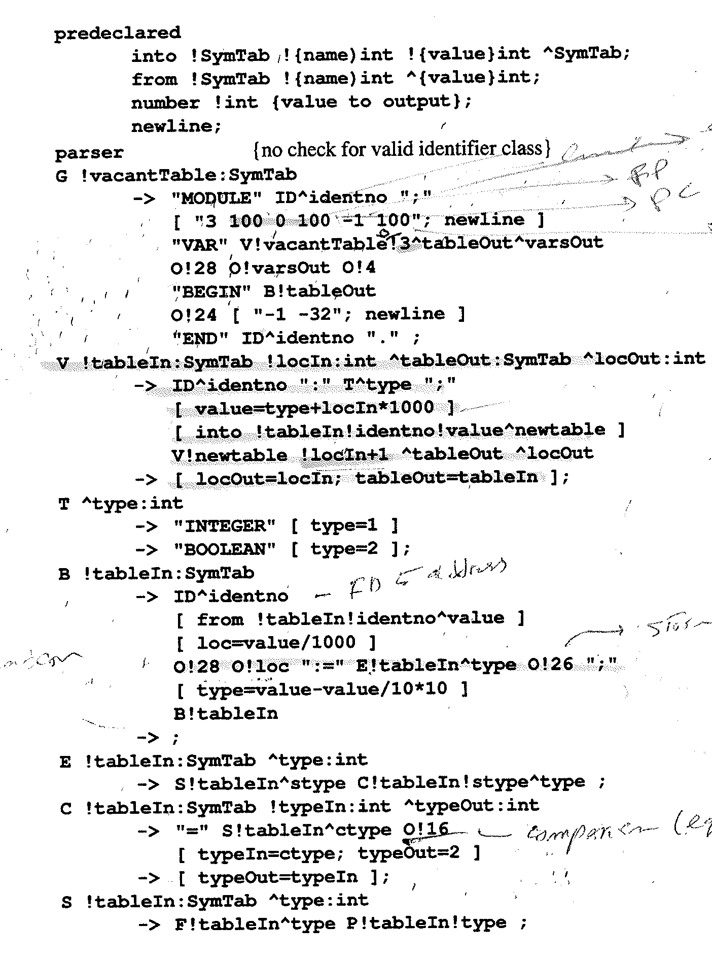

Slide 26
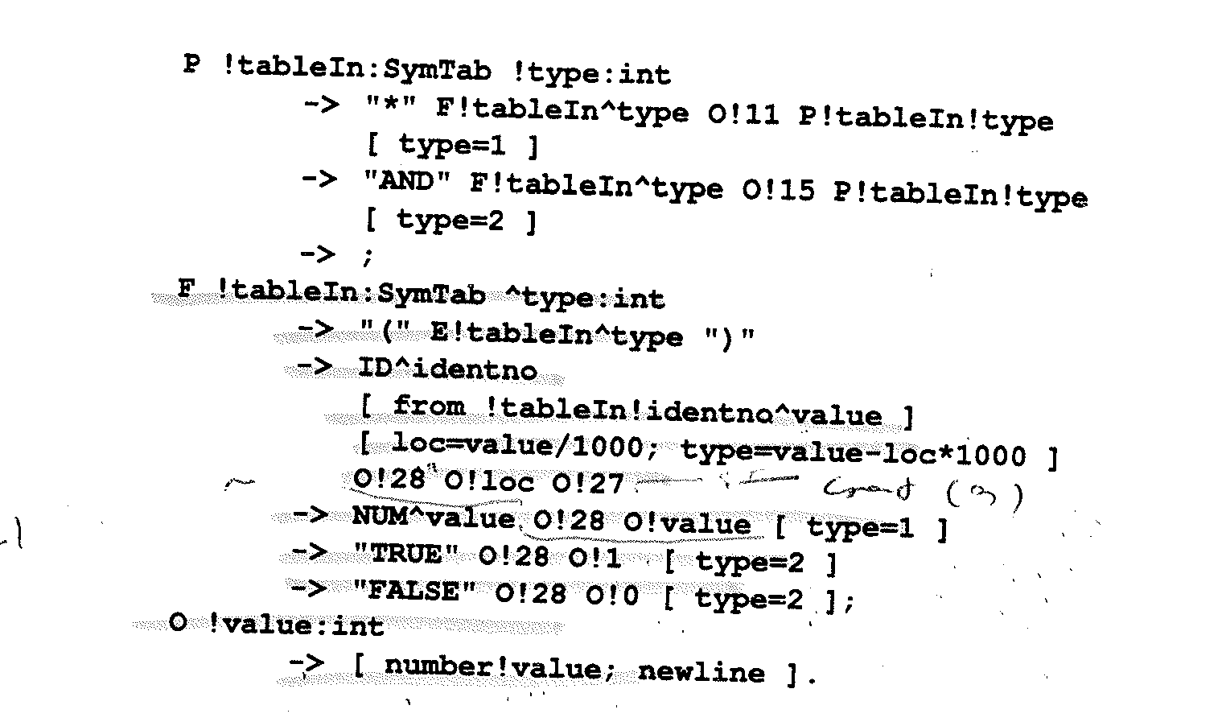
The non-terminal symbol O generates Output code

Slide 27
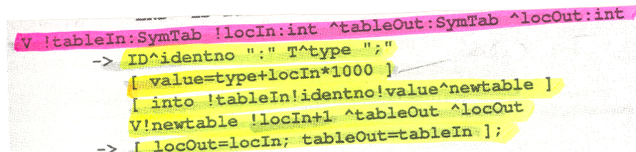
Add to symbol table
Increment
Notes:
The location of the new variable is packed into the symbol table by multiplying it with 1000 and adding the integer value that encode the type. When an identifier occurs on the left side of an assignment (B) or in an expression F, it is found in symbol table, and the value is unpacked. The type is checked, the location is extracted and used to generate the LoadCon instruction with that address.
On the left side of assignment the address is all that is needed.

Slide 28
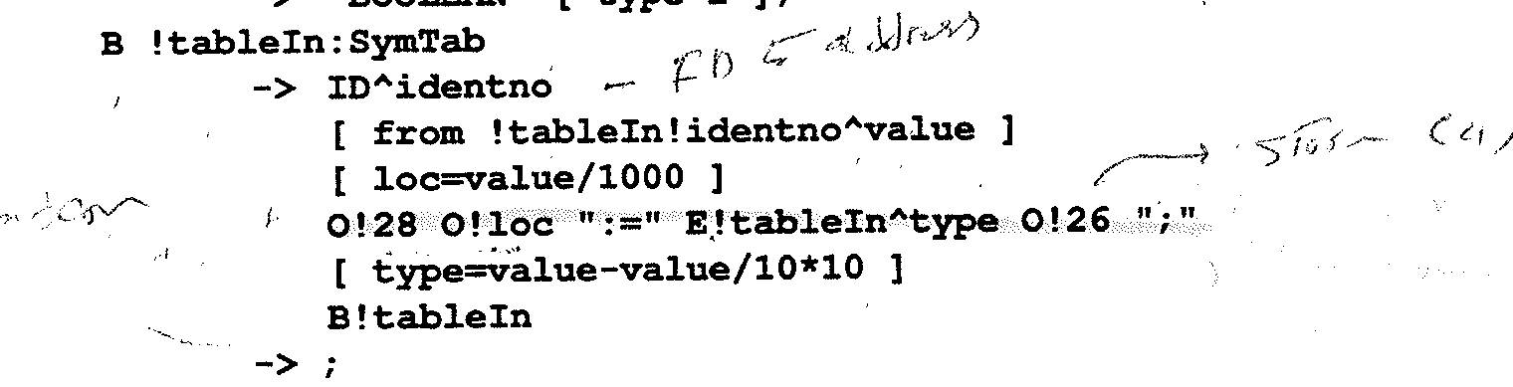
Assignment statement
2)Compute value
1) Loadcon address
4)store
Notes:
The following Code sequences are generated:
1) Loadcon <address) pushed
2) Value generated by expression pushed into stack
3) Store

Slide 29
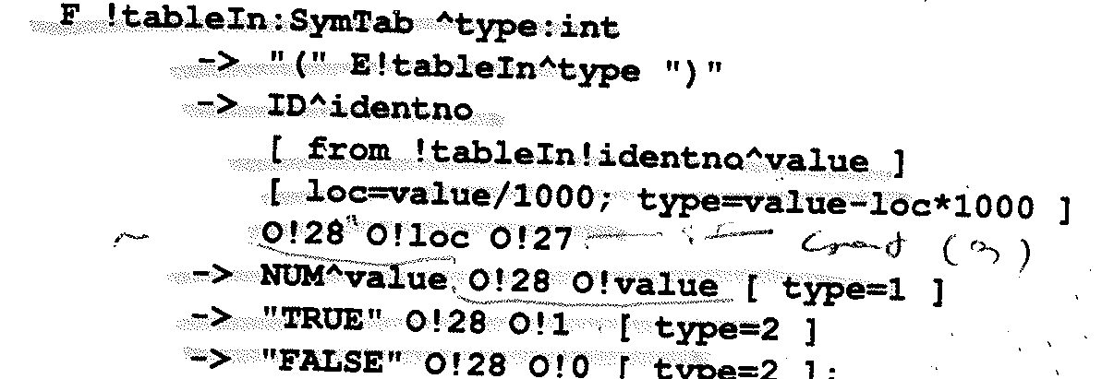
F to generate code for expression
The non-terminal symbol O generates Output code
3) load
2) Loadcon value
Notes:
The non-terminal symbol O generates Output code

Slide 30
Example a:= b
Using the grammar, a:= b will generate the following code
1
2
3
4

Slide 31
Summary of Translation process
Compilation of a program consists of:
High Level source program translated into assembly language (compiler time)
Assembly language translated into machine code for the target machine using assembler (compile time)
Linking objects program (link time)
Linked program is loaded into MM (load time)
Execute the program (run time)

Slide 32
Translation process
HL Program
Preprocessor
HL Program
Compiler
Target Assembly Program
Assembler
Relocatable Object Code
Linker
Libraries and
Other Object Files
Machine Code

Slide 33
About Assembler: X86 Quick Review

Slide 34
Example: Read and Write in C and Assembler Intelx86
C version:
c = getchar() ;
putchar( c ) ;
8086 version:
mov ah, 1h ; keyboard input subprogram
int 21h ; read character into al
mov dl, al ; copy character to dl
mov ah, 2h ; character output subprogram
int 21h ; display character in dl

Slide 35
Complete Program
prog2.asm: read a character and display it
.model small
.stack 100h
.code
start:
mov ah, 1h ; keyboard input subprogram
int 21h ; read character into al
mov dl, al
mov ah, 2h ; display subprogram
int 21h ; display character in dl
mov ax, 4c00h ; return to ms-dos
int 21h
end start

Slide 36
More on Function/Procedure
Function/Procedure
Translated into a segmented of assembly language consists of
Boilerplate
Entry sequence instructions (prologue)
Body
Exit sequence instructions (epilogue)
Assembly codes to initialize data and announce the end of a function

Slide 37
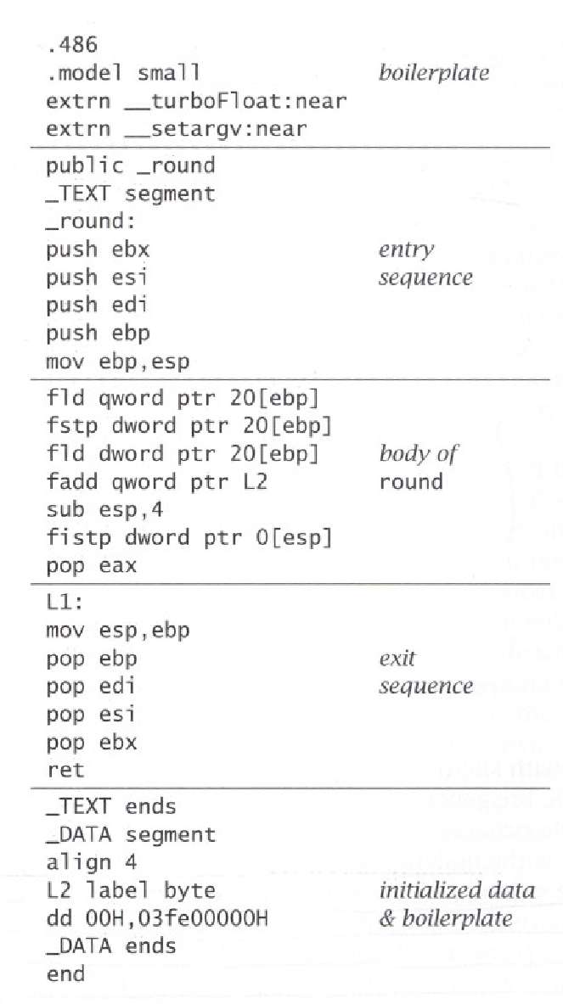
Generated Assembler Language
Or Prologue
base ptr points to the top of the stack
the top of the stack (sp) resets to points to old sp
Or Epilogue

Slide 38
The Prologue
The Prologue contains
Pseudo-instructions to declare the beginning of a function
A label definitions for the function name
An instruction to set the SP (to allocate a new frame)
Instructions to save “escaping” arguments into the frame, and to move non-escaping arguments into fresh temporary registers
Store instructions to save any callee-saved registers including the return address register ,which has been used within the function

Slide 39
The Epilogue
The epilogue comes after the body contains
An instruction to move the return value (i.e., result of function call) to the designated register
restore the callee-save registers
reset the SP (de-allocate the frame);
Move Return, BODY // puts the result of body in the return
A return instruction (i.e., JUMP to the return address)
Pseudo-instructions, as needed, to declare the end of a function

Slide 40
Phase | Output | Sample
Programmer (source code producer) | Source string | Position = initial + rate * 60
Scanner (performs lexical analysis) | Token string | <id,1> <=> <id, 2> <+> <id, 3> <*> <60> And symbol table with names
Parser (performs syntax analysis based on the grammar of the programming language) | Parse tree or abstract syntax tree
Semantic analyzer (type checking, etc) | Annotated parse tree or abstract syntax tree
Intermediate code generator | Three-address code, quads, etc.
Optimizer | Three-address code, quads, etc.
Code generator | Assembly code

Slide 41
Control Flow Statements and 3-address code
Control flow statements can be
S→ if (E) S1
S→ if (E) S1 else S2
S→ while (E) S1
Where
E is a Boolean expression (predicate)
S is a statement (e.g. assignment, etc.)

Slide 42
Code for if, if/else, and while loop
Go to E.true
Go to E.true
E.code
Go to E.false
E.code
Go to E.false
E.true:
S₁.code
E.true:
S₁.code
E.false:
…
goto S.next
E.false:
S.code
(a) if
S.next:
…
S. begin:
E.code
Go to E.true
(b) if-THEN-else
Go to E.false
E.true:
S₁.code
goto s.begin
E.false:
S2.nxt
(c) while

Slide 43
SDD for flow control statements:1
PRODUCTION | SEMANTIC RULES
P→ S | S.next= newlable() P.code =S.code|| label(S.next)
S→ assign | S.code= assign.code
S→if (E) S₁ | E.True = newlable() E.False = S₁.next =S.next S.Code = E.code || lable (E.True ‘:’)|| S₁.code
S→ if (E) S₁ else S₂ | E.True = newlable() E.False =newlable S₁.next =S.next S₂.next =S.next S.Code = E.code || lablel (E.True ‘:’)|| S₁.code ||gen(‘goto’, S.next) ||label (E.false ‘:’)|| S₂.Code

Slide 44
SDD for flow control statements:2
PRODUCTION | SEMANTIC RULES
S→ While (E) S₁ | S.begin = newlabel() E.True = newlabel() E.False = S.next S₁.next = begin S.code = lable(S.begin ‘:’) ||E.code || lablel (E.true ‘:’)|| S₁.code||gen(‘goto’, S.begin)

Slide 45
Generating 3-address code for compound Boolean expressions using AND, OR
production | Semantic rules
E→ E₁ || E₂ | E₁.true = E. True E₁. false= newlabel() E₂.true = E. true E₂.false = E.false E. code = E₁.code || label(E₁.false)||E₂.code
E→ E₁ && E₂ | E₁.true = Newlabel() E₁. false=E.false E₂.true = E. true E₂.false = E.false E. code = E₁.code || label(E₁.true)||E₂.code
Notes:
I used E, which represents more general form of Boolean expressions. The book used B for E, and B1 for E1 and B2 for E2. Either representation is fine.

Slide 46
Generating 3-address code for SIMPLE Boolean expressions
production | Semantic rules
E→ !E1 | E1.true = E. false E1. false= E.true E. Code = E1.code
E→ E1 relop E2 | E. Code = E1.code ||E2.code || gen (“if “ E1.addr rel.op E2.addr ‘goto’ E.true) ||gen(‘goto’ E.false)
E→true | E.Code = gen (‘goto’ E.true)
E→ false | E.Code = gen (‘goto’ E.false)
e.g. E is of the form a<b , it can be translated into:
If a < b goto B.True
goto B.false

