Slide 1


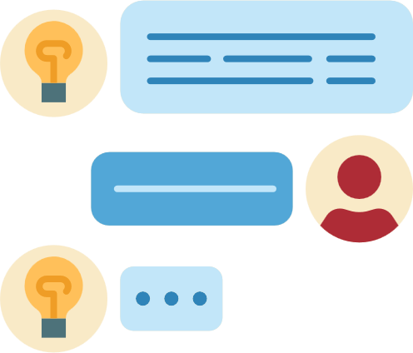
CONNECT-CHAT APPLICATION

Slide 2
DESCRIPTION
1. Instant Messaging
Text Chat: Real-time text communication is the core feature of chat apps, allowing users to send and receive messages instantly. Messages can be one-on-one or in group chats, making it versatile for different use cases, from personal conversations to professional discussions.
Typing Indicators: Users can see when someone is typing, which adds a layer of interactivity and engagement to the conversation.
2. Multimedia Sharing
Image and Video Sharing: Users can send photos, videos, and GIFs, enriching conversations with visual content. This feature is crucial for a more engaging and dynamic chat experience.
Voice Messages: Voice recordings enable users to communicate more naturally, especially when text is not convenient or when expressing tone and emotion is important.
Documents and Files: The ability to share files, such as PDFs, documents, spreadsheets, or presentations, makes the app useful for business or study groups.
3. Group Chats
Group Conversations: Users can create and participate in group chats, where multiple people can join the conversation. Group management features often include setting group names, assigning admins, and controlling who can participate in the group.
Mentions and Notifications: In group chats, users can mention others by name to draw their attention, and notification settings can be customized to ensure important messages aren’t missed.
4. Real-time Presence Indicators
Online/Offline Status: Users can see who is online or offline, adding a layer of context to the conversation. Many apps show "Last Seen" status or "Active Now" indicators.
Read Receipts: These apps often feature "read" receipts that show when a message has been seen by the recipient, improving communication transparency.
5. Push Notifications
Real-Time Alerts: Push notifications are used to alert users of incoming messages, calls, or important updates, even when the app is closed or running in the background. This ensures users don’t miss important communications.

Slide 3
Introduction
In today’s digital age, instant communication has become an integral part of our daily lives. Whether for personal or professional use, real-time chat applications have become the backbone of online interaction. This article outlines the process of building a real-time chat application for Android using Firebase as the backend solution. Firebase simplifies backend infrastructure, providing easy-to-integrate services like Firebase Authentication for secure login, Firebase Realtime Database for data synchronization, and Firebase Cloud Messaging (FCM) for push notifications.
Objective
The goal of this project is to develop a fully functional real-time chat application where users can log in, send and receive messages instantly, and interact in a secure and engaging environment. Firebase provides an ideal backend service to handle real-time data synchronization and authentication with minimal configuration.

Slide 4
Technologies Used
Android (Java/Kotlin): The mobile platform for app development.
Firebase Realtime Database: Stores and syncs messages across devices in real-time.
Firebase Authentication: Secure user authentication via email/password.
Firebase Cloud Messaging (FCM): Push notifications for new messages.
Android Studio: The official IDE for Android development.
01
03

Slide 5


The user interface consists of a RecyclerView for displaying chat messages, an EditText for typing messages, and a Button to send messages. Here's a simple example layout in
xml
<LinearLayout xmlns:android=Add a little bit of body text
android:layout_width="match_parent"
android:layout_height="match_parent"
android:orientation="vertical">
<!-- Message List -->
<RecyclerView
android:id="@+id/recyclerView"
android:layout_width="match_parent"
android:layout_height="0dp"
android:layout_weight="1" />
<!-- Input Section -->
<LinearLayout
android:layout_width="match_parent"
android:layout_height="wrap_content"
android:orientation="horizontal">
<EditText
android:id="@+id/messageInput"
android:layout_width="0dp"
android:layout_height="wrap_content"
android:layout_weight="1"
android:hint="Type a message" />
<Button
android:id="@+id/sendButton"
android:layout_width="wrap_content"
android:layout_height="wrap_content"
android:text="Send" />
</LinearLayout>
</LinearLayout>
Designing the User Interface
Studio Shodwe

Slide 6
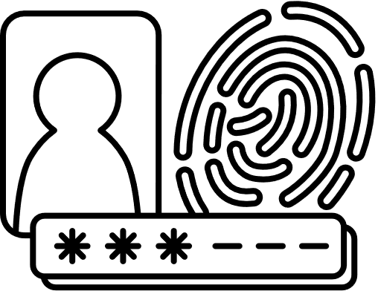
User Authentication with Firebase
Firebase Authentication allows users to securely log in with their email and password. Here's how you implement it in your MainActivity.java:
Java
FirebaseAuth mAuth = FirebaseAuth.getInstance();
mAuth.signInWithEmailAndPassword(email, password)
.addOnCompleteListener(this, task -> {
if (task.isSuccessful()) {
FirebaseUser user = mAuth.getCurrentUser();
} else {
// Handle login failure
}
});

Slide 7

Real-Time Messaging with Firebase Realtime Database
Once the user is authenticated, the app can send and receive messages in real-time. Here’s how you can send a message:
java
Copy code
sendButton.setOnClickListener(v -> {
String messageText = messageInput.getText().toString();
DatabaseReference messagesRef = FirebaseDatabase.getInstance().getReference("messages");
String messageId = messagesRef.push().getKey();
messagesRef.child(messageId).setValue(new Message(messageId, messageText, userName));
messageInput.setText("");
});
To retrieve messages in real-time:
java
Copy code
DatabaseReference messagesRef = FirebaseDatabase.getInstance().getReference("messages");
messagesRef.addChildEventListener(new ChildEventListener() {
@Override
public void onChildAdded(DataSnapshot snapshot, String previousChildName) {
Message newMessage = snapshot.getValue(Message.class);
messageList.add(newMessage);
adapter.notifyDataSetChanged();
}
});

Slide 8

Displaying Messages in RecyclerView
To display messages in the chat interface, create a custom MessageAdapter for the RecyclerView:
java
@Override
public void onBindViewHolder(@NonNull MessageViewHolder holder, int position) {
Message message = messageList.get(position);
holder.messageText.setText(message.getText());
holder.userName.setText(message.getUserName());
}

Slide 9

Push Notifications with Firebase Cloud Messaging (FCM)
To keep users notified about new messages, we can use Firebase Cloud Messaging (FCM). Here’s a simple setup to send a notification when a new message arrives:
Set up Firebase Cloud Messaging in the Firebase Console.
Add the firebase-messaging dependency in your project.
Send a notification on new message:
Java
FirebaseMessaging.getInstance().send(new RemoteMessage.Builder("your_firebase_cloud_messaging_key")
.setMessageId(Integer.toString(messageId))
.addData("message", messageText)
.build());
Handle push notifications in FirebaseMessagingService:
Java
@Override
public void onMessageReceived(RemoteMessage remoteMessage) {
// Display notification
}

Slide 10
