Slide 1
Fake news detection
Super Saiyans

Slide 2
Table of contents
01
Introduction
02
Project Management
03
Current Progress
04
Future Plans
05
Roles Assigned

Slide 3


01
Introduction
Fake news detection using
Sentiment Analysis

Slide 4
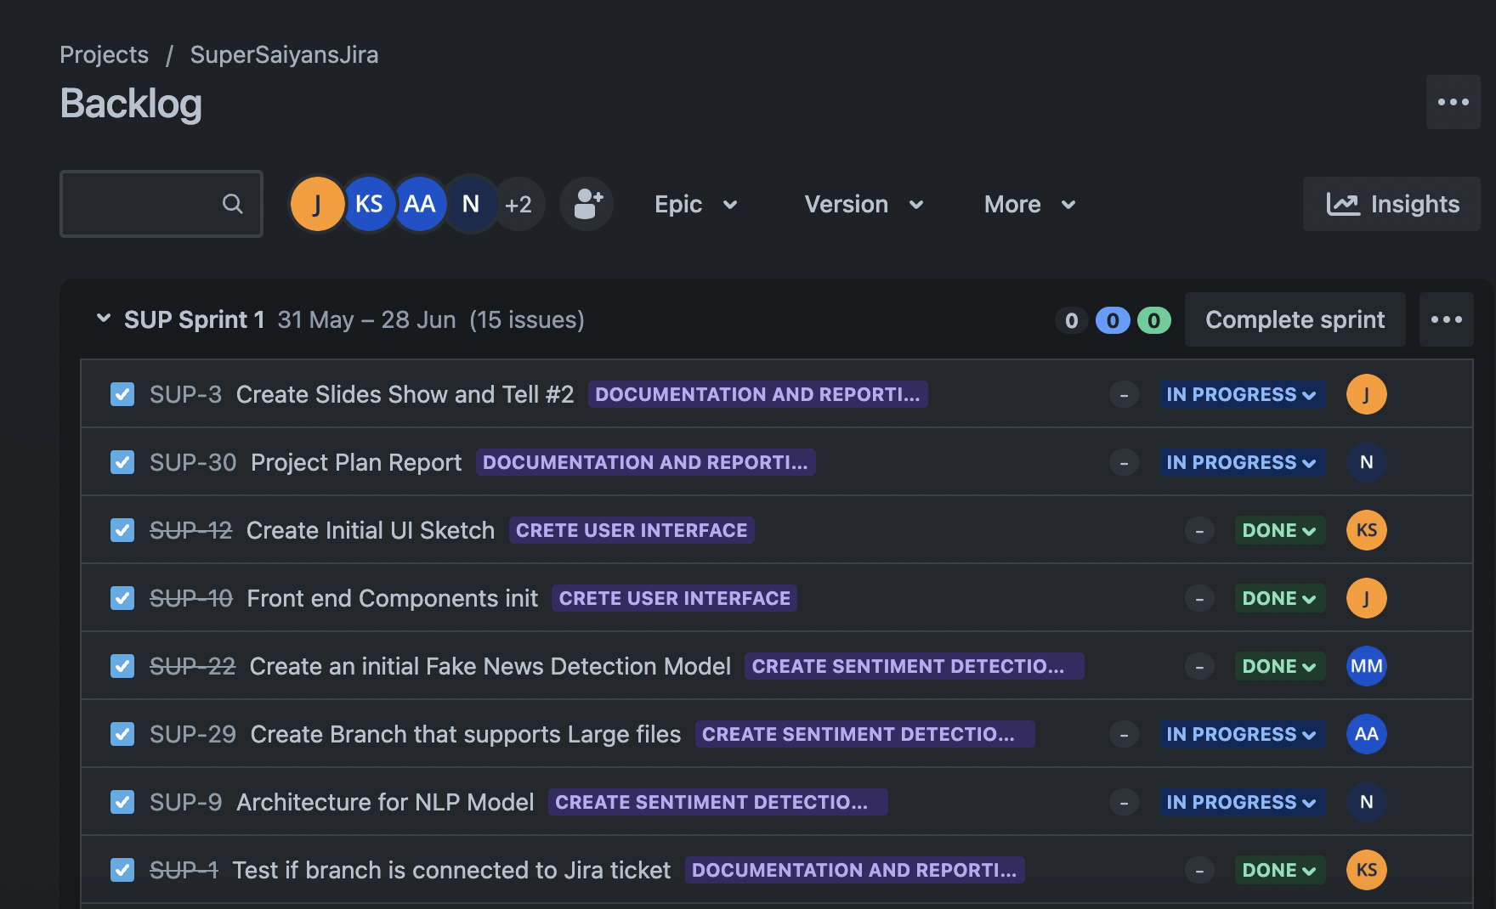
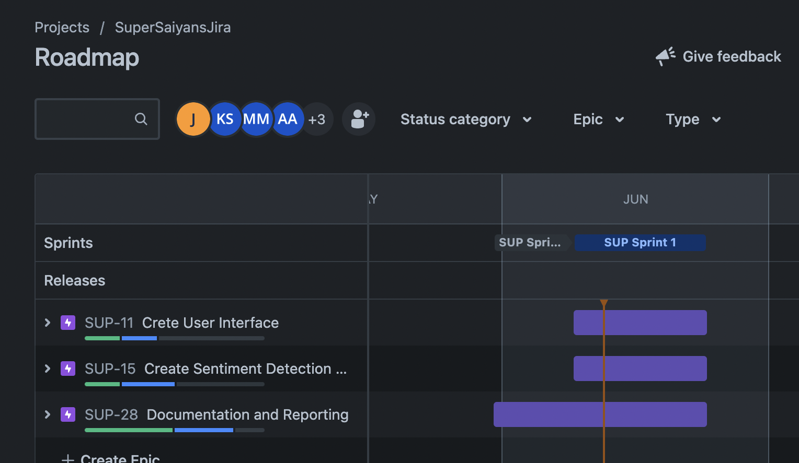
02
Project Management

Slide 5
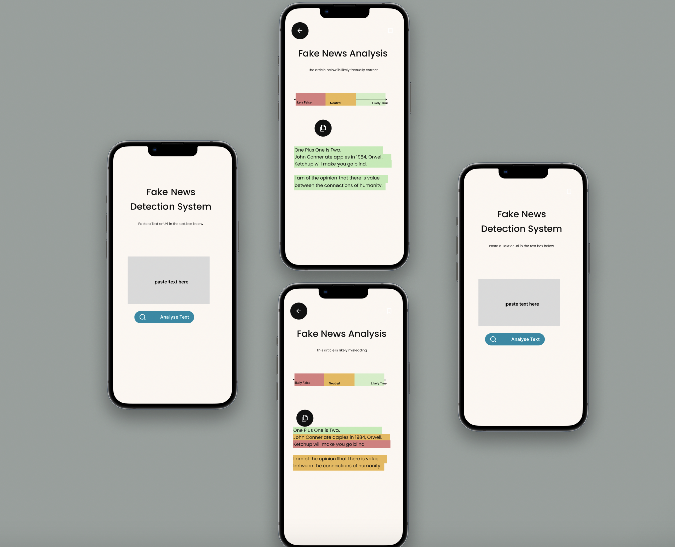
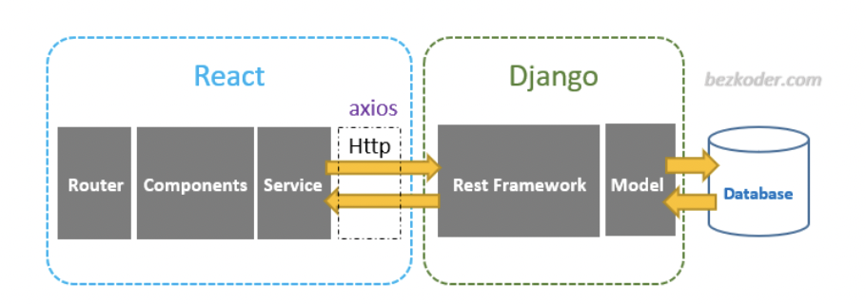
03
Current Progress
Jira board set up
Architecture
UI Mockup
Front-end Prototype

Slide 6
……
Data collection
Initial model
Meet with Microsoft team
Documentation

Slide 7
Future Plans
04
Data cleaning
Improve UI and connect front-end and back-end
Improve model
Set up cloud environment

Slide 8
Roles Assigned
05
MEMBER
Kevin Singpurwala
Jianhao Feng
Madhav Mohan
AhmedFaizel Asharafali
Anju Krishna
Natasha Suman
ROLE
Front-End
Front-End
Back-End
Back-End
Tester
Data Analyst/ ML Engineer

Slide 9
Questions?

