Slide 1
KPI

Slide 2



Slide 3
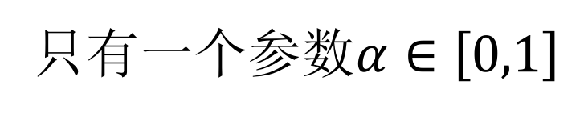
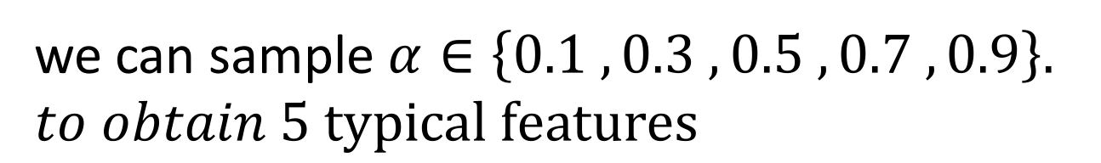
EWMA(Exponentially Weighted Moving Average)
只有一个参数$α∈\left[0,1\right]$
we can sample $α∈\left\{0.1 , 0.3 , 0.5 , 0.7 , 0.9\right\}.$
$to obtain 5 typical features$

Slide 4
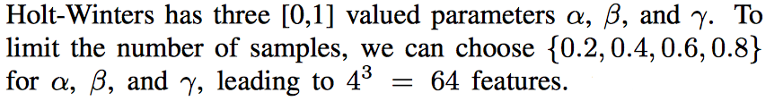
Holt-Winters

Slide 5
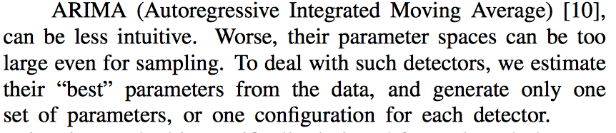
ARIMA (Autoregressive Integrated Moving Average)

Slide 6
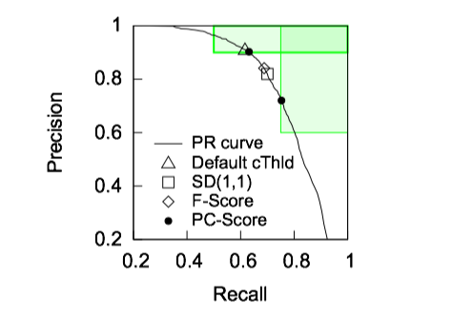




Slide 7

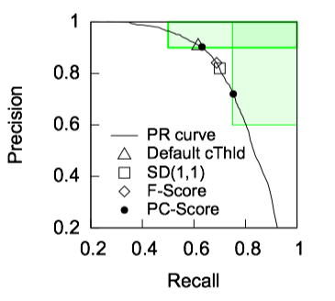
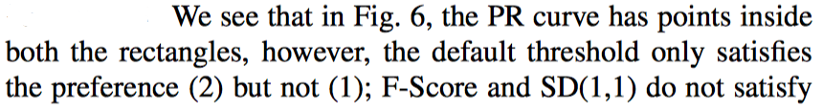

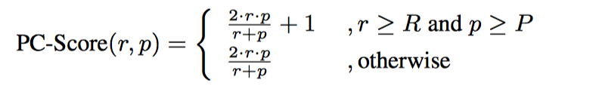

Slide 8
