Slide 1



Implementing “static” control flow in C++14
http://vittorioromeo.info
vittorio.romeo@outlook.com
http://github.com/SuperV1234/cppcon2016
Notes:
About me (tutorials, open-source work, conferences, SW Engineer at Bloomberg LP)
GitHub repo
Look for TODO
TODO: align everything in every slide

Slide 2
Talk overview
What is “static” control flow?
Compile-time branching.
History of static if in C++.
C++17: if constexpr.
C++14: static_if.
Implementation details.
Compile-time iteration.
for_each_argument.
static_for.
Notes:
TODO: picture/drawing

Slide 3
What is “static” control flow?
static is a specifier with multiple meanings in C++.
It’s also a word commonly used by developers to refer to compile-time control flow.
Existing languages, such as D, have powerful compile-time constructs like static if.
Goals of this talk:
Understand the benefits of static control flow.
Look at the history of static_if proposals in C++, analyze if constexpr.
Implement two C++14 constructs: static_if and static_for.
Notes:
"static if" is a name given to the compile-time counterpart of the `if` statement - its inclusion in the C++ language has been controversially proposed multiple times, but it has found a home in other languages. (C++17 will finally introduce a compile-time branching construct that we're going to analyze in this talk.)
C++ developers often feel that the functional purity of template metaprogramming and its lack of explicit control flow options make compile-time code harder to implement and to reason about.
In this talk, we'll analyze and implement two powerful compile-time C++14 control flow constructs: `static_if` and `static_for`.
Before doing that, we'll look at some examples of `static if` in action in other languages, and at the new `if constexpr` construct.

Slide 4
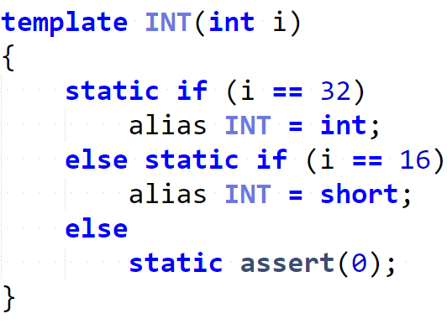
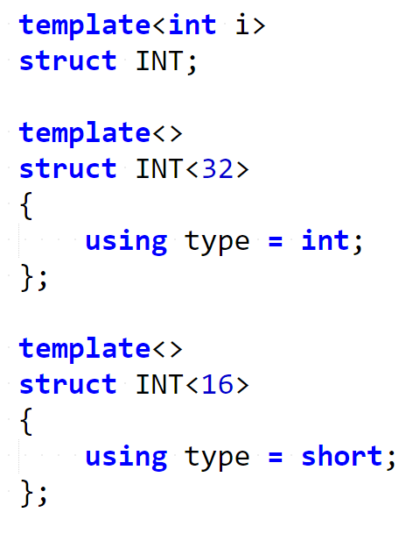
Example: static if in D
Notes:
The above D code snippet shows a working compile-time `static if`, where every branch does not introduce a new scope.
Ask audience: how to achieve that in C++?
To achieve the same result in C++, a solution based on "explicit template specialization" can be used.

Slide 5
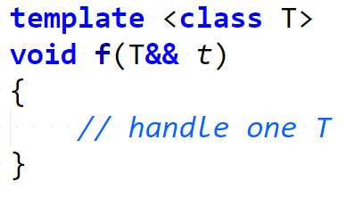
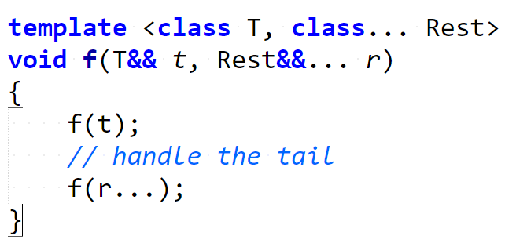
Example: handling variadic argument packs (traditional)
Notes:
"static if" is not only useful when defining type aliases, but it's very convenient (and considered superior to specialization) in contexts where a small piece of code needs to be conditionally executed depending on a compile-time condition.
Traditional: two overloads, repetition

Slide 6
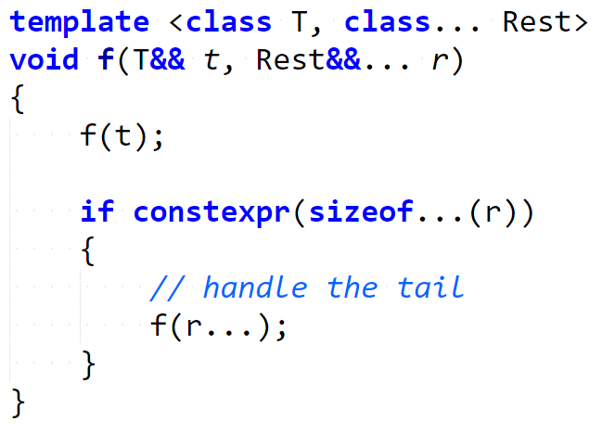
Example: handling variadic argument packs (static if)
Notes:
Static if: a single overload, no repetition, “more local” code

Slide 7
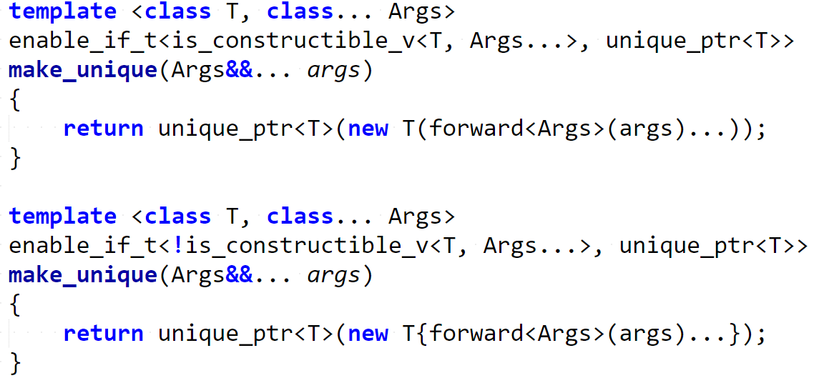
Example: {} vs () object construction (traditional)
Notes:
Traditional: explicit specialization, enable_if, two functions, repetition

Slide 8
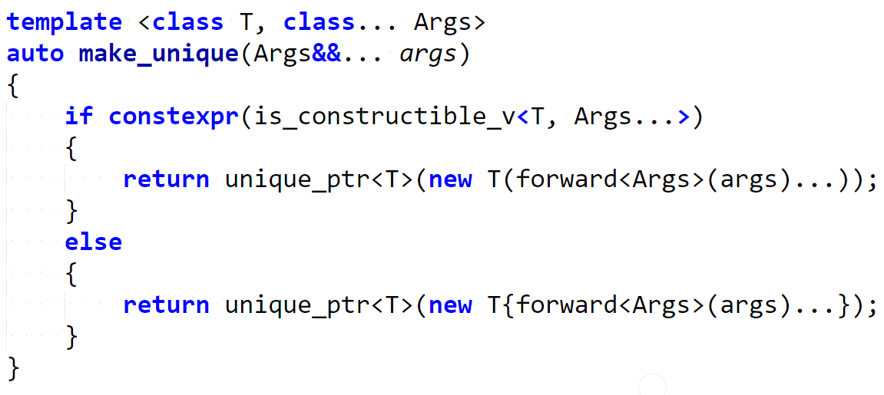
Example: {} vs () object construction (static if)
Notes:
Static if: one function, no enable if, no repetition, “cleanliness” and “locality”
The above examples were not created by me: they are part of a series of proposals that led to the inclusion of `if constexpr` in the upcoming C++17 standard.

Slide 9
History of static if proposals - 1
The previous examples were taken from proposal P0128R0:
"constexpr if" - Ville Voutilainen
This paper was originally created as a "resurrection" of the very controversial previous "static if" N3322 and N3329 proposals:
"A Preliminary Proposal for a Static if" - Walter E. Brown
"static if declaration" - W. Bright, H. Sutter, A. Alexandrescu
The two above proposals were considered harmful in N3613, due to their unintuitive scope rules and inconsistency with the rest of the language:
"Static if considered" - B. Stroustrup, G. Dos Reis, A. Sutton
Notes:
Original static if proposals were similar to D’s construct (they did not follow familiar scope rules)

Slide 10
History of static if proposals - 2
Starting with N4461 by V. Voutilainen, the idea of a compile-time `if` construct with familiar scope rules began to gain traction.
“Static if resurrected“ – Ville Voutilainen
Eventually, the proposed syntax and standard wording was revised multiple times in P0128R0, P0128R1, P0292R0, and P0292R1.
“constexpr_if” – Ville Voutilainen
“constexpr_if” – Ville Voutilainen, Daveed Vandevoorde
“constexpr if: A slightly different syntax” – Jens Maurer
“constexpr if: A slightly different syntax” – Jens Maurer

Slide 11
History of static if proposals - 3
The final revision, P0292R2, was accepted for C++17:
“constexpr if: A slightly different syntax” - Jens Maurer
Notes:
TODO: pictures/drawings
TODO: mention location of standard meeting

Slide 12
if constexpr(…) – valid C++17 example
Notes:
Same example, seen earlier

Slide 13
if constexpr(…) – rules
Restricted to block scopes.
Always going to establish a new scope.
Required that there exists values of the condition so either condition branch is well-formed.
Notes:
First two rules: consistency with runtime if and scopes in the language. I.e. the D example does not work in C++.
(show animation)
Last rule: basically, the two branches have to be parseable and well-formed. Only the matched branch will be instantiated, though.
The above rules deal with the controversial ideas of N3613, making `constexpr if` an intuitive and familiar compile-time version of the regular `if` statement.

Slide 14
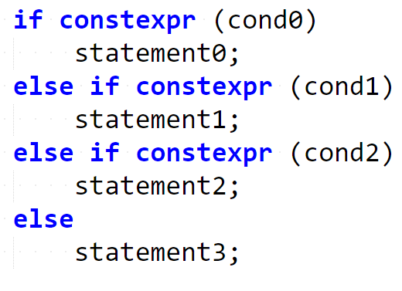
if constexpr(…) – branch chaining

Slide 15
“Do I have to wait until C++17 is supported in my company/architecture?”
Notes:
`if constexpr` is part of the C++17 standard... ...but you don't have to wait for your compiler to implement it!
It turns out that we can create an equivalent construct with C++14 language features, with, unfortunately, a slightly less enticing syntax.

Slide 16
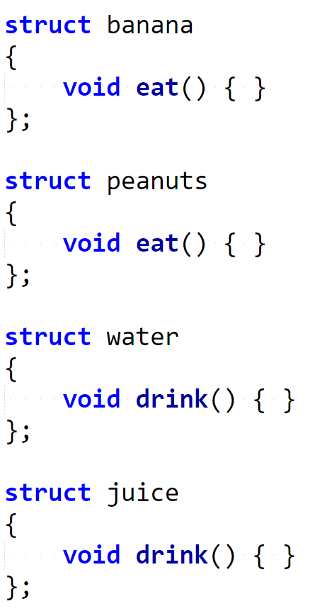
C++14 static_if – example (1)
Example situation:
Multiple food-related classes with slightly different interfaces.
Goal:
Create a generic consume(x) function that will accept any kind of food instance and will print something to stdout.

Slide 17
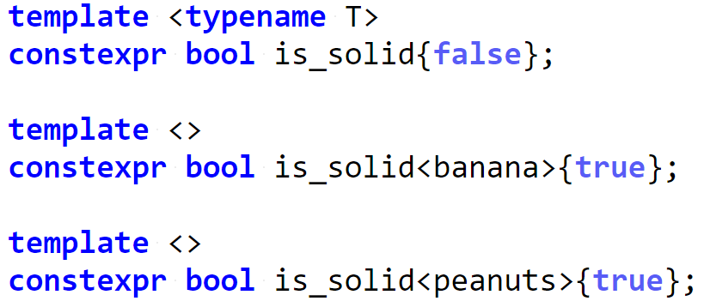
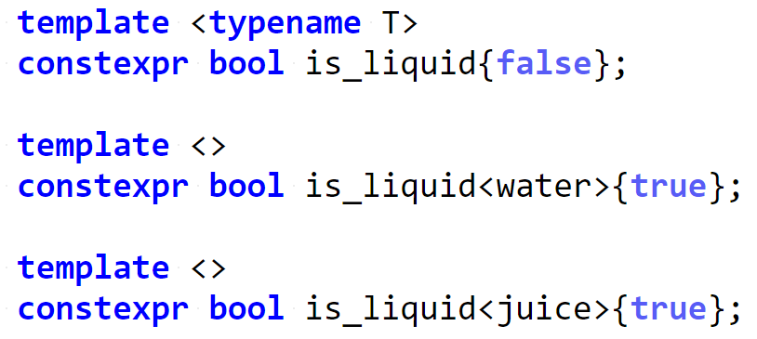
C++14 static_if – example (2)
Both if constexpr and my static_if implementation require a constant expression as their branching condition.
Let’s define some constexpr bool variable templates to categorize the foods depending on their interface.

Slide 18
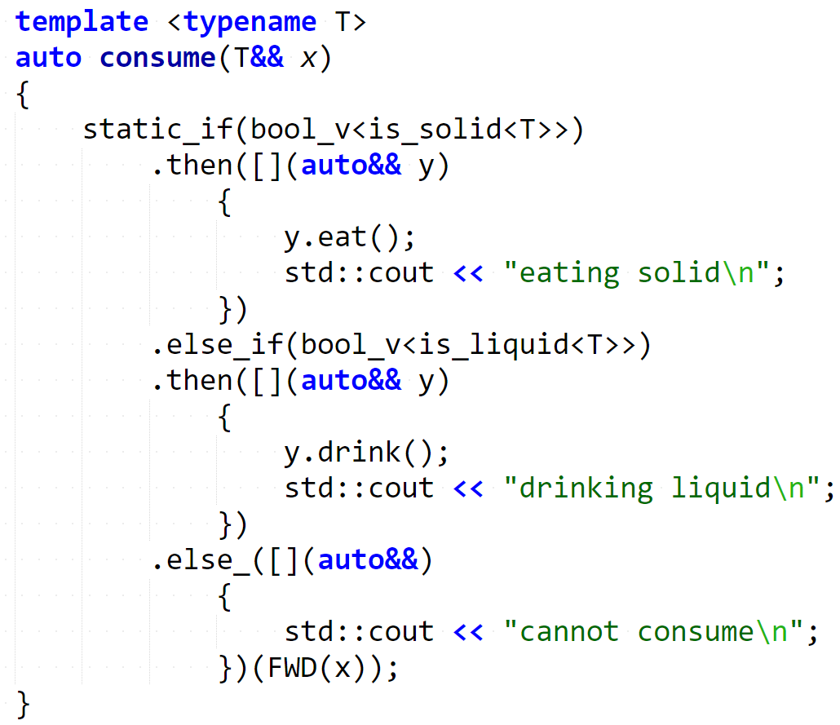
Wrapping types inside values is what allows amazing libraries such as boost::hana (by Louis Dionne) or fit and tick (by Paul Fultz II) to provide extremely powerful, clean, and intuitive metaprogramming facilities.
The implementation requires the condition to be wrapped inside a compile-time boolean variable wrapper: that's what bool_v is for.
More info regarding "type-value encoding"/"dependent typing": http://pfultz2.com/blog/2015/01/24/dependent-typing/ http://boostorg.github.io/hana/index.html#tutorial-type

Slide 19
Think of every branch of the static_if as a template function that will only be instantiated if the predicate matches.
In this example, even if y.eat() does not exist, we won't get a compilation error, because the branch won't be instantiated, thus triggering SFINAE.
Scope rules are what you would expect.

Slide 20
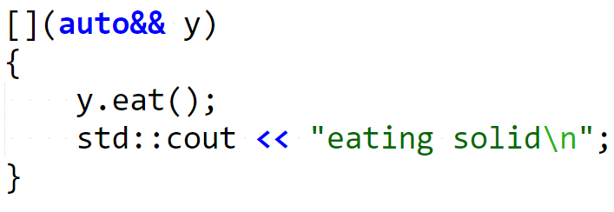
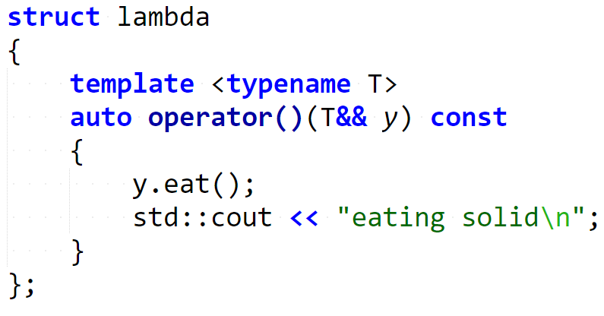
This can happen thanks to C++14's generic lambdas.

Slide 21
C++14 static_if – instantiating matching branch
What allows static_if branches to only be instantiated when the condition is true?
"Passing the argument back to static_if" with the final call does that: thanks to this trick, the instantiation of the branches is "delayed" so that SFINAE can take place.

Slide 22
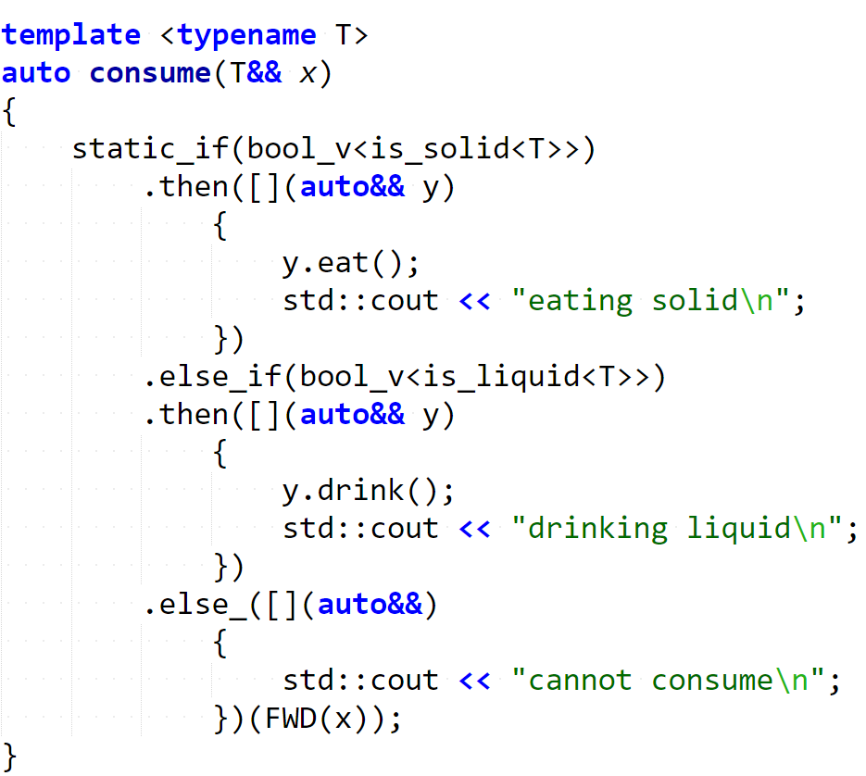

Step 0: call consume

Slide 23
Step 1: find matching branch

Slide 24
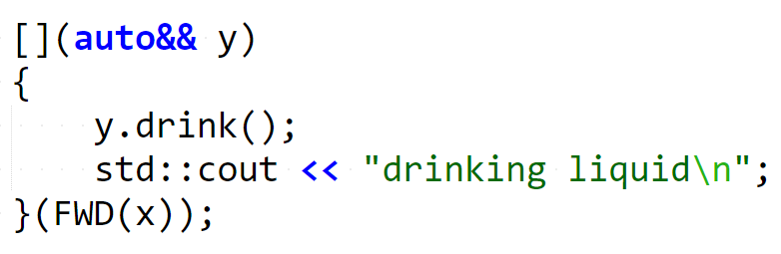
Step 2: instantiate and call matching branch
Imagine that the entire static_if “collapses” to the first matching branch’s body. The body can then be called with the argument FWD(x).

Slide 25
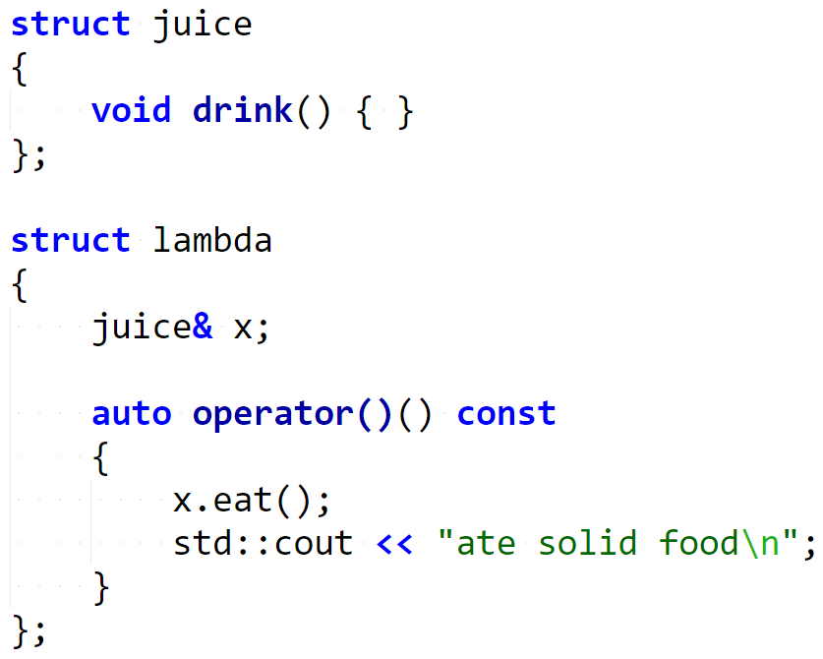
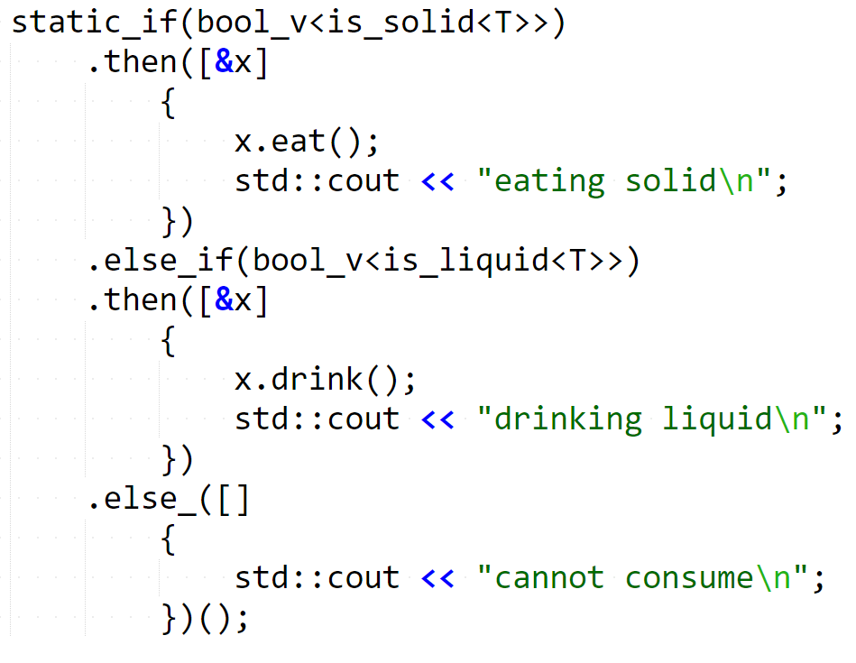
C++14 static_if – capture?
Would capturing the variable work?
Nope.
Notes:
Ask audience

Slide 26
Questions?
http://vittorioromeo.info vittorio.romeo@outlook.com http://github.com/SuperV1234
Thank you for attending!

