Slide 1

Bloomberg @ CppCon 2016
#CppCon
TODO: other Bloomberg talks
Dietmar Kuhl: “Constant Fun”
John Lakos: “???”
???

Slide 2



Implementing “static” control flow in C++14
http://github.com/SuperV1234/cppcon2016

Slide 3
Talk overview
What is “static” control flow?
Compile-time branching.
History of static if in C++.
C++17: if constexpr.
C++14: static_if.
static_if implementation details.
Compile-time iteration.
for_each_argument.
static_for.

Slide 4
What is “static” control flow?
static is a specifier with multiple meanings in C++.
It’s also a word commonly used by developers to refer to compile-time control flow.
Existing languages, such as D, have powerful compile-time constructs like static if.
Goals of this talk:
Understand the benefits of static control flow.
Look at the history of static_if proposals in C++, analyze if constexpr.
Implement two C++14 constructs: static_if and static_for.
Notes:
"static if" is the compile-time counterpart of the `if` statement - its inclusion in C++ has been controversially proposed multiple times, but it has found a home in other languages. (C++17 will introduce compile-time branching: we're going to look at it in this talk.)
C++ developers may feel that the functional purity of TMP and its lack of explicit control flow options make compile-time code harder to implement and to reason about.
In this talk, we'll analyze and implement two powerful compile-time C++14 control flow constructs: `static_if` and `static_for`.
Before doing that, we'll look at some examples of `static if` in action in other languages, and at the new `if constexpr` construct.

Slide 5
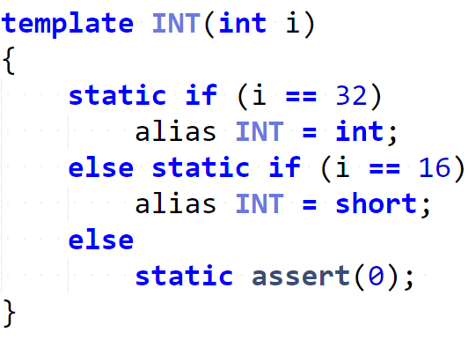
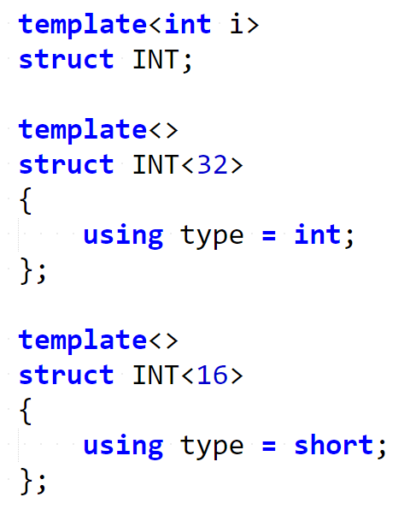
Example: static if in D
Notes:
The above D code snippet shows a working compile-time `static if`, where every branch does not introduce a new scope.
It’s like having the compiler completely ignore the unmatched branches.
Ask audience: how to achieve that in C++?
To achieve the same result in C++, a solution based on "explicit template specialization" can be used.

Slide 6
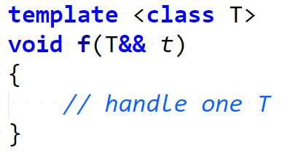
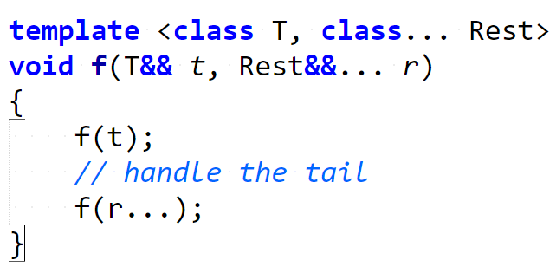
Example: handling variadic argument packs (traditional)
Notes:
"static if" is not only useful when defining type aliases, but it's very convenient (and considered superior to specialization) in contexts where a small piece of code needs to be conditionally executed depending on a compile-time condition.
Traditional: two overloads, repetition

Slide 7
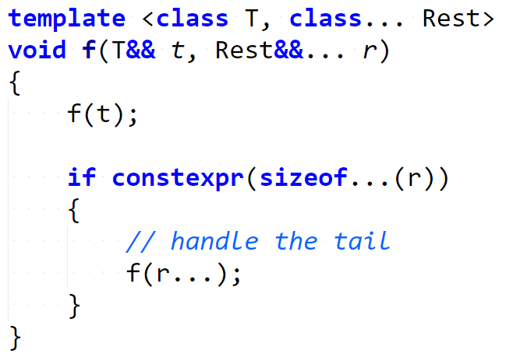
Example: handling variadic argument packs (static if)
Notes:
Assume we had a `static if`in C++ called `if constexpr(….)`.
Static if: a single overload, no repetition, “more local” code

Slide 8
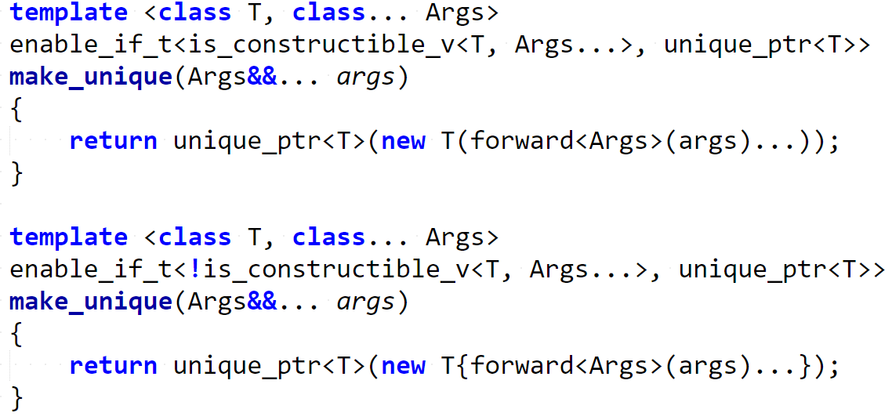
Example: {} vs () object construction (traditional)
Notes:
Traditional: explicit specialization, enable_if, two functions, repetition

Slide 9
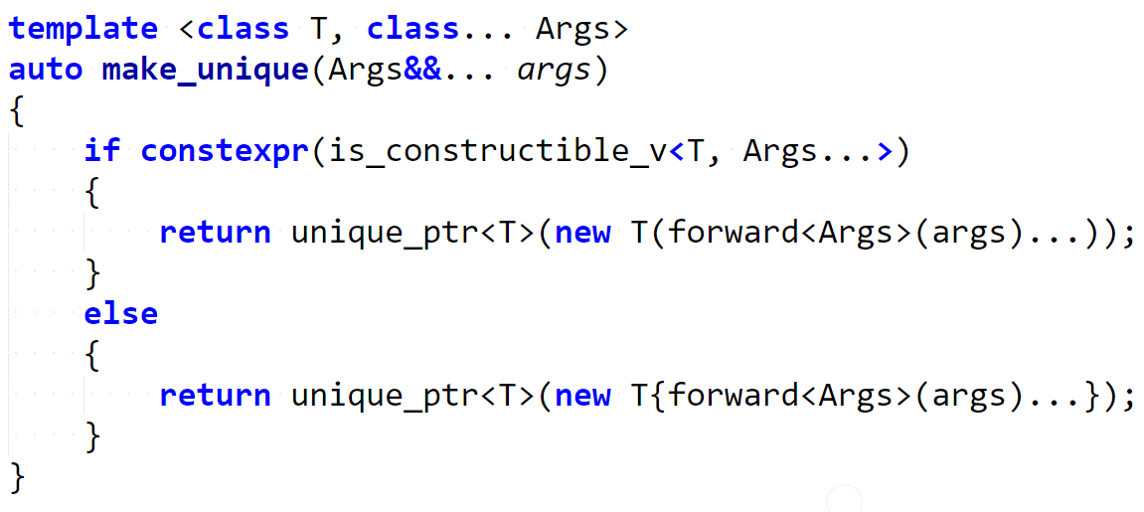
Example: {} vs () object construction (static if)
Notes:
Static if: one function, no enable if, no repetition, “cleanliness” and “locality”
The above examples were not created by me: they are part of a series of proposals that led to the inclusion of `if constexpr` in the upcoming C++17 standard.

Slide 10
History of static if proposals - 1
The previous examples were taken from proposal P0128R0:
"constexpr if" - Ville Voutilainen
This paper was originally created as a "resurrection" of the very controversial previous "static if" N3322 and N3329 proposals:
"A Preliminary Proposal for a Static if" - Walter E. Brown
"static if declaration" - W. Bright, H. Sutter, A. Alexandrescu
The two above proposals were considered harmful in N3613, due to their unintuitive scope rules and inconsistency with the rest of the language:
"Static if considered" - B. Stroustrup, G. Dos Reis, A. Sutton
Notes:
Original static if proposals were similar to D’s construct (they did not follow familiar scope rules)

Slide 11
History of static if proposals - 2
Starting with N4461 by V. Voutilainen, the idea of a compile-time `if` construct with familiar scope rules began to gain traction.
“Static if resurrected“ – Ville Voutilainen
Eventually, the proposed syntax and standard wording was revised multiple times in P0128R0, P0128R1, P0292R0, and P0292R1.
“constexpr_if” – Ville Voutilainen
“constexpr_if” – Ville Voutilainen, Daveed Vandevoorde
“constexpr if: A slightly different syntax” – Jens Maurer
“constexpr if: A slightly different syntax” – Jens Maurer

Slide 12

History of static if proposals - 3
The final revision, P0292R2, was accepted for C++17:
“constexpr if: A slightly different syntax” - Jens Maurer
Notes:
Standard meeting: Oulu

Slide 13
if constexpr(…) – valid C++17 example - 1
Notes:
Same example, seen earlier

Slide 14
if constexpr(…) – valid C++17 example - 2
Notes:
Same example, seen earlier

Slide 15
if constexpr(…) – rules
Restricted to block scopes.
Always going to establish a new scope.
Required that there exists values of the condition so either condition branch is well-formed.
Notes:
First two rules: consistency with runtime if and scopes in the language. I.e. the D example does not work in C++.
(show animation)
Last rule: basically, the two branches have to be parseable and well-formed. Only the matched branch will be instantiated, though.
The above rules deal with the controversial ideas of N3613, making `constexpr if` an intuitive and familiar compile-time version of the regular `if` statement.

Slide 16
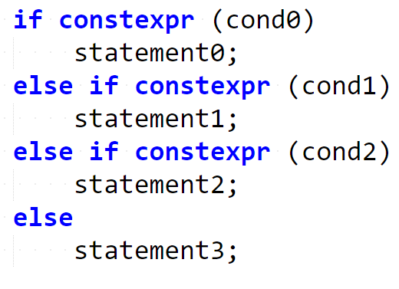
if constexpr(…) – branch chaining

Slide 17
“Do I have to wait until C++17 is supported by my company/architecture?”
Notes:
`if constexpr` is part of the C++17 standard... ...but you don't have to wait for your compiler to implement it!
It turns out that we can create an equivalent construct with C++14 language features, with, unfortunately, a slightly less enticing syntax.

Slide 18
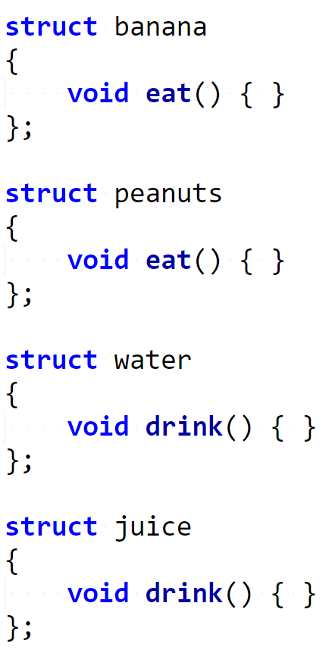
C++14 static_if – example (1)
Example situation:
Multiple food-related classes with slightly different interfaces.
Goal:
Create a generic consume(x) function that will accept any kind of food instance and will print something to stdout.

Slide 19
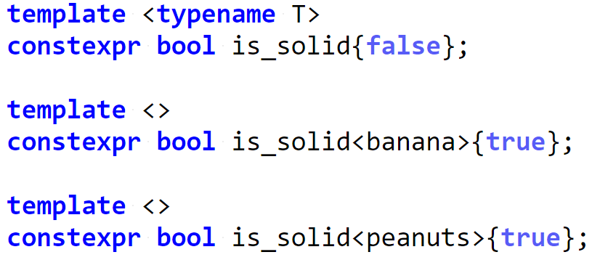
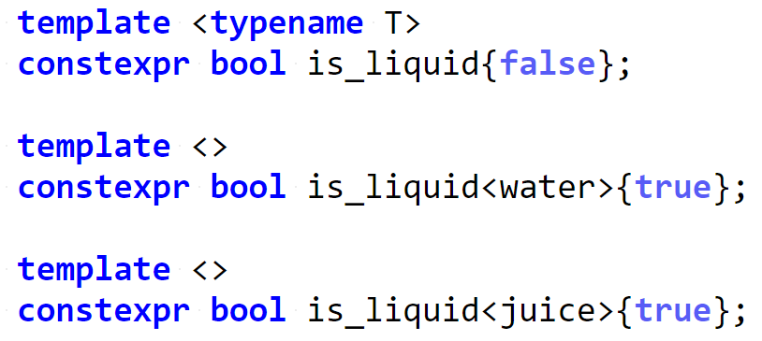
C++14 static_if – example (2)
Both if constexpr and my static_if implementation require a constant expression as their branching condition.
Let’s define some constexpr bool variable templates to categorize the foods depending on their interface.
Notes:
These are specialized C++14 variable templates.

Slide 20
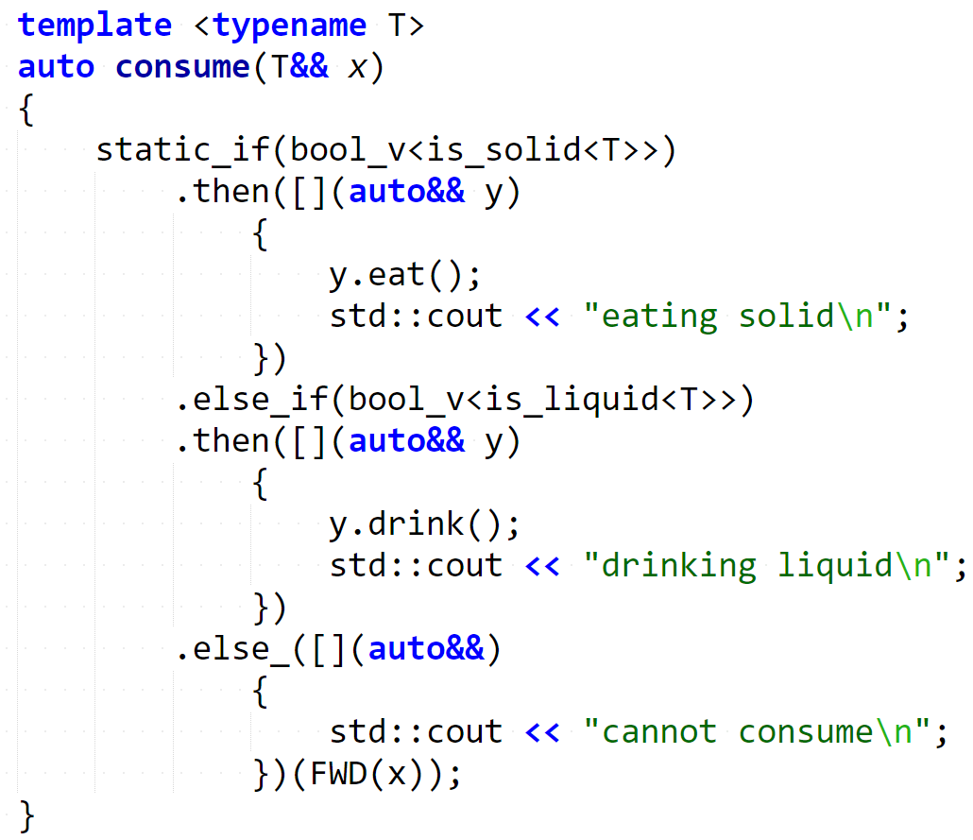
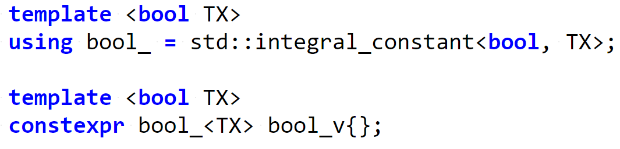
Wrapping types inside values (and vice versa) is what allows amazing libraries such as boost::hana (by Louis Dionne) or fit and tick (by Paul Fultz II) to provide extremely powerful, clean, and intuitive metaprogramming facilities.
The implementation requires the condition to be wrapped inside a compile-time boolean variable wrapper: that's what bool_v is for.
More info regarding "type-value encoding"/"dependent typing": http://pfultz2.com/blog/2015/01/24/dependent-typing/ http://boostorg.github.io/hana/index.html#tutorial-type

Slide 21
Think of every branch of the static_if as a template function that will only be instantiated if the predicate matches.
In this example, even if y.eat() does not exist, we won't get a compilation error, because the branch won't be instantiated.
Scope rules are what you would expect.

Slide 22
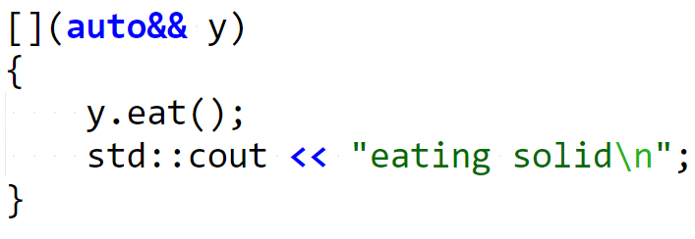
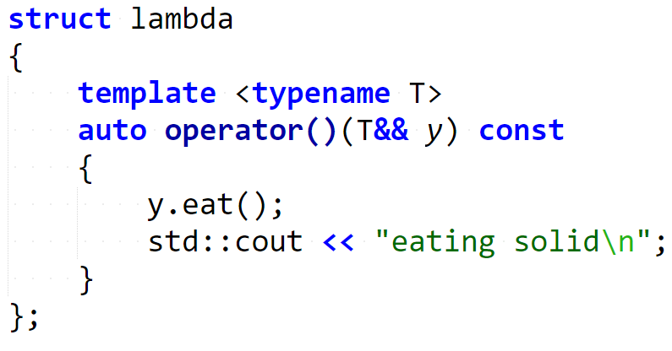
This pattern works thanks to C++14's generic lambdas.

Slide 23
C++14 static_if – instantiating matching branch
What allows static_if branches to only be instantiated when the condition is true?
"Passing the argument back to static_if" with the final call does that: thanks to this trick, the instantiation of the branches is "delayed" so that potentially invalid branches do not cause a compilation error unless chosen.

Slide 24
Let’s analyze the technique, step-by-step.

Slide 25
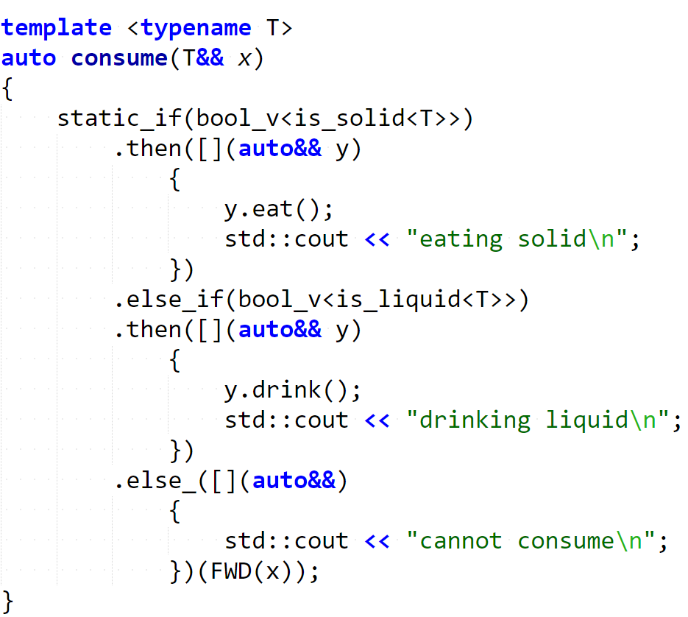

Step 0: call consume

Slide 26
Step 1: find matching branch

Slide 27
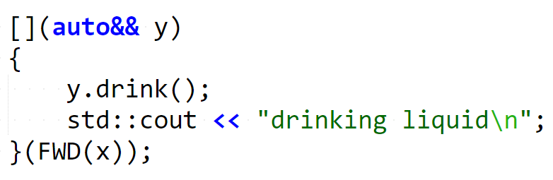
Step 2: instantiate and call matching branch
Imagine that the entire static_if “collapses” to the first matching branch’s body. The body can then be called with the argument FWD(x).

Slide 28
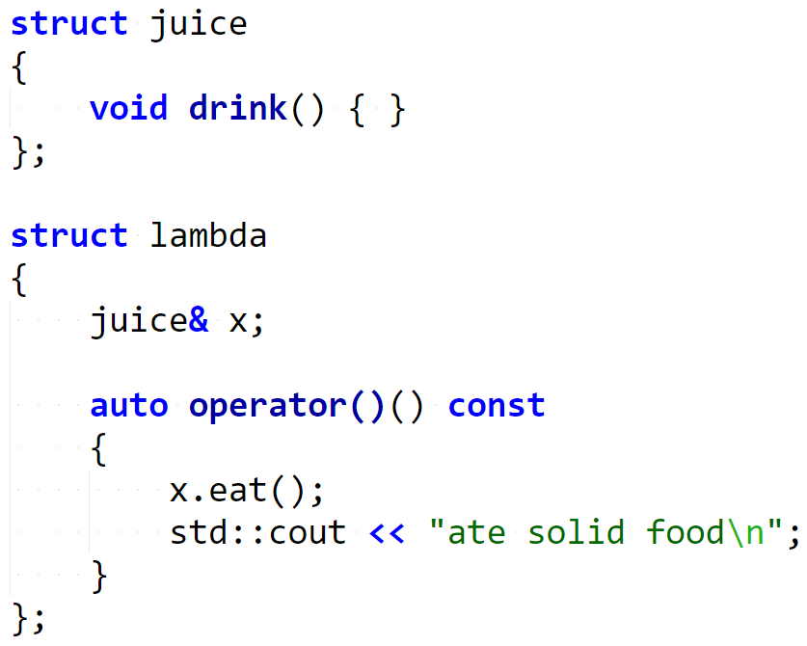
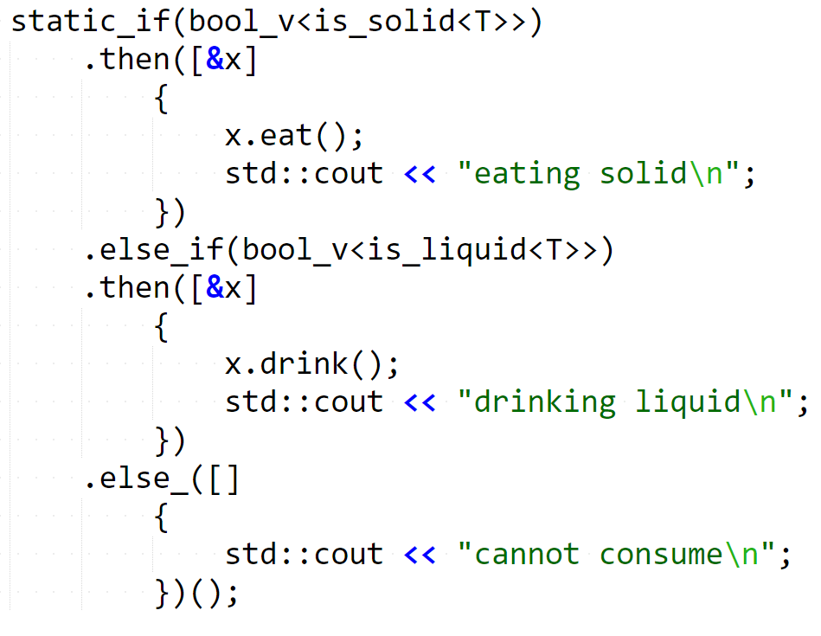
C++14 static_if – capture?
Would capturing the variable work?
Nope.
This gets “immediately instantiated” and causes a compilation error.
Notes:
Ask audience

Slide 29
code();

Slide 30
Questions?
http://vittorioromeo.info http://github.com/SuperV1234 vittorio.romeo@outlook.com vromeo5@bloomberg.net
Thank you for attending!

