Slide 1
Implementing “static” control flow in C++14
Todo: Vittorio Romeo, Bloomberg, CppCon (check c++now ecst)

Slide 2
What is “static” control flow?
static is a specifier with multiple meanings in C++.
It’s also a word commonly used by developers to refer to compile-time control flow.
Existing languages, such as D, have powerful compile-time constructs like static if.
Goals of this talk:
Understand the benefits of static control flow.
Look at the history of static_if proposals in C++, analyze if constexpr.
Implement two C++14 constructs: static_if and static_for.
Notes:
// "static if" is a name given to the compile-time counterpart of the `if` statement - its inclusion in the C++ language has been controversially proposed multiple times, but it has found a home in other languages. (C++17 will finally introduce a compile-time branching construct that we're going to analyze in this talk.)
// C++ developers often feel that the functional purity of template metaprogramming and its lack of explicit control flow options make compile-time code harder to implement and to reason about.
// In this talk, we'll analyze and implement two powerful compile-time C++14 control flow constructs: `static_if` and `static_for`.
// Before doing that, we'll look at some examples of `static if` in action in other languages, and at the new `if constexpr` construct.

Slide 3
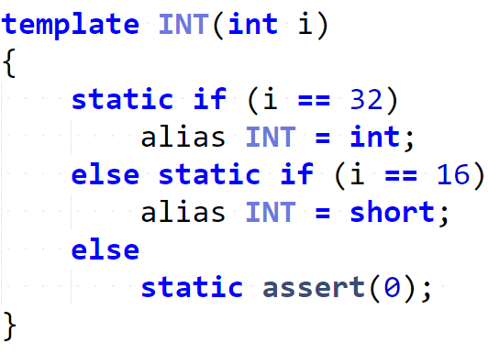
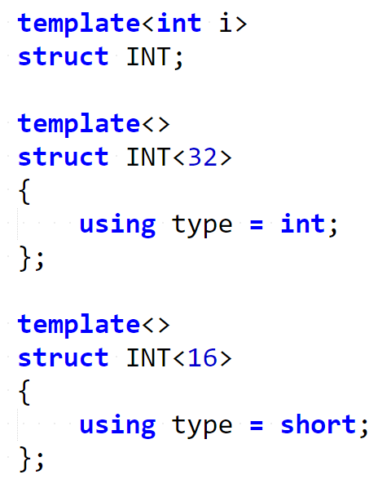
Example: static if in D
Notes:
// The above D code snippet shows a working compile-time `static if`, where every branch does not introduce a new scope.
// To achieve the same result in C++, a solution based on "explicit template specialization" can be used:

Slide 4
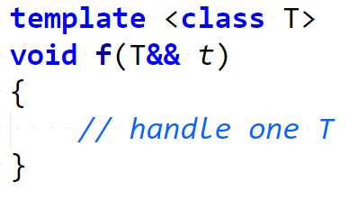
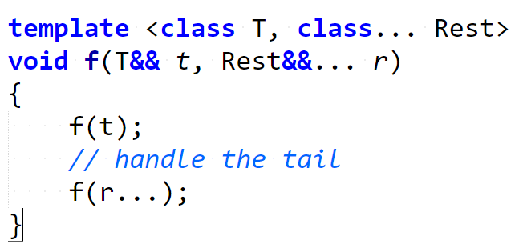
Example: handling variadic argument packs (traditional)
Notes:
// "static if" is not only useful when defining type aliases, but it's very convenient (and considered superior to specialization) in contexts where a small piece of code needs to be conditionally executed depending on a compile-time condition.
Traditional: two overloads, repetition

Slide 5
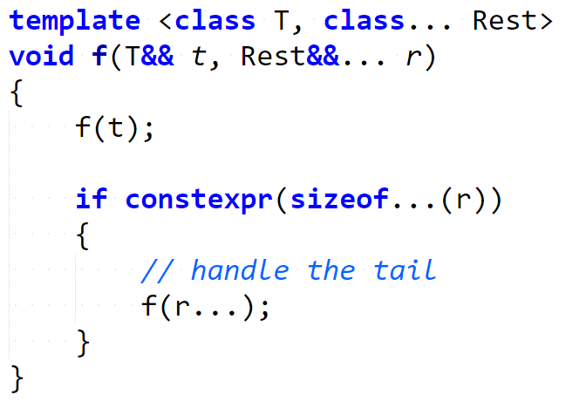
Example: handling variadic argument packs (static if)
Notes:
Static if: a single overload, no repetition, “more local” code

Slide 6
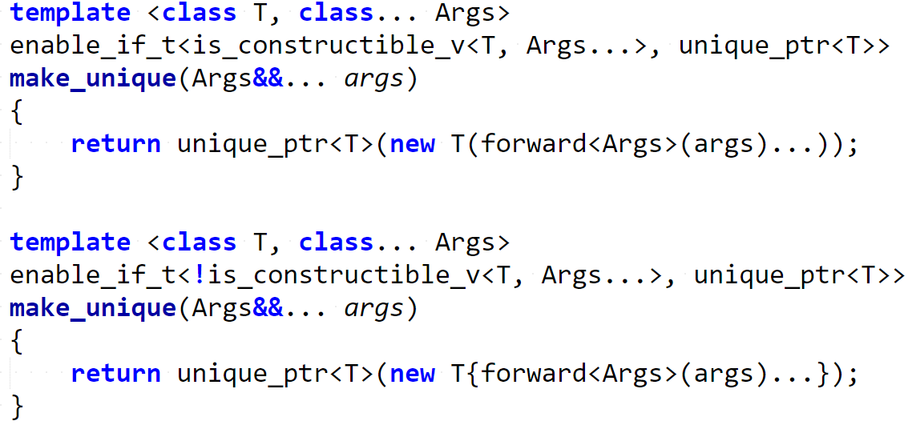
Example: {} vs () object construction (traditional)
Notes:
Traditional: explicit specialization, enable_if, two functions, repetition

Slide 7
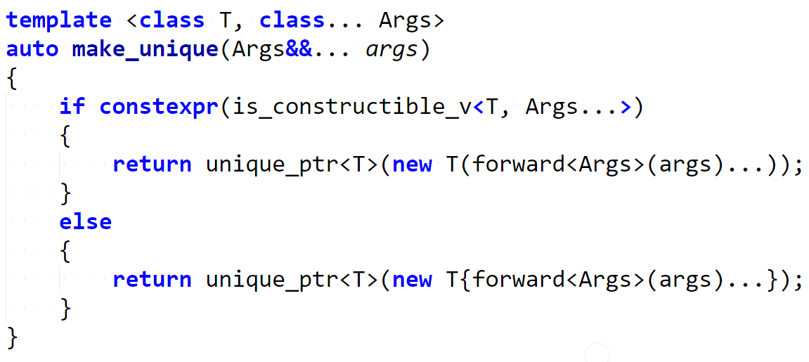
Example: {} vs () object construction (static if)
Notes:
Static if: one function, no enable if, no repetition, “cleanliness” and “locality”
// The above examples were not created by me: they are part of a series of proposals that led to the inclusion of `if constexpr` in the upcoming C++17 standard.

Slide 8
History of static if proposals - 1

Slide 9
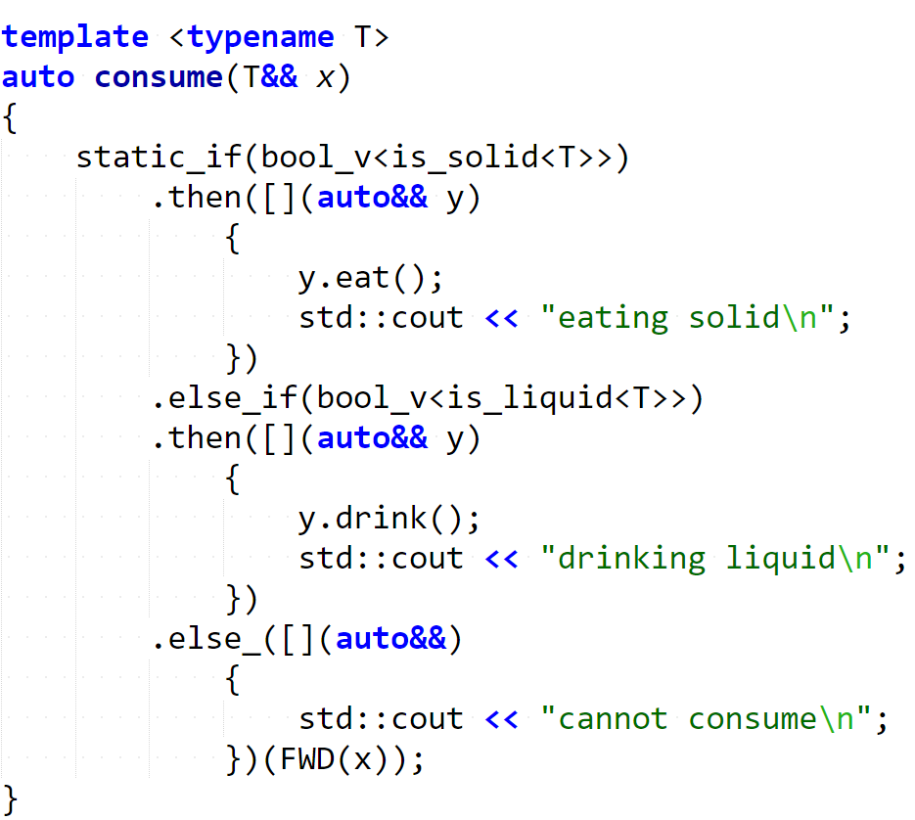

Step 0: call consume

Slide 10
Step 1: find matching branch

Slide 11
Step 2: instantiate matching branch

