Slide 1
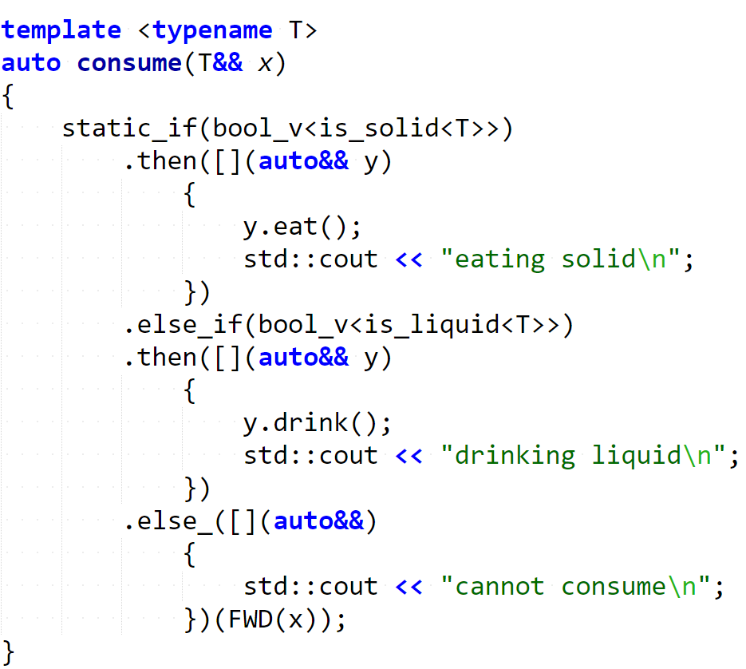

Step 0: call consume

Slide 2
Step 1: find matching branch

Slide 3
Step 2: instantiate matching branch

