Slide 1
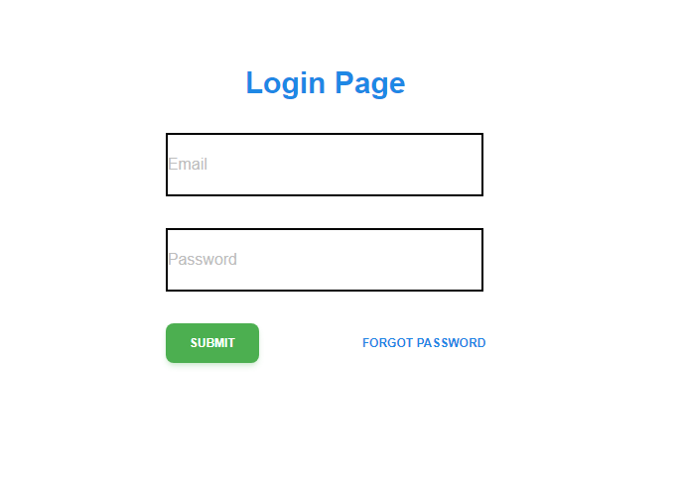

Slide 2
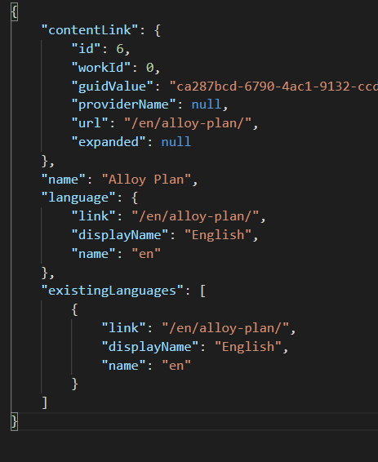
Enter field : https://aymanelbadawy.com/data-modelling-using-json/
Display field:
for example:

Slide 3
Goals and expectation
Able to enter a webpage in textfield, which the web apps should return all data in Jason
Able to store the json data in to sql database ( postgresSQL or Mysql)
Login page should allow to user to access dataScrapApps page
Backend should be written in - python/javascript
Frontend is written in reactjs.

