Slide 1
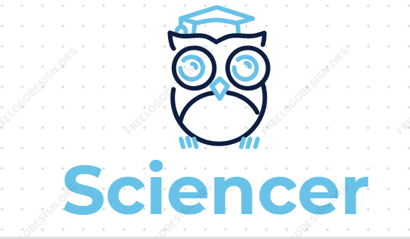

Slide 2

The Problem
Sophia is an average student
She has a new subject, science
Has trouble
Open ended science requires secret language
key words, special phrases

Slide 3

Our solution
Sciencer an AI powered application
Teachers are shackled by the answer key
Show example answer key
Sciencer can automatically judge how close is the answer
gives feedback to students

Slide 4
Demonstration
Walk through the test page
1st question completely wrong
2nd question spelling mistake on keyword
3rd question inofensive spelling mistake
4th question correct
Students can leave feedback which the admin can use to improve the AI

Slide 5
Demonstration, management
Human friendly definition files
Management interface
Examples and counterexamples
Easy to integrate with other sources of information

Slide 6

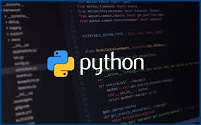


Technology
Built upon the Watson library for natural language processing
Python for programming logic also know as the brain
Web design, multiplatform application (Flask, page templates)

Slide 7
Future technical development
Automatic information extraction from textbooks and test sheets
Use custom intent datatypes to specify key elements of the answer
Genertate example using tsaurses

Slide 8
Conclusion
School outreach

Slide 9


