Slide 1
DAA HACKATHON DEFENSE
LOWERBOUND: University Timetable Room Minimizer
A graph-coloring solution with a proof of optimality.
20
rooms for 702 classes across 36 periods · lower bound 20 · gap 0
Notes:
LOWERBOUND schedules 702 university classes across 36 periods using 20 rooms. The lower bound is 20, so the final gap is 0.
This defense explains the model, algorithm, implementation evidence, and why the result is optimal.

Slide 2
Problem Understanding, Input and Output
The timetable is a constrained assignment with a minimum-room objective.
GOAL
INPUT
OUTPUT
Schedule every class
27 · 49 · 26 · 36
One complete assignment
Schedule all classes so no section and no teacher has two classes at the same time, using the minimum number of classrooms.
27 sections, 49 teachers, 26 classes per section per week, and 6 days × 6 periods = 36 periods.
A period and room for every one of the 702 classes, the room count, and a proof that it is minimal.
2
Notes:
The goal is to schedule all classes without section or teacher conflicts while minimizing classrooms.
The input contains 27 sections, 49 teachers, 26 classes per section per week, and 36 periods. The output assigns every class to a period and room and proves minimality.

Slide 3
Constraints
FEASIBILITY
SCALE
A section cannot attend two classes in the same period.
A teacher cannot teach two classes in the same period.
Classes sharing a period need different rooms.
n = 702 classes · T = 36 periods
S = 27 sections · F = 49 teachers.
n ≤ 1,000, so O(n²) is fast enough at about 0.5 million basic steps; trying every timetable means 36^702 assignments.
EDGE CASES
Overfull section or teacher, empty input, malformed CSV rows, a stuck solver, and the combined CSE-G + CSE-H group.
3
Notes:
Feasibility requires distinct periods for classes sharing a section or teacher, and distinct rooms for classes sharing a period.
The instance has 702 classes, 36 periods, 27 sections, and 49 teachers. The implementation also handles malformed, empty, overfull, stuck, and special grouped inputs.

Slide 4
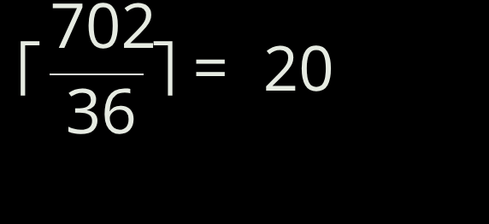
Proposed Approach: Model, Lower Bound, Technique
MODEL
PROOF
TECHNIQUE
Conflict graph
DSatur + repair
Class → vertex
Same section or teacher → edge
Period → color
Rooms → largest color class
702 vertices · 12,345 edges
Greedy DSatur, local search repair, and polish, checked against the lower bound.
Exact minimum is NP-hard.
Not used: shortest-path, spanning-tree, dynamic-programming, or divide-and-conquer algorithms.
With 19 rooms, 19 × 36 = 684 slots, 18 short of 702.
Fewer than 20 rooms is impossible.
4
Notes:
Each class becomes a vertex, and shared section or teacher membership creates a conflict edge. Periods are colors, while rooms are determined by the largest color class.
The lower bound is the ceiling of 702 divided by 36, which is 20. DSatur, repair, and polish are used to reach that bound; unrelated algorithmic structures are not used.

Slide 5
Algorithm and Pseudocode
ALGORITHM
PSEUDOCODE
Build the conflict graph.
Select the uncolored class with highest saturation, then degree; assign the least-loaded free period.
Repair the fullest period with ejection chains; polish same-subject-twice-a-day cases without increasing the busiest period.
Use seeded restarts if the lower bound is not reached; assign rooms after periods are fixed; verify.
DSATUR(G, T): while some vertex is uncolored, choose v by saturation then degree; choose t as the least-loaded period not used by a neighbour; color v with t.
rooms = max classes in any period.
REPAIR repeats while rooms > lower bound: repair the fullest period with ejection chains; polish same-subject-twice-a-day cases without increasing the busiest period.
Use seeded restarts if the lower bound is not reached; assign rooms after periods are fixed; verify.
5
Notes:
DSatur repeatedly chooses the uncolored class with highest saturation and then degree, assigning the least-loaded free period.
If the lower bound is not reached, repair uses ejection chains and polish without increasing the busiest period. Seeded restarts continue the search; rooms are assigned after periods are fixed, and the result is verified.

Slide 6
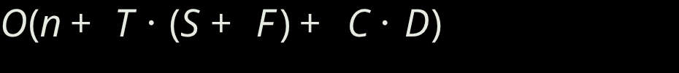
Complexity Analysis
Stage | Complexity / bound
DSatur | O(n² + E); n steps scan up to n vertices; neighbour saturation updates contribute O(E). Given n = 702 and E = 12,345.
Pipeline | LOWERBOUND: O(n² + E) + local search; repair capped at 20,000 iterations; polish at 5,000 iterations.
Other stages | Fill in order O(n·T); Welsh–Powell O(n log n + n·T); room assignment O(n·R) worst case; verification O(n).
SPACE
C = 162 section-subject rows · D = 6 days · the 12,345 edges are never stored.
6
Notes:
DSatur runs in O(n² + E), with n steps scanning up to n vertices and neighbor saturation updates contributing O(E).
Repair and polish are capped at 20,000 and 5,000 iterations. Other stages include fill, Welsh–Powell, room assignment, and linear verification, while the 12,345 edges are never stored.

Slide 7
Implementation and Test Cases
ENGINE
TRACE
TypeScript engine
Conflict graph, DSatur step by step, ejection chains, and verification.
Four coloring methods, repair, polish, room assignment, and verification; runs in the browser with fixed random seed 7.
COVERAGE
TEST RESULT
Normal 702-class dataset; minimum random college.
Maximum 24 sections × 36 classes over 6 days × 8 periods.
Malformed and overfull inputs; a stuck greedy solver; special unavailable-day cases.
39
automated tests
Including an exact-match check between the TypeScript engine and the original engine.
7
Notes:
The implementation is a TypeScript engine running in the browser with four coloring methods, repair, polish, room assignment, and verification. Its random seed is fixed at 7.
Coverage includes the normal dataset, random and maximum cases, malformed and overfull inputs, a stuck greedy solver, and unavailable-day cases. There are 39 automated tests, including an exact-match check with the original engine.

Slide 8
Results and Conclusion
ROOM COMPARISON
Verification: all 702 classes placed with no section, teacher, or room clash.
Feasible + rooms = lower bound → OPTIMAL.
Method | Rooms | Gap
Fill in order | 27 | +7
Welsh–Powell | 20 | 0
DSatur | 20 | 0
LOWERBOUND | 20 | 0
BEFORE → AFTER
INCREMENTAL REPAIR
Measure | Result
Rooms | 27 → 20
Empty room-periods | 270 → 18
Classrooms freed | 7
When Dr. Harish Kumar is absent on Monday: 4 classes affected, 5 moved, 697 untouched, still 20 rooms, verified.
LIMITATIONS
Room capacity is not modelled; labs are single periods.
8
Notes:
Fill in order uses 27 rooms, while Welsh–Powell, DSatur, and LOWERBOUND all reach 20 rooms. The result moves from 27 to 20 rooms, reduces empty room-periods from 270 to 18, and frees 7 classrooms.
All 702 classes are placed without section, teacher, or room clashes, so feasibility plus equality with the lower bound proves optimality. Incremental repair preserves 20 rooms after Dr. Harish Kumar is absent on Monday, while room capacity is not modelled and labs are single periods.

