Slide 1
FruitBlend24
Revenue Management Analysis
Data Analyst Intern Case Study by Thawanhathai Laonark
4
2
4
central kitchens
delivery platforms
goals: profit · inventory · waste · decisions

Slide 2
SLIDE 1 · DATA PREPARATION
Data Preparation & Quality
Orders
Platform & promo
Fruit cost
Waste
Budget
Cost assumptions
Python (Pandas): validate · standardize SKUs · map codes · combine · build P&L
Raw Data
›
Cleaning & Transform
›
Revenue & Profit Model
›
Power BI Dashboard
›
Recommendations
FruitBlend24 | Revenue Management Analysis 2

Slide 3
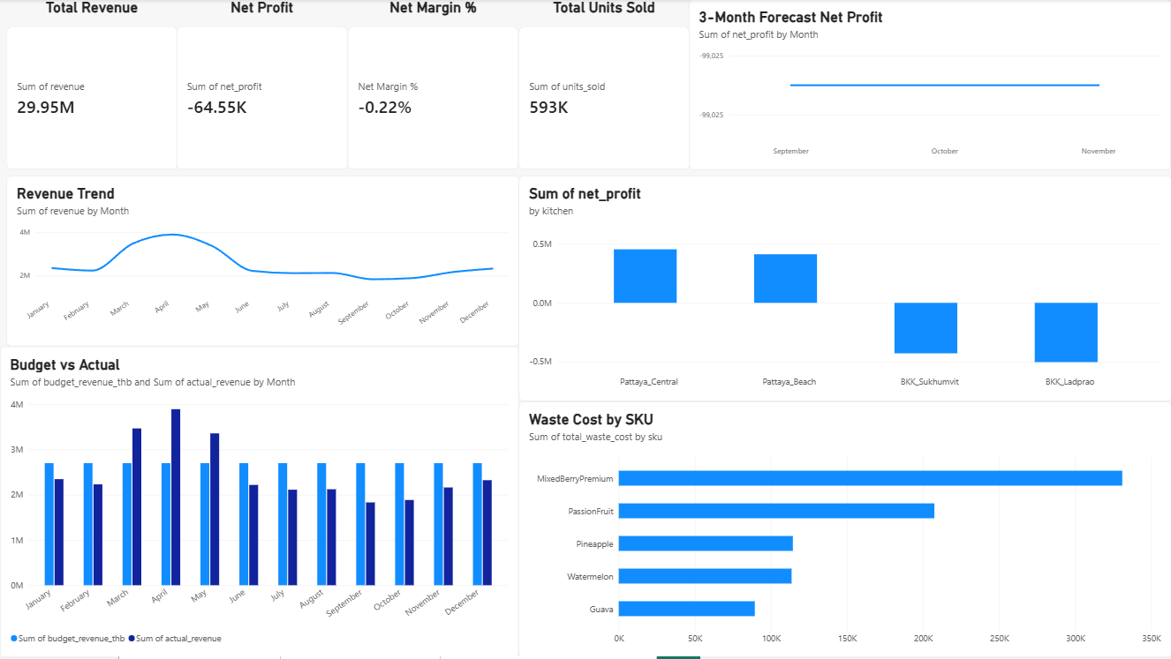
SLIDE 2 · OVERVIEW
Revenue & Profitability Overview
29.95M
Total revenue
−64.55K
Net profit
−0.22%
Net margin
593K
Units sold
Big revenue, thin margin
FruitBlend24 | Revenue Management Analysis 3

Slide 4
SLIDE 3 · PROFITABILITY
P&L Model Construction
Revenue
− Platform Commission
− Fruit Cost
− Packaging Cost
− Labor Cost
− Kitchen Overhead
= Net Profit
Which kitchens profit · Which products create value · Where to cut cost
FruitBlend24 | Revenue Management Analysis 4

Slide 5
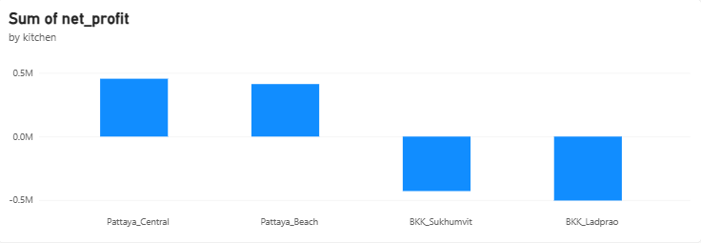
SLIDE 4 · KITCHENS
Kitchen Performance Insight
Pattaya_Central
Pattaya_Beach
BKK_Sukhumvit
BKK_Ladprao
≈ +0.45M net profit
≈ +0.41M net profit
≈ −0.42M net profit
≈ −0.50M net profit
Recommendation: optimize Bangkok
Cost reduction
Menu mix improvement
Better resource allocation
Net profit by kitchen (approx., read from dashboard)
FruitBlend24 | Revenue Management Analysis 5

Slide 6
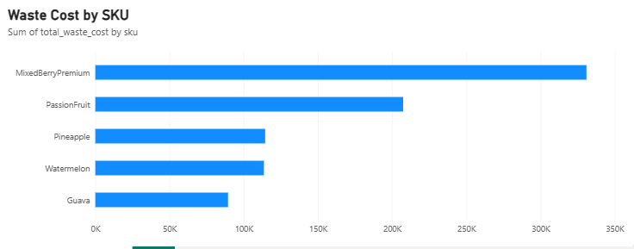
SLIDE 5 · WASTE
Waste Analysis
330.9K
Mixed Berry Premium waste cost
= 39% of 855.8K total
45.6
THB lost per wasted unit
(Watermelon: 13.7)
Recommendation: manage premium SKUs
Adjust purchase quantity · Improve demand forecasting · Review product pricing
FruitBlend24 | Revenue Management Analysis 6

Slide 7
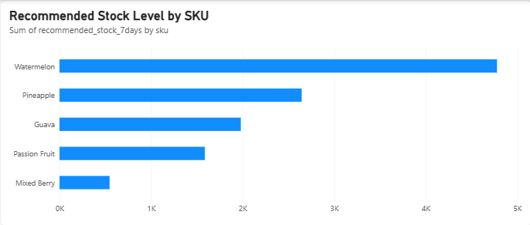
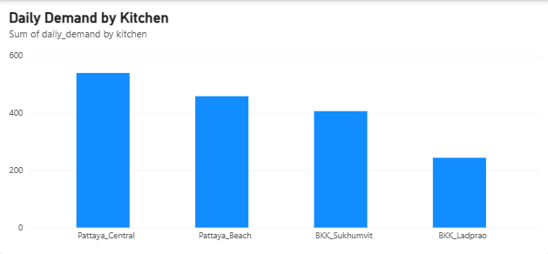
SLIDE 6 · INVENTORY
Inventory Optimization
Watermelon · ≈4.8K units / 7 days
Mixed Berry · ≈0.5K units / 7 days
Highest demand → highest safety stock
Lowest stock → tight control
Demand-based ordering + Safety stock management
FruitBlend24 | Revenue Management Analysis 7

Slide 8
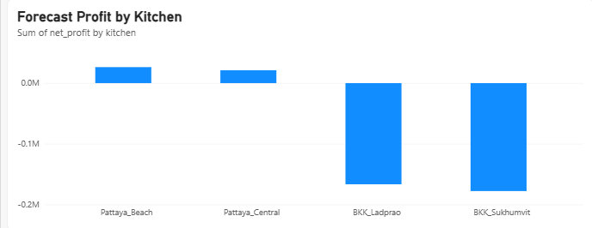
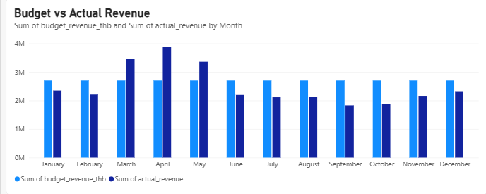
SLIDE 7 · FORECAST
3-Month Forecast & Planning
6.53M
Forecast revenue (Sep–Nov)
−297.07K
Forecast net profit
−4.55%
Forecast margin
Loss widens vs history
Margin −0.22% → −4.55%. Only Pattaya kitchens stay positive.
FruitBlend24 | Revenue Management Analysis 8

Slide 9
SLIDE 8 · RECOMMENDATIONS
Business Recommendations
1 Pricing Strategy
2 Portfolio Optimization
3 Inventory Strategy
Review premium pricing
Ingredient cost
Contribution margin
Waste impact
Review weak kitchens
Cut unnecessary opex
Improve menu mix
Raise efficiency
Demand-based planning
More stock for high demand
Less overstock & waste
Better purchasing
FruitBlend24 | Revenue Management Analysis 9

Slide 10
SLIDE 9 · TOOLS
Tools & Methodology
Python
Power BI
Data cleaning
Data transformation
Profit calculation
Dashboard development
KPI monitoring
Business visualization
Data
›
Insight
›
Recommendation
›
Business Action
FruitBlend24 | Revenue Management Analysis 10

Slide 11
SLIDE 10 · NEXT STEPS
Further Exploration
Customer Analytics
Promotion Analytics
Advanced Forecasting
Ordering behavior
Repeat purchase
Promo effectiveness
Price elasticity
ML forecasting
Inventory optimization model
FruitBlend24 | Revenue Management Analysis 11

Slide 12
Conclusion
FruitBlend24 can improve profitability by:
1
Optimizing kitchen operations
2
Reducing waste from high-cost products
3
Improving inventory planning
4
Data-driven pricing & portfolio decisions

