Slide 1
¿hasCrack?
A crack and damage analyser made by Bauer Andreas, Ginter Pascal, Stoian Mihail and Wei Wen Qing

Slide 2
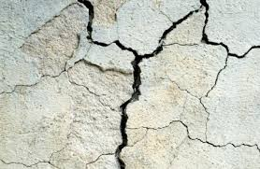
Cracks are not good

Slide 3
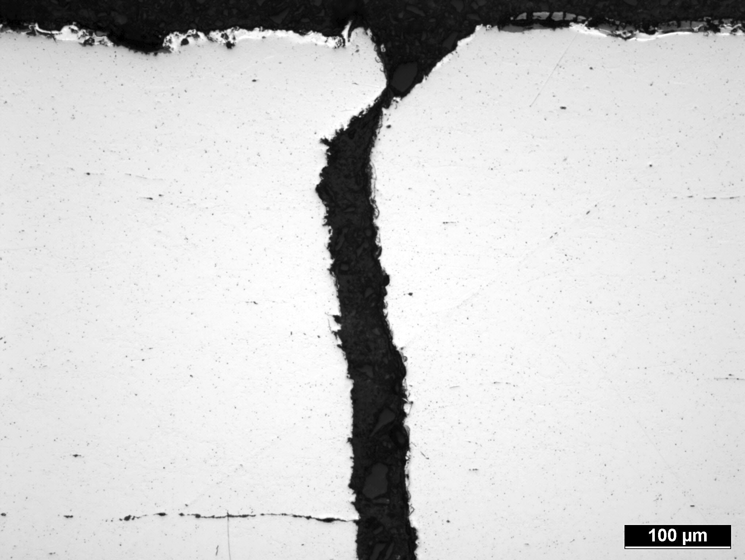

Slide 4


Slide 5
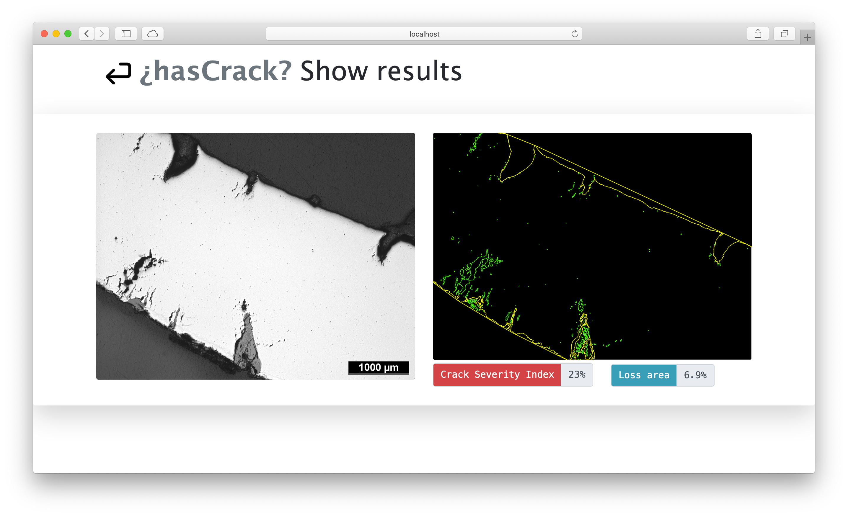
Our crackingly good solution
Web Service to locate cracks and evaluate the risks they cause
How do we do that?
Identification of object
Locating cracks
Applying criteria to evaluate risks (depth and lost area)
Used tools
Python (cv2, shapely, numpy, ...)
Node.js Express Web Server

