Slide 1
Online Behavior Tracking
SEED Workshop
June 2, 2016

Slide 2
Behavior Tracking
Online Advertising
Cookies
Browser Cookies
Flash Cookies
Web Beacons
Browser Fingerprinting
Defenses

Slide 3
Online Advertising
Allow advertisers to reach significantly more people
Has large-scale distribution capabilities
Can be more targeted than some traditional media, ensuring that their messages are seen by the most relevant audiences

Slide 4
Online user activities
To make online advertisement more targeted, tracking activities of online users is important.
User activities include searches users make, websites visited, web content viewed, email content, watched videos, interactions on social network, and online transaction

Slide 5


An Online Advertising Example: Adchoice
Cleared all cookies
Visit USPS.com
Visit AARP.com
Visit Allstate.com
Three websites allow Adchoice to track their visitors’ preference

Slide 6
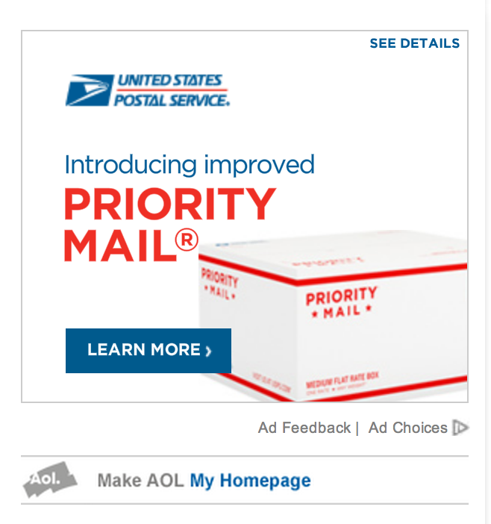

An Online Advertising Example: Adchoice
Visit website that have banner hosted for Adchoice including
Yahoo.com
msn.com

Slide 7
Online advertising
Banner ads (Doubleclick)
Standardized ad shapes with images
Normally not related to content
Context linked ads (Google AdSense)
Related to content on page
Search linked ads (Google Adwords)
Related to search terms

Slide 8
Ads Preferences Manager Video
https://youtu.be/PN0I_YlDF1A

Slide 9
What is web behavior tracking?
Refers to the practice of tracking users across web sites in order to learn user interests and preferences
Benefits
Advertisers targets a more focused audience which increases the effectively
Consumer is “bothered” by more relevant and interesting ads

Slide 10
What is tracked?
IP address – general vicinity of your location
Time you accessed the page / email
Computer type and operating system
The browser you used
searches users make
websites visited
interactions on social network
Any previous information stored in cookies
Notes:
searches users make
websites visited
web content viewed
email content
watched videos
interactions on social network
online transaction
personal information

Slide 11
Online Behavior Tracking
Track user behavior as they move from site to site
Ways of tracking
Browser Cookies
Flash Cookies
Beacons

Slide 12

Browser Cookies
What is a cookie?
Browsers have allowed websites to store small amounts of information on the computer: Number of visits, Preferences, Login
Record your browsing activities
Pages and content you looked at
When you visited
What you searched
You clicked on an ad

Slide 13
Browser Cookies
First Party vs. Third Party Cookies
First party cookies
Place by a site when you visit it
Make your experience on the web more efficient
For example:
Items in your shopping cart
Log-in name
Preference
Game scores
Sessions

Slide 14
Turning Cookies Off
Browsers allow you to turn cookies off. However, there is a downside:
Many times the functionality of the website fails. For example, you may not be able to login to the site, or preferences are lost, shopping carts don’t work.

Slide 15
Third Party Cookies
Cookies with a different domain than the site you are visiting.
Quite often used in advertising to track the websites you visit.

Slide 16
Third party cookies (tracking across multiple sites)
Trackers, often advertising networks, use websites to install their cookies in users machine, known as third party cookies.
The third-party cookies can track users across multiple sites and tracking networks where its advertising banners or web beacons are placed
Condition: websites allow the tracker to collect data about their visitors.
Notes:
Pages visited by a user allows the advertising company to target advertisements to user’s presumed preferences
The advertising networks use the information collected by the third party cookie to create the profile of the user, which is also known as cookie profiling. The created profile is segmented as sports enthusiast, fashion enthusiast, parent, gamer, etc., and sold to the advertisers for ad targeting. The advertisers also pay the advertising networks to purchase the space and to place their ads on the websites. These third party services have tremendous value as they support free content and facilitate web innovation.

Slide 17
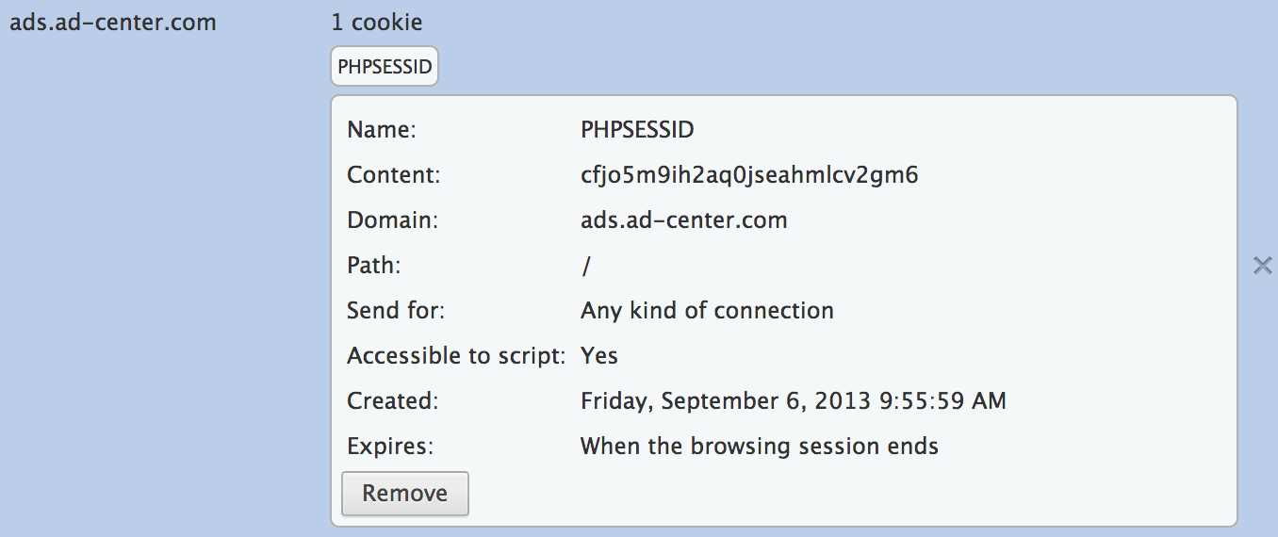
Browser Cookies
Transient (session) vs. Persistent Cookies
Transient Cookies
Jobs is to help “sessionize” your experience on a website
“set” when we visit the site, it disappears when we leave
Transient Cookies

Slide 18
Persistent Cookies
Set the first time we visit the website
It will remain there for the duration that the website determines
Example
Analytics cookies are typically 18 months
Other can be 18 months to 18 years
Help identify a unique browser to our website, closest thing to tracking a “person”/”unique visitor”
Contain not always a Personally Identifiable Information (PII) data.
Random string of numbers or alphabets that only the company who set the cookie can read.

Slide 19
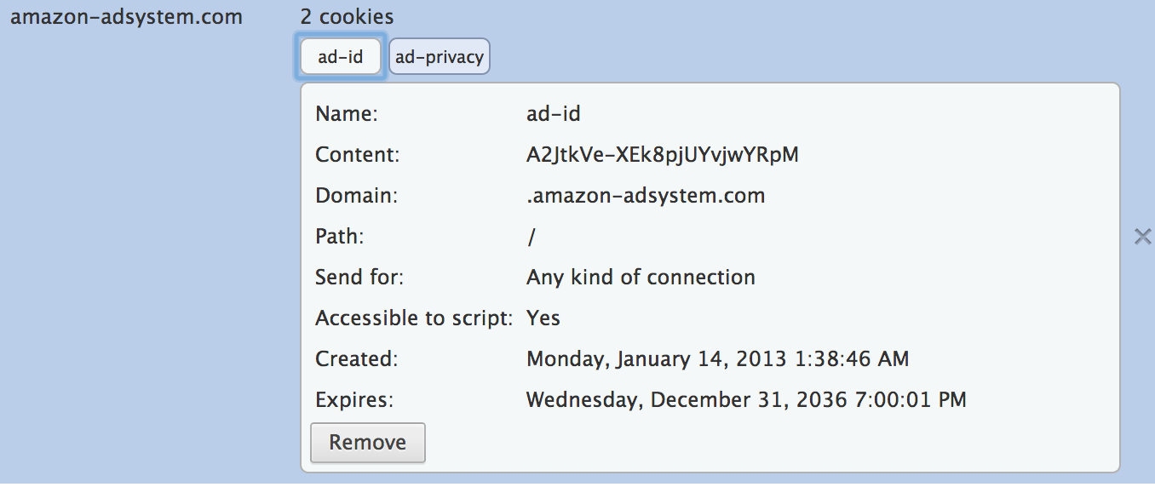
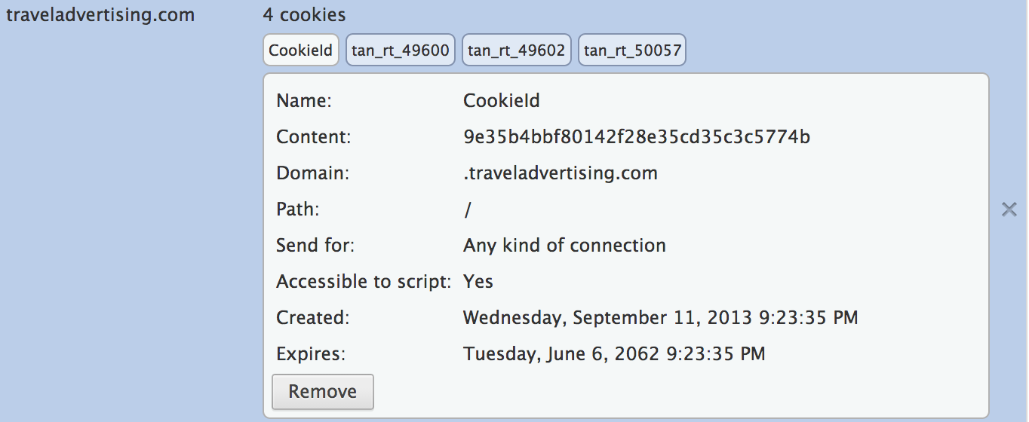
Persistent Cookies

Slide 20
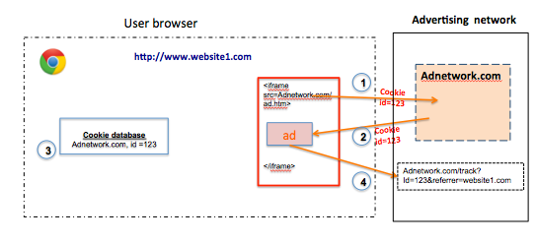
iFrame in third-party cookie
Tracker’s code chooses an ad to display on the page as an image or as an iFrame. The ad is hosted by Adnetwork.com instead of website1.com in this example.
<iframe src="http://www.Adnetwork.com"> </iframe>
Notes:
When user interacts with an third-party ad (1,2) on the first-party webpage the third party cookie is set on user’s browser (3), the cookie communicates back to the Adnetwork.com with user’s tracking information (4).

Slide 21
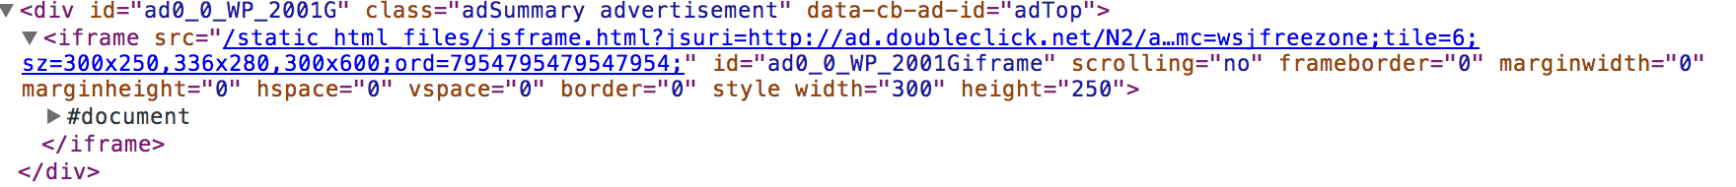
Sample iFrame from doubleclick.net

Slide 22
Flash Cookies, a Supper Cookie
Tougher version of tracking cookie, harder to locate and delete
It can be set through Adobe Flash via an embedded object in Flash, browser independent
The website running Adobe Flash can place these cookies on user’s hard drive, which is outside of browser’s control.
It can store user’s information up to 100 kilobytes whereas HTTP cookie can hold info up to 4 kilobytes.

Slide 23
Flash Cookies, a Supper Cookie
Flash cookies’ location on the user machine depends on the operating system.
In case of Windows it is:
[Root drive]:\Documents and Settings\[username]\Application Data\Macromedia\Flash Player\#SharedObjects\
Flash cookies are files with .SOL extension
For non-Windows, Macintosh OSX
/Users/[username]/Library/Preferences/Macromedia/Flash Player
Latest versions of Flash do not allow 3rd party sharing.

Slide 24
New Information Collected
Assess what you are doing on a web
Determine your location
Estimate your income
Determine shopping interests
Assess medical conditions

Slide 25
New Market
Your profiles is built as you browse the web.
Companies buy and sell your profile to target their specific ads to certain types of individuals.

Slide 26
Ever Cookie, another super cookie
Released by Samy Kamakar in 2010
Can identify a client even when standard cookies and flash cookies are deleted
Combine storage possibilities like HTTP cookies, flash cookies, HTML 5 storage functions, and others.
Its is saved redundantly and it can be easily restored.

Slide 27
Web Beacons (tracking across multiple sites)
Also called web bugs and are used in combination with cookies to help people running websites to understand the behaviour of their customers.
A web beacon is typically a transparent graphic image (usually 1 pixel x 1 pixel) that is placed on a site or in an email.
To see the web beacon, we view the source of HTML page or email message

Slide 28
Web Beacons
<img src=“http://ad.doubleclick.net/ad/pixel.quicken/NEW” width=1 height=1 border=0
Single 1x1 image fetched from DoubleClick
Bugs alerts Doubleclick when any user views the website quicken.com
DoubleClick has systems for monitoring users who view DoubleClick advertisements
This web beacon allow companies to use DoubleClick monitoring system without the need to first show a banner advertisement

Slide 29
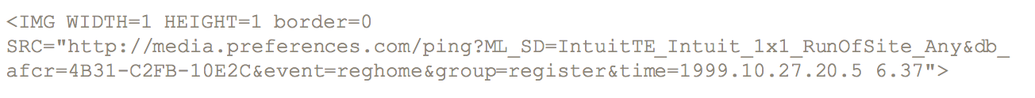
Web Beacons
This beacon fetches image from media.preferences.com server
Sends unique user identification
Similar to what is found in a cookie

Slide 30
Web Beacons
Does not need to a 1x1 pixel graphics.
Can be any other content that is pulled from a third-party we server
Can be used to monitor its user
Impact privacy by introducing a third party into a consumer web site relationship

Slide 31
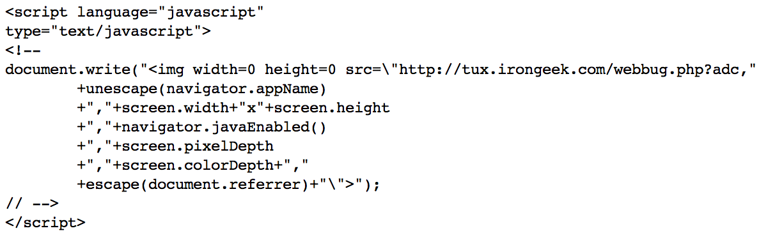

Slide 32
Uses of Web Bugs
According to Privacy Foundation, companies use web bugs to accomplish the following tasks:
Gather viewing and usage statistics for a particular page.
Correlate usage statistics between multiple web sites.
Profile users of a web site by gender, age, Zip code, and other demographics.
Transfer personally identifiable information from the web site directly to an Internet marketing company. This transfer would be accomplished with a web bug URL that contains the personal information that the company wishes to transfer.
Transfer search strings from a search engine to a marketing company.
Verify the statistics reported by a banner advertising company, to gauge the effectiveness of different banner advertisements.
Have third-party providers prepare web usage statistics for web sites that do not have the technical capability to prepare their own statistics.
Check if email messages are actually read, and, if they are read, to see if they are forwarded.
Detect copyright infringement

Slide 33
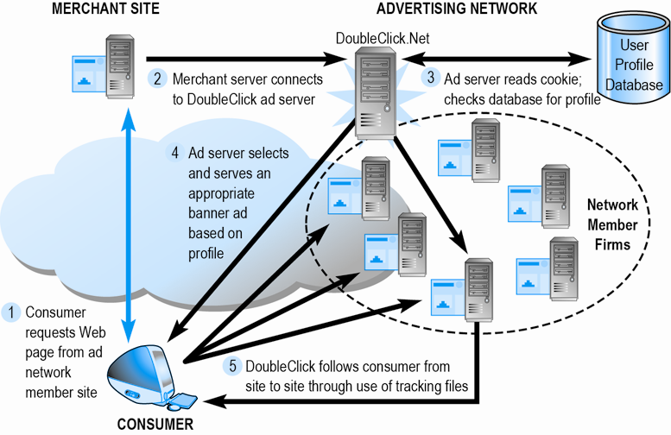
Web tracking example one: DoubleClick Tracking

Slide 34
Canvas Finger Printing
The HTML5 ‘canvas’ feature is exploited here, where the website visited by the user instructs the user's browser to draw a hidden line of text or 3D graphic which is then converted into digital token.
The data gathered can be used for profiling the user by the tracking ad networks which can be used for targeting the ads.

Slide 35
Web tracking example two How Advertisers Use Internet Cookies to Track You

Slide 36
Web tracking example three

Slide 37
Why Cookies Don’t Work Well on Mobile Platforms
Each of us may have several mobile devices. A single person may have a work cell phone, a home cell phone, a tablet, an Internet-connected game console, a car-based Internet-connected device, and more.
How can ad servers and other players identify that person as the same person when she surfs the Web on different devices?

Slide 38
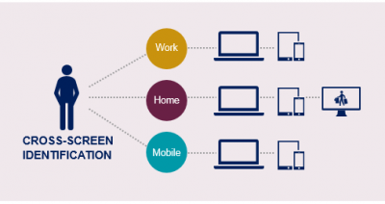
Cross-device identification (no cookie)
Cross-device identification primarily meant linking desktop computers, tablets and smartphones. With the advent, still nascent, of connected TVs, wearables and the Internet of Things, the concept of cross-device is expanding to potentially include anything that gives off a signal.
Notes:
http://blog.hartehanks.com/6-data-integration-techniques/

Slide 39
User-ID: Measuring Real Users Instead of Devices
When a person loads a page on your website, Google Analytics automatically assigns that person a Client ID, which is unique to the specific browser and device and stored in cookies.
A single person may be assigned many Client IDs, such as if they visit your website from their mobile phone and then later return on their desktop computer.
Each unique Client ID that is sent to Google Analytics is reported as an individual User.
Based on information such as login feature on your website, customized promotions, preference, purchase history, personal information, unique device ID.
Notes:
http://www.lunametrics.com/blog/2015/08/13/user-id-measuring-real-users/

Slide 40
Fingerprinting Devices
A study from the Electronic Frontier Foundation reveals that more than 94% of Flash- and Java-enabled browsers can be uniquely identified, while updating your browser and/or plugins changes the fingerprint, in more than 99% of cases, a simple set of rules can identify the new fingerprint as connected to the earlier one.
Take combinations of unique properties of the computer
Browser, operating system, your time zone, language settings, fonts, screen resolution, plug-ins installed, device IDs,
which Wi-Fi network or networks you use to access the Internet, the types of sites you visit (think financial sites, sports sites, news sites, etc.), and many others.
Make the best possible guess about users without ever installing anything on the computer
Notes:
http://www.allaboutcookies.org/mobile/mobile-tracking.html
While a user could always delete the cookies from his browser, the more he changed his plugins and settings relative to the default, the more unique and easily-identifiable his browser becomes. While this type of solution can identify and track the user across apps on a single device, tracking across platforms is beyond its reach.

Slide 41
BlueCava – A case of cross device tracking
BlueCava connect the dots between mobile, desktop and tablet screens across all channels, resulting in an actionable map of today’s consumers, households and their many devices.
http://bluecava.com/how-it-works/
Notes:
http://bluecava.com/how-it-works/

Slide 42
Network-inserted management
Implementing state management through intermediaries such as Wi-Fi networks, Internet Service Providers (ISPs), and other third party servers
Such a solution allows unified identification and preference management for all devices in the same household or office
Intermediaries can determine the web sites that user frequent or articles that were viewed
Intermediaries can profile users

Slide 43
Discussion
Is it of concern that advertisers are tracking you?

Slide 44



Opting Out
http://www.google.com/ads/preferences/
http://privacy.yahoo.com/aim
Companies including Yahoo, Microsoft, Google and AOL allow web surfers to opt out of tracking.
DoNotTrack:An HTTP header field “DNT” that requests a web application disables its tracking or cross-domain tracking. 1 (track), 0 (no track)

Slide 45

Defenses
Clearing all cookies: browser & flash
Blocking third party cookies (http://www.cnet.com/how-to/disable-third-party-cookies-in-ie-firefox-and-google-chrome/)
Private browsing allows you to browse the Internet without saving any information about which sites and pages you’ve visited.
Privacy Badger (was ShareMeNot): browser extension
Users can choose if they want to interact with social widgets, and if widgets can track users.
Notes:
Do Not Track is a technology and policy proposal that enables users to opt out of tracking by websites they do not visit, including analytics services, advertising networks, and social platforms.
ShareMeNot is a browser extension designed to prevent third-party buttons (such as Facebook's “Like” or Twitter's “tweet” button) embedded by sites across the Internet from tracking you until you actually click on them.
Private browsing
Firefox: https://support.mozilla.org/en-US/kb/private-browsing-use-firefox-without-history
iPhone, iPad: https://support.apple.com/en-us/HT203036
Chrome with incognito mode: https://support.google.com/chrome/answer/7005900?hl=en&rd=1

Slide 46
Security Visualization
June 2, 2016
SEED Workshop

Slide 47
Visualization
Visualization has been used in a variety of fields in computer science education, such as algorithms, computer networks, computer architecture [GVU02, Holliday03, Null05]
Visualization technology positively impacts learning based on surveys conducted by Naps et al. [Naps03a]
Notes:
, motivated by the age-old adage “a picture speaks more than thousand words”,

Slide 48
interactive visualization tools
Attacks that could occur in web-based applications:
Cross-Site Scripting (XSS) attacks
Cross-Site Request Forgery (CSRF) attacks
DNS cache poisoning and pharming attacks

Slide 49
Cross-Site Scripting (XSS)
Cross-Site Scripting exploits vulnerabilities commonly found in web applications. Attackers can craft malicious code (e.g. JavaScript programs) which will be executed through victim’s web browser.
Attackers can steal the victim’s credentials, such as cookies. The access control policies (i.e., the same origin policy) employed by the browser to protect those credentials can be bypassed.
http://web2.utc.edu/~djy471/XSS/xss.html

Slide 50
Cross-Site Request Forgery (CSRF)
Cross-Site Request Forgery is an attack whereby a malicious website sends a request to a web application that a user is already authenticated against from a different browser. This way an attacker can access functionality in a target web application via the victim’s already authenticated browser. Targets include web applications such as social media, in browser email clients, online banking, and web interfaces for network devices.
http://web2.utc.edu/~djy471/csrf/csrf.html

Slide 51
DNS cache poisoning and pharming attacks
Demonstrates normal operation, which is what legitimate DNS protocol does.
DNS cache poison and pharming attack by showing how an attacker could poison DNS cache, leading the victim to view or download undesired content, such as malware.
http://web2.utc.edu/~djy471/DNS/index.html

Slide 52
Other Security Visualization from NC A&T
Packet sniffer simulator
A learning tool for Kerberos authentication architecture
A visualization tool for wireless network attacks
Syn Flood Animated Simulator
Encryption Tool
http://williams.comp.ncat.edu/IA_visualization_labs/security_visual_tools/VisTools.html

Slide 53
References
[GVU02] GVU, 2002. Algorithm animation. Available at http://www.cc.gatech.edu/gvu/softviz/algoanim/
[Holliday03] Holliday, M. A. 2003. Animation of computer networking concepts, ACM Journal of Educational Resources in Computing, Vol. 3, No. 2, Article 2.
[Null05] Null, L. and Rao, K., 2005. CAMERA: Introducing memory concepts via visualization, In Proceedings of the 36th SIGCSE Technical Symposium, St. Louis, Missouri, Feburary 23-27, 2005, 96-100.
[Naps03a] Naps, T. L. et al. 2003a. Exploring the role of visualization and engagement in computer science education, ACM SIGCSE Bulletin, Vol. 35, Issue 2, 131-152, 2003.

