Slide 1

Introduction to Machine Learning and Data Science at Ingeus
Bridging Technology and Innovation
Presenter:
Fahad Rehmani
Chartered Statistician and Advanced Data Science Professional

Slide 2
Agenda
• Introduction to Machine Learning
• What is Data Science?
• Understanding Models: Creation and Function
• Our Approach at Ingeus
• Q&A

Slide 3
Machine Learning
What is Machine Learning?
The ability of a computer to do some task without being explicitly programmed.
The ability to do the tasks come from the underlying model which is the result of the
learning process.
The model is generated by learning from huge volume of data, huge both in breadth and depth reflecting the real world in which the processes are performed.
What machine learning algorithms do?
Search through the data to look for patterns in form of trends, cycles, associations, etc.
Express these patterns as mathematical structures.

Slide 4
What is Data Science?
Definition:
An interdisciplinary field that uses scientific methods, processes, algorithms and systems to extract knowledge and insights from structured and unstructured data.
Key Components:
Data Exploration and Analysis
Predictive Analytics
Machine Learning
Data-driven Decision Making

Slide 5
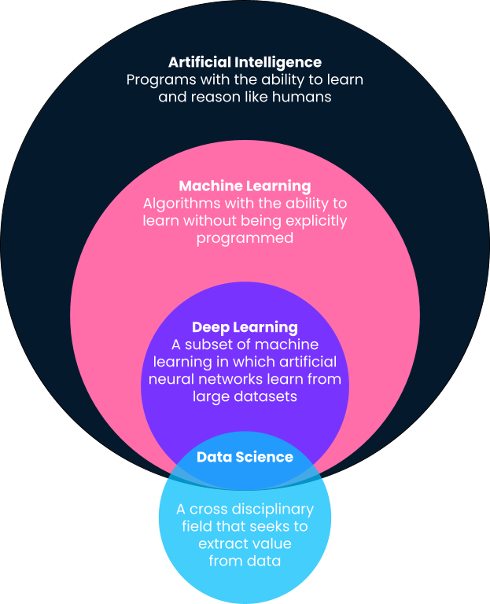
Artificial Intelligence and Branches

Slide 6
What is a Model? How Does it Work?
Explanation:
A model in Machine Learning is like a recipe that the system follows to make decisions
Process:
Data Collection -> Data Cleaning -> Model Training -> Testing -> Deployment

Slide 7
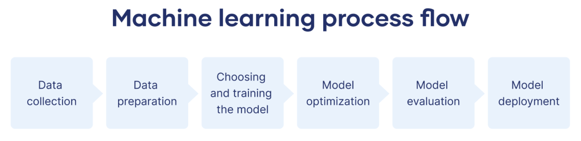
Steps in Machine Learning

Slide 8
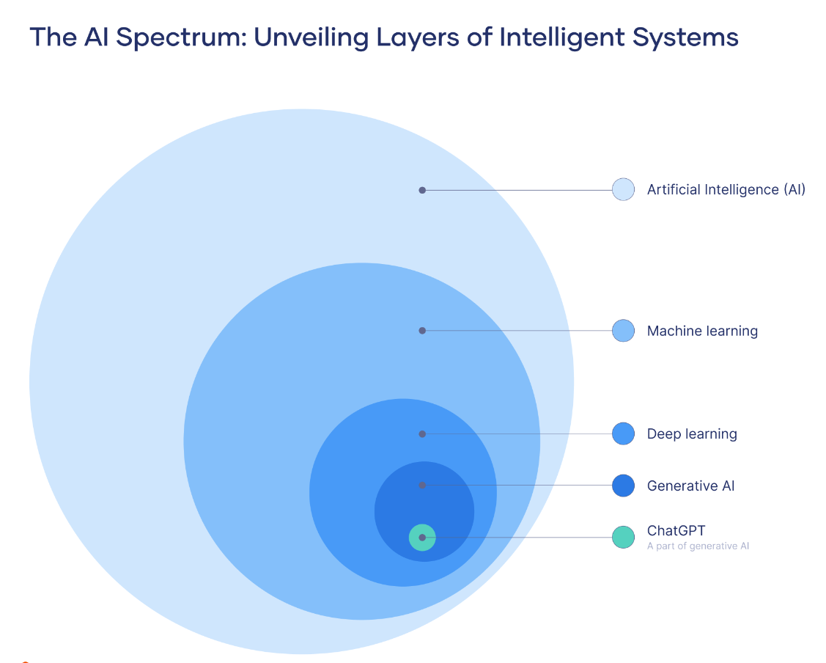

Slide 9
Our Approach at Ingeus
Overview of Ingeus-specific strategies:
• Types of data collected
• Tools and technologies used
• Examples of current projects and applications

Slide 10
Example of a Model at Work at Ingeus
Case Study:
• Show a real or hypothetical scenario where a machine learning model was used to solve a problem at Ingeus
• Results and Impact

Slide 11
Challenges and Opportunities
Challenges:
• Data Privacy
• Model Bias
• Complexity of Integration
Opportunities:
• Automation of Routine Tasks
• Enhanced Data Insights
• Personalized Services

Slide 12
Conclusion and Future Directions
Summary of Key Points
Future Trends in Machine Learning and Data Science at Ingeus

Slide 13
Q&A
Invite Questions from the Audience

