Slide 1

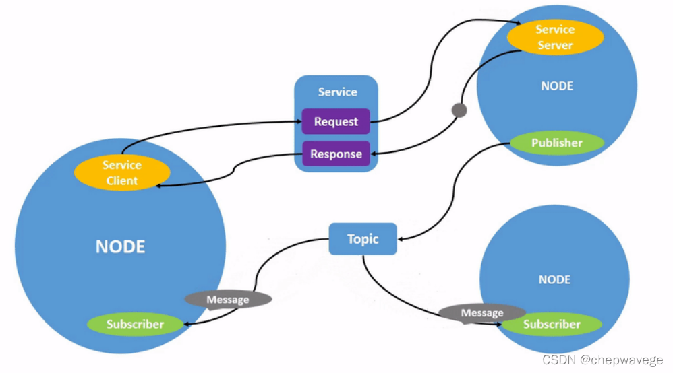
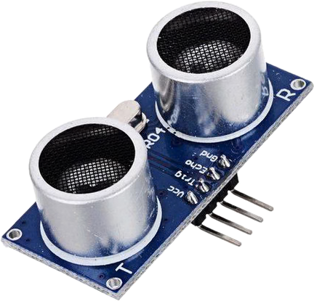
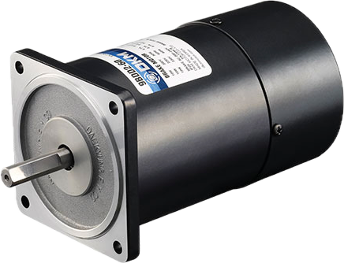
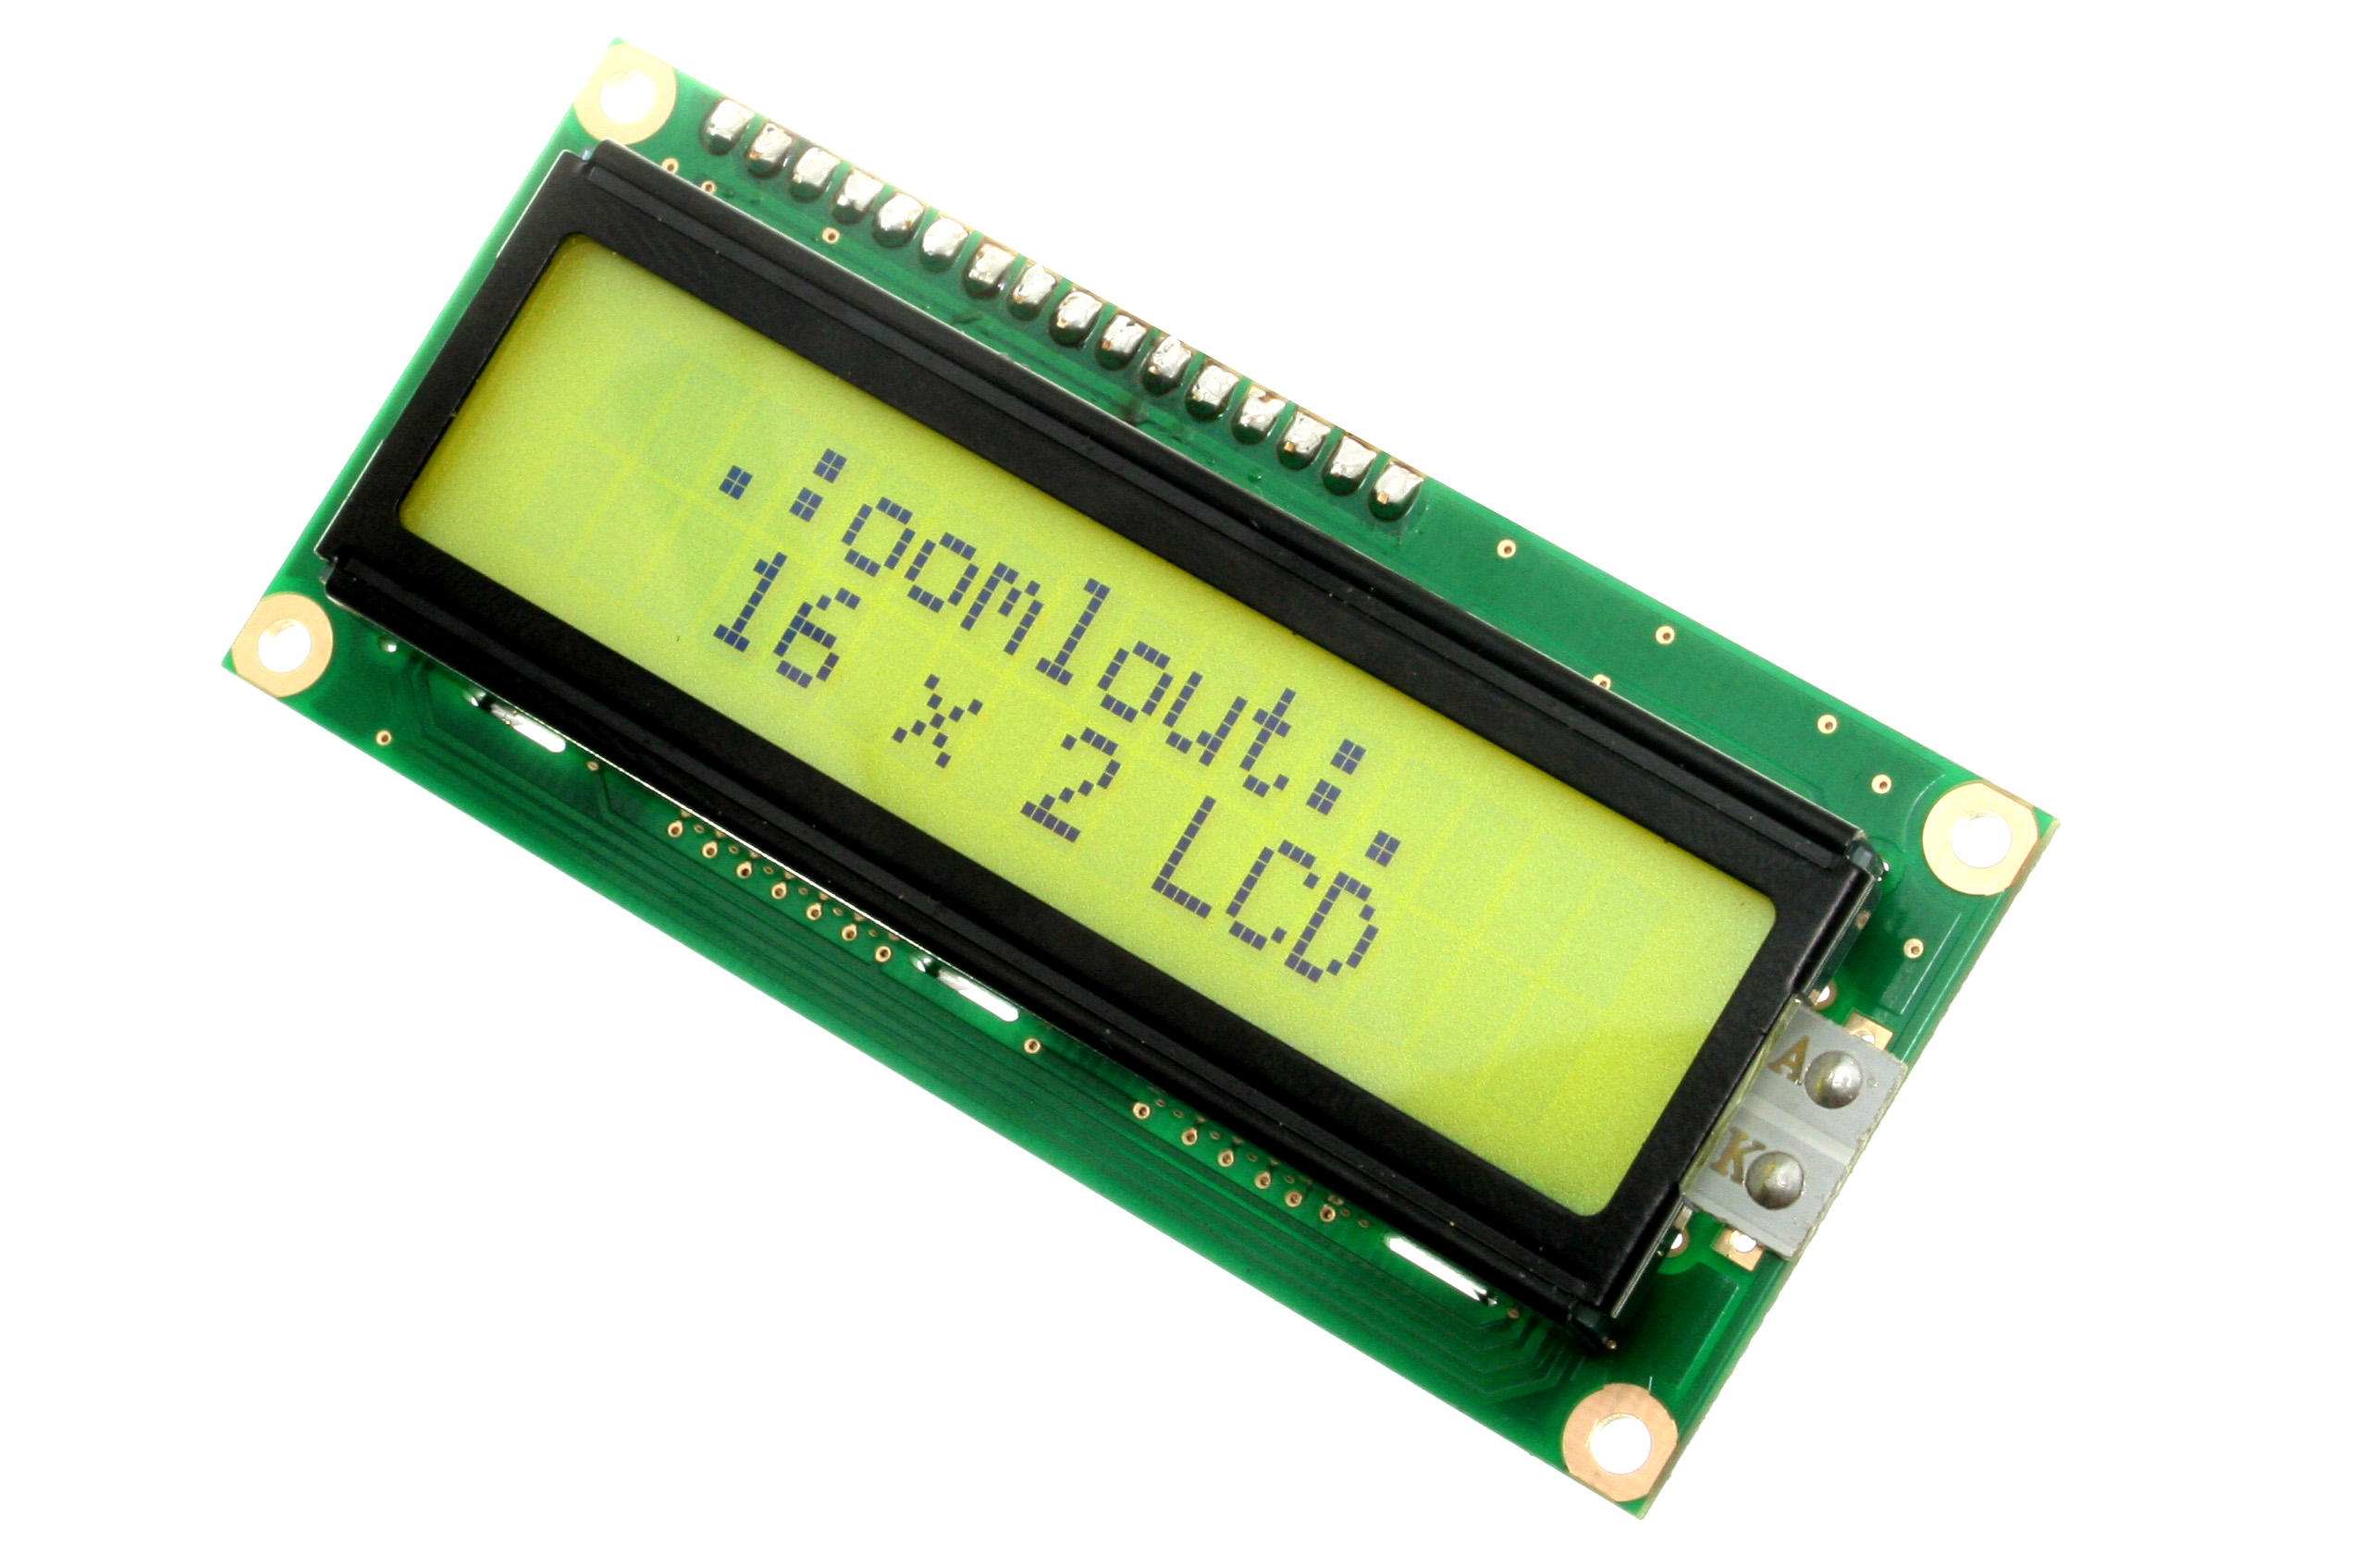
ROS
ROS: An open framework for robotics that provides tools and libraries
for developing, managing, and deploying robot software.
Core Concepts
Node: Executable program unit
(sensor drivers, SLAM, controllers, etc.)
Topic: Asynchronous streaming channel
(e.g., /camera/image)
Service: Request–response call
(RPC-like, one-shot)
Action: Long-running goal with feedback/cancel/result (asynchronous command)
Message: Typed data structure for communication (standard + custom)

Slide 2
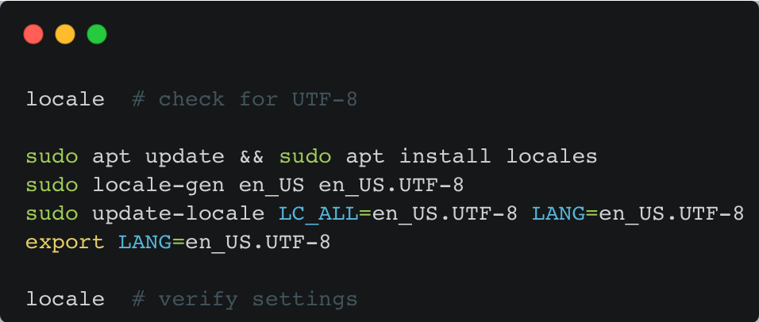
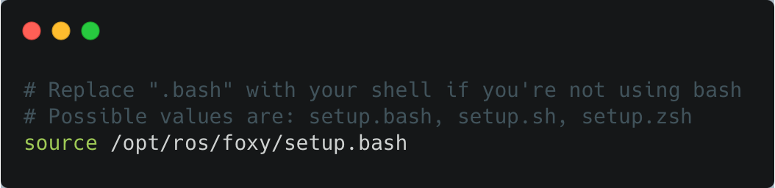
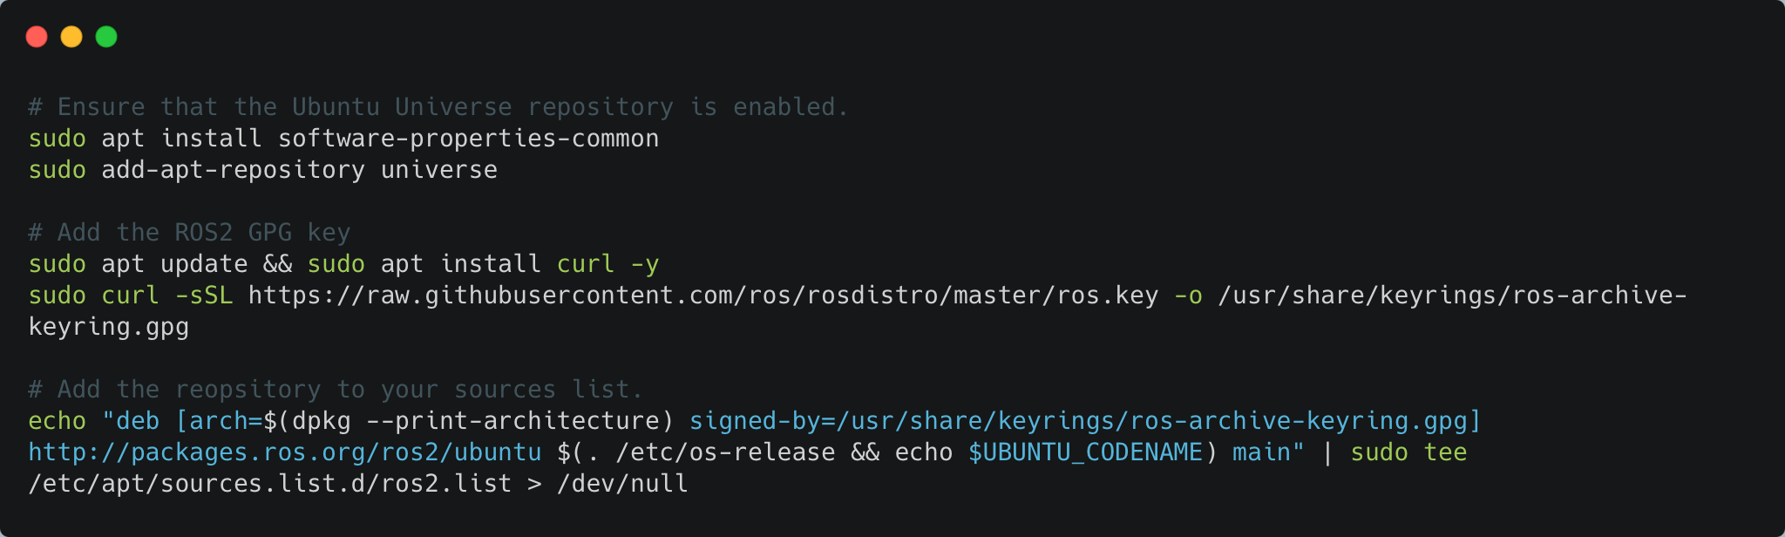
ROS2(Foxy) Installation
1. Set Locale
2. Setup Sources
3. Environment Setup

Slide 3
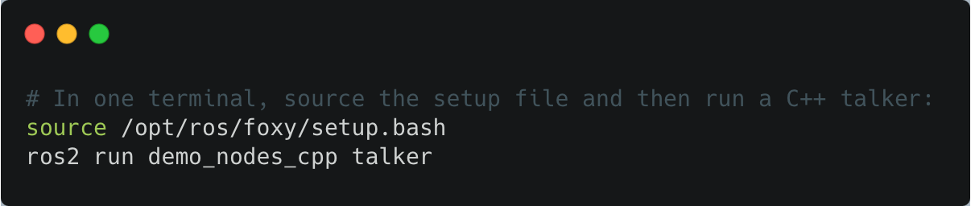
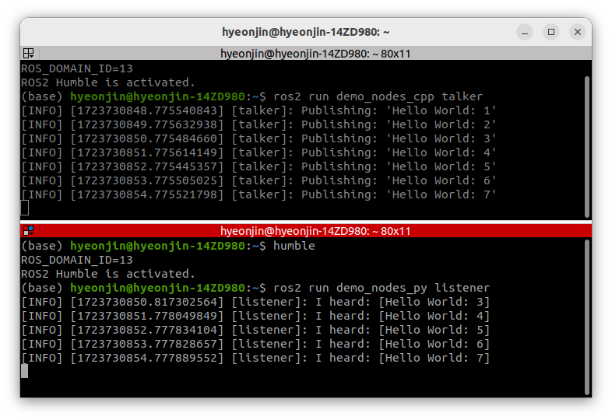
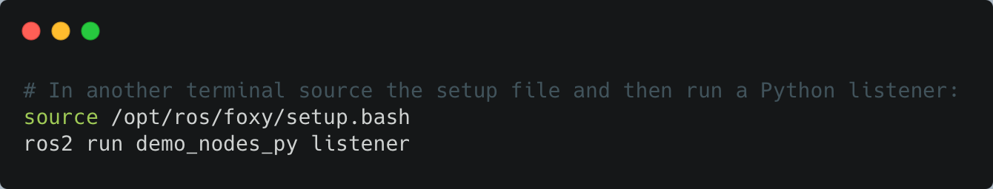
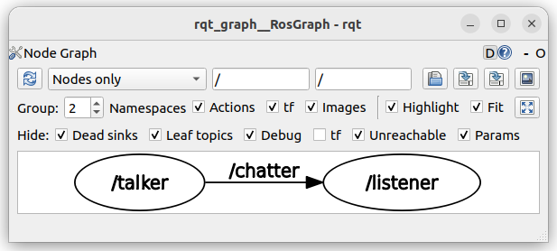
ROS2 Example
1. Talker
2. Listener

