Slide 1
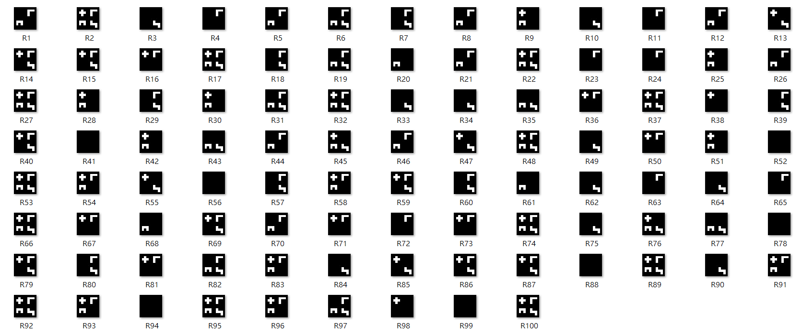


Each row of X
Each entry of Z follows Bernoulli(0.5)
True W
Our results

Slide 2
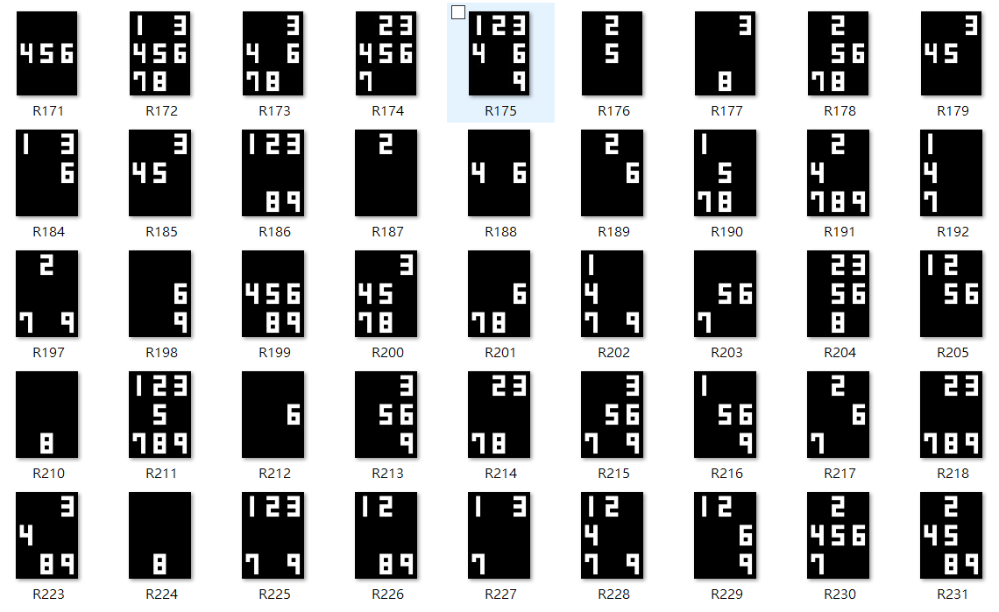

Some rows of X
Our guess of W

Slide 3
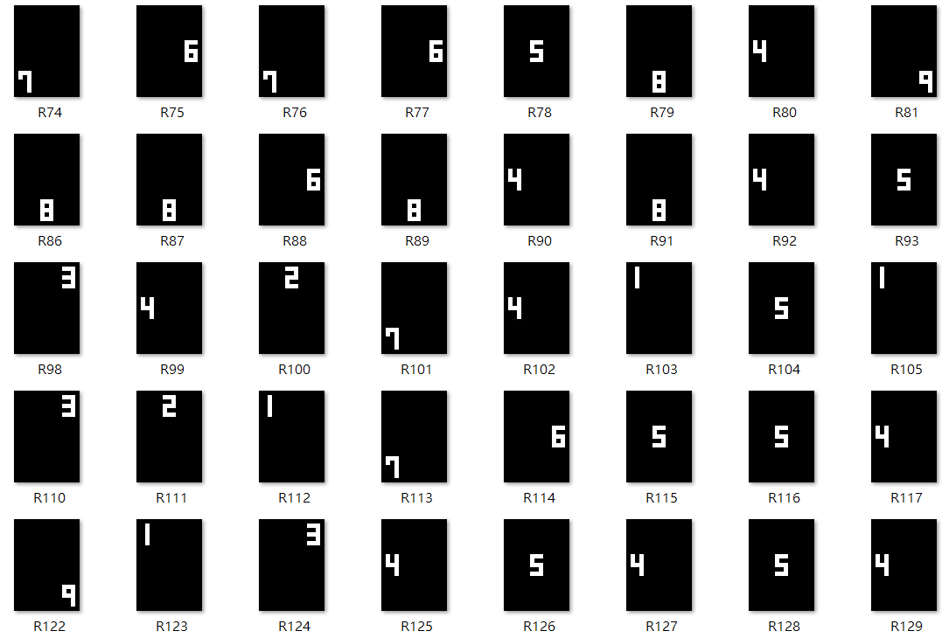
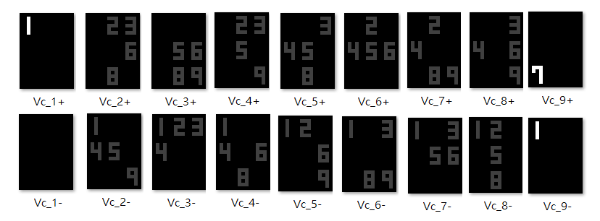
Some rows of X
Our guess of W

