Slide 1
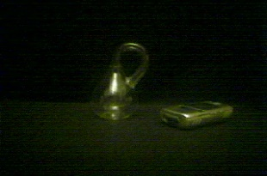

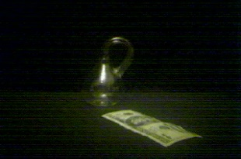
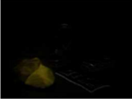
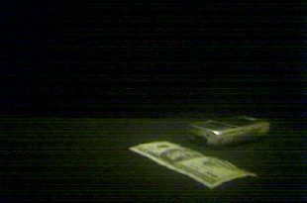
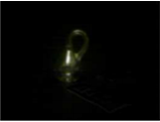
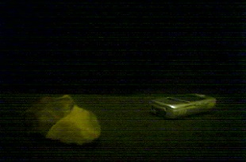
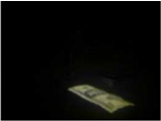
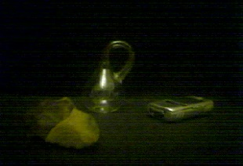
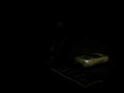
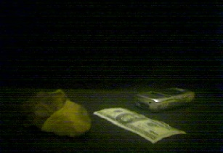


10101
X(1,:)
W(1,:)
10110
X(2,:)
W(2,:)
10011
X(3,:)
W(3,:)
11001
X(4,:)
W(4,:)
11101
X(5,:)
W(5,:)
X(6,:)

Slide 3
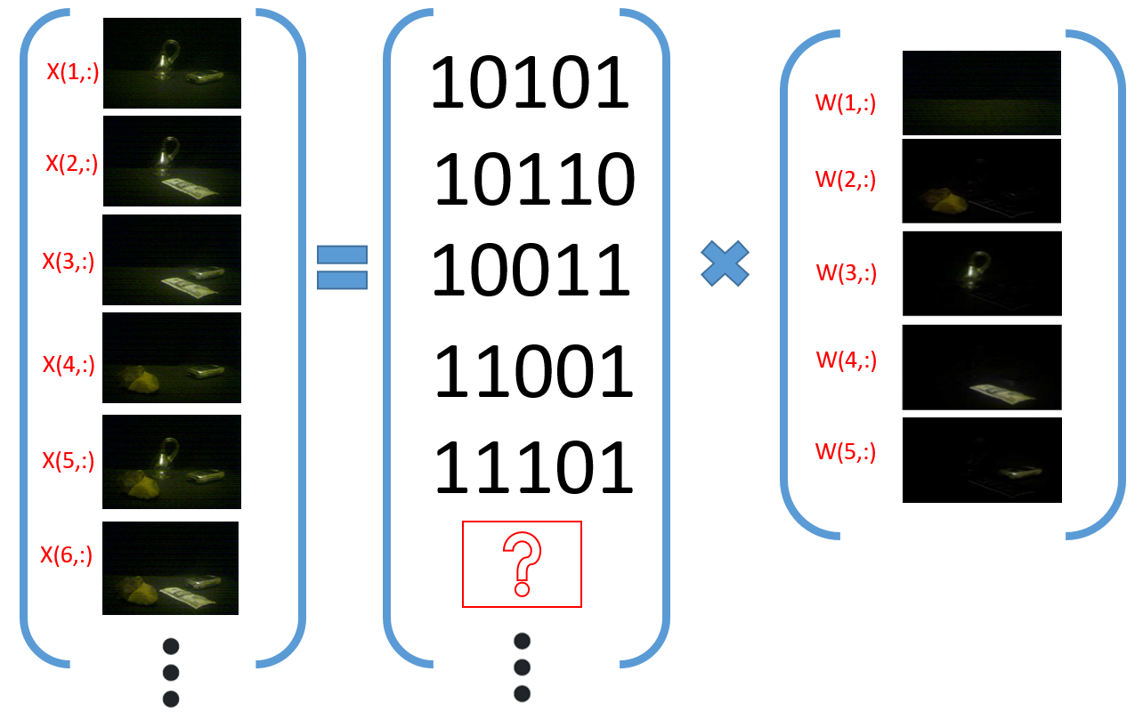
X
Z
W

Slide 4
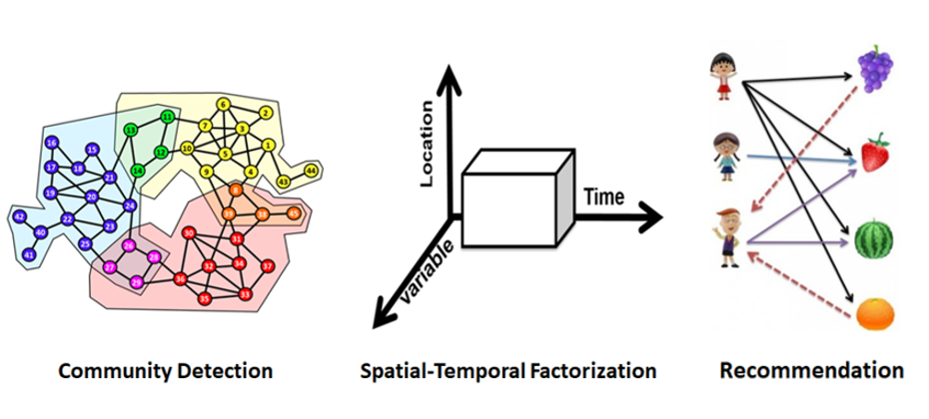
N | People | Location | Movies
D | People | Meteorological data | People
X value | 0/1 for being friends or paper coauthorship | real value for temperature, precipitation, wind scale … | Ratings
possible latent K | Groups, Affiliations | Weather events (typhoon, blizzard, cold current…) | Film genres

Slide 5
